Slide 1

The Dissertation: What you need to do to succeed

Slide 2
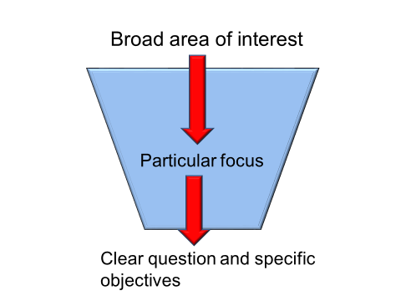
Don't
Try to cover too many things
Do
Focus on a narrow research question and clear research objectives

Slide 3
Don't
Think that you can just rely on literature you have already covered in the other modules
Do
Search for literature specific to your area of research, using the University databases and Google Scholar

Slide 4
Don't
Try to prove a point
Do
Be open minded – or at least be prepared to be surprised about what you will find – and make a fair evaluation of the information you gather

Slide 5
Don't
Try to do it all alone
Do
Work with your supervisor: get feedback on plans and on drafts, and act on that feedback.
Keep in touch with colleagues, too, and compare notes and help each other out with moral support.

Slide 6
Don't
Leave it all till the last minute – it is a big piece of work
Do
Plan the work and undertake it over the period allowed for the dissertation.
Leave time to test interview outlines and/or questionnaires
Allow time for analysing data
Build in time to get feedback from your supervisor on plans and drafts.

Slide 7
Don't
Assume that the field work will be straightforward and that everyone will cooperate with you
Do
Check on access to information and to respondents at an early stage and adjust your plans where necessary

Slide 8
Don't
Forget about the material on research methods from this week, from the videos, and from the readings
Do
Use the research methods material that is relevant to your approach: apply it in the research and discuss it in the dissertation

Slide 9
Don't
Treat the dissertation as a collection of separate chapters
Do
Try to see the dissertation as an integrated whole, with connections between each different part

Slide 10
Introduction
Research question
Objectives
Literature review
Methodology
Findings
Analysis
Conclusions
Reflections

Slide 11
Introduction
Literature review
Methodology
Research question
Objectives
Analysis
Findings
Conclusions
Reflections

Slide 12
Don't
Think this is all hard work – a chore
Do
Find time to enjoy yourself while you are doing this

Slide 13
