Slide 1
MBA Residency
Welcome!

Slide 2
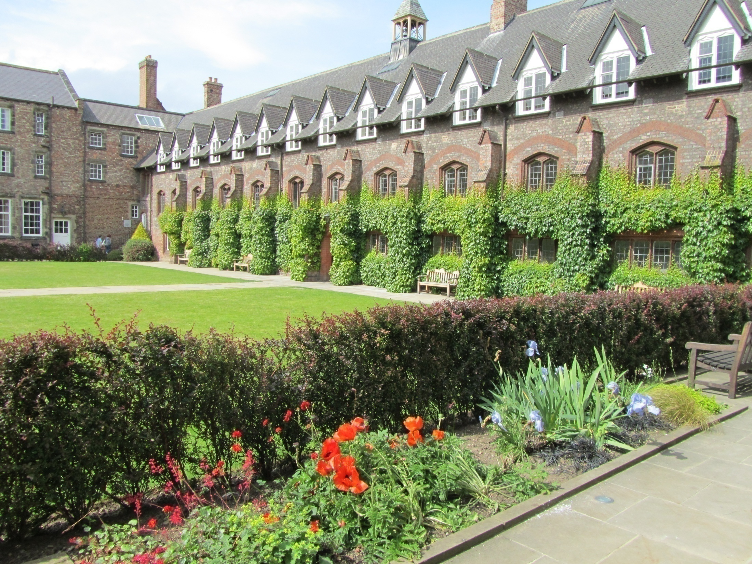

Slide 3
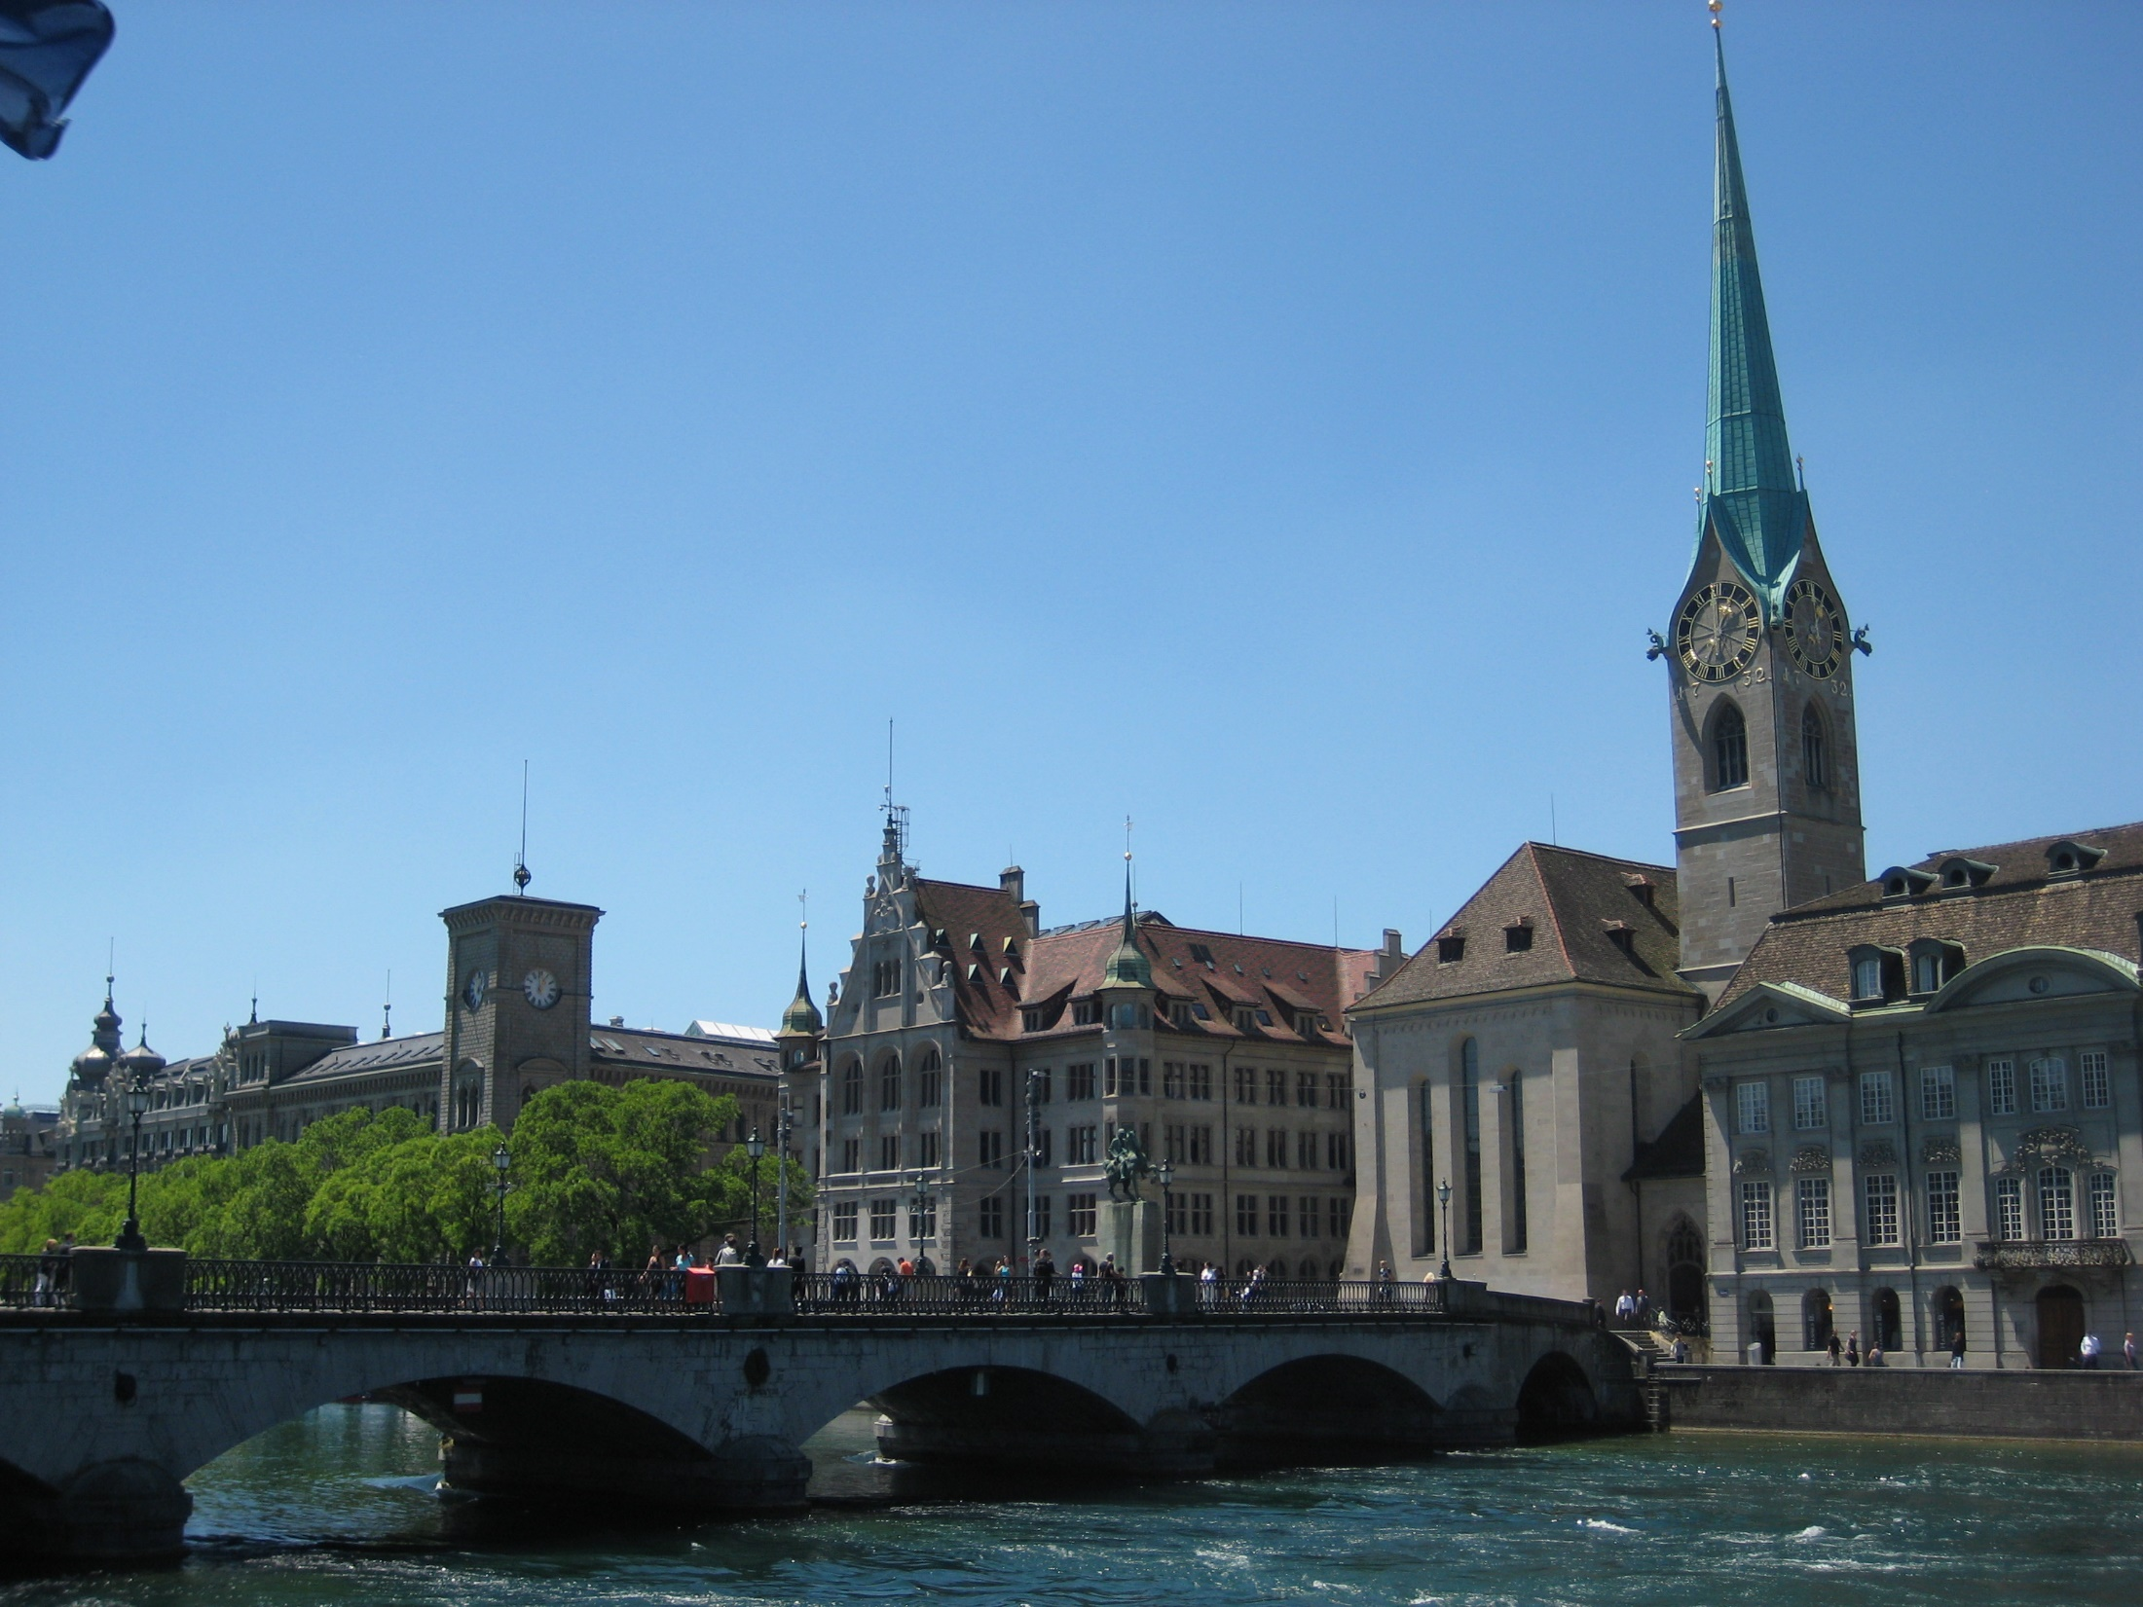

Slide 4
Aim of the week
The main aim of the week is:
For you to understand what is required in the dissertation, and to acquire (or reinforce) a foundation for the research skills you will need for this part of the programme.

Slide 5
Agenda for today
Processes for the residency
Ground rules
Using the technology
Introductions
Agenda for the week
What is the dissertation? Any questions?
Using the library resources
Research question and research objectives
Small group discussions

Slide 6
Processes
Some short inputs from us
Questions from you
Small group exercises and discussion
Exercises for you to tackle between session
Feedback and discussion on those exercises

Slide 7
Ground rules
Respect
Active learning
Confidentiality
Recording

Slide 8
Technology
Ask questions by raising hand
Or in Chat
Mute microphones when not speaking
What to do if the system crashes

Slide 9
Introductions
10 second introductions –
Who are you?
What sector do you work in?
Where are you right now?
The Introduction Sheets…

Slide 10
Agenda for the week
Today – literature search and research question & objectives
Tuesday - review literature search exercise and research question & objectives exercise; qualitative and quantitative approaches to research
Wednesday - review qualitative and quantitative research exercises; introducing the research strategy exercise
Thursday – review research strategy exercise; writing a great dissertation
Friday - discussion of your ideas for your research

Slide 11
What is the dissertation?
Prep work
11 PPTs with audio
A paper on The Dissertation

Slide 12
The Prep PPTs
Introducing the dissertation: the basics
Assessment criteria
Choosing your topic
Focusing your research
Scope and scale of the research
Designing your research project
What the dissertation looks like
Working with your supervisor
Enrolling on the dissertation module
What you need to do to succeed
Research ethics

