Slide 1

Quantitative Research
Data Analysis

Slide 2
Analysing questionnaire returns
Measures of central tendency
Mean (add numbers, divide by the number of cases)
Median (number in the middle - after ordering your numbers)
Mode (the most popular number)
What are the mean, median & mode?
Which measure is the best representation of the ‘average’ salary in the company?
Staff | 1 | 2 | 3 | 4 | 5 | 6 | 7 | 8 | 9 | 10
Salary | 15k | 18k | 16k | 14k | 15k | 15k | 12k | 17k | 90k | 95k

Slide 3
Analysing questionnaire returns
Measures of central tendency
Mean – 30.7
Median/number in the middle – 15.5
Mode - 15
Which measure is the best representation of the ‘average’ salary in the company?
Staff | 1 | 2 | 3 | 4 | 5 | 6 | 7 | 8 | 9 | 10
Salary | 15k | 18k | 16k | 14k | 15k | 15k | 12k | 17k | 90k | 95k

Slide 4
Analysing questionnaire returns
Chi-squared calculation
Is the difference between the answers of two groups of respondents statistically significant?
For example is the evaluation of the success of a change by senior managers and by junior managers significantly different?
Is there a significant difference between male and female respondents’ opinions of the scope for innovation in a company?

Slide 5
Analysing questionnaire returns
Correlation
How strong is the relationship between two or more variables?
Are there correlations between answers to different questions?
For example:
The length of time working in a company and a positive rating of the company’s employee relations policies
The age of the respondent and their attitude towards learning to use Artificial Intelligence

Slide 6
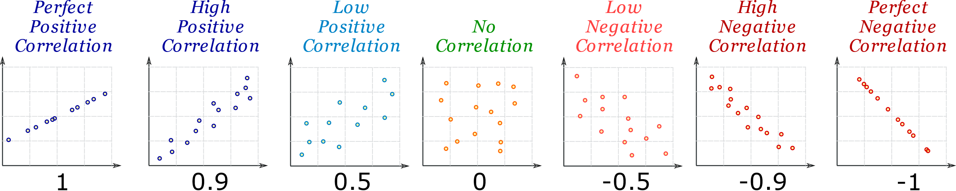
Analysing questionnaire returns
Correlation

Slide 7
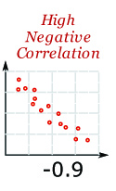
The length of time working in a company and a positive rating of the company’s employee relations policies

Slide 8
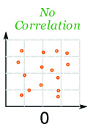
The age of the respondent and their attitude towards learning to use Artificial Intelligence (positive or negative)

Slide 9
Further reading/viewing
Harvey Maylor and Kate Blackmon 2005 Researching Business and Management Palgrave Macmillan: Basingstoke ch 10 'Analysing quantitative data' pp. 297-322 https://contentstore.cla.co.uk/secure/link?id=f768be39-e00e-eb11-80cd-005056af4099
N Salkind 2014 Statistics for People Who (Think They) Hate Statistics, Sage: London ch 9 'Significantly Significant' pp. 169-188
https://contentstore.cla.co.uk/secure/link?id=0469be39-e00e-eb11-80cd-005056af4099
See the video lecture ‘Chi Square’
StatsCast - StatsCast: What is a Chi-Square? – YouTube
How to use Excel to do a Chi Square calculation - Chi Square Test for Independence in Excel 2016 - YouTube

