Slide 1
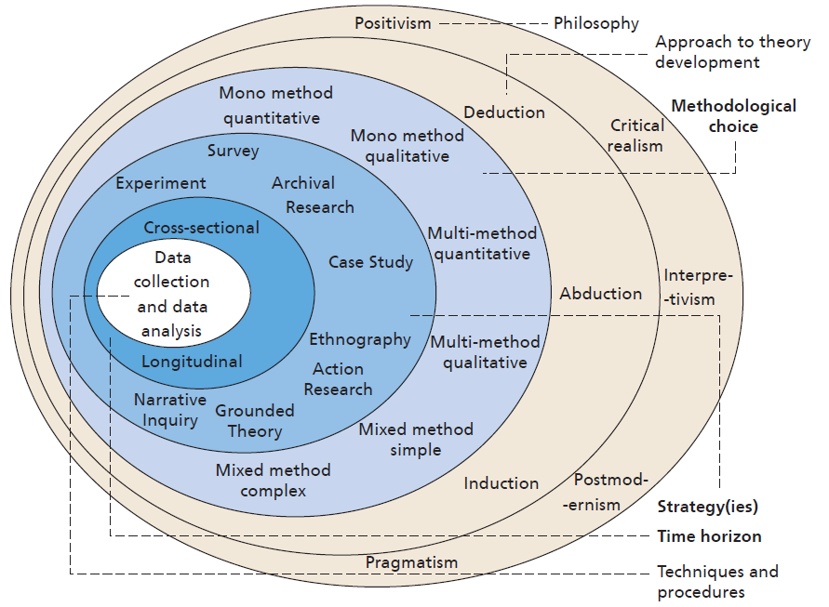

Research strategies
Saunders et al 2019 Research Methods For Business Students, Pearson, p.174

Slide 2
Designing your research project
WHAT do you want to find out?
WHY do you want to find this out?
WHO will you gather information from?
HOW will you gather that information?

Slide 3
Research strategies
Deductive or inductive?
Quantitative or qualitative data?
At one point in time, or over a period of time?
A fixed or a flexible data gathering strategy?

Slide 4
Methods
Interviews
Questionnaires
Focus groups
Analysing documents
Observation

Slide 5
Tackle EXERCISE 5: Research strategies. In the file on the Online campus, you will find a scenario where someone is considering undertaking research for an MBA dissertation. For tomorrow:
1. Consider the different research designs and methodologies that are proposed
• Which method would you use? Or
• Would you adapt one of them, or use a hybrid of them
both?
Set out the advantages and limitations of the design you have chosen
At the start of tomorrow’s session, we will ask you to discuss your ideas in small groups, and then in a plenary session.

