Slide 1
Group interviews and discussions

Slide 2
You may include group interviews or group discussions in your research:
the opportunity is naturally present to gather information from people in groups
you can include more people in the research in this way than by 1:1 interviews
more and better information may emerge during discussion between people in groups than in 1:1 interviews, or if the participants answered questionnaires

Slide 3
Research into how 12 different teams of clinical therapists are going about bringing about change and improvement to the services they provide. Information gathered:
through surveys of team leaders
through telephone interviews with the team leaders
at progress meetings of all the team leaders

Slide 4
Case studies of three teams:
Team A: an interview with two team members together, and then two 1:1 interviews with team members
Team B: an interview with the team leader together with a key member of her team
Team C: offered an hour on the agenda of a full team meeting of 16 therapists

Slide 5
Focus groups
Group discussion with a distinctive set of features.
used in market research since the 1920s
used by political parties and government departments
used in organisational research since at least the 1940s
An emphasis on discussing a fairly tightly defined topic
(Barbour, 2007).

Slide 6
Focus groups
Group interaction is an important part of the process.
You need to ensure 'that participants talk amongst themselves rather than interacting only with the researcher' Barbour (2007:2)
The discussion between members in a focus group will often provide a researcher with information about why people hold certain opinions (Denscombe, 2007).
The discussion 'enables this method to generate more insights in the research issues than a series of in-depth interviews with the same number of participants' (Hennink et al (2011: 136)

Slide 7
The discussion may lead to consensus, or may lead to the expression of a range of opinions and feelings around a topic - either of these outcomes can be of value to the researcher.

Slide 8
Size: between 3 and 8 people (Barbour, 2007)
Timing, an hour to two hours.
Need a moderator to introduce questions and guide discussion.
The moderator should aim to create 'an informal comfortable group environment' and avoid being too directive (Hennink et al, 2011: 159)
Need some means of recording the information you wish to capture – eg note taking and/or audio recording

Slide 9
Participants should have some experience of the topic being researched
Bring together people who are similar or people who are different?
A group of people with a similar background are more likely to provide valuable information 'because participants are more likely to share their views and experiences with others who are similar to themselves‘ (Hennink et al, 2011:150)
You could hold different focus group meetings for different groups, and compare the views that are expressed.

Slide 10
Should you bring together people who know each other, or people who are strangers to one another?
Should the discussion guide have a small number of questions, or many questions?

Slide 11
Limitations/disadvantages
Group effects - some people may dominate and others feel not able to contribute
Sometimes people may be inhibited from providing information or expressing what they really think
Even where there is apparent consensus, you can't take this to be what each member of the group thinks
They can produce a lot of data, but this may be difficult to transcribe and analyse
They can be difficult to organise and to get people to attend
(Based on Bryman, 2008)

Slide 12
Not every group is a focus group
Group of 16 therapists….
Briefing on the project, why I was there and what information I was interested in
Break into their working teams and discuss….
…. with a note-taker in each team…
…. what they liked about the current arrangements, and what they saw as problems…
… feed back some points to the whole group at the end, and discuss

Slide 13
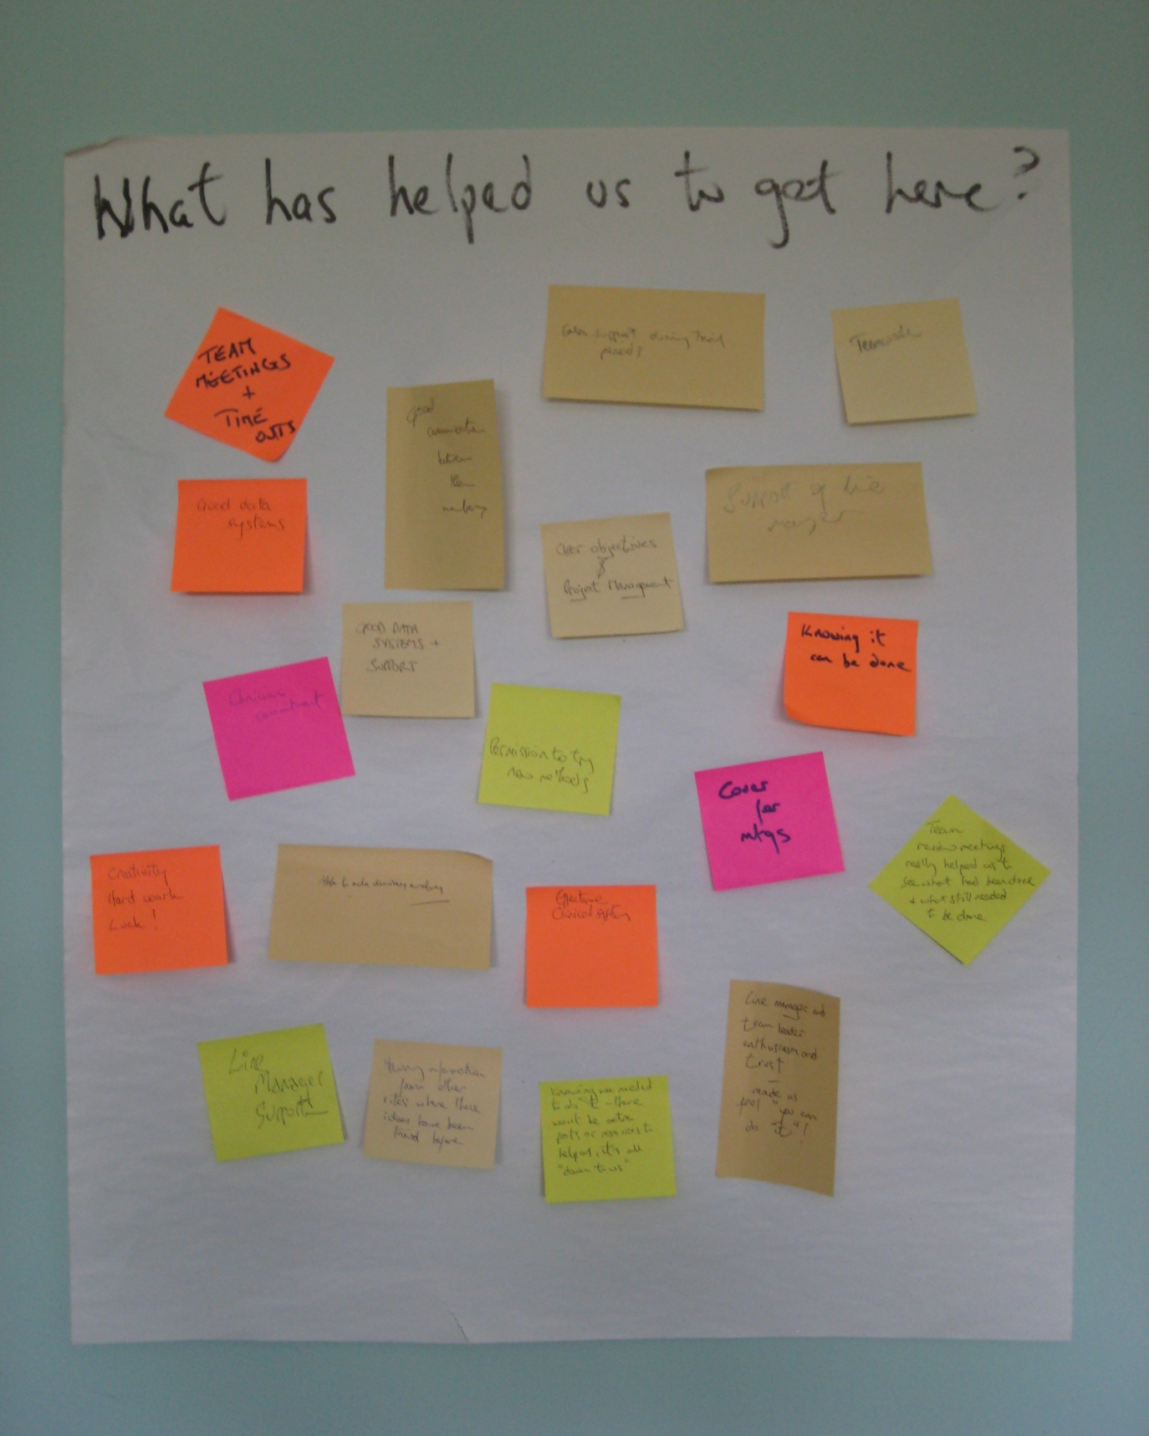
Another approach

Slide 14
Briefing about the research, and answer questions…
…perhaps some discussion in smaller groups…
… each individual asked to write their thoughts…
… about specified topics
eg for research into a change suitable topic headings might be
'What has helped us to get here?'
'What has been difficult about getting here?'
'What do we need to do next?'

Slide 15
You may then ask people to read the comments…
…indicate agreement with them…
…cluster them to identify themes…
…and discuss some themes.

Slide 16
Advantages
You can get many comments in a short period of time
Comments are almost completely anonymous
You can avoid group effects in getting the comments
You can often easily identify common themes
Provides some documentary data that you can take away
Flexible – you can agree on topic headings in the meeting
Limitations
Some comments may be difficult to understand
Group effects may begin as soon as you discuss

