Slide 1
Research philosophy

Slide 2
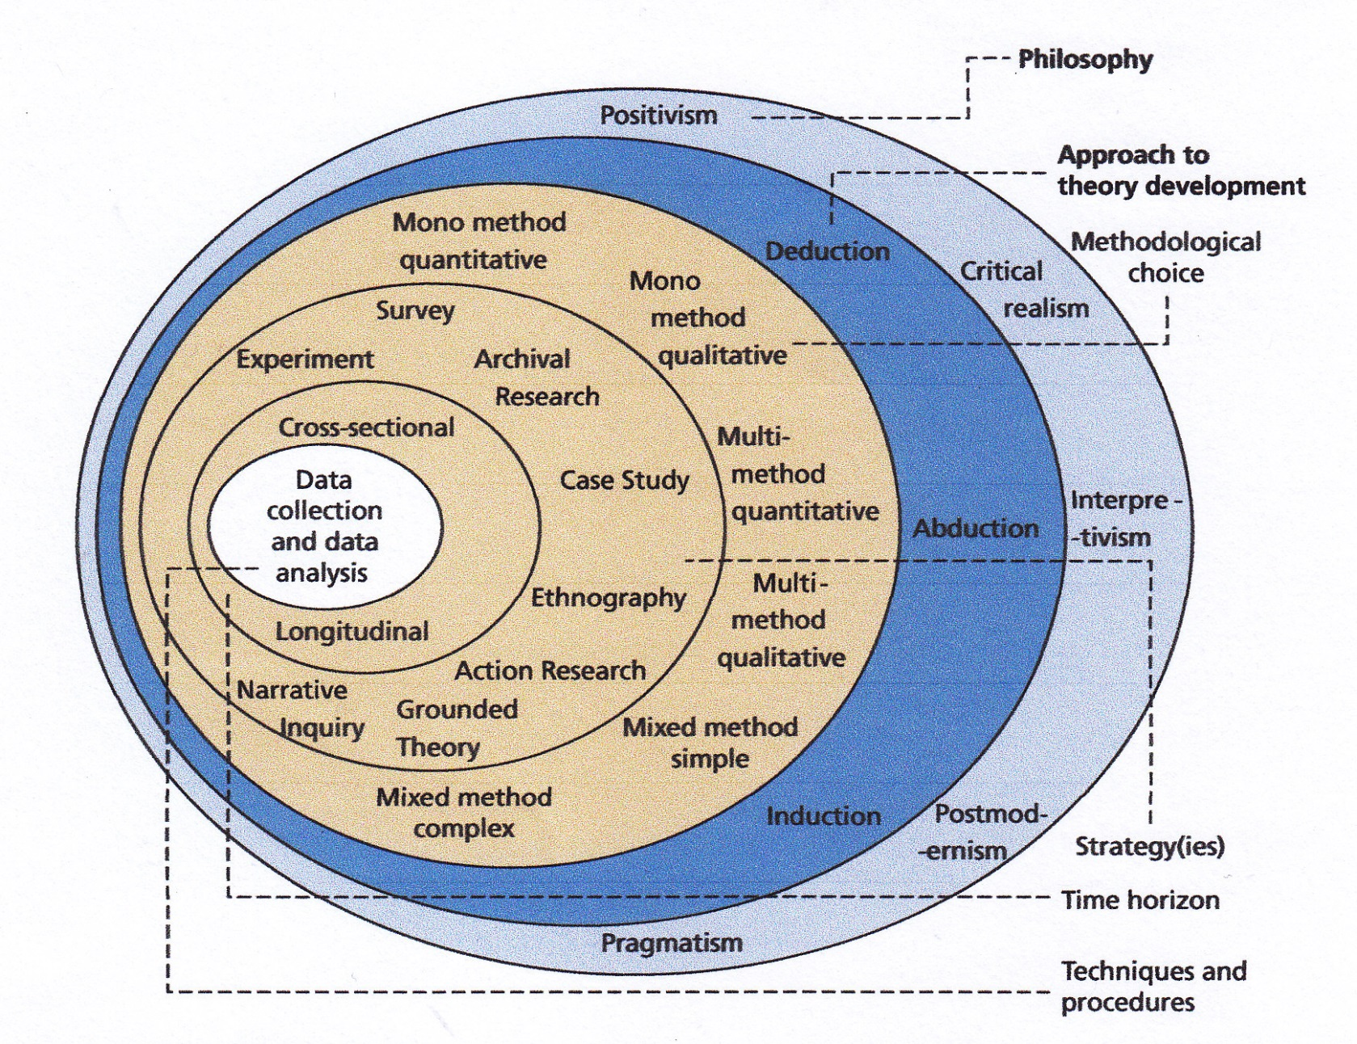
The research onion, Saunders et al., (2019)

Slide 3
Epistemology
Ontology
Methods and Techniques
Methodology
Easterby-Smith et al., (2018)

Slide 4
Methods and techniques
individual techniques for data collection and analysis
Methodology
a combination of techniques used to inquire into a specific situation
Easterby-Smith et al. (2018)

Slide 5
Methods and techniques
individual techniques for data collection and analysis
Methodology
a combination of techniques used to inquire into a specific situation
Epistemology
a set of assumptions about how to inquire into the nature of the world
Ontology
assumptions about the nature of reality
Easterby-Smith et al. (2018)

Slide 6
Methods used in natural science, developed from the 16th Century onwards in Europe, may not always be appropriate for research in social science –

Slide 7
Methods used in natural science, developed from the 16th Century onwards in Europe, may not always be appropriate for research in social science –
because people are conscious beings who act on the basis of how they interpret events
because much behaviour depends on context
social science can be concerned with intangibles (such as values, skills, personal characteristics etc)

Slide 8
Ontology
Contrast between:
Realism (or Objectivism) | Nominalism (or Subjectivism)
Easterby-Smith et al., (2018) (Saunders et al., 2019)

Slide 9
Ontology
Contrast between:
Realism (or Objectivism) | Nominalism (or Subjectivism)
There is a social reality that is independent of our knowledge of it | Social reality is a creation or projection of our consciousness
Easterby-Smith et al., (2018) (Saunders et al., 2019)

Slide 10

Physical/chemical reality is different from social reality

Slide 11
The ontology of…
Strategy
Organisation
Competencies and skills
Organisational culture
Creativity
Charisma

Slide 12
A range of ontologies
Realism
There is a single truth
Facts exist and can be revealed
Internal realism
Truth exists, but it is obscure
Facts exist but cannot be accessed directly
Relativism
There are many 'truths'
Facts depend on the viewpoint of the observer
Nominalism
There is no truth
Facts are all human creations
Easterby-Smith et al. (2018, p.67)

Slide 13
Epistemology
– beliefs about knowledge and how we can know things
Represented as a spectrum of beliefs:
Positivism Social constructionism
(Easterby-Smith et al., 2018)

Slide 14
Positivism
Approach that is used in natural sciences – medicine, physics, chemistry etc. Characteristics include:

Slide 15
Positivism
Approach that is used in natural sciences – medicine, physics, chemistry etc. Characteristics include:
Belief that researcher is/should be independent of what they are researching, and should use objective measures
Seeks to establish/confirm general rules
Tends to start with a theory of how something works and tests to see if this is true (deductive approach)
Usually uses quantitative methods and large samples

Slide 16
Postpositivism
Takes many of the positivist approaches, but there is a belief that social reality can only be known imperfectly, and may be shown to be incorrect by later research
(Robson and McCartan, 2016, p. 22; also Lincoln et al., 2018)

Slide 17
Social constructionism
(or Interpretivism - Saunders et al., 2019; Bryman, 2016)
We can best develop an understanding of situations by studying what actually happens (an inductive approach)
Understanding is developed based on how individuals interpret events
Tends to use small samples and qualitative data – so limited generalisability
Research may be flexible, design may be emergent

Slide 18
Strong positivism
Positivism
Constructionism
Strong constructionism
Easterby-Smith et al. (2018)

Slide 19

Positivism Social constructionism
My research

Slide 20

Positivism Social constructionism
My research

Slide 21
Pragmatism
A concern with action and with ‘what works’.
In research:
use whichever philosophy is most appropriate for your research question
you can use mixed methods and approaches in one study
(Robson and McCartan, 2016; Saunders et al., 2019)

Slide 22
Management research
Research using positivistic-type methodologies will tend to focus on:
What can be measured or counted (eg sales, costs, profitability, staff turnover, attendance at training programmes)

Slide 23
But…
Use of positivistic-type methodologies to explore intangible characteristics is very common:

Slide 24
But…
Use of positivistic-type methodologies to explore intangible characteristics is very common:
Bass’s Transformational Leadership dimensions (the Multifactor Leadership Questionnaire)
Models of national/organisational culture – eg Hofstede, House et al., Cameron and Quinn

Slide 25
Management research
Interpretivist-type methodologies will tend to focus on perceptions and opinions of people: eg
How do different people perceive the role of a football club manager?
How do different groups in an organisation perceive the role of management consultants?
What do key people think are the main factors influencing a particular change?
What do top managers think are the key skills for bringing about change?

Slide 26
Management research
Moderate constructionist-type methodologies will often try to verify opinions – eg by triangulation
For example, for the research question:
What do key people think are the main factors influencing a particular change?
- can we compare ideas between these people? Or get other data, to help us to assess the actual impact of these main factors?

Slide 27
Numbers can be convincing, but some small scale qualitative studies have had a big effect:
Mintzberg’s study of the roles of managers
John Kotter’s study of general managers
Rosabeth Moss Kanter’s Change Masters
Schein’s development of theories of organisational culture

Slide 28
No single ‘right’ approach
Robson and McCartan (2016): the most appropriate research philosophy for you will depend on the research questions you are trying to answer (a pragmatic approach).
Your methodology may contain a mix of methods – qualitative and quantitative

Slide 29
References
A Bryman 2016 Social Research Methods, Oxford: Oxford U press
M Easterby-Smith, R Thorpe, PR Jackson and LJ Jasperson 2018 Management Research, London: Sage
YS Lincoln, SA Lynham and EG Guba 2018 'Paradigmatic Controversies, Contradictions, and Emerging Confluences, Revisited' in NK Denzin and YS Lincoln (Eds.) The Sage Handbook of Qualitative Research, London: Sage, pp. 108-150
C Robson and K McCartan 2016 Real World Research, Chichester: Wiley
Mark Saunders, Philip Lewis & Adrian Thornhill 2019 Research Methods for Business Students, Harlow: Pearson Education

