Slide 1
Clustering Colleges in Maryland
Megan Bittner
Coursera Capstone Course

Slide 2
Introduction
College is an important decision
Many factors to consider
Campus community is important

Slide 3
Data
Foursquare API for venues
Geopy Nominatim for coordinates

Slide 4
Methodology
K-Means Clustering
Separate list of colleges into clusters based on venues
Plot number of venues versus enrollment

Slide 5
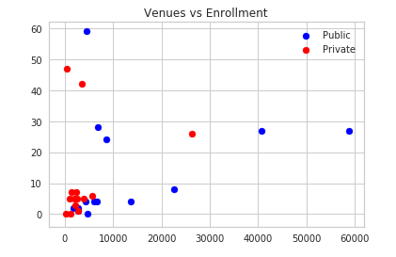
Results
Most clusters had one college only
Enrollment had little effect on venue count

Slide 6
Discussion
API returned few or no venues for some colleges
Insufficient data or incorrect coordinates
Other factors to be considered for future analysis

Slide 7
Conclusion
Other factors to consider besides community
Colleges should still consider surrounding venues when advertising

