Slide 1
Cloud Computing Teachback:
Muhammad Bilal Jamil
Data Scientist at BlackLine | MS Candidate in Data Analytics at Yeshiva University

Slide 2
Table of Contents:
Motivation
Services to be covered
Case Study on the services
Architecture Diagram
Challenges Faced
Demo

Slide 3

Motivation
In my data science project at work. I was working on a set of data science tasks where there was “NO” data.
So, I figured why not create the data then? Utilized the concepts taught in class and project and worked with DevOps to develop an architecture

Slide 4


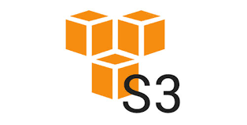
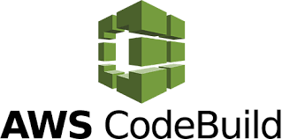

Services To Be Covered

Slide 5
Services To Be Covered …. CONT
S3 is used for storing any sort of files, be it csv, excels, pdf or images from anywhere at anytime.
Lambda can be used to run a serverless architecture and allows to run a piece of code after an event trigger is activated as an example.
RDS is used to store data in a relational database environment in the cloud.
Code build allows a user to seamlessly connect their github with AWS and use the concept of CI/CD to deploy/release/update code
Github, a platform to store all your codebase.

Slide 6
Case Study on the services
All the previous services together can be utilized to create a log of events for any use-case where the data is not saved in a database.
I used these services together to create data for a chain of events in the financial process of my project where ‘there was no data’.
Utilized these services to use S3 data in an RDS to be used in a data science project.

Slide 7
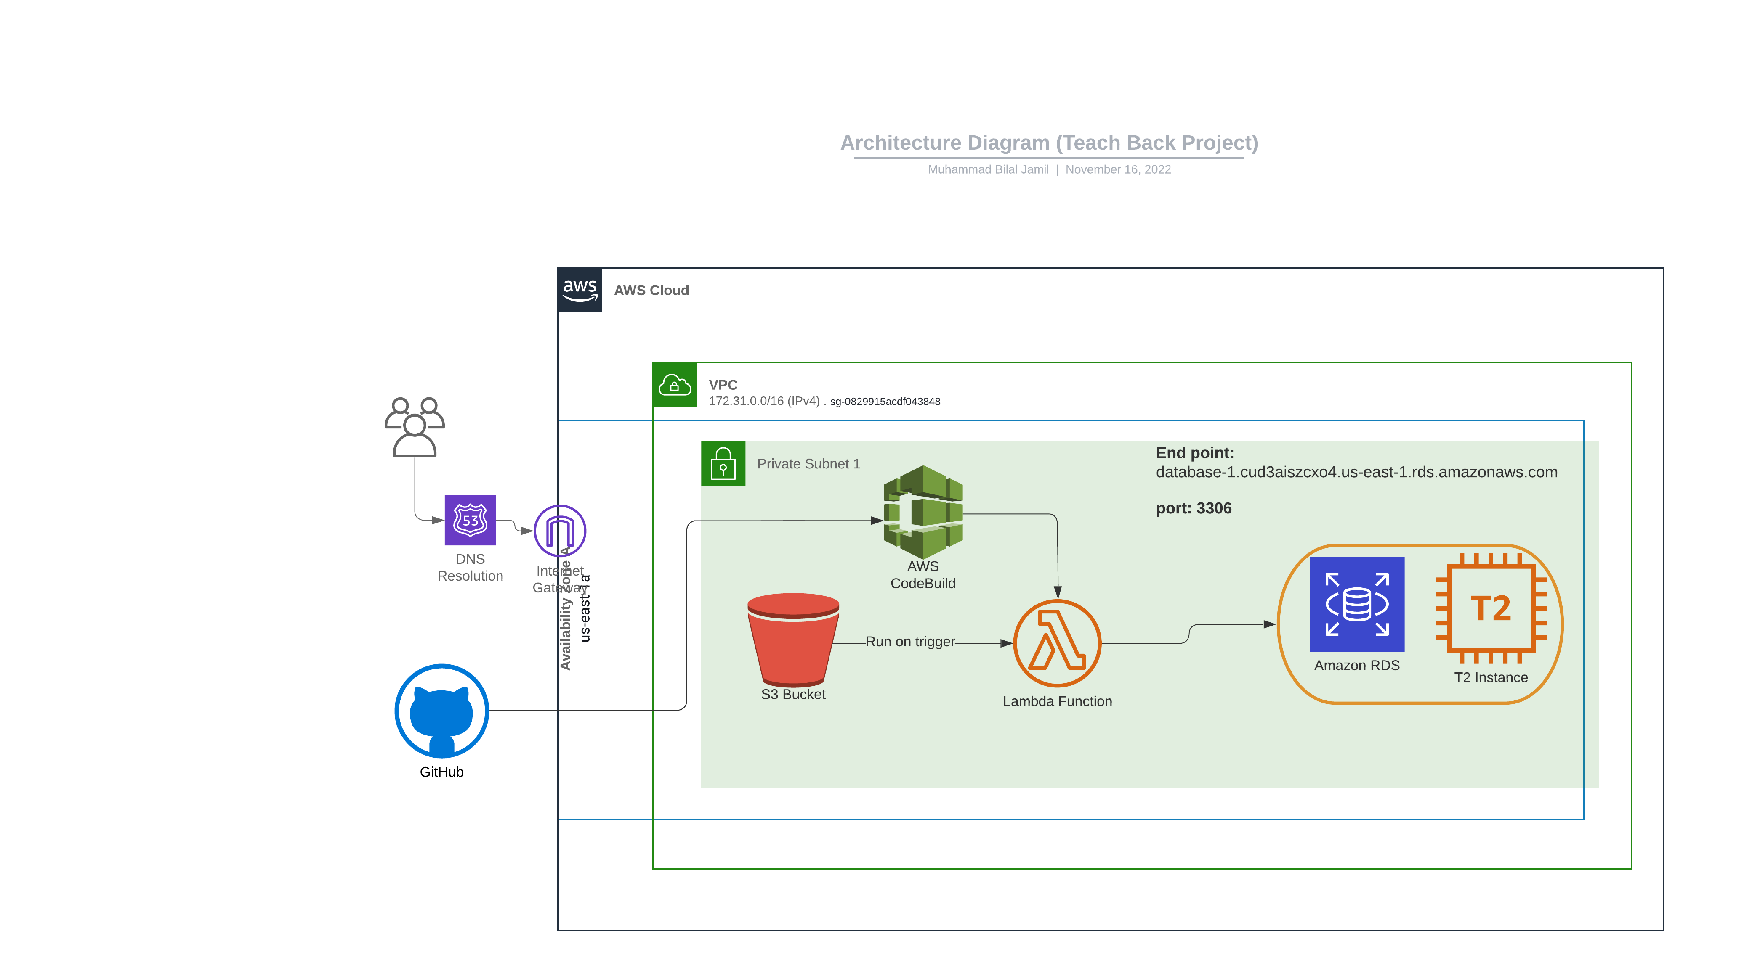
Architecture Diagram

Slide 8
Challenges Faced
When Lambda didn’t have a VPC, connecting to S3 data was not an issue. But when Lambda was supplied a VPC, and a SG then faced S3 data issues.
Fixed this by creating an s3 endpoint in the VPC.
VPC networking issues. (lambda unable to access RDS)
Fixed this by creating a SG separately for Lambda and assigned that SG to the RDS-SG.
Made sure the RDS-SG inbound rules are there in outbound Lambda-SG rules.
Faced issue with environment variables not loading successfully in lambda code, I was originally using ‘os.getenv()’ but AWS documentation suggested to use ‘os.environ.get()’ solved the issue.

Slide 9

Notes:
Python project: Focused on web-scraping, APIs, text mining, pandas/numpy, and machine learning etc.
Sql projects = Using data warehouse concepts like ETL, stored procedures, triggers etc.

