Slide 1
Trunk-Based Development
just push straight to master
Notes:
- 7 godina
- 5 i pol godina feature branching
- 1 i pol godinu trunk-based development
tl, dr: just push to master

Slide 2
Thank you for your attention!
Q & A
Notes:
Ipak nije toliko jednostavno

Slide 3
Deployed code makes money
You have some code
You build it
You deploy it
You make it available
Users interact with it
Profit ?

Slide 4
Deployed code needs to be changed
Add new feature
Remove a feature
Bugfix
Performance improvement
Configuration change
...
Notes:
- kako najefikasnije raditi promjene na samom kodu
- jer kod se mijenjati mora
- koji je nacin radjenja promjena ekonomski najisplativiji
obicno ne razmisljamo o tome kao o ekonomskoj odluci, ali o tome se zapravo radi

Slide 5
The change should be good
It is quick
It is safe

Slide 6
Change should not make developers cry
It can be stressful
It can cause fatigue
It can cause burnout
It can lower job satisfaction
Profit?
Notes:
dobro dusevno stanje developera je isto kompetitvna prednost
treba bit oprezan, ako developerima predlozite trunk based development nekima se nece svidjeti

Slide 7
What is Continuous Integration?
Changes are integrated to mainline (main, master, trunk)
Changes are integrated continuously

Slide 8
What is Continuous Integration?
All code is in version control
Changes are integrated every day (merged to master at least once a day)
Automated test run on every merge
If the build fails all the work stops
New work does not break delivered work
Notes:
ci pipeline nije ci
jenkins plus git server
github actions i sl. to je tehnologija
ci je praksa
ako ne integrirate promjene jednom dnevno ne radite ci
Najcesci pristup integriranju koda je feature branching

Slide 9
What is feature branching?
Feature Branching is a practice where people do not merge their code into mainline until the feature they are working on is ”done” (but not yet “done done”).
- Jez Humble

Slide 10
What is feature branching?
Alice: Branch A
Bob: Branch B
Master
Notes:
Taj je pristup nastao u low trust environmentu
core maintainers kontrola nad projektom
contributori iz cijelog svijeta
git je razvio Linus Torvaldsa za potrebe razvoja linux kernela
feature branching

Slide 11
Feature Branching – everyone is doing it
Open-source project contributors
Enterprise project contributors
don’t know each other
don’t trust each other
usually don’t talk to one another directly
don’t get alerts
drink coffee and go to lunch together
should trust each other
can talk to one another directly
get alerts

Slide 12


Feature Branching lowers quality

Slide 13
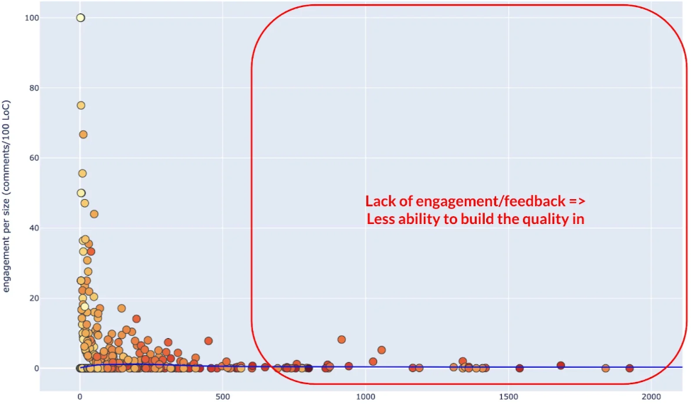
Feature Branching lowers quality

Slide 14
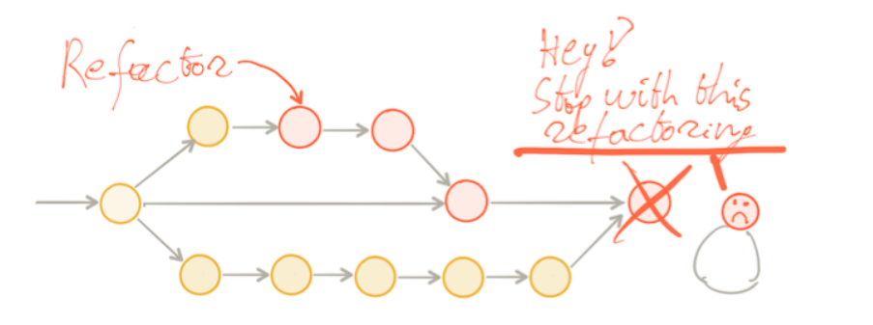
Feature Branching lowers quality
Feature branching discourages refactoring
Notes:
nije buisness kriv za tech debt, niti pm-ovi nego izbor nacina kolaboracije
TBD - refaktorirali smo usput golimu stvari, svaki dan ponesto
FB - skoro nista jer je tesko reviewati, postoje pristupi stack diffs i slicno, arlo commit notation, stop the world refactoring, refactoring i new feature commits

Slide 15

Feature Branching slows you down
Notes:
pull request koji ceka na review je oportunitetni trosak

Slide 16
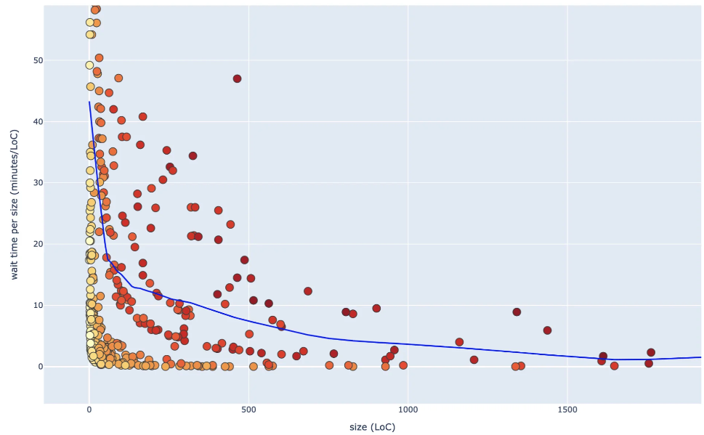
Feature Branching slows you down

Slide 17
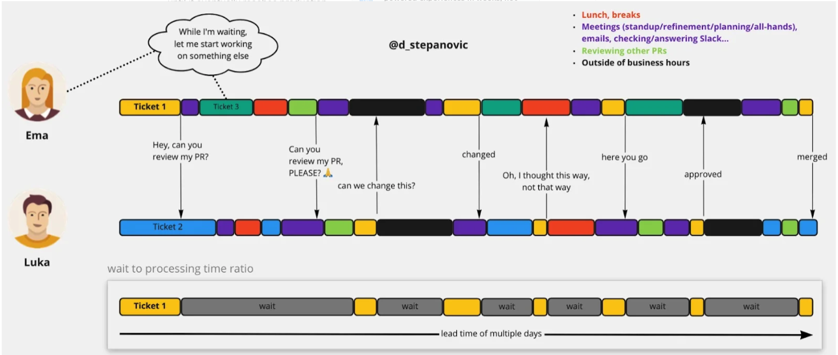
Feature branching slows you down

Slide 18
Feature Branching has ”benefits”
Individual goes faster, but team goes slower
You don’t have to talk to people -> less social anxiety
Sometimes you get to work on coolest ticket by yourself
You can hide your progress, so you can chill
You can blame the delay on reviewers
You can appreciate the memes more
Not sharing knowledge is a competitive advantage
Notes:
1 suradnja moze postat natjecanje, sprint u kojem sprintamo jedni protiv drugih ko ce brze

Slide 19
What is Trunk-Based Development?
… each developer divides their own work into small batches and merges that work into trunk at least once (and potentially several times) a day … the key difference is scope. Feature branches typically involve multiple developers and take days or even weeks of work. In contrast, branches in trunk-based development typically last no more than a few hours, with many developers merging their individual changes into trunk frequently.
- dora.dev

Slide 20
Trunk-Based Development is safe when
there are a lot of automated tests
all tests run on every commit
the commits are small
the build is fast
tests can run locally
build is never broken (longer than 10 minutes)
mainline is always in releasable state
team communicates a lot
the tasks are small and well defined
Notes:
if it hurts do it more often,
then you will find a way to do it without it hurting

Slide 21
How we do Trunk-Based Development?
Most of the code is written in pair or mob
We commit straight to master
We write tests first (Test Driven Development)
Commits are very small
The tests are automatically run on each push to origin
The pipeline runs all tests, static code analysis, security analysis
We fix forward: if the build is broken we stop what we are doing and fix it immediately
We deploy daily
We do post-merge code reviews
Notes:
dva juniora, koja rade na legacy projektu koji mora bit stalno up i ima dosta prometa i jako su zadovoljni i opusteni, a mob i pair su druga prica, o tom ce vise Marko na iducem predavanju
2. vrti lokalno relevantne tetove i direkt u master
4. svaka smislena promjena koja ne brejka funkcionalnost ide u. master
7. slack notifikacija sve nas taga
8. deployamo redovito, deployamo funkcionalnost koja nije do kraja gotova
9. sto ako nema moba ili para

Slide 22
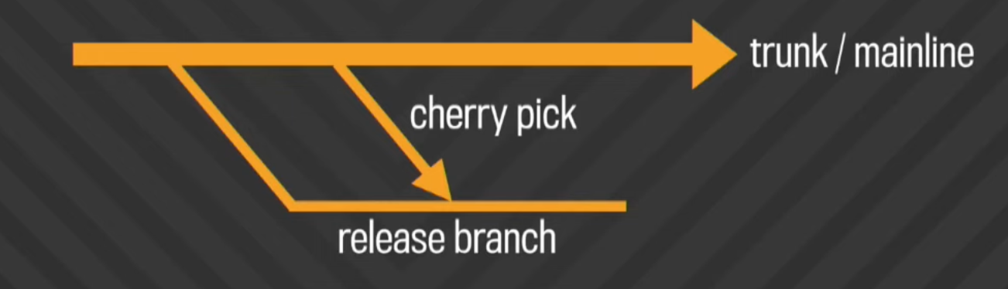
How Google does it?
Notes:
google, netflix i facebook, ali samo za google sam procitao detalje
mozda google zna sto radi

Slide 23
You don’t need to break stuff
Feature toggles
Write in test code
Copy and replace
Branch by abstraction
Notes:
vezano za refactor i nedovrsenu funkcionalnost

Slide 24
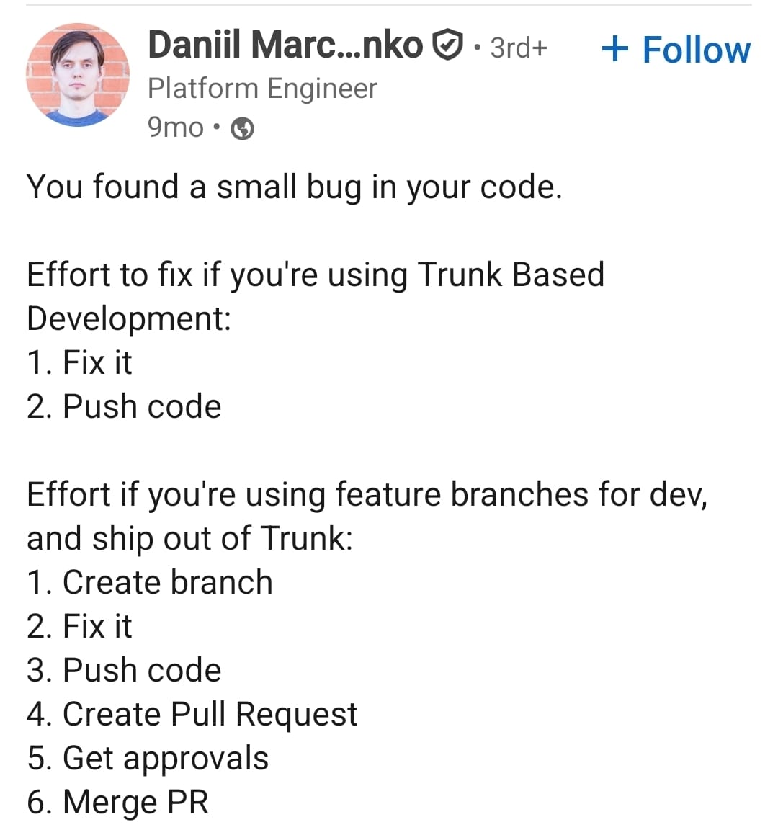
You can fix stuff faster
Notes:
iskustvo sa jednim timom koji ima jedan mali bug u metrikama koji se manifestira jednom godisnje, inace odlican tim.

Slide 25
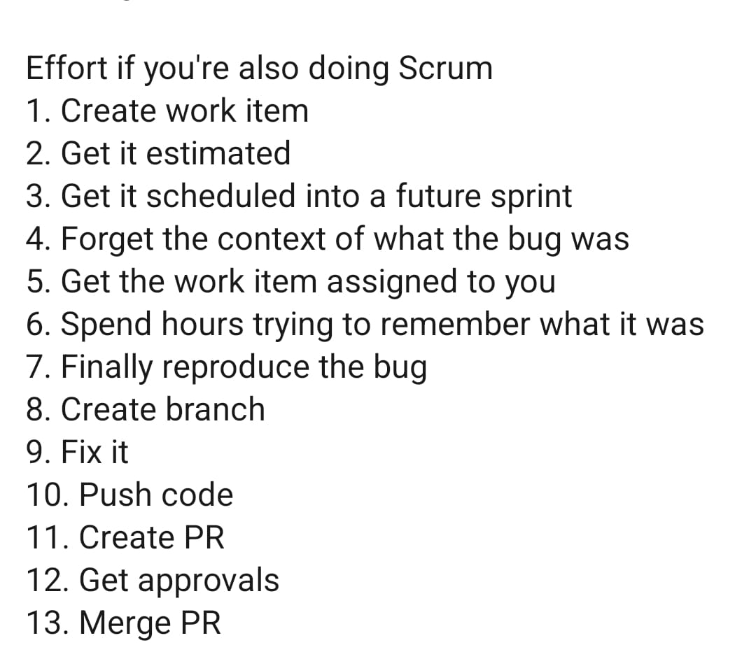
You can fix stuff faster

Slide 26
Trunk-Based works, says who?!
https://dora.dev/capabilities/trunk-based-development/
(State of the DevOps Report)
Analysis of DORA data from 2016 (PDF) and 2017 (PDF) shows that teams achieve higher levels of software delivery and operational performance (delivery speed, stability, and availability) if they follow these practices:
Have three or fewer active branches in the application’s code repository.
Merge branches to trunk at least once a day.
Don’t have code freezes and don’t have integration phases.

Slide 27

Trunk-Based is not insane, says who?!
One of the capabilities that are highly correlated with accelerated engineering velocity is trunk-based development (also known as TBD). High-performing teams have fewer than three active branches at any time, and their branches have a short lifetime (less than a day) before being merged into the main branch

Slide 28

Trunk-Based is based, trust me bro
”(Mainline development) is an extremely effective way of developing, and the only one which enables you to perform continuous integration.”

Slide 29
Feature branching vs Trunk-Based
Delays integration
Hides work in progress
Smaller number of big changes
Harder to revert
Lower throughput
Prevents refactoring
Frequent integration
Makes work in progress visible
Many small changes
Easy to revert
Higher throughput
Encourages refactoring

Slide 30
Resources
https://dora.dev/capabilities/trunk-based-development/
https://www.infoq.com/articles/co-creation-patterns-software-development/
https://thinkinglabs.io/articles/2021/04/26/on-the-evilness-of-feature-branching.html
https://www.linkedin.com/pulse/how-easy-trunk-based-development-martin-mortensen-16tgf
Compliance: https://thinkinglabs.io/articles/2022/02/22/on-the-evilness-of-feature-branching-but-compliance.html

