Slide 1
Reconciling divergent effects of diversity on disease
Maxwell Joseph, Joseph Mihaljevic, and Pieter Johnson

Slide 2


Acknowledgements
University of Colorado P&P group
Pieter Johnson's lab group, CU
Kim Medley
Amanda Hund
CU Research Computing
JANUS supercomputer

Slide 3
Host diversity
Disease
risk

Slide 4
Host diversity
Disease
risk
-
Dilution effect

Slide 5
Amplification effect, ecological disservice
Host diversity
Disease
risk
+
-
Dilution effect

Slide 6
Disease risk
Density of infected vectors
Density of infected reservoir hosts
Rate of change in the density of infected hosts
Human risk of zoonotic infection
Parasite transmission rate
Parasite prevalence in reservoir hosts
Parasite prevalence in vectors
Invasibility of a host community
Probability that an individual will be infected with a disease agent

Slide 7
Host diversity
Disease
risk
Disease
risk
Disease
risk
Disease
risk
?
Disease
risk
Disease
risk
Disease
risk

Slide 8
Host diversity
Disease
risk
Disease
risk
Disease
risk
Disease
risk
Disease
risk
Disease
risk
Disease
risk
Disease
risk
Disease
risk
Disease
risk
?
Disease
risk
Disease
risk
Host diversity
Disease
risk

Slide 9
Parasite
diversity
Host
functional
diversity
Parasite
transmission

Slide 10
Expectations
Diversity begets diversity
Parasite diversity
Host diversity
Hechinger & Lafferty 2005

Slide 11
Expectations
Diversity reduces* transmission
Parasite transmission
Host diversity
* on average, we think, theoretically, most of the time, when host community density is constant (Joseph et al. 2013)

Slide 12
Contradiction
Parasite diversity
Increased disease risk
Decreased disease risk
Transmission
Host diversity

Slide 13
Reconciliation
Parasite diversity
Both patterns emerge from same mechanisms in a simple multi-host, multi-symbiont model
Transmission
Host diversity

Slide 14
Reconciliation
Parasite diversity
Both patterns emerge from same mechanisms in a simple multi-host, multi-symbiont model
Apparent contradiction arises from multiple definitions of risk
Transmission
Host diversity

Slide 15
Model structure

Slide 16
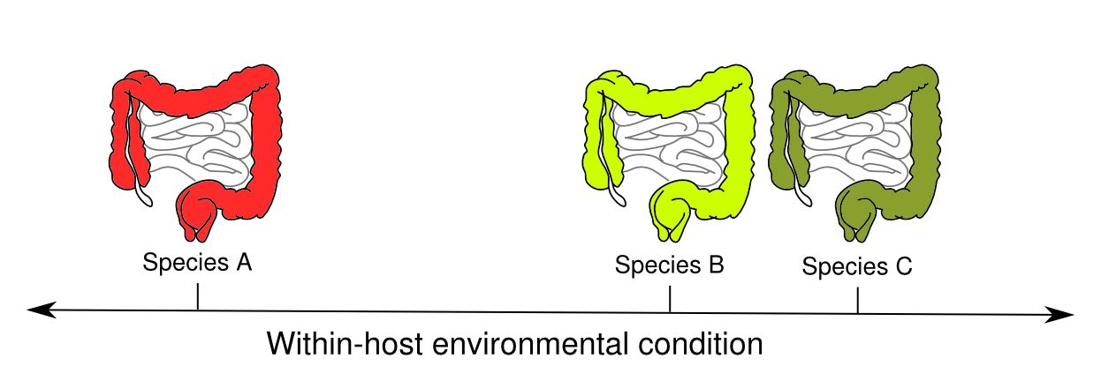

Slide 17
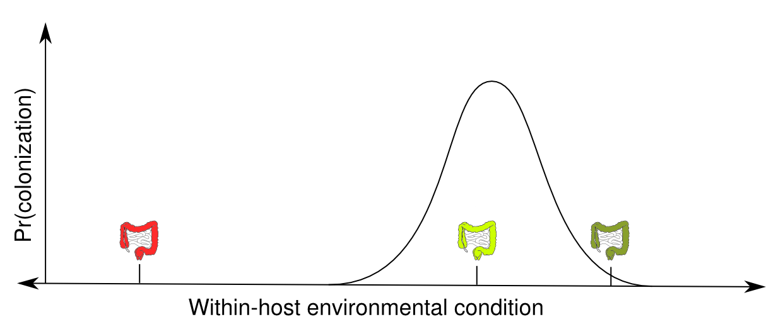
Pr(establishment)

Slide 18
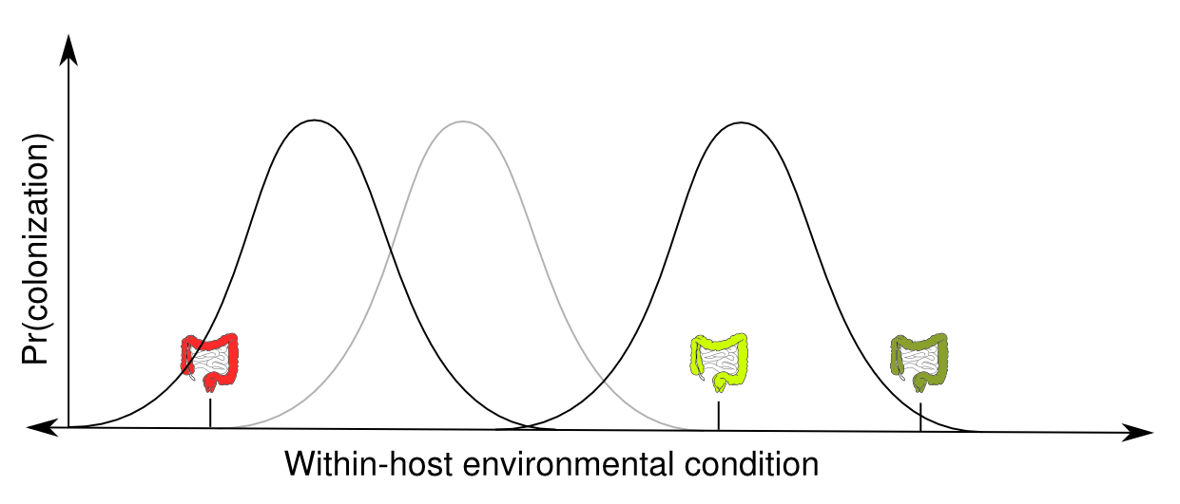
Pr(establishment)

Slide 19
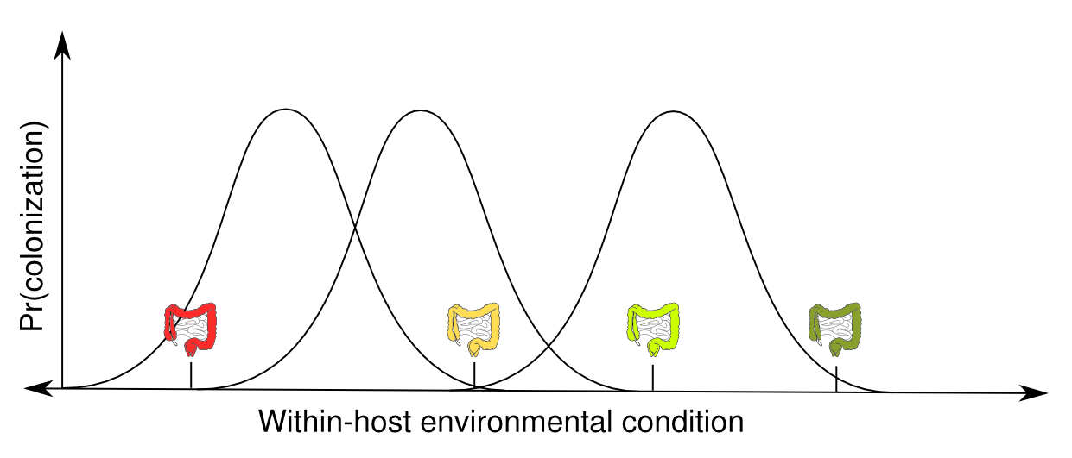
Pr(establishment)

Slide 20
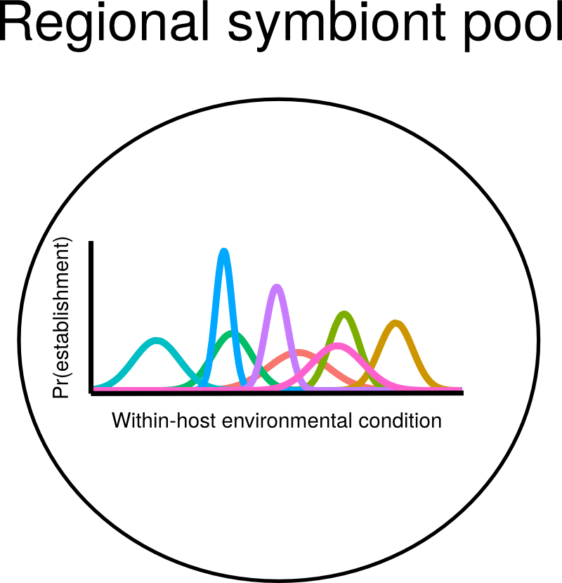

Slide 21
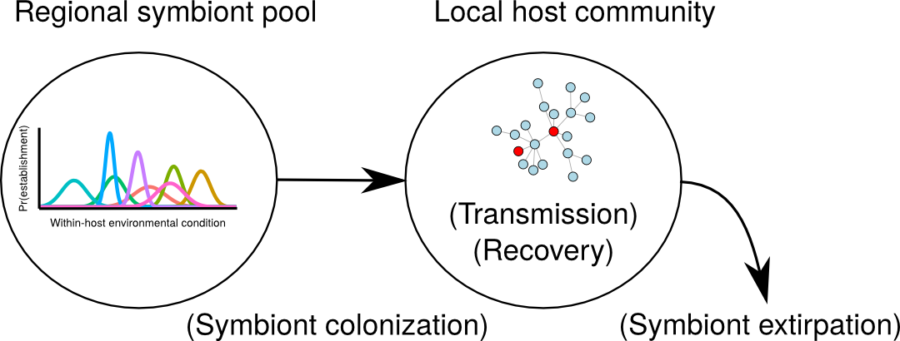

Slide 22
Simplifying assumption:
no cost of infection

Slide 23
Symbiont
diversity
Host diversity
Symbiont
transmission

Slide 24
Benefits of considering symbionts
Data availability
Generality
Explicit distinction between infection and disease
Less controversial
Symbiont
diversity
Host
diversity
Symbiont
transmission

Slide 25
Analysis
Iteratively
Vary host functional diversity

Slide 26
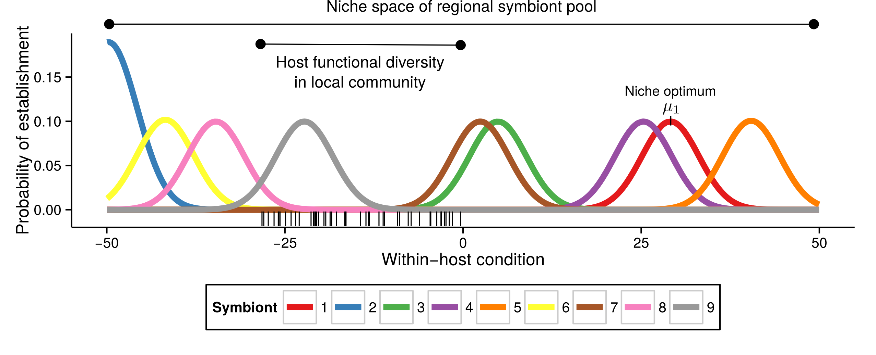

Slide 27
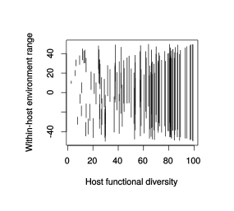

Slide 28
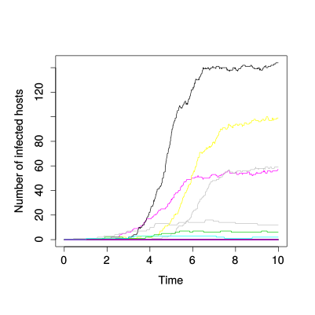
Analysis
Iteratively
Vary host functional diversity
Simulate local infection trajectories

Slide 29
Analysis
Iteratively
Vary host functional diversity
Simulate local infection trajectories
Quantify symbiont richness and transmission

Slide 30
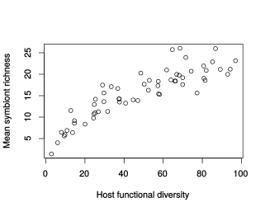
Results
Diversity begets diversity

Slide 31
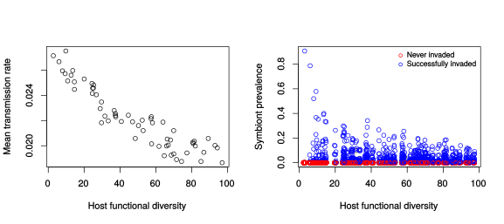
Results
Diversity reduces transmission

Slide 32
Results
Diversity reduces transmission

Slide 33
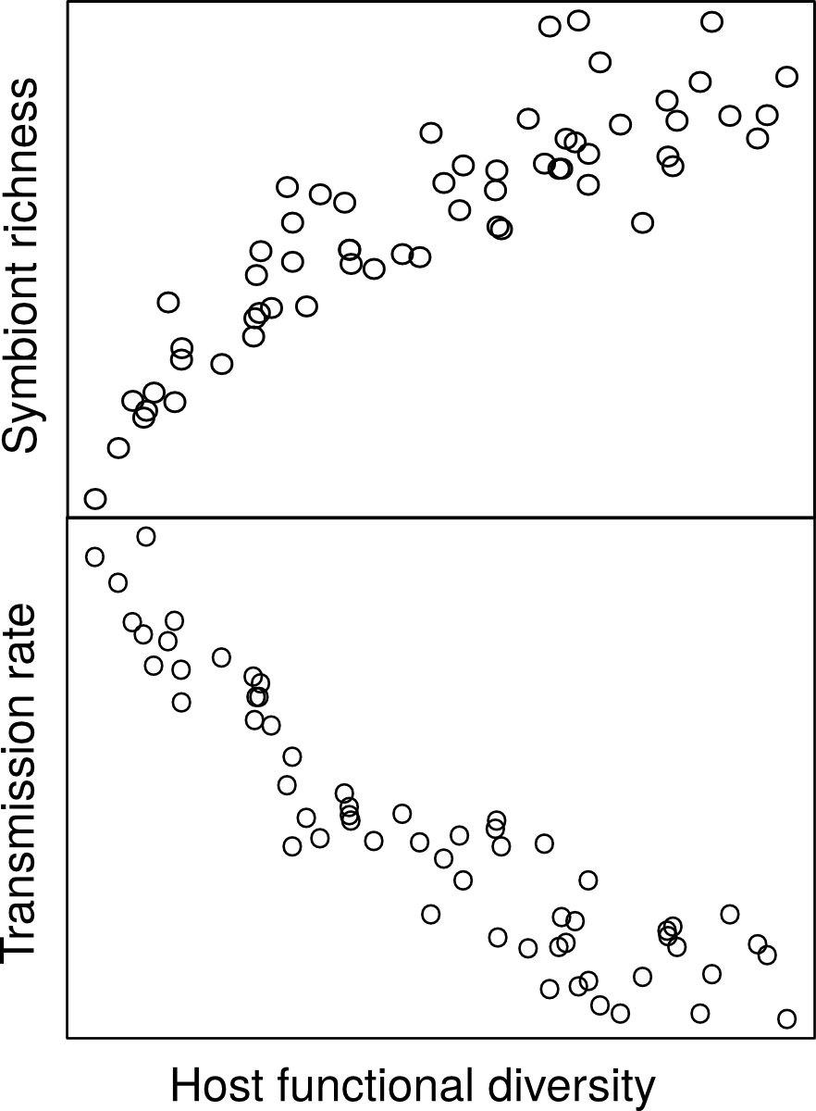
Expectations Results
Parasite diversity
Transmission
Host diversity

Slide 34
Take home
Diverse host communities:
  Rich symbiont communities, lower prevalence
Depauperate host communities:
  Depauperate symbionts, high prevalence

Slide 35
What about disease risk?
Still important, but integrates many factors
Focal host choice
Transmission potential
Exposure
Diversity of infectious agents
i.e. more complicated than constituent parts

Slide 36
What about management?
Management goals
  High symbiont richness & low transmission or
  low symbiont richness & high transmission?

Slide 37
Parallels
Habitat area-heterogeneity trade-off (Allouche et al. 2012)
Host abundance-diversity trade-off

Slide 38
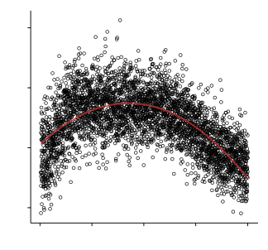
Parallels
Habitat area-heterogeneity trade-off (Allouche et al. 2012)
Host abundance-diversity trade-off
Extremely high host diversity:
- high colonization potential
- low host abundance
- transmission & persistence unlikely
Symbiont richness
Host functional diversity

Slide 39
Parallels
Habitat area-heterogeneity trade-off (Allouche et al. 2012)
Host abundance-diversity trade-off
Extremely high host diversity:
- high colonization potential
- low host abundance
- transmission & persistence unlikely
Specialists vs. generalists
Realism
Symbiont richness
Host functional diversity

Slide 40
Thank you

