Slide 1
Reconciling divergent effects of diversity on disease
Maxwell Joseph, Joseph Mihaljevic, and Pieter Johnson
QDT Feb 2015

Slide 2
Host diversity
Disease
risk

Slide 3
Host diversity
Disease
risk
-
Dilution effect

Slide 4
Amplification effect, ecological disservice
Host diversity
Disease
risk
+
-
Dilution effect

Slide 5
Disease risk
Density of infected vectors
Density of infected reservoir hosts
Rate of change in the density of infected hosts
Human risk of zoonotic infection
Parasite transmission rate
Parasite prevalence in reservoir hosts
Parasite prevalence in vectors
Invasibility of a host community
Probability that an individual will be infected with a disease agent

Slide 6
Host diversity
Disease
risk
Disease
risk
Disease
risk
Disease
risk
?
Disease
risk
Disease
risk
Disease
risk

Slide 7
Host diversity
Disease
risk
Disease
risk
Disease
risk
Disease
risk
Disease
risk
Disease
risk
Disease
risk
Disease
risk
Disease
risk
Disease
risk
?
Disease
risk
Disease
risk
Host diversity
Disease
risk

Slide 8
Parasite
richness
Host
functional
diversity
Parasite
transmission

Slide 9
Expectations
Diversity begets diversity
Parasite diversity
Host diversity
Hechinger & Lafferty 2005

Slide 10
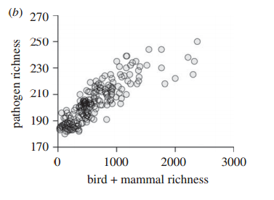
Diversity begets diversity
Dunn et al. 2010

Slide 11
Expectations
Diversity reduces* transmission
Parasite transmission
Host diversity
* on average, we think, theoretically, most of the time, when host community density is constant (Joseph et al. 2013)

Slide 12
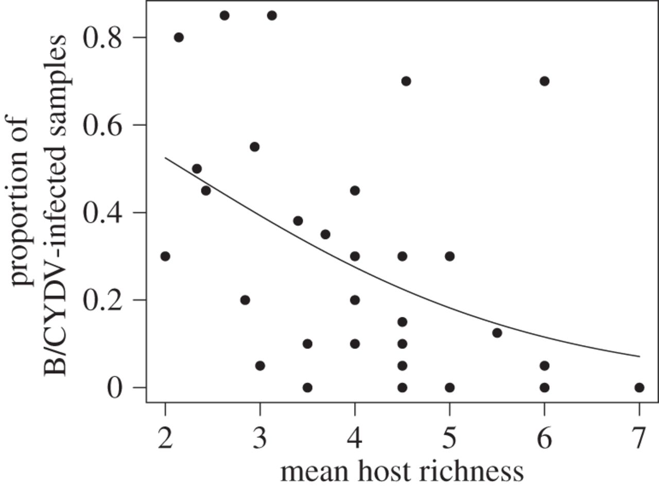
Lacroix et al. 2014

Slide 13
Contradiction?
Parasite diversity
Increased disease risk
Decreased disease risk
Transmission
Host diversity

Slide 14
Model structure

Slide 15
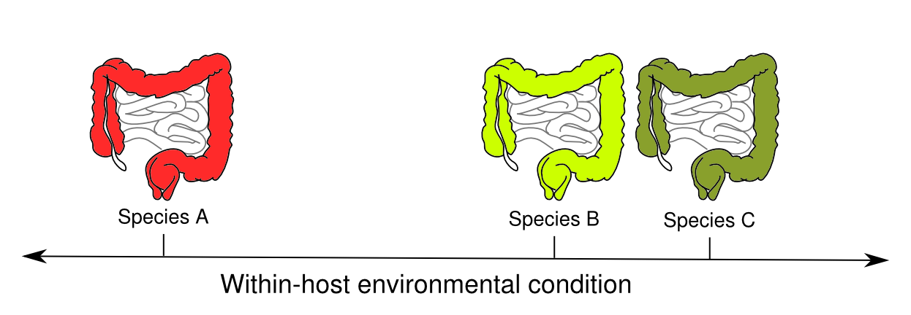

Slide 16
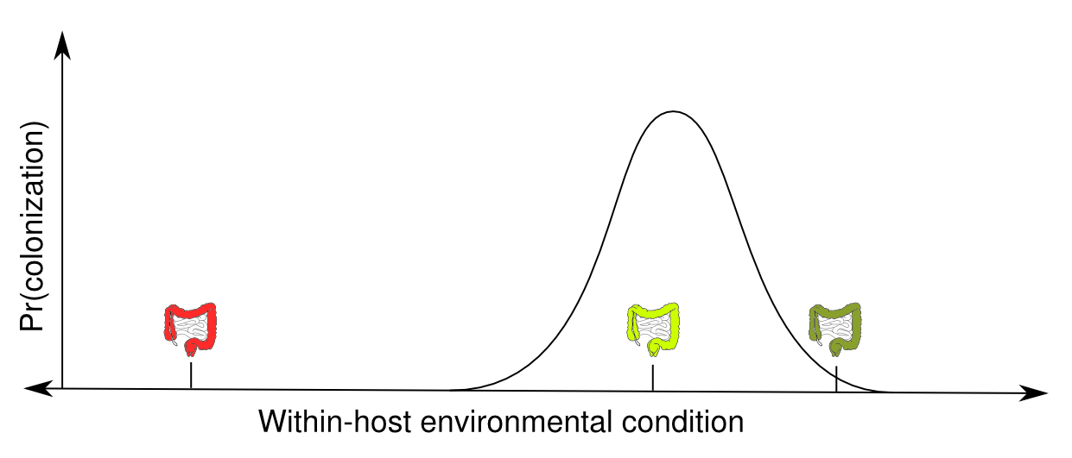
Pr(establishment)

Slide 17
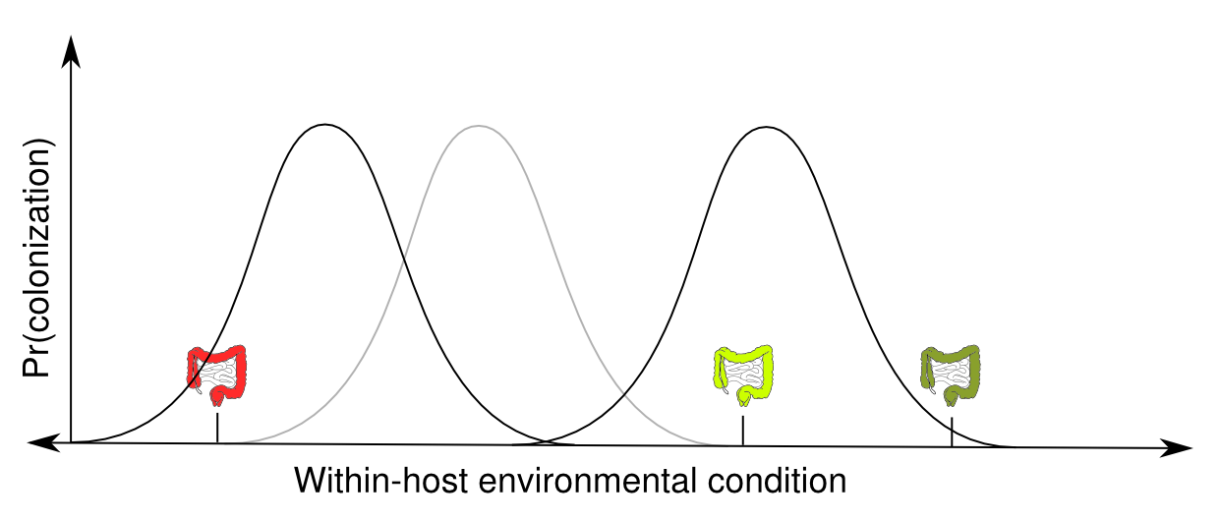
Pr(establishment)

Slide 18
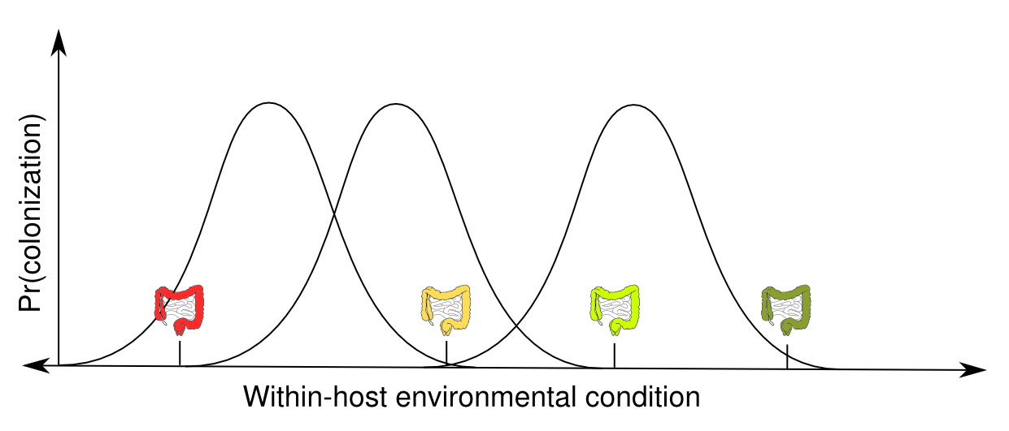
Pr(establishment)

Slide 19
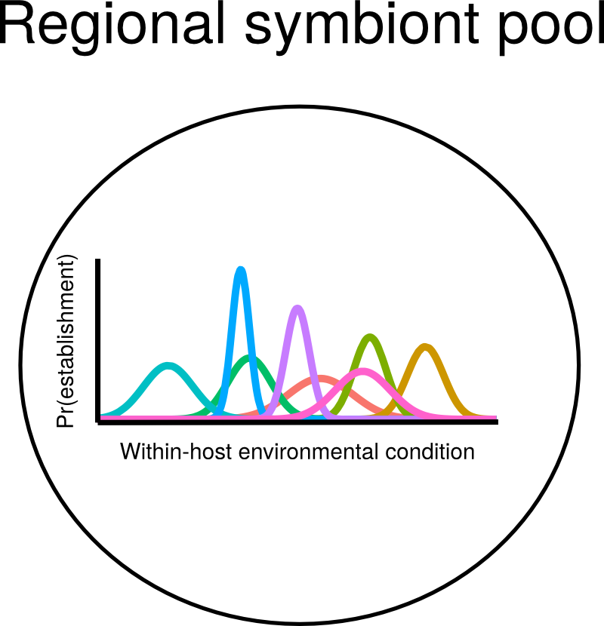

Slide 20
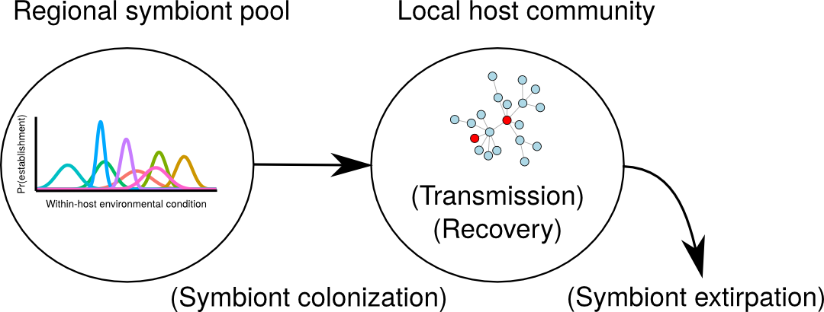

Slide 21
Simplifying assumption:
no cost of infection

Slide 22
Symbiont
richness
Host diversity
Symbiont
transmission

Slide 23
Benefits of considering symbionts
Data availability
Generality
Explicit distinction between infection and disease
Less controversial
Symbiont
richness
Host
diversity
Symbiont
transmission

Slide 24
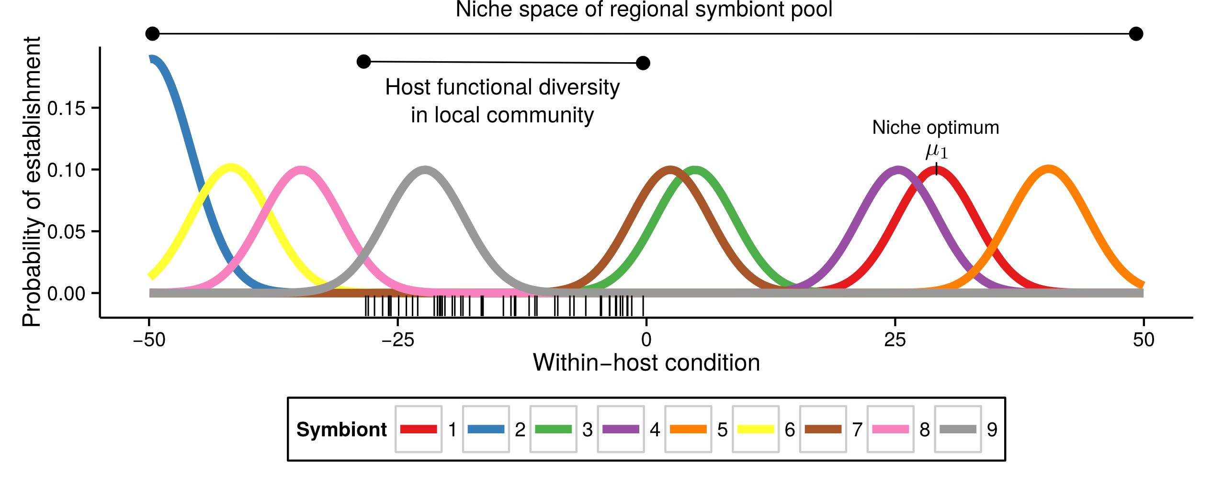
Analysis
Iteratively
Vary host functional diversity

Slide 25
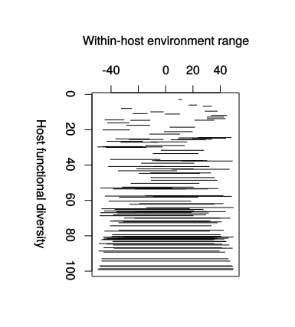

Host functional diversity

Slide 26
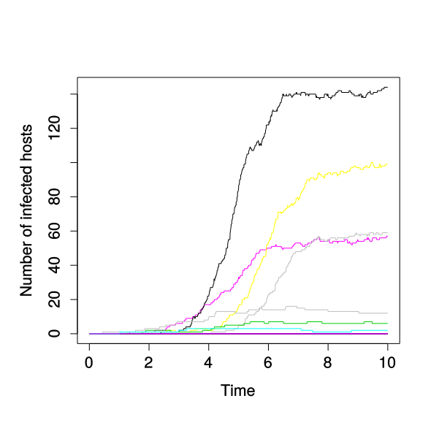
Analysis
Iteratively
Vary host functional diversity
Simulate local infection trajectories

Slide 27
Analysis
Iteratively
Vary host functional diversity
Simulate local infection trajectories
Quantify symbiont richness and transmission

Slide 28
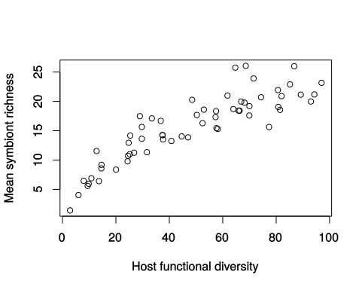
Results
Diversity begets diversity

Slide 29
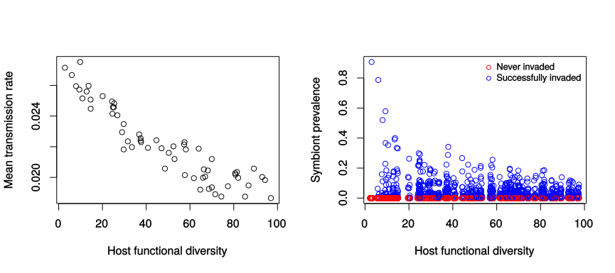
Results
Diversity reduces transmission

Slide 30
Results
Diversity reduces transmission

Slide 31
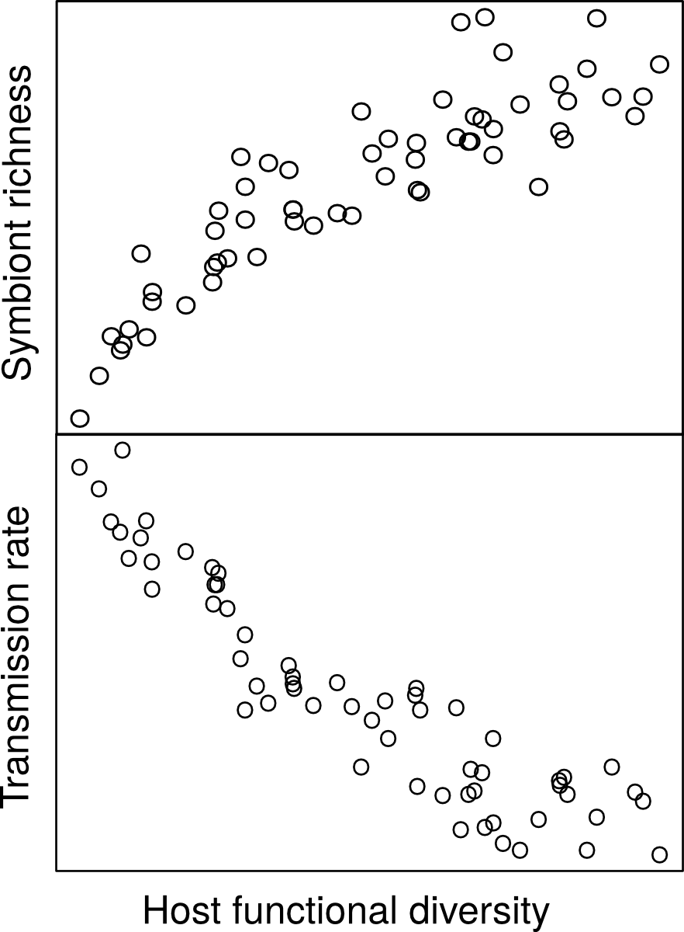
Expectations Results
Parasite diversity
Transmission
Host diversity

Slide 32
Take home: static host model
Diverse host communities:
Rich symbiont communities, lower prevalence
Depauperate host communities:
Depauperate symbionts, high prevalence
Caveat: static host communities
Timescale argument
Surface dynamics

Slide 33
New stuff
Added features:
Dynamic host communities
Costs & benefits of infection
Frequency & density dependent transmission
Final steps:
Explore effect of costs/benefits of infection
Explore differential impacts on generalists and specialists

Slide 34
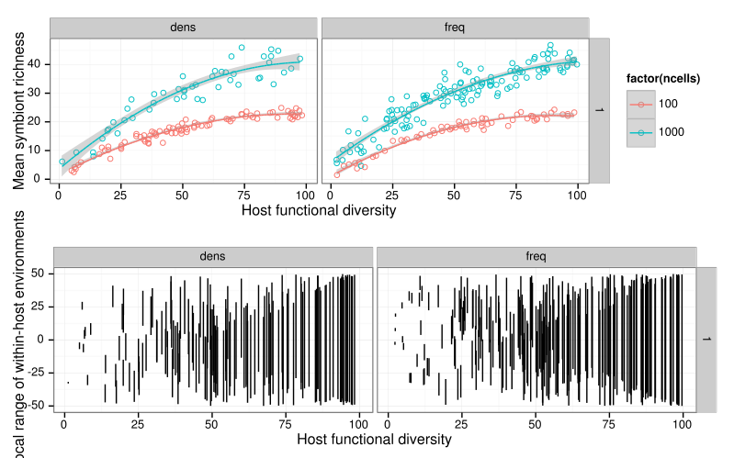
Dynamic model results

Slide 35
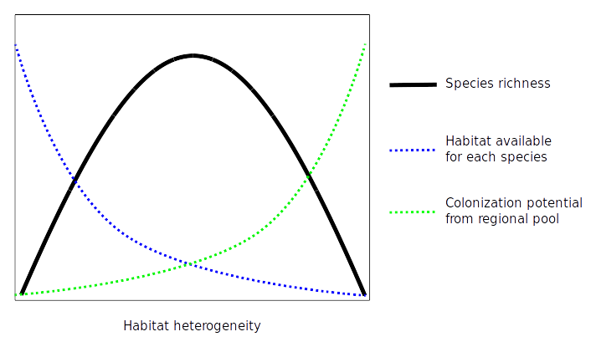
Unimodality in habitat model

Slide 36

Unimodality in static host model

Slide 37
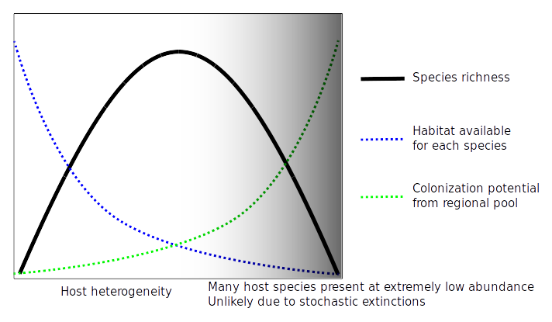
Unimodality in dynamic host model?

Slide 38

Dynamic model results

Slide 39
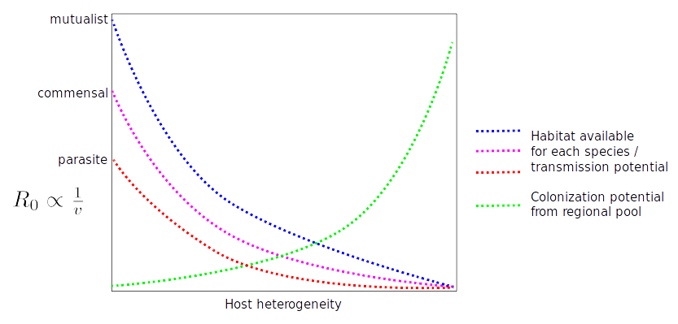
Effect of parasitism & mutualism
Expectation: persistence is harder for parasites

Slide 40
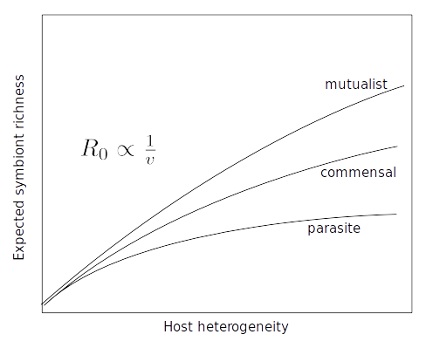
Effect of parasitism & mutualism
Expectation:

Slide 41
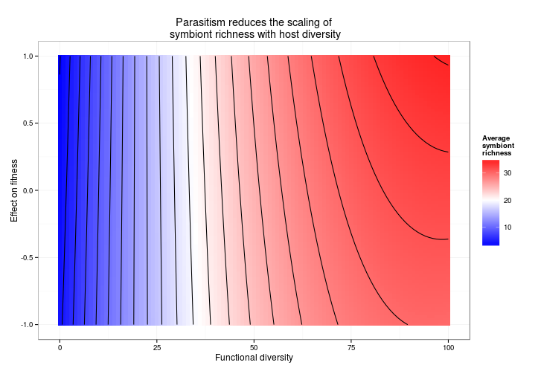
Effect of parasitism & mutualism
Expectation: Results:

Slide 42
Next steps:
Specialists vs. generalists
Quantify important events:
“wasted” contacts
Within vs. among species transmission
Failed symbiont invasions
Symbiont losses from system

Slide 43
Questions

