Slide 1


HACK-A-DUCK HACKATHON
WELCOME!
Link ref : https://www.etsy.com/au/listing/1220728441/bad-usb-rubber-ducky-digispark-attiny85

Slide 2
CAPITAL ONE PROJECT
Make Credit Simple :
Context: Good credit is important, especially given the Cost of
Living Crisis. We'd love to see some hacks that would help us to
help customers with their credit.

Slide 3
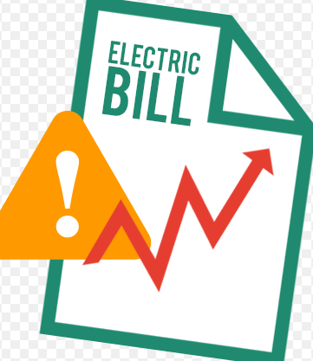
Energy bills (factor1) --> Credit should derive based on limitation of energy bills (calculate : old bill < new bill (credit score get reduced) old bill > new bill (credit score get increased)) Benefits : - Save the Energy (Environmental saving) - This will not be going to cost company a single penny they are not going to investing anything here - Client will be happy by saving his own money and light bills
Link ref : https://www.google.com/url?sa=i&url=https%3A%2F%2Fdraydinduygu.com%2Fnotes.aspx%3Fiid%3D140449625-reduce%2Belectricity%2Bbill%26cid%3D6&psig=AOvVaw2K9ouLq485-RbmA_jVYQ7W&ust=1698646380852000&source=images&cd=vfe&opi=89978449&ved=0CBEQjhxqFwoTCMCKiIXNmoIDFQAAAAAdAAAAABAc

Slide 4
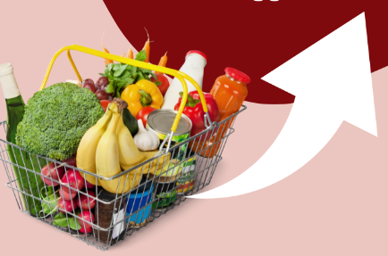
Inflation: food, fuel and more (factor2) --> Budget Wisely - allow customer to add the limit based on necessity. (How? : Prioritize Payment, Build an Emergency Fund, Avoid New Debt) Benefits : - Customer will be able to choose a healthy life to managing necessary(healthy) food requirement - Except some emergency if customer use the public transport, it will reduce the cost of spending on fuel - No Revenue expenditures
Link ref : https://www.google.com/url?sa=i&url=https%3A%2F%2Fwww.niesr.ac.uk%2Fblog%2Ffood-fuelling-inflation-more-energy-prices&psig=AOvVaw18IzZwoK17FVQKcPwOxzYT&ust=1698653535778000&source=images&cd=vfe&opi=89978449&ved=0CBEQjhxqFwoTCOiDjNfnmoIDFQAAAAAdAAAAABBC

Slide 5
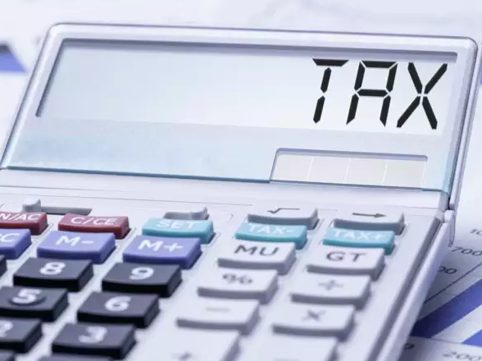
National insurance, tax (based on the payment scale),EMI (factor3) --> If customer is paying for the NI , tax and EMI on monthly/yearly basis based on regularity of the payment company can manage the credit score Benefits : - Company do not require Revenue expenditures - Customers tax will get paid on time for which they will get credit
https://www.google.com/url?sa=i&url=https%3A%2F%2Fm.economictimes.com%2Fwealth%2Ftax%2Fincome-tax-refunds-of-rs-2-4-lakh-crore-issued-up-till-jan-10-2023-how-to-check-tax-refund-status%2Farticleshow%2F96933965.cms&psig=AOvVaw0KvWrpv1Ko_LZmq_F7cbzV&ust=1698657745077000&source=images&cd=vfe&opi=89978449&ved=0CBEQjhxqFwoTCLC6xbX3moIDFQAAAAAdAAAAABAs

Slide 6

If you establish a good credit score, you can save money on interest payments and use the savings to invest in your future. Based on the given three factors customer get “Good Credit score”.
Link Ref : https://www.google.com/url?sa=i&url=https%3A%2F%2Fwww.vectorstock.com%2Froyalty-free-vectors%2Fconclusion-icon-vectors&psig=AOvVaw3D0tZd5Zxsp1a5azd6Tbdr&ust=1698660293790000&source=images&cd=vfe&opi=89978449&ved=0CBEQjhxqFwoTCOCg6vCAm4IDFQAAAAAdAAAAABBF

