Slide 1



NextGen Flu vaccine project
Team: Naomi Waterlow, Sreejith Radhakrishnan, Rosalind Eggo, Mark Jit
R2R

Slide 2
Overview
Potential benefits of next generation vaccines: longer duration, greater efficacy/breadth of protection, potential use as pre-pandemic vaccines, potential use in countries with multiple epidemics a year.
Estimate the incremental health and economic impact of next generation vaccines in seasonal and pandemic situations in key countries, compared to current vaccines.
Use these results to estimate the potential market size for these vaccines under different price points.
These estimates can then be used to inform potential R&D investments by research funders and manufacturers, as well as the return on investment on vaccines for both producers and countries.

Slide 3
Next Generation Flu Vaccines: WHO PPC
 | Improved influenza vaccines | Universal influenza A vaccines
Projected year of licensure | 2022 | 2027
Target population | Children 6-59 months old | All clinical risk groups including children 6-59 months old
Duration of protection | At least one year/influenza season (equal or better than current vaccines) | At least 5 years
Clinical efficacy | Better than current vaccines for either vaccine-matched or drifted strains | Better than current vaccines for vaccine-matched AND drifted strains

Slide 4
Schedule
Year 1 (Dec 2021 – Nov 2022)
Use calibrated models of seasonal influenza in two settings (Kenya + LMIC in Asia)
Compare the impact and cost-effectiveness of current vs. next generation influenza vaccines
Year 2 (Dec 2022 – Nov 2023) subject to funding
Extrapolate model findings to other parts of the world
Analyse the impact of next generation vaccines in pandemic situations

Slide 5
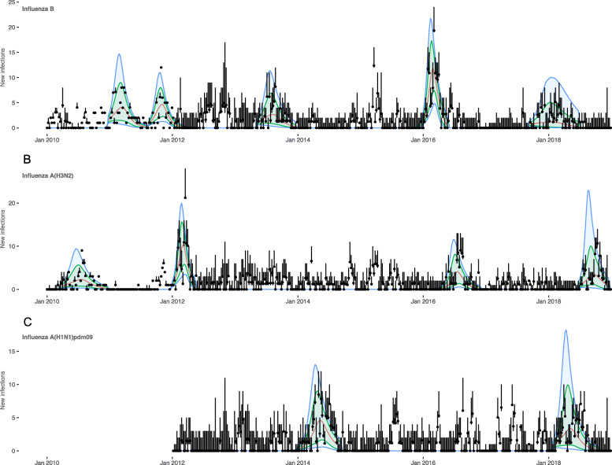
Dawa et al. (2020) - influenza in Kenya
Epidemics fit with fluevidencesynthesis R package
SEEIIR epidemic model, with vaccination.
Parameters estimated: transmissibility, age-specific susceptibility, age-specific ascertainment rates, initial number of infections

Slide 6
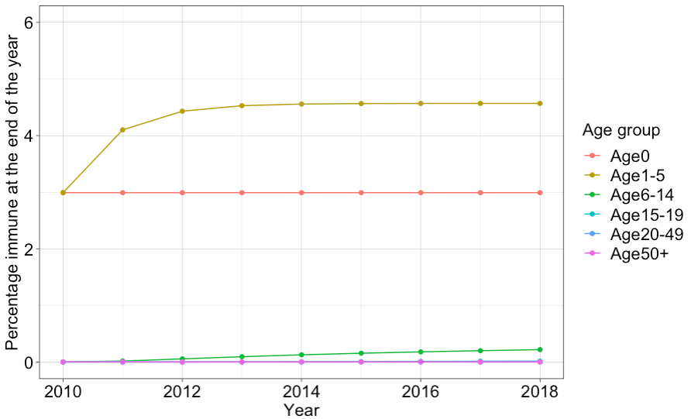
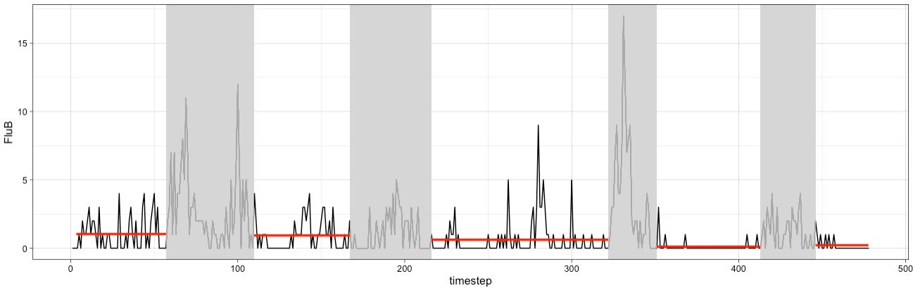
Major differences
Allow vaccination to persist for more than one season, with waning and ageing of vaccinated individuals.
Include a background Force of Infection for “off-season”, by fitting a Poisson to the cases. This can then be reduced dependent on the Vaccination model.
Notes:
This is a suggested plan -> let us know if you have other ideas regarding the vaccination model

Slide 7
Overview of modelling
Over whole time period

Slide 8
Main vaccine scenarios of interest
No vaccine (scenario 1)
Current vaccines (scenario 4 –, 70/40 efficacy, 6months waning)
Incremental vaccines broadness (scenario 75 – 70 efficacy, 3 years)
Incremental vaccines efficacy (scenario 77 – 90/70 efficacy, 3 years)
Universal vaccines (scenario 122 – 90 efficacy, 5 years)
Waning of vaccination immunity
Build up of immunity for longer lasting vaccines
Ageing included, born susceptible
Different efficacy by flu subtype and season (SH and NH seasons)
Non-leaky immunity. I.e. % remain S, 1-% R
Used as input into transmission models

Slide 9
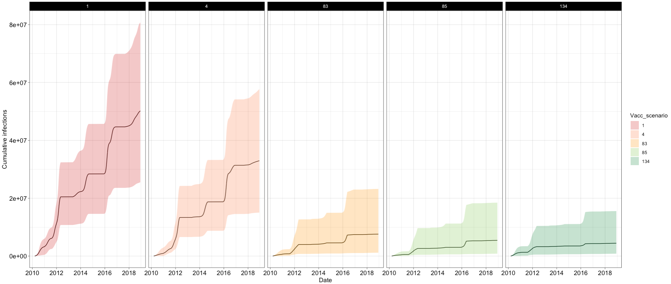
Combined output over time
Aiming to focus on comparison between:
Currently available vaccines
Improved vaccines (WHO PPC)
Universal vaccines (WHO PPC)

