Slide 1
Susceptibility options

Slide 2
3 options
‘OFF’: No change in susceptibility from previous season i.e. the infections in the previous season do not impact the susceptibility of the next season
‘MULT’: multiplier = proportion of cases avoided in the previous epidemic compared to no vaccine scenario * immunity. I.e. All the immunity in a season is as a result of infections in the previous season, therefore reducing infections reduces immunity in the same proportion e.g. avoid X proportion of cases previous year, then new susceptibility = base susceptibility + (1- base susceptibility)*X -> mathematically can’t go above 1 -> can go below 0 if vaccination causes more cases. (e.g. base susceptibility = 20%, get 100% more cases, new susceptibility = 0.2 +(1-0.2)*-0.9= -0.32)
‘POP_AD’: add the proportion of the population that avoided infection to the susceptibility. i.e. There is a baseline immunity in a season from a combination of factors, but this is modified by infections in the previous year, where a 1% change in the population infected in the previous year alters the immunity in the current season by 1% (i.e. one-for-one ) E.g. X proportion of the population avoids infection in previous year as a result of vaccination, then new susceptibility = base susceptibility + X
-> can go below 0 and over 1

Slide 3
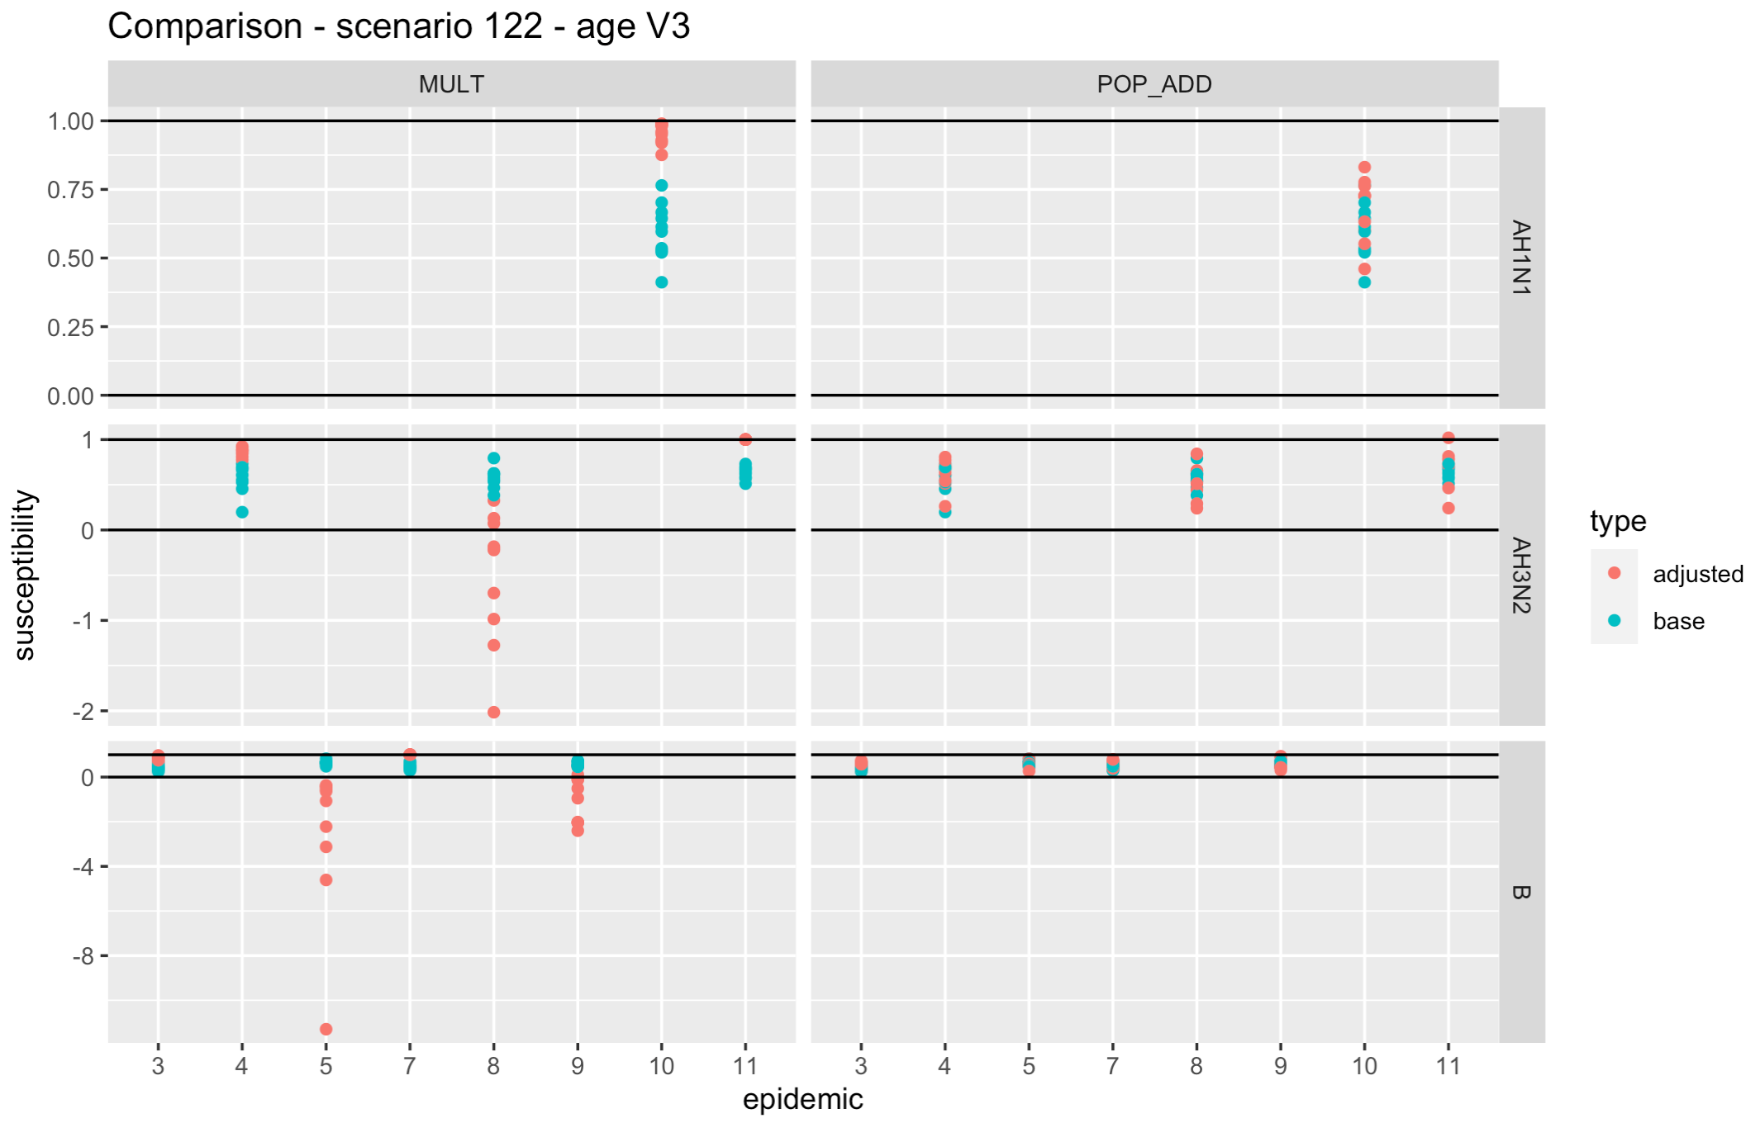
Susceptibility differences example

Slide 4
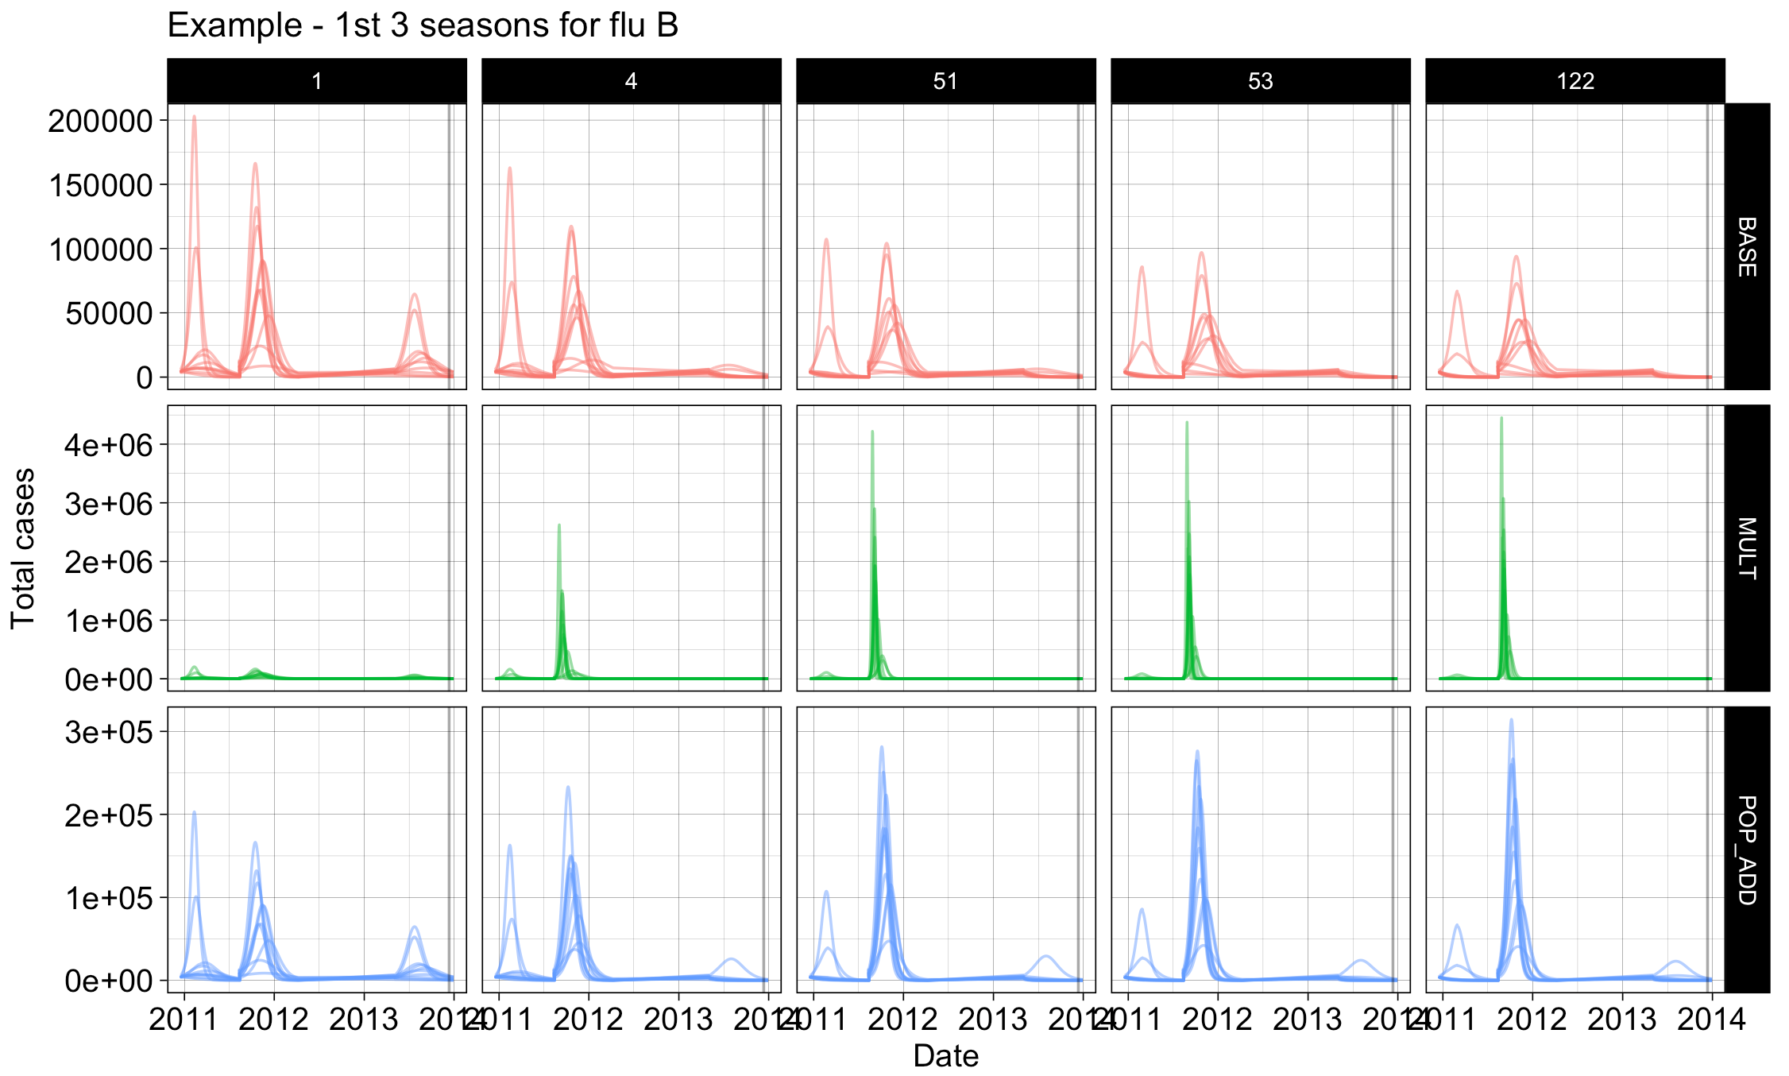
Example epidemics
NO VACCINE
No change in susceptibility
Note different scales!

Slide 5
More detailed look at each epidemic

Slide 6
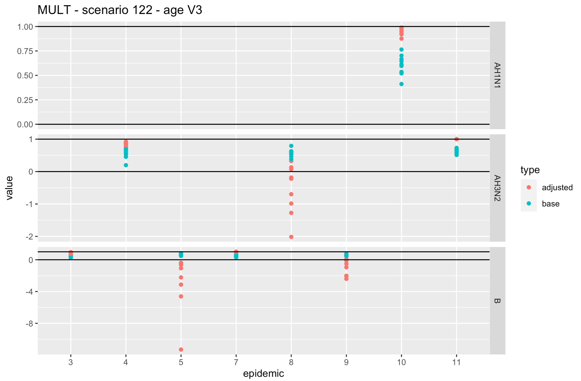
MULT
Susceptibility

Slide 7
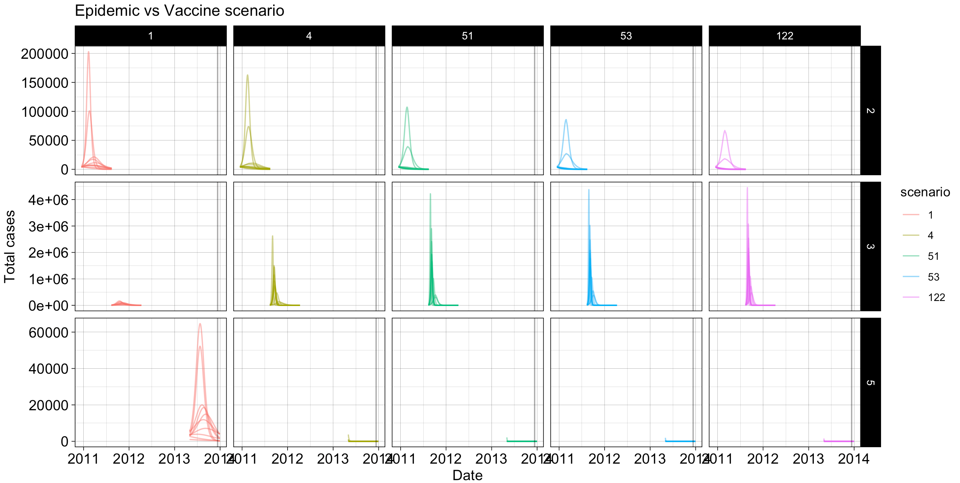
The corresponding epidemics (with susceptibility set to 0 instead of minus numbers)
No vaccine

Slide 8
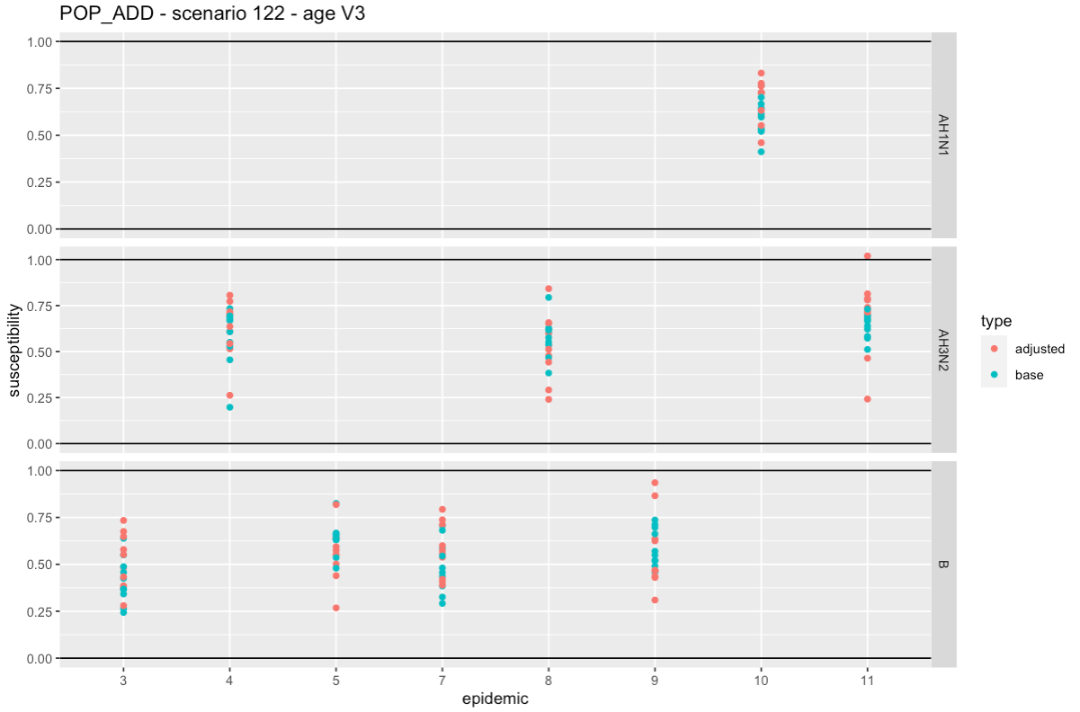
POP_AD

Slide 9
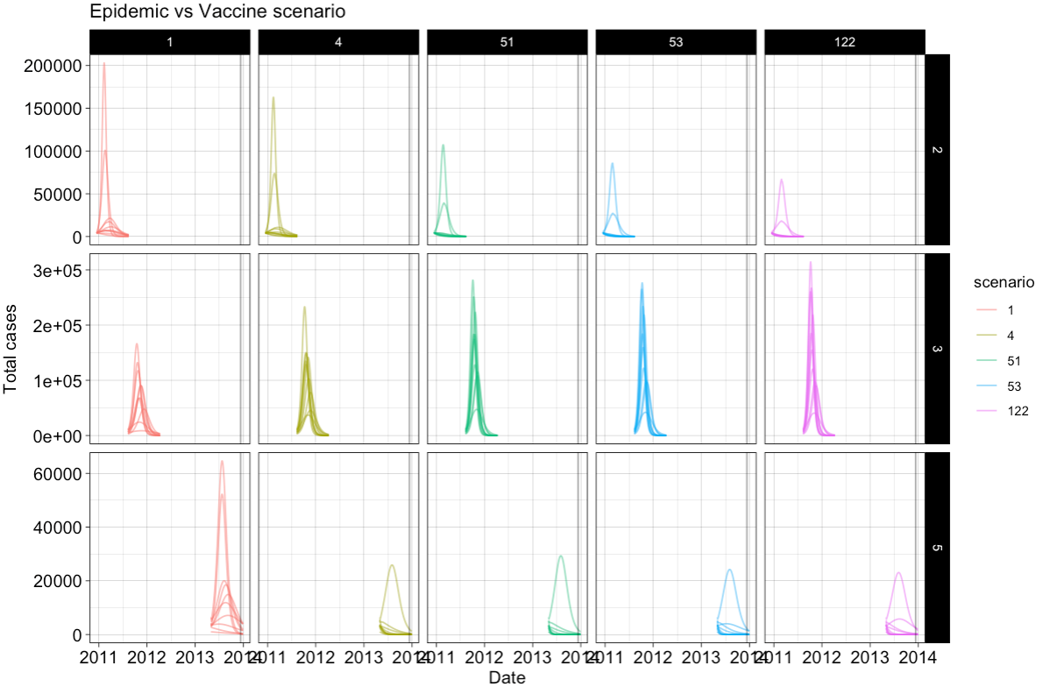
The corresponding epidemics (with susceptibility set to 1 if bigger than)

Slide 10
Conclusions
Increasing by the % of the population that avoided infection seems more reasonable than increasing relative to the %of infections that were avoided
However in both scenarios you see increased outbreaks with vaccination in subsequent years
There is either scenario reasonable?

