Slide 1
Ch 12 Polymorphism
Willetta song
Css 133 winter 18

Slide 2
Class hierarchy
Base Class vs Derived Class:
Base Class - Supplies member functions to other classes
Derived Class – Inherits member functions from other classes (can inherit and supply)

Slide 3
Class Hierarchy Example
A game with Monster objects:
Cyclops
Vampire
Swamp Thing
Zombie
All Cyclops, Vampires, Swamp Things, and Zombies are Monsters
Not all Monsters are Zombies!

Slide 4
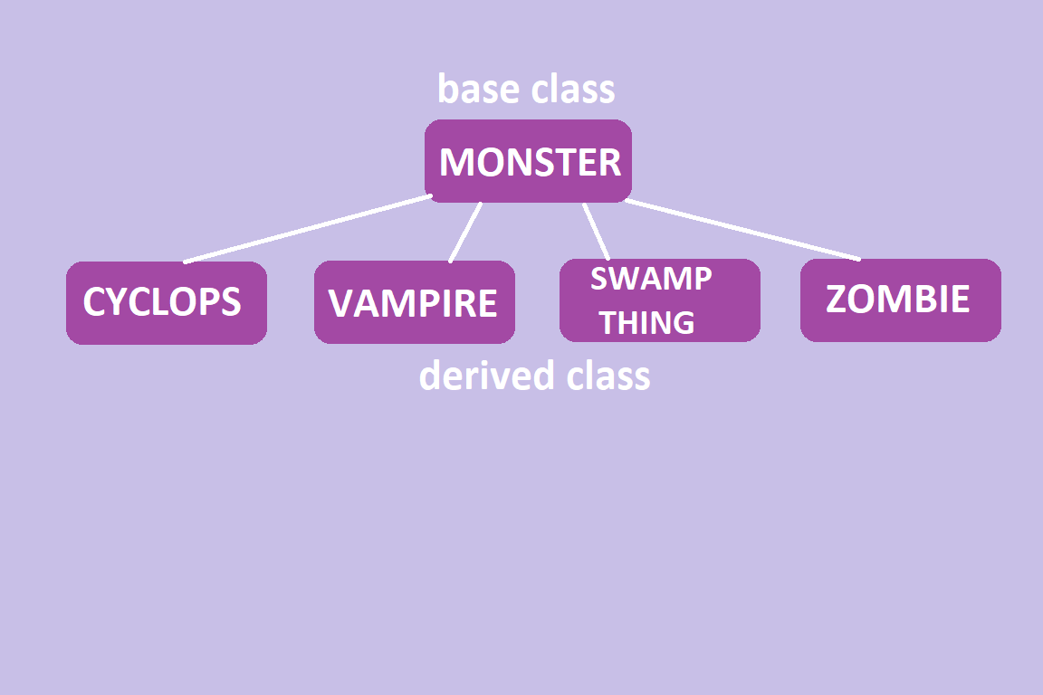
Class Hierarchy (cont.)

Slide 5
Inheritance & Polymorphism
All monsters have a scary attack function, but each attack is different:
Cyclops attacks you with a club and says “Rawr!” (Hit points: 3)
Vampire says “Vlah!” and bites your arm. (Hit points: 5)
Swamp Thing gurgles and slathers you with toxic waste (Hit points: 8)
Zombie shouts “Brrrrraaains..” and bites your toe (Hit points: 10)
Same member function (attack), sent to different objects (scary monsters), has different forms: Polymorphism!

Slide 6
Polymorphism
Build additional classes without modifying entire program (or cutting and pasting)
Uses pointer and reference handles (not name handles)
Do:
Base-class pointer at base-class object
Derived-class pointer at derived class object
Base-class pointer at derived-class object
Don’t:
Derived-class pointer at base-class object
Base-class pointer at derived class object AND attempt to access derived class-only functions

Slide 7
Polymorphism (cont.)
When aiming a base-class pointer at a derived class object:
A base class pointer can be used to invoke ONLY functions declared in base class
Program chooses functionality based on pointer type – not object type
Example: If only vampires turn into bats during attack, monsterPtr->attack won’t call bat feature.
EXCEPT: Virtual functions

Slide 8
Virtual
Declare base-class function (attack) a virtual function to enable polymorphic behavior
Example: virtual void attack(); // base-class member function in class Monster
Derived-class function is declared virtual & override
Example: virtual void attack() override; // derived-class member function in class Vampire
Program now chooses derived class function based on object type – not pointer type
Want to override an override? Declare final 😐
Example: virtual void lurch() final; // all monster lurch the same way
Example: class MyClassNotYours final {} // cannot be used as a base class by anyone ever

Slide 9
Polymorphism - summary
Before Polymorphism:
Using switch or if statements to distinguish an object & perform correct action
Multiple switch or if statements sprinkled about code
Exposes program to errors, esp. when modifications occur
After Polymorphism:
Simplified code
Less errors

Slide 10
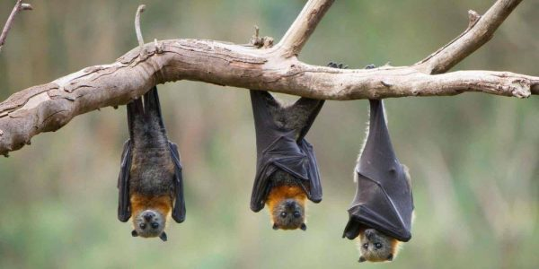
Questions?
Image Source: http://artvallejo.org/events/mysteries-of-the-natural-world-bats-with-norcal-bats/

