Slide 1
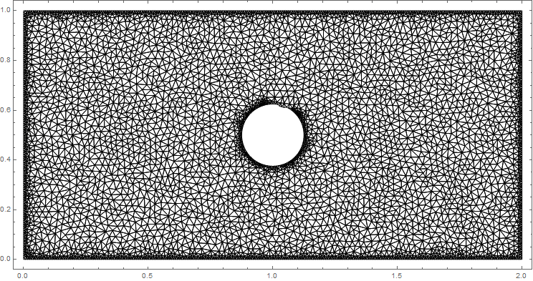
Phase-field modeling with finite element method
Hu, Monpara, Lai

Slide 2
PHASE-FIELD MODELING
Solidification
Grain growth
Solid-state phase transformations
Vesicle dynamics
Notes:
Phase-field modeling is a mathemical model for solving interfacial problems. (Easier def.?) It has a wide range of uses, including: solidification, grain growth, solid-state phase transformations, and vesicle dynamics.

Slide 3
Finite element method
Pros:
Cons:
Can implement complex geometries
Regional mesh refinement easy
Existing code can be tweaked to solve different equations
Writing code from scratch is… not easy
Conceptually more difficult than finite difference methods
Notes:
There are many benefits to the finite element method of analysis. For example, it’s able to account for complex shapes and it can easily be modified to change the mesh or solve different equations. However, it’s not so easy to code from scratch and it’s conceptually much more difficult than finite difference methods.

Slide 4
FINITE ELEMENT method
Convert strong form PDE to weak integral form
Discretize domain into elements → approximate numerical solution via shape, or weight, functions
Notes:
Finite Element analysis is behind some of the most accurate and efficient numerical methods to date. Finite element analysis involves the conversion of the strong form PDE to the weak integral form. The domain is then discretized into elements from which an approximate numerical solution can be obtain through shape, or weight, function. The finer the discretization, the closer the approximate solution gets to the actual solution.

Slide 5
Generating a weak form
Obtain strong form of PDE.
Rearrange to get zero on the right hand side.
Multiply equation by test function. (Galerkin)
Integrate whole equation over the domain.

Slide 6
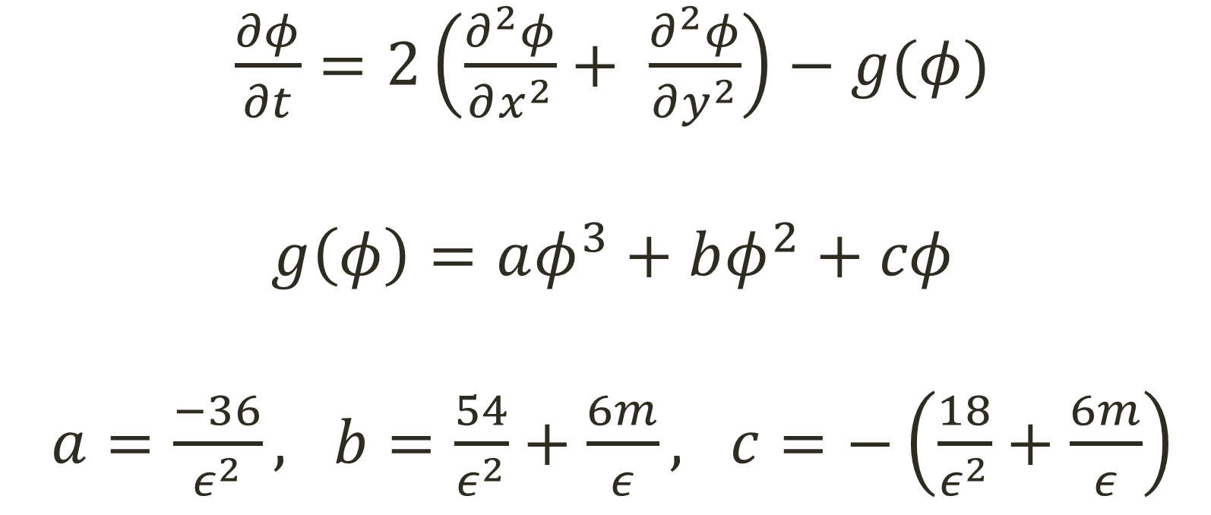
1. Obtain strong form of PDE
$\frac{∂φ}{∂t}=2\left(\frac{∂^{2}φ}{∂x^{2}}+ \frac{∂^{2}φ}{∂y^{2}}\right)−g(φ)$
$g\left(φ\right)=aφ^{3}+bφ^{2}+cφ$
$a=\frac{−36}{ε^{2}}, b=\frac{54}{ε^{2}}+\frac{6m}{ε}, c=−\left(\frac{18}{ε^{2}}+\frac{6m}{ε}\right)$
Notes:
G(phi) is a combination of surface energy and driving force for the interface.
For simplicity, we set surface energy to 1, hence making interface isotropic.

Slide 7
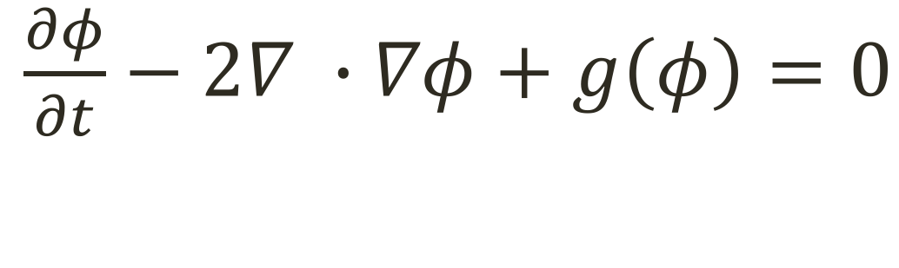
2. get zero on the right hand side
$\frac{∂φ}{∂t}−2∇ ∙∇φ+g\left(φ\right)=0$

Slide 8
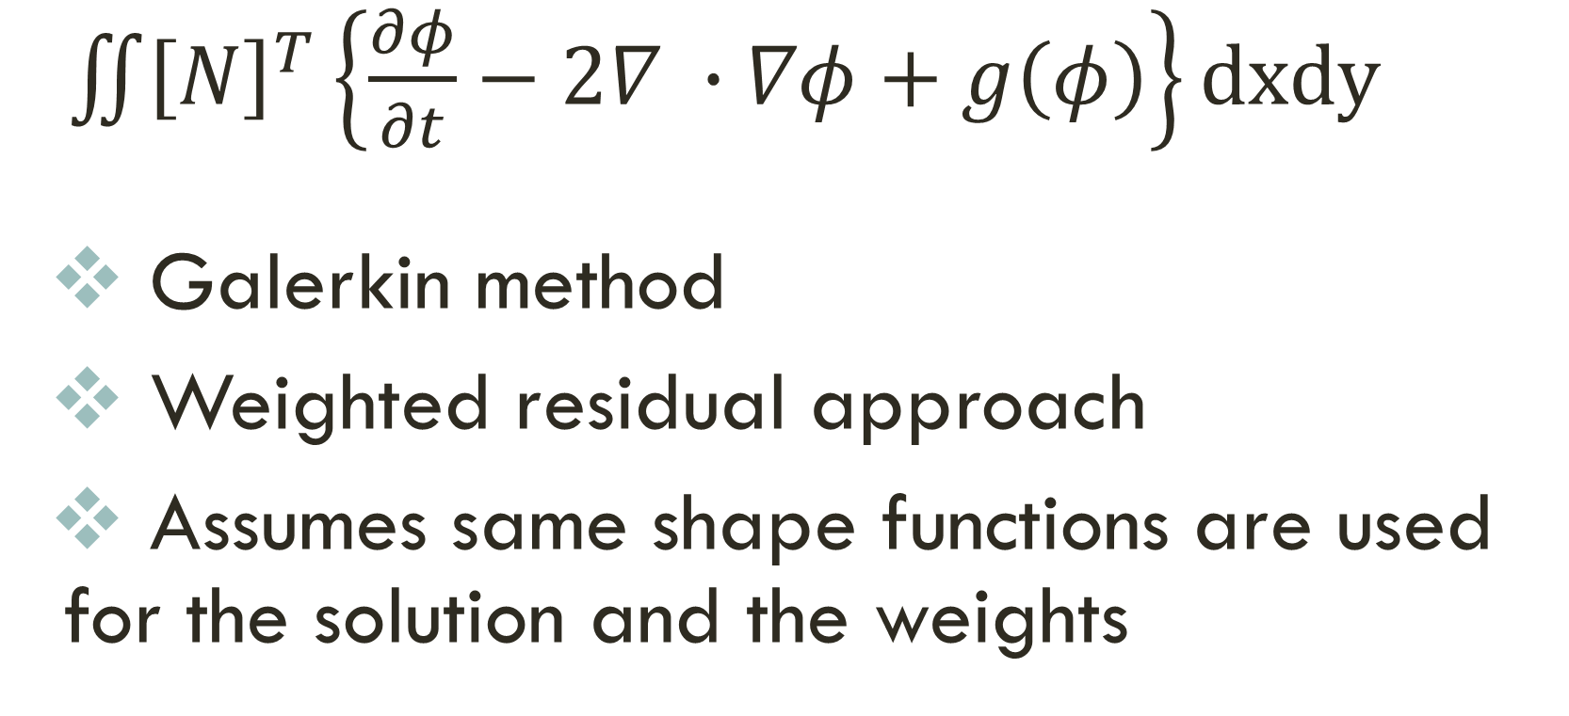
3. Multiply equation by test function
$\iint{{\left[N\right]}^{T}}\left\{\frac{∂φ}{∂t}−2∇ ∙∇φ+g\left(φ\right)\right\}dxdy$
Galerkin method
Weighted residual approach
Assumes same shape functions are used for the solution and the weights

Slide 9
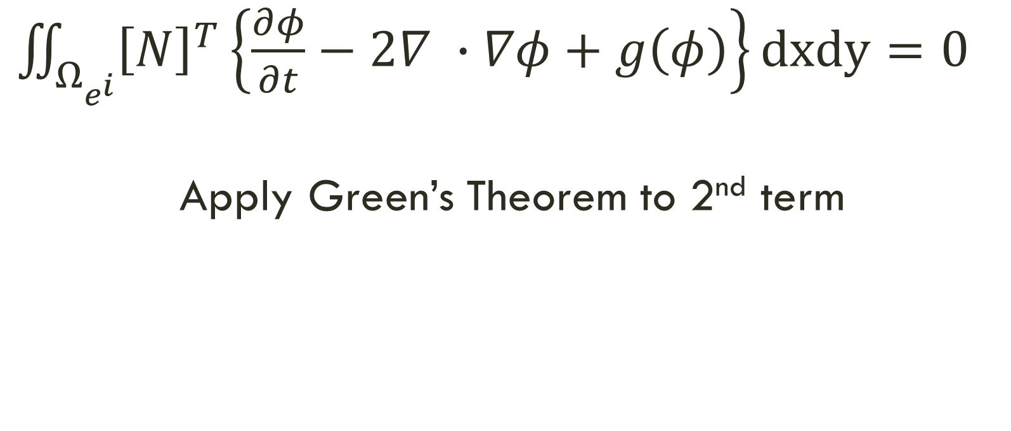
4. Integrate over the domain
$\iint_{Ω_{e^{i}}}{{\left[N\right]}^{T}\left\{\frac{∂φ}{∂t}−2∇ ∙∇φ+g\left(φ\right)\right\}dxdy=0}$
Apply Green’s Theorem to 2nd term
Notes:
We end up with a system of equations

Slide 10
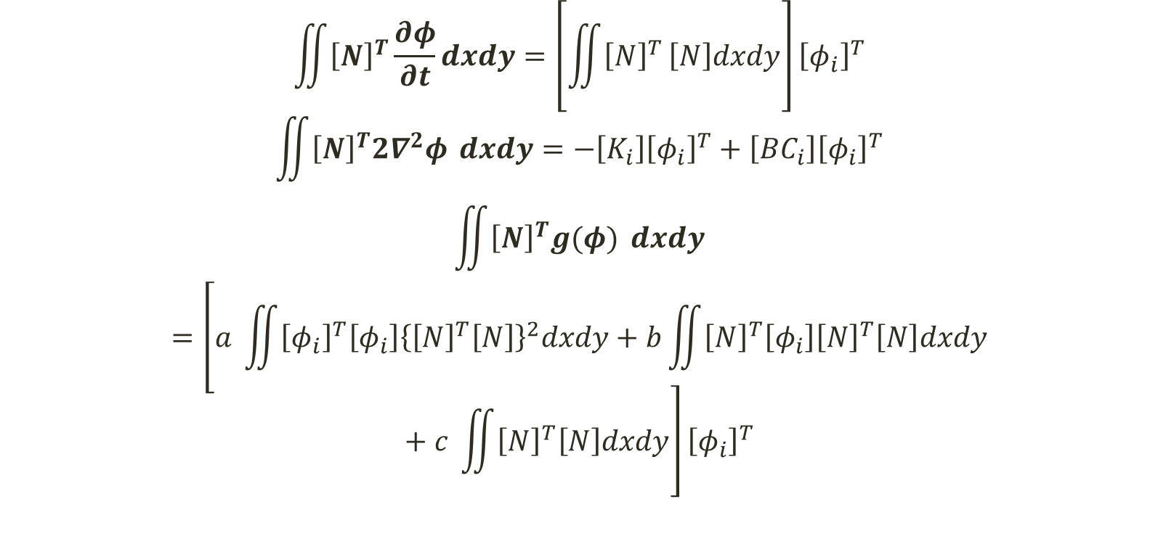
FINITE ELEMENT FORMULATION
$$\iint{{\left[N\right]}^{T}\frac{∂φ}{∂t}}dxdy=\left[\iint{{\left[N\right]}^{T}}\left[N\right]dxdy\right]{\left[φ_{i}\right]}^{T}$$
$$\iint{{\left[N\right]}^{T}2∇^{2}φ }dxdy=−\left[K_{i}\right]{\left[φ_{i}\right]}^{T}+\left[BC_{i}\right]{\left[φ_{i}\right]}^{T}$$
$$\iint{{\left[N\right]}^{T}g(φ) }dxdy=\left[a \iint{{\left[φ_{i}\right]}^{T}\left[φ_{i}\right]{\left\{{\left[N\right]}^{T}\left[N\right]\right\}}^{2}dxdy}+b\iint{{\left[N\right]}^{T}\left[φ_{i}\right]{\left[N\right]}^{T}\left[N\right]dxdy}+c \iint{{\left[N\right]}^{T}\left[N\right]dxdy}\right]{\left[φ_{i}\right]}^{T}$$

Slide 11
Implementing finite element method
Rectangular domain with triangular elements
Modify existing Matlab code
Neumann, Periodic, and Dirichlet conditions
Notes:
Xiukun can talk about Matlab code

Slide 12
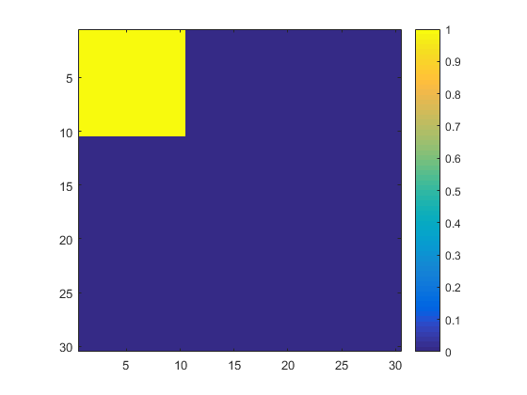

Stage 1
Ignoring $g(φ)$: $\frac{∂φ}{∂t}=2\left(\frac{∂^{2}φ}{∂x^{2}}+ \frac{∂^{2}φ}{∂y^{2}}\right)$
Heat Equation!
Initial Condition
Notes:
Not considering g(phi). Red square is equal to one, everything else is equal to zero.

Slide 13
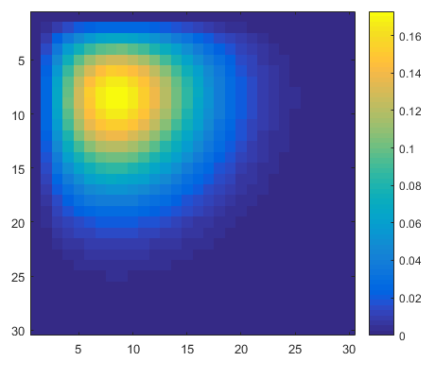
Results: Dirichlet
All boundaries fixed to zero
Notes:
Time = 0.01 sec

Slide 14
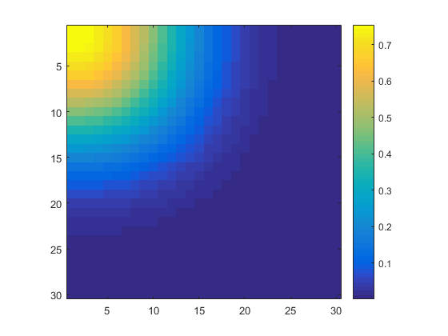

Results: Neumann
$∇φ∙n_{∂Ω}=0$
$φ_{0,j}=φ_{1,j} ;φ_{N_{x},j}=φ_{N_{x}−1,j}$
$φ_{i,0}=φ_{i,1} ;φ_{i,N_{y}}=φ_{i,N_{y}−1}$
Where, i,j = 0, 1, 2, … $N_{x}/N_{y}$

Slide 15
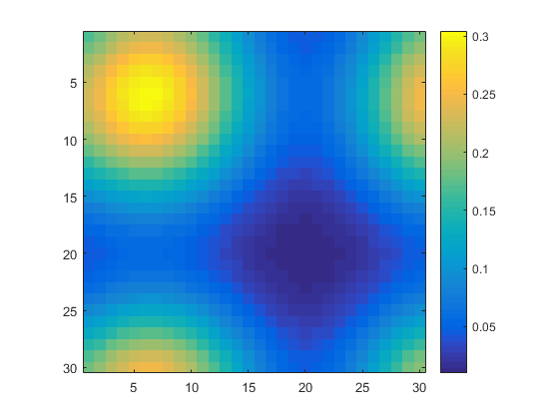

Results: Periodic
$φ_{0,j}=φ_{N_{x}−1,j} ; φ_{N_{x},j}=φ_{1,j}$
$φ_{i,0}=φ_{i,N_{y}−1} ; φ_{i,N_{y}}=φ_{i, 1}$
Where, i,j = 0, 1, 2, … $N_{x}/N_{y}$

Slide 16
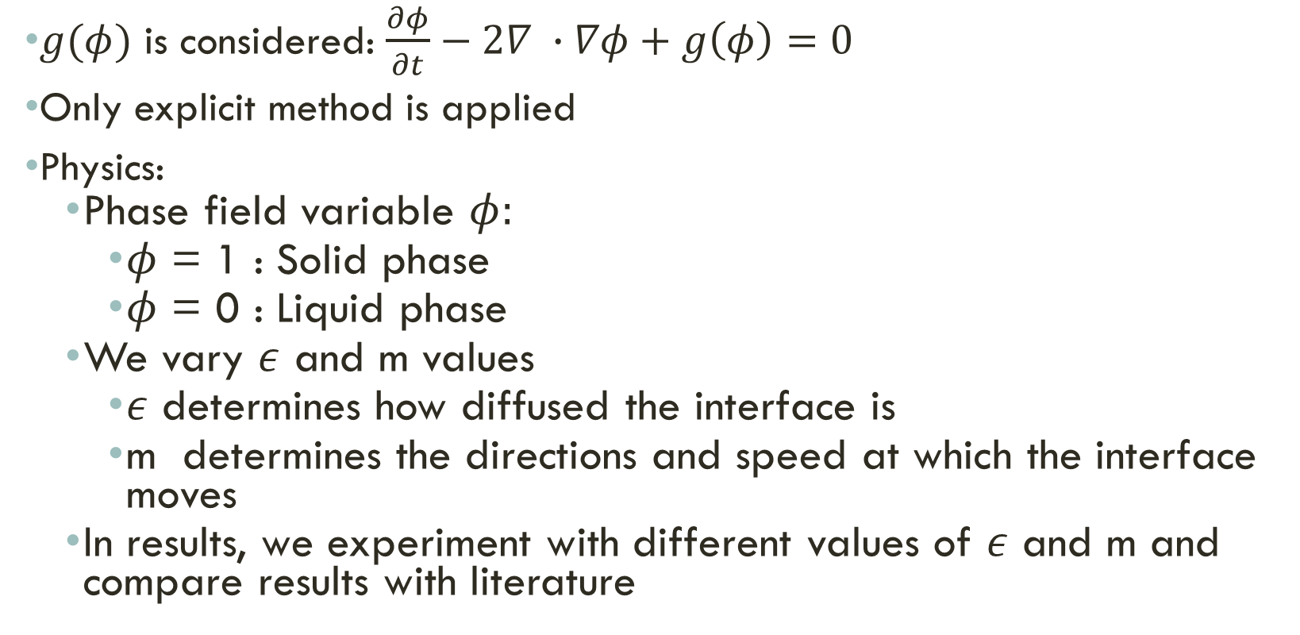

stage 2
$g(φ)$ is considered: $\frac{∂φ}{∂t}−2∇ ∙∇φ+g\left(φ\right)=0$
Only explicit method is applied
Physics:
Phase field variable $φ:$
$φ$ = 1 : Solid phase
$φ$ = 0 : Liquid phase
We vary $ε$ and m values
$ε$ determines how diffused the interface is
m determines the directions and speed at which the interface moves
In results, we experiment with different values of $ε$ and m and compare results with literature
$$g\left(φ\right)=aφ^{3}+bφ^{2}+cφ$$
$$a=\frac{−36}{ε^{2}},$$
$$b=\frac{54}{ε^{2}}+\frac{6m}{ε}, c=−\left(\frac{18}{ε^{2}}+\frac{6m}{ε}\right)$$

Slide 17
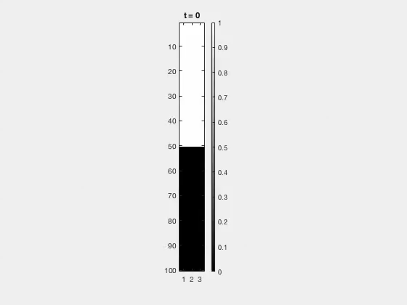


$$ε=1$$
$$m=0$$
$$ε=10$$
$$m=0$$

Slide 18


$$ε=1$$
$$m=−1$$
$$ε=1$$
$$m=+1$$

Slide 19
Future work/Considerations
Flexibility
mesh grid
quadrature points
quadratic base functions
Error Analysis
stable condition
error bound
Speed
algorithm
C code
Simulating Realistic micro-structures

