Slide 1
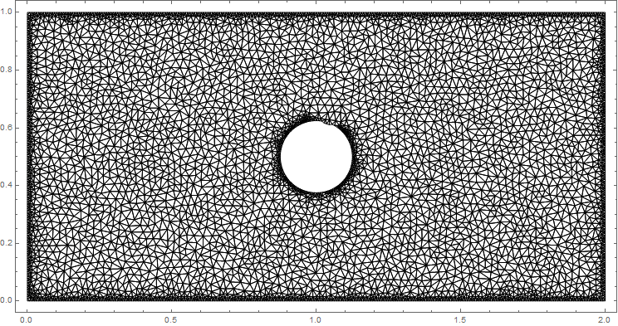
Phase-field modeling with finite element method
Hu, Monpara, Lai

Slide 2
PHASE-FIELD MODELING
Solidification
Grain growth
Solid-state phase transformations

Slide 3
FINITE ELEMENT ANALYSIS
Convert strong form PDE to weak integral form
Discretize domain into elements → numerical solution via shape, or weight, functions

Slide 4
Finite element analysis
Pros:
Cons:
Can implement complex geometries
Regional mesh refinement easy
Existing code can be tweaked to solve different equations
Writing code from scratch is… not easy
Conceptually more difficult than finite difference methods

Slide 5
Galerkin method
Weighted residual approach
Assumes same shape functions are used for the solution and the weights

Slide 6
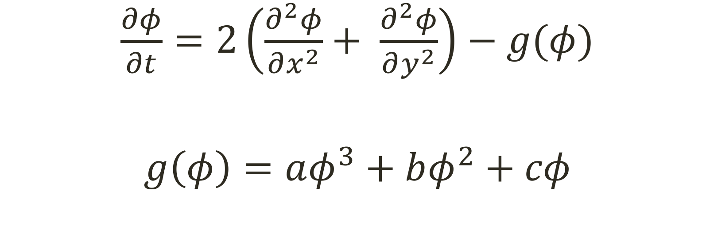
Strong form
$\frac{∂φ}{∂t}=2\left(\frac{∂^{2}φ}{∂x^{2}}+ \frac{∂^{2}φ}{∂y^{2}}\right)−g(φ)$
$g\left(φ\right)=aφ^{3}+bφ^{2}+cφ$

