Slide 1



Variant calling
Detecting variants in NGS data
The Genome Analysis ToolKit (GATK)
University of Cambridge
Cambridge, UK
4th March 2014

Slide 2

The pipeline
Fastq
Sequence preprocessing
Fastq
Mapping
BAM
Visualization
BAM
Variant calling
RNA-Seq processing
VCF
Count matrix
Exome analysis
RNA-Seq analysis
Variant annotation
RNA-Seq data analysis
Association studies
Functional analysis

Slide 3
Genomic variation
Terminology
Variant: sequence data difference that exists between individuals in a population
Mutation: molecular event that created a variant
Allele: alternative state of a sequence variant
Genotype: allelic state in a specific individual
  AA homozygous or AT heterozygous at specific base
Polymorphism: sequence variation that is common within a population
  "SNP on chromosome 16 associated with obesity"
Types of Genome Sequence Variants
Single Nucleotide Variants (SNVs)
Single base changes, e.g., A→T.
Insertions-Deletions (Indels)
Consisting of one or a few bases, e.g., +ATGA, ΔT.
Structural Variants (SVs)
Everything else: large deletions, insertions, duplications, inversions, translocations, mobile element insertions, horizontal gene transfer

Slide 4
Objective
Some variation observed in BAM files is caused by mapping and sequencing artifacts
Separate true variation from machine artifacts
Balance between:
  Sensitivity: minimize false negatives (i.e.: failing to identify real variants)
  Specificity: minimize false positives (i.e.: failing to reject artifacts)

Slide 5
Processing pipeline
Mark duplicates
  Duplicates shouldn't be counted as additional evidence
Local realignment around INDELS
  Reads mapping on the edges of INDELS often get mapped with mismatching bases introducing false positives
Base quality score recalibration (BQSR)
  Calling algorithms rely on the base quality score
  Quality scores provided by sequencing machines are generally inaccurate and biased
Variant calling
  Discover variants and their genotypes

Slide 6
1. Mark duplicates
All NGS sequencing platforms are NOT single molecule sequencing → the same DNA molecule can be sequenced several times
PCR → duplicate DNA fragments in the final library
If there is a base variation it will have high depth support
Can result in false variant calls
Tools
Samtools: samtools rmdup or samtools rmdupse
Picard/GATK: MarkDuplicates
Notes:
DNA molecules can be sequenced several times.
Duplicate reads are not informative and should not be counted as additional evidence for or against a putative variant.
The duplicate marking process identifies these reads as such so that the GATK tools know they should ignore them.
These steps are performed with tools such as Samtools and Picard that are not part of GATK, so we don't provide detailed documentation of all the options available. For more details, please see those tools' respective documentations.

Slide 7
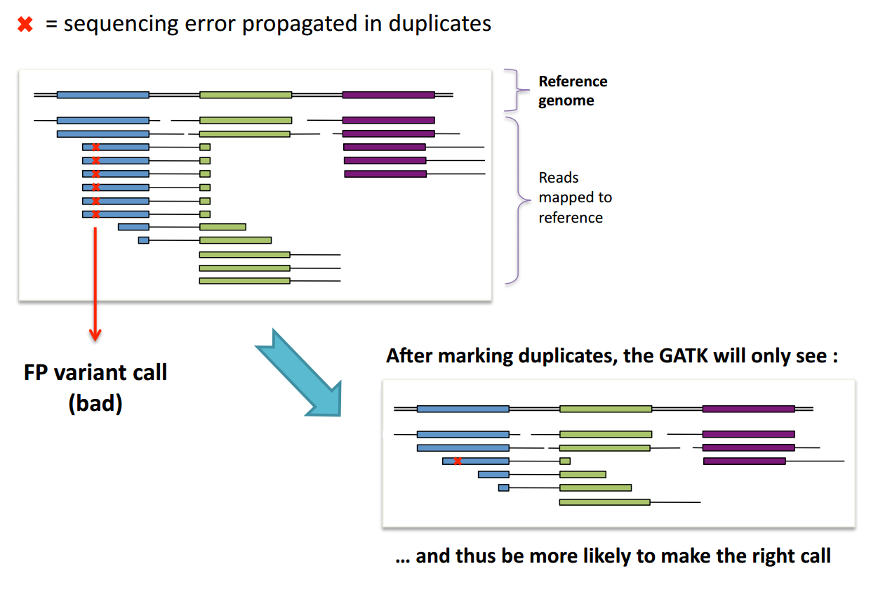
1. Mark duplicates
The reason why duplicates are bad
Notes:
DNA molecules can be sequenced several times.
Duplicate reads are not informative and should not be counted as additional evidence for or against a putative variant.
The duplicate marking process identifies these reads as such so that the GATK tools know they should ignore them.
These steps are performed with tools such as Samtools and Picard that are not part of GATK, so we don't provide detailed documentation of all the options available. For more details, please see those tools' respective documentations.

Slide 8
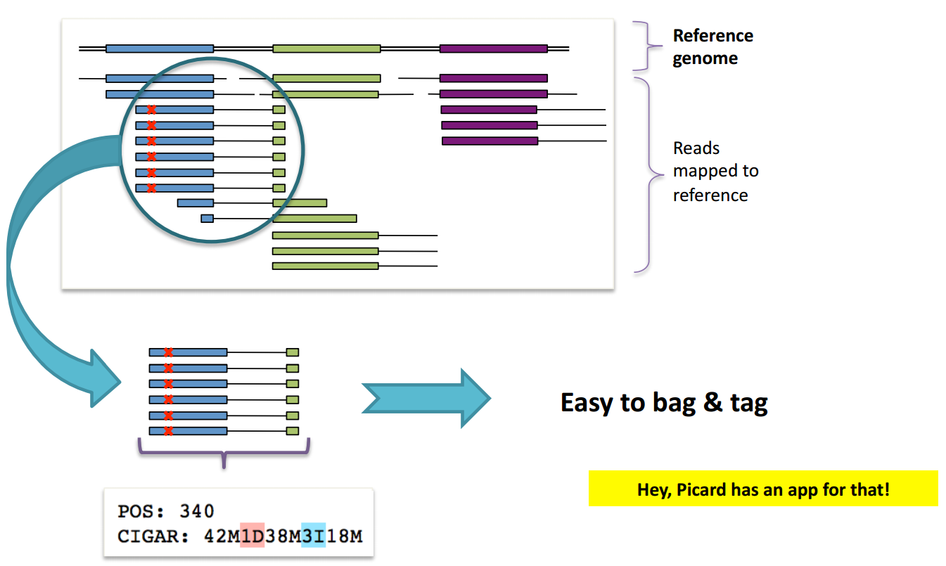
1. Mark duplicates
Duplicate identification
Duplicates have the same starting position and the same CIGAR string
Notes:
DNA molecules can be sequenced several times.
Duplicate reads are not informative and should not be counted as additional evidence for or against a putative variant.
The duplicate marking process identifies these reads as such so that the GATK tools know they should ignore them.
These steps are performed with tools such as Samtools and Picard that are not part of GATK, so we don't provide detailed documentation of all the options available. For more details, please see those tools' respective documentations.

Slide 9
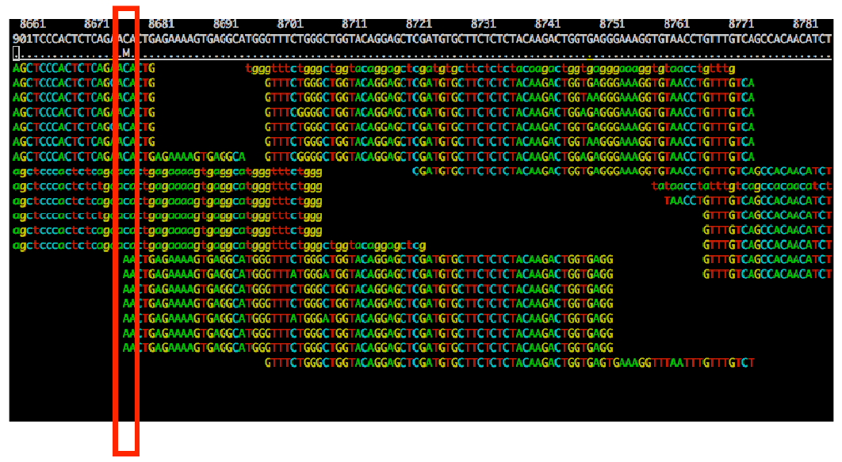
1. Mark duplicates
Duplicated induce biased SNP calls
But it is not perfect…
Does not account for sequencing errors
Does not account for natural duplicates
Does not account for duplicate reads with different mapping locations

Slide 10
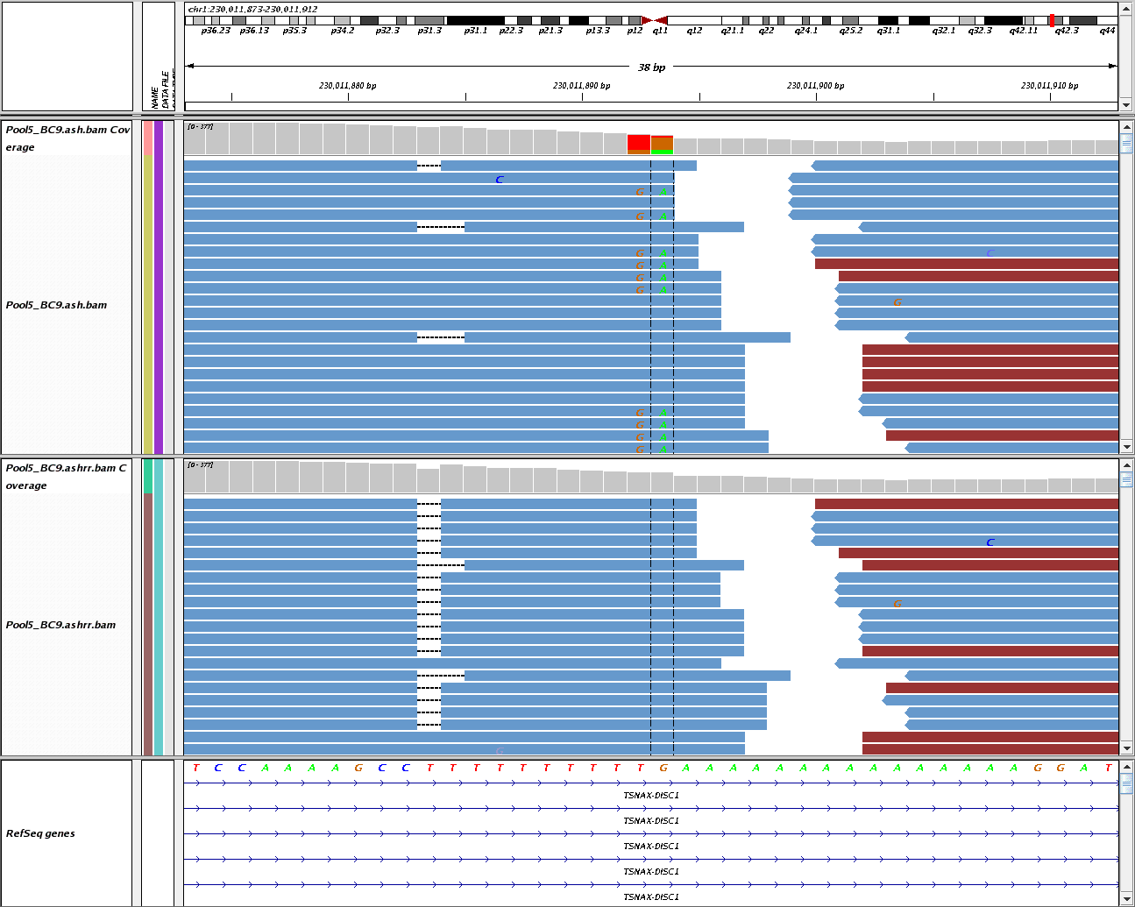
2. Local realignment around INDELS
Alignment algorithms tend to produce some artifacts
Reads near INDELS are mapped with mismatches
Realignment can identify the most consistent placement for these reads
  Identify problematic regions
  Determine the optimal consensus sequence
Minimizes mismatches with the reference sequence
Refines location of INDELS
Potential FP SNPs
10bp “T” homopolymer
15bp “A” homopolymer
DePristo MA, et al. A framework for variation discovery and genotyping using next-generation DNA sequencing data. Nat Genet. 2011 May;43(5):491-8. PMID: 21478889

Slide 11
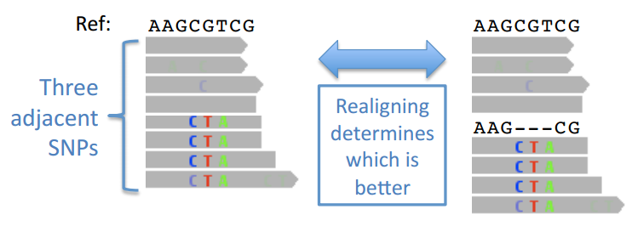
2. Local realignment around INDELS
Alignment algorithms tend to produce some artifacts
Reads near INDELS are mapped with mismatches
Realignment can identify the most consistent placement for these reads
  Identify problematic regions
  Determine the optimal consensus sequence
Minimizes mismatches with the reference sequence
Refines location of INDELS
DePristo MA, et al. A framework for variation discovery and genotyping using next-generation DNA sequencing data. Nat Genet. 2011 May;43(5):491-8. PMID: 21478889

Slide 12
3. Base quality score recalibration
Calling algorithms rely heavily on the quality scores assigned to the individual base calls in each sequence read
Unfortunately, the scores produced by the machines are subject to various sources of systematic error, leading to over- or under-estimated base quality scores in the data
How?
Analyse covariation among several features of a base:
  Reported quality score
  Position within the read
  Preceding and current nucleotide
Use a set of known variants (i.e.: dbSNP) to model error properties of real polymorphism and determine the probability that novel sites are real
Adjust the quality scores of all reads in a BAM file
Requires a reference genome and a catalog of known variable sites.
Notes:
Improvements:
More accurate base qualities
Better accuracy of our variant calls

Slide 13
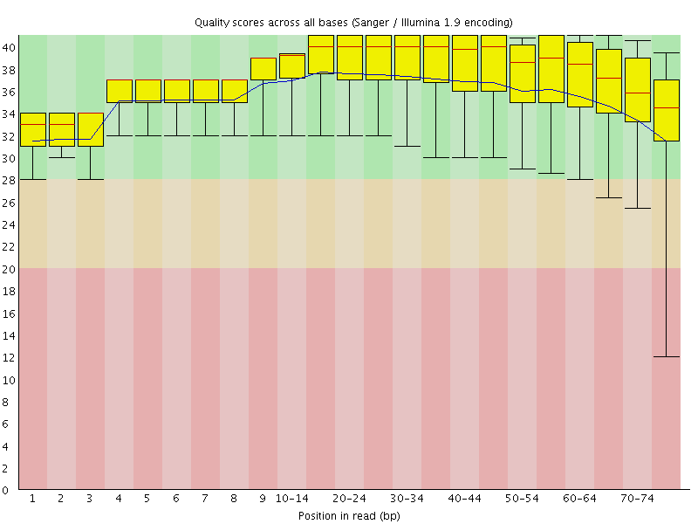
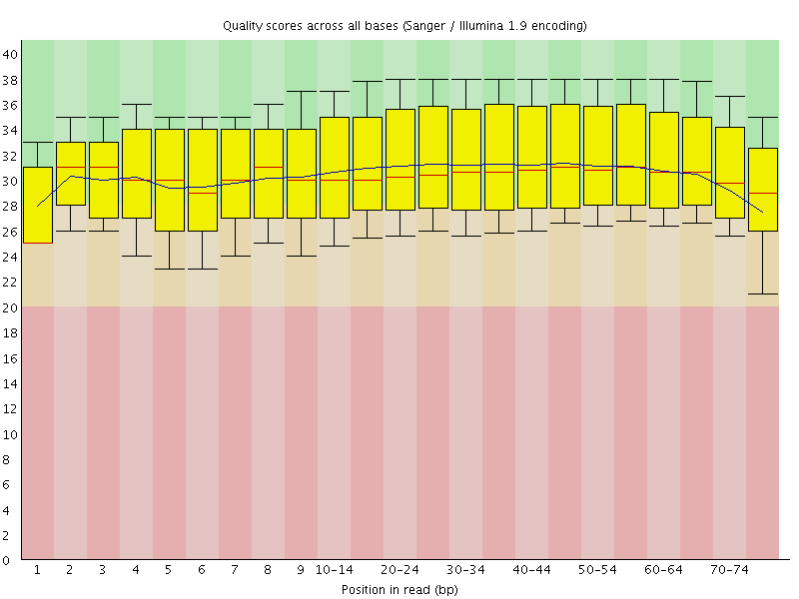

3. Base quality score recalibration
Before
After
Phred Quality score:
A score of 20 corresponds to 1% error rate in base calling
Notes:
Improvements:
More accurate base qualities
Better accuracy of our variant calls

Slide 14
4. Variant calling
Variant discovery process
Steps
  Variant calling: Identify the positions that differ from the reference
  Genotype calling: calculate the genotypes for each sample at these sites
Initial approach
  Independent base assumption
  Counting the number of times each allele is observed
Evolved approach
  Bayesian inference → Compute genotype likelihood
  Advantages:
    Provide statistical measure of uncertainty
    Lead to higher accuracy of genotype calling

Slide 15
4. Variant calling
Two different methods
UnifiedGenotyper
Call SNPs and indels separately by considering each variant locus independently
Accepts any ploidy
Pooled calling
High sample numbers
HaplotypeCaller
Call SNPs, indels, and some SVs simultaneously by performing a local de-novo assembly
More accurate, especially for indels
Will eventually replace UG

Slide 16
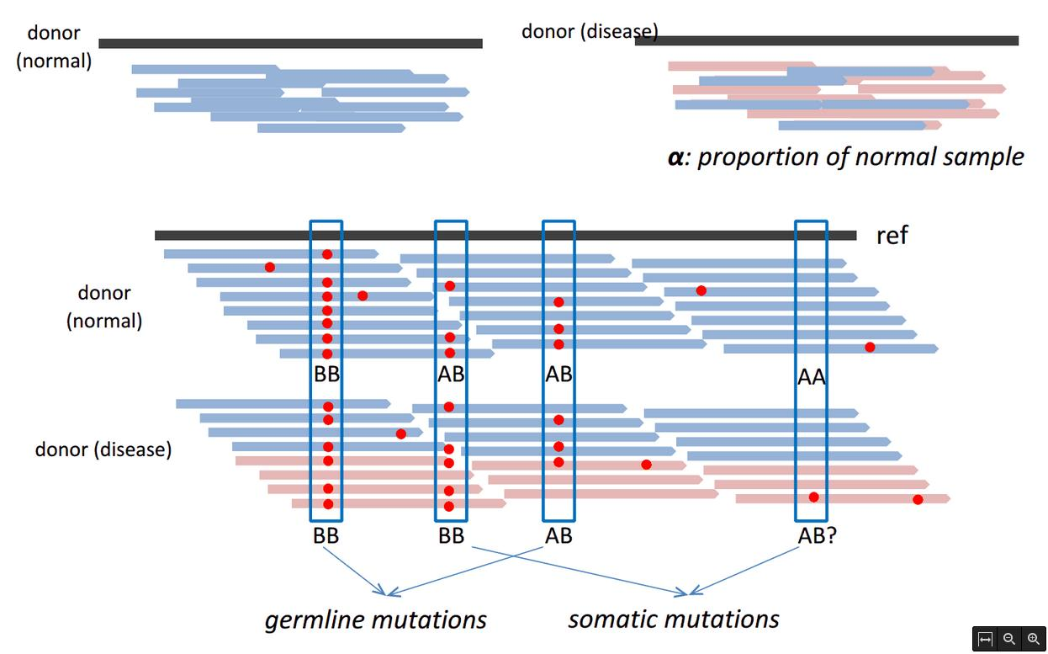
Somatic calling
Detenting somatic SNVs in cancer
Challenges:
Somatic variants occur at low frequency in genome
Most tumors are impure and heterogeneous

Slide 17
GATK
Basic command syntax
The basic GATK command syntax (for all tools)
Java-based command line tool
Argument names and default values can change
Exact arguments depend on the given tool
java –jar GenomeAnalysisTK.jar
–T WalkerName
–R reference.fasta
–I inputBAM.bam
–V inputVCF.vcf
–o outputs.someformat
-L 20:1000000-2000000

Slide 18
VCF file format
Specification defined by the 1000 genomes (current version 4.2):
http://www.1000genomes.org/wiki/Analysis/Variant%20Call%20Format/vcf-variant-call-format-version-41
Commonly compressed and indexed with bgzip/tabix
Single-sample or multi-sample VCF
##fileformat=VCFv4.1
##fileDate=20090805
##source=myImputationProgramV3.1
##reference=file:///seq/references/1000GenomesPilot-NCBI36.fasta
##contig=<ID=20,length=62435964,assembly=B36,md5=f126cdf8a6e0c7f379d618ff66beb2da,species="Homo sapiens",taxonomy=x>
##phasing=partial
##INFO=<ID=NS,Number=1,Type=Integer,Description="Number of Samples With Data">
##INFO=<ID=DP,Number=1,Type=Integer,Description="Total Depth">
##INFO=<ID=AF,Number=A,Type=Float,Description="Allele Frequency">
##INFO=<ID=AA,Number=1,Type=String,Description="Ancestral Allele">
##INFO=<ID=DB,Number=0,Type=Flag,Description="dbSNP membership, build 129">
##INFO=<ID=H2,Number=0,Type=Flag,Description="HapMap2 membership">
##FILTER=<ID=q10,Description="Quality below 10">
##FILTER=<ID=s50,Description="Less than 50% of samples have data">
##FORMAT=<ID=GT,Number=1,Type=String,Description="Genotype">
##FORMAT=<ID=GQ,Number=1,Type=Integer,Description="Genotype Quality">
##FORMAT=<ID=DP,Number=1,Type=Integer,Description="Read Depth">
##FORMAT=<ID=HQ,Number=2,Type=Integer,Description="Haplotype Quality">
#CHROM POS ID REF ALT QUAL FILTER INFO FORMAT NA00001 NA00002 NA00003
20 14370 rs6054257 G A 29 PASS NS=3;DP=14;AF=0.5;DB;H2 GT:GQ:DP:HQ 0|0:48:1:51,51 1|0:48:8:51,51 1/1:43:5:.,.
20 17330 . T A 3 q10 NS=3;DP=11;AF=0.017 GT:GQ:DP:HQ 0|0:49:3:58,50 0|1:3:5:65,3 0/0:41:3
20 1110696 rs6040355 A G,T 67 PASS NS=2;DP=10;AF=0.333,0.667;AA=T;DB GT:GQ:DP:HQ 1|2:21:6:23,27 2|1:2:0:18,2 2/2:35:4
20 1230237 . T . 47 PASS NS=3;DP=13;AA=T GT:GQ:DP:HQ 0|0:54:7:56,60 0|0:48:4:51,51 0/0:61:2
20 1234567 microsat1 GTC G,GTCT 50 PASS NS=3;DP=9;AA=G GT:GQ:DP 0/1:35:4 0/2:17:2 1/1:40:3

Slide 19
VCF file format
##fileformat=VCFv4.1
##fileDate=20090805
##source=myImputationProgramV3.1
##reference=file:///seq/references/1000GenomesPilot-NCBI36.fasta
##contig=<ID=20,length=62435964,assembly=B36,md5=f126cdf8a6e0c7f379d618ff66beb2da,species="Homo sapiens",taxonomy=x>
##phasing=partial
##INFO=<ID=NS,Number=1,Type=Integer,Description="Number of Samples With Data">
##INFO=<ID=DP,Number=1,Type=Integer,Description="Total Depth">
##FILTER=<ID=q10,Description="Quality below 10">
##FILTER=<ID=s50,Description="Less than 50% of samples have data">
##FORMAT=<ID=GT,Number=1,Type=String,Description="Genotype">
##FORMAT=<ID=GQ,Number=1,Type=Integer,Description="Genotype Quality">
##FORMAT=<ID=DP,Number=1,Type=Integer,Description="Read Depth">
##FORMAT=<ID=HQ,Number=2,Type=Integer,Description="Haplotype Quality">
#CHROM POS ID REF ALT QUAL FILTER INFO FORMAT NA00001 NA00002 NA00003
20 14370 rs6054257 G A 29 PASS NS=3;DP=14;AF=0.5;DB;H2 GT:GQ:DP:HQ 0|0:48:1:51,51 1|0:48:8:51,51 1/1:43:5:.,.
20 17330 . T A 3 q10 NS=3;DP=11;AF=0.017 GT:GQ:DP:HQ 0|0:49:3:58,50 0|1:3:5:65,3 0/0:41:3
20 1110696 rs6040355 A G,T 67 PASS NS=2;DP=10;AF=0.333,0.667;AA=T;DB GT:GQ:DP:HQ 1|2:21:6:23,27 2|1:2:0:18,2 2/2:35:4
20 1230237 . T . 47 PASS NS=3;DP=13;AA=T GT:GQ:DP:HQ 0|0:54:7:56,60 0|0:48:4:51,51 0/0:61:2
20 1234567 microsat1 GTC G,GTCT 50 PASS NS=3;DP=9;AA=G GT:GQ:DP 0/1:35:4 0/2:17:2 1/1:40:3
CHROM: chromosome
POS: position
ID: identifier
REF: reference base(s)
ALT: non-reference allele(s)
QUAL: quality score of the calls (phed scale)
FILTER: “PASS” or a filtering tag
INFO: additional information
FORMAT: describes the information given by sample

Slide 20
INFO column
INFO column: semicolon-separated fields. <key>=<data>[,data]
Some reserved (but optional) keys:
AA ancestral allele
AC allele count in genotypes, for each ALT allele, in the same order as listed
AF allele frequency
CIGAR cigar string describing how to align an alternate allele to the reference allele
DB dbSNP membership
MQ RMS mapping quality, e.g. MQ=52
MQ0 Number of MAPQ == 0 reads covering this record
NS Number of samples with data
SB strand bias at this position
SOMATIC indicates that the record is a somatic mutation, for cancer genomics
VALIDATED validated by follow-up experiment

Slide 21
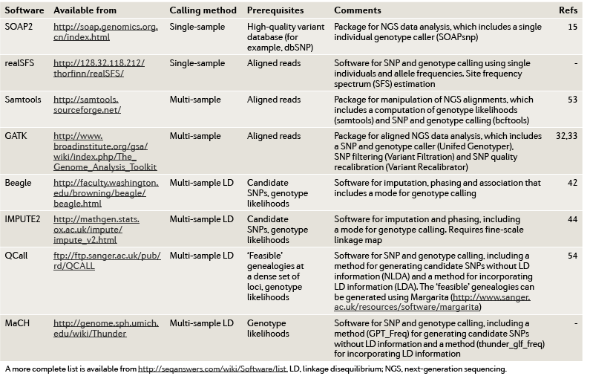
Software

Slide 22
GATK (Genome Analysis ToolKit)
http://www.broadinstitute.org/gatk/
Probabilistic method: Bayesian estimation of the most likely genotype
Calculates many parameters for each position of the genome
SNP and INDEL calling
Used in many NGS projects, including the 1000 Genomes Project, The Cancer Genome Atlas, etc.
Base quality recalibration
INDEL realignment
Uses standard input and output files
Multi-sample calling

Slide 23
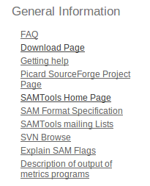
GATK prerequisites
Requires Java (http://www.oracle.com/technetwork/java/javase/downloads/index.html)
  Check your java version
  GATK ≥ 2.6 → Requires Java version 1.7
Picard
  Website: http://picard.sourceforge.net/
  Go to Download page and select
  Download picard-tools-1.108.zip (47.0 MB)
  Testing:
  Usage
java –version
java -jar AddOrReplaceReadGroups.jar -h
java –jar <ToolName> [options]

Slide 24
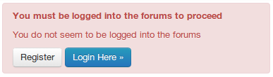

GATK installation
GATK 2.8 download
  http://www.broadinstitute.org/gatk/
  We need to register before download
  Go to Downloads and click
  Accept the license agreement
  Extract the file in the applications folder
Check if GATK is working
Usage
Show GATK help
java –jar GenomeAnalysisTK.jar -h
java –jar GenomeAnalysisTK.jar -T <ToolName> [arguments]

Slide 25
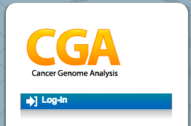
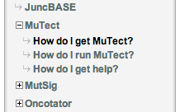
MuTect installation
MuTect download
  http://www.broadinstitute.org/cancer/cga/mutect
  Click Log-in and go to the Create new account tab
  Fill the form
  Go to How do I get mutect and accept the license agreement
  Download the latest version
  muTect-1.1.4-bin.zip
  Extract the file in the applications folder
Check if MuTect is working
Usage
java –jar muTect-1.1.4.jar -h
java –jar muTect-1.1.4.jar --analysis_type MuTect [arguments]

Slide 26
THANK YOU.

