Slide 1
Introduction to
NGS Technologies
Ignacio Medina
imedina@ebi.ac.uk
Project Manager & Senior Software Engineer at EBI Variation
European Bioinformatics Institute (EMBL-EBI)
European Molecular Biology Laboratory
Wellcome Trust Genome Campus
Hinxton, Cambridge

Slide 2

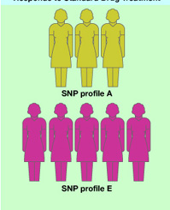
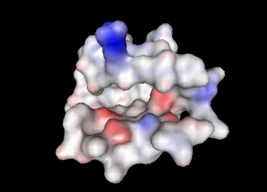
Genetic Research, pre-genomic scenario
Genes in the DNA...
…produces the final phenotype
…code for proteins...
>protein kinase
acctgttgatggcgacagggactgtatgctgatctatgctgatgcatgcatgctgactactgatgtgggggctattgacttgatgtctatc....
From genotype to phenotype.
…plus the environment...
…whose structure accounts for function...
Data is information
Notes:
02/04/12

Slide 3
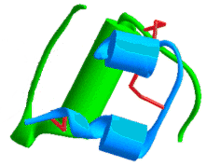
Bioinformatics tools for
pre-genomic sequence data analysis
Phylogenetic tree
Molecular databases
Search results
Information
Sequence
Motif databases
alignment
Motif
Conserved region
Secondary and tertiary protein structure
Notes:
02/04/12

Slide 4
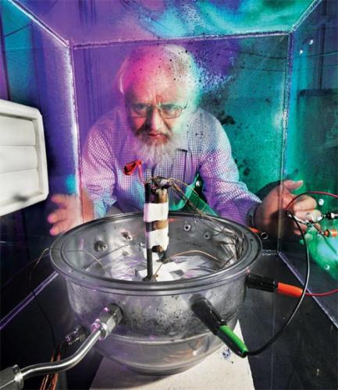
The aim:
Extracting as much information as possible for one single data
Notes:
02/04/12

Slide 5
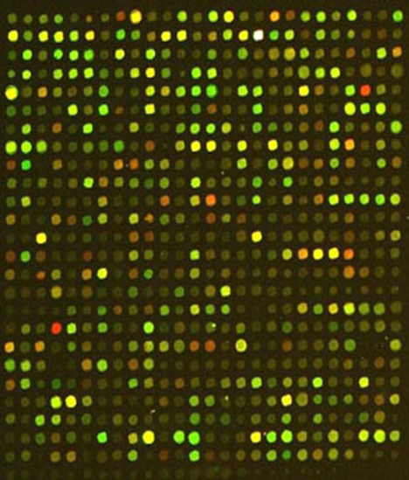
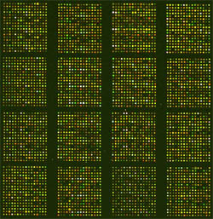
High Throughput Technologies
1988 arrayed DNAs were used
1991 oligonucleotides are synthesized on a glass slide through photolithography (Affymax Research Institute)‏
1995 DNA Microarrays
1997 Genome wide Yeast Microarray
Nature Milestones DNA Technologies
Notes:
02/04/12

Slide 6
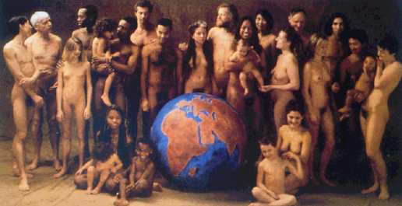
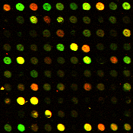
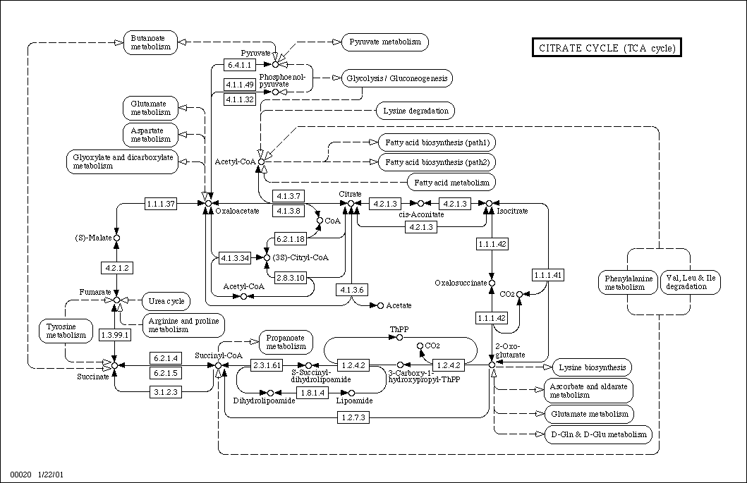

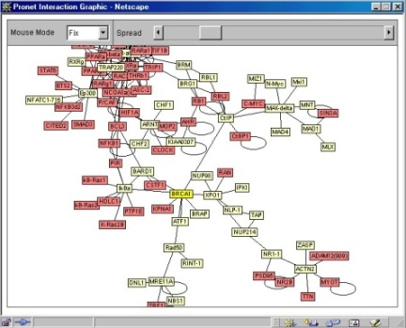
Genes in the DNA...
…which can be different because of the variability.
Next Generation Sequencing
SOLID 12Gbp per round
10 million SNPs
>protein kunase
acctgttgatggcgacagggactgtatgctgatctatgctgatgcatgcatgctgactactgatgtgggggctattgacttgatgtctatc....
…whose final effect configures the phenotype...
…when expressed in the proper moment and place...
Data
≠
Information
A typical tissue is expressing among 5,000 and 10,000 genes
From genotype to phenotype.
(in the functional post-genomics scenario)‏
…code for proteins...
…conforming complex interaction networks...
Each protein has an average of 8 interactions
That undergo post-translational modifications, somatic recombination...
100K-500K proteins
…in cooperation with other proteins…
…whose structures account for function...
Notes:
02/04/12

Slide 7

Date
Cost per Mb
Cost per Genome
Date
Cost per Mb
Cost per Genome
Sep-01
Mar-02
Sep-02
Mar-03
Oct-03
Jan-04
Apr-04
Jul-04
Oct-04
Jan-05
Apr-05
Jul-05
Oct-05
Jan-06
Apr-06
Jul-06
Oct-06
Jan-07
Apr-07
$5,292.39 $3,898.64 $3,413.80 $2,986.20 $2,230.98 $1,598.91 $1,135.70 $1,107.46 $1,028.85
$974.16
$897.76
$898.90
$766.73
$699.20
$651.81
$636.41
$581.92
$522.71
$502.61
$95,263,072
$70,175,437
$61,448,422
$53,751,684
$40,157,554
$28,780,376
$20,442,576
$19,934,346
$18,519,312
$17,534,970
$16,159,699
$16,180,224
$13,801,124
$12,585,659
$11,732,535
$11,455,315
$10,474,556
$9,408,739
$9,047,003
Jul-07
Oct-07
Jan-08
Apr-08
Jul-08
Oct-08
Jan-09
Apr-09
Jul-09
Oct-09
Jan-10
Apr-10
Jul-10
Oct-10
Jan-11
Apr-11
Jul-11
Oct-11
Jan-12
$495.96
$397.09
$102.13
$15.03
$8.36
$3.81
$2.59
$1.72
$1.20
$0.78
$0.52
$0.35
$0.35
$0.32
$0.23
$0.19
$0.12
$0.09
$0.09
$8,927,342
$7,147,571 $3,063,820
$1,352,982
$752,080
$342,502
$232,735
$154,714
$108,065
$70,333
$46,774
$31,512
$31,125
$29,092
$20,963
$16,712
$10,497
$7,743
$7,666

Slide 8
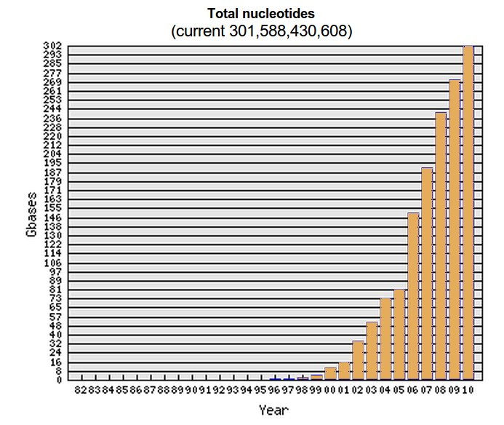
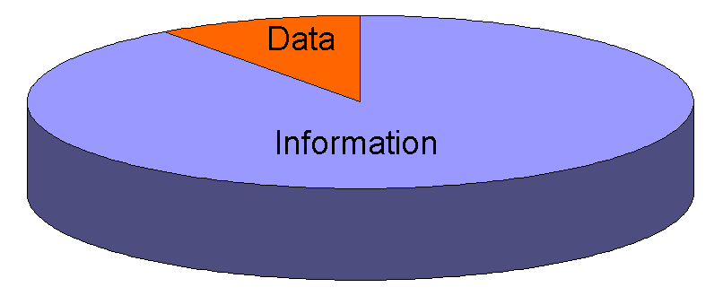
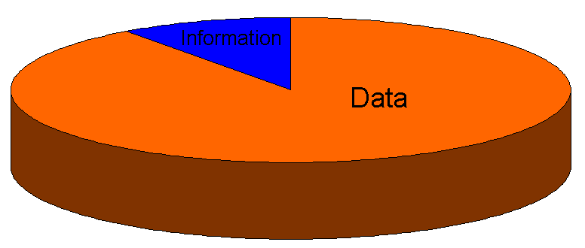
Pre & Post-genomic databases
EMBL database growth (March 2011)
Notes:
02/04/12

Slide 9
Genome sizes in nucleotide base pairs
plasmids
viruses
bacteria
fungi
plants
algae
insects
The size of the human
genome is ~ 3 Gbp;
almost all of its complexity
is in single-copy DNA.
The human genome is thought
to contain ~30,000-40,000 genes.
mollusks
bony fish
amphibians
reptiles
birds
mammals
10^4
10^5
10^6
10^7
10^8
10^9
10^10
10^11
http://www3.kumc.edu/jcalvet/PowerPoint/bioc801b.ppt
Computing capabilities (CPU power doubles in ~18-24 moths, hard drive capacity doubles in ~12 moths, network bandwidth doubles in ~20 moths) should increase : 7-10x in 5 years. Follows Moors’s law
Data projection in 3-5 years: 100x increase in sequencing volume. Still new technologies with higher throughput to come very soon !!!
Notes:
02/04/12

Slide 10
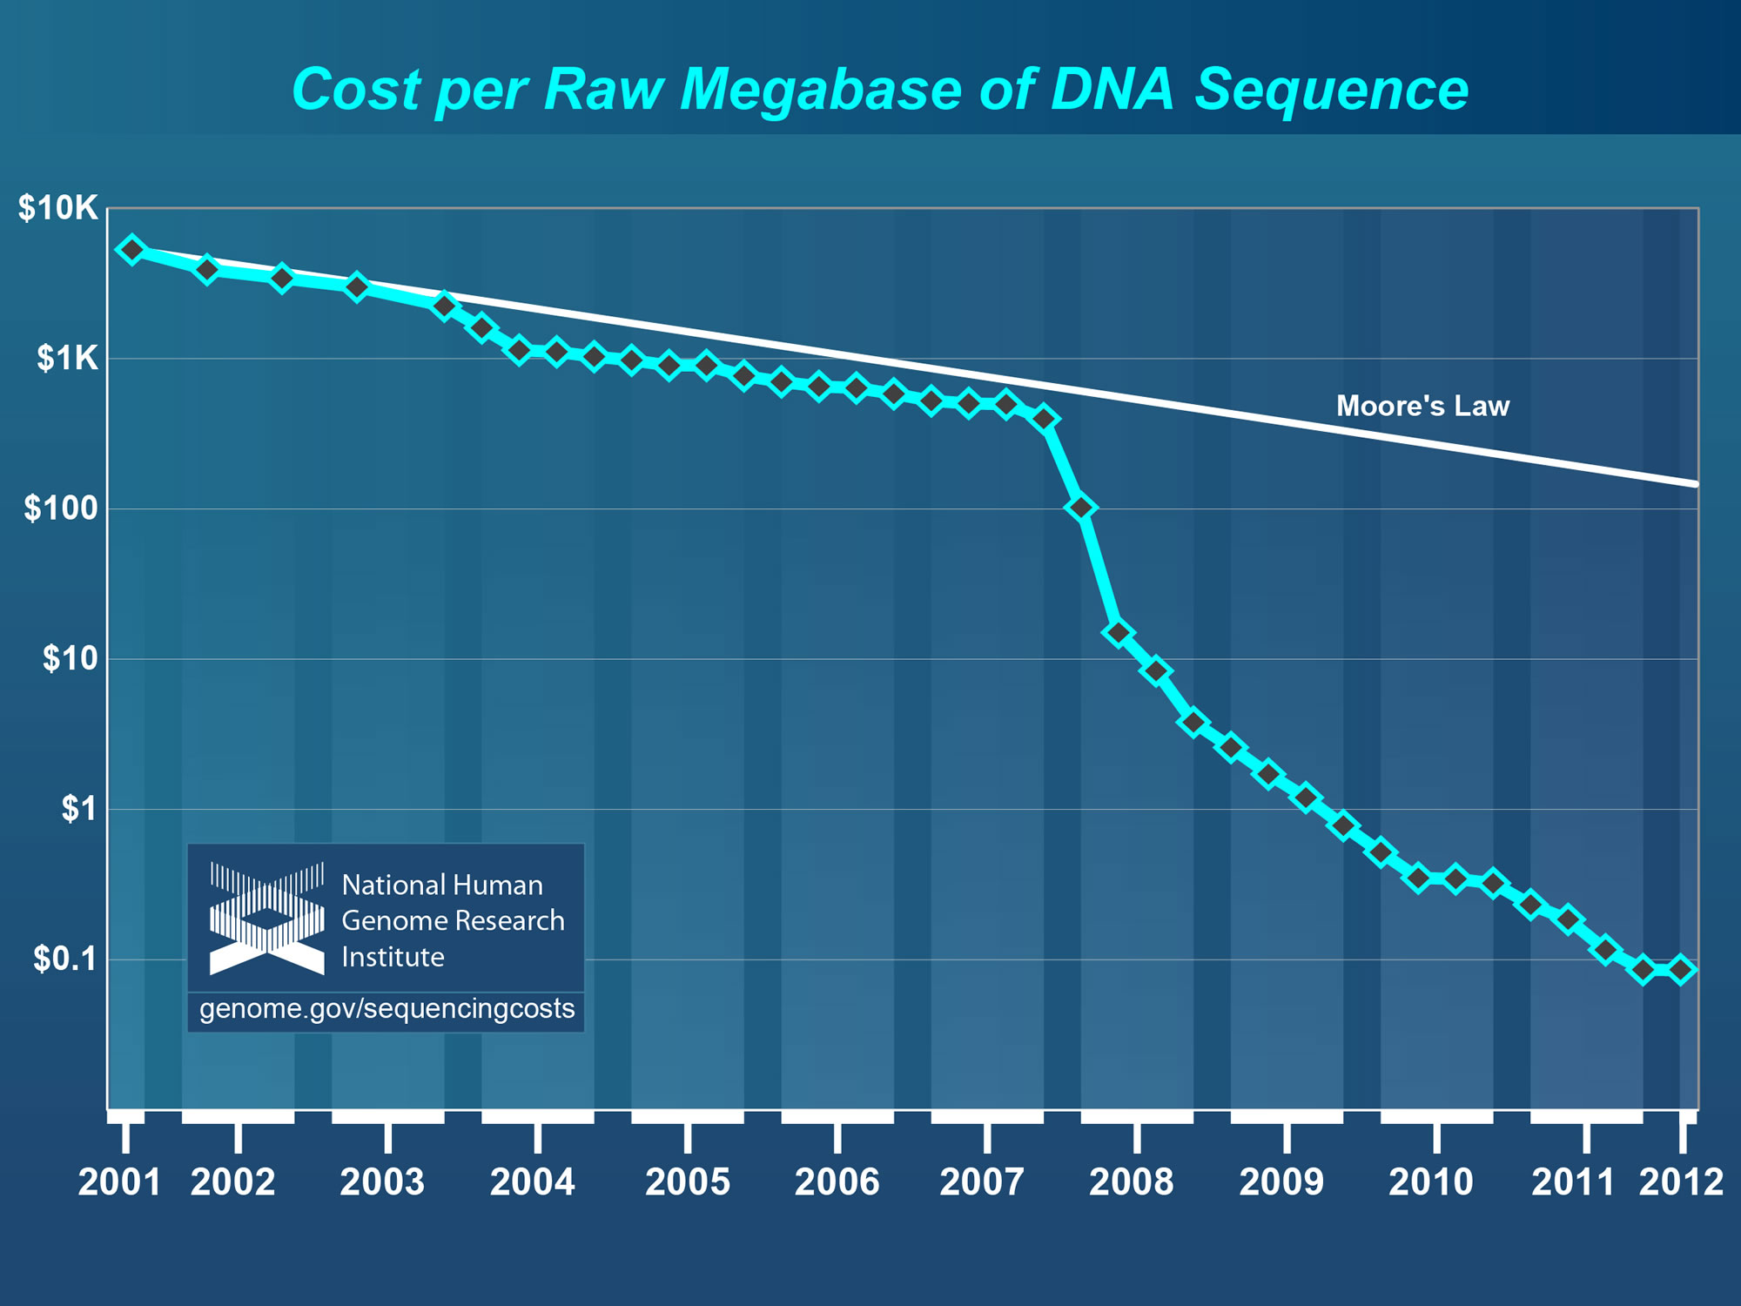

Slide 11
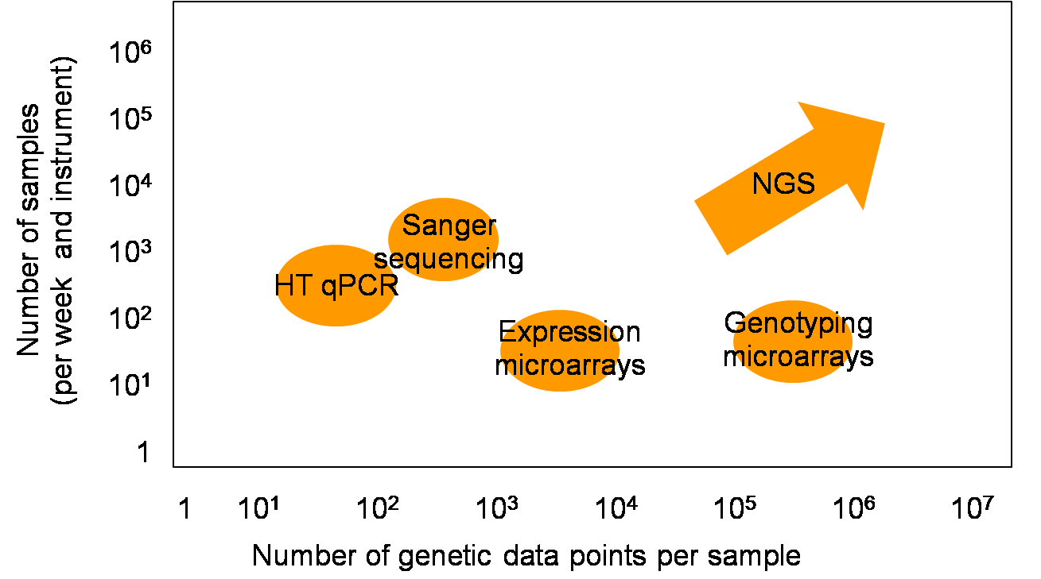
Relative throughput of the different HT technologies
NGS emerges with a potential of data production that will, eventually wipe out conventional HT technologies in the years coming
Too many sequences to be handled
in a standard computer
Notes:
02/04/12

Slide 12
 | Sanger (1st-gen) Sequencing | Next-Gen Sequencing, and 3rd generation
Whole Genome | Human (early drafts), model organisms, bacteria, viruses and mitochondria (chloroplast), low coverage | New human (!), individual genome, exomes, 2,500 normal (1K genome project), 25,000 cancer (TCGA and ICGC initiatives), CNV, matched control pairs, time course, rare-samples
RNA | cDNA clones, ESTs, Full Length Insert cDNAs, other RNAs | RNA-Seq: Digitization of transcriptome, alternative splicing events, miRNA, allele specific transcripts
Communities | Environmental sampling, 16S RNA populations, ocean sampling, | Human microbiome, deep environmental sequencing, Bar-Seq
Other |  | Epigenome, rearrangements, ChIP-Seq
Notes:
02/04/12

Slide 13





NGS technologies
Cost-effective
Fast
Ultra throughput
Cloning-free
Short reads
Notes:
01/30/12

Slide 14
Differences between the various platforms:
Nanotechnology used.
Resolution of the image analysis.
Chemistry and enzymology.
Signal to noise detection in the software
Software/images/file size/pipeline
Cost
Applications
Notes:
02/04/12

Slide 15
Similarities- LOTS of DATA
General ways of dealing at the sequences
Assemble them and look at what you have
You map them (align against a known genome) and then look at what you have.
Or a mixture of both!
Sometimes you select the DNA you are sequencing
or you try to sequence everything
Depends on biological question, sequencing machine you have, and how much time and money you have.
NGS is relatively cheap but think what you want to answer, because the analysis won’t do magic
Notes:
02/04/12

Slide 16
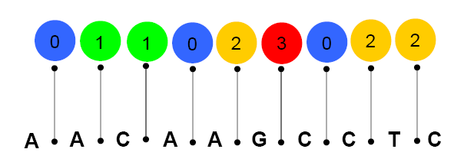
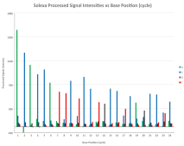
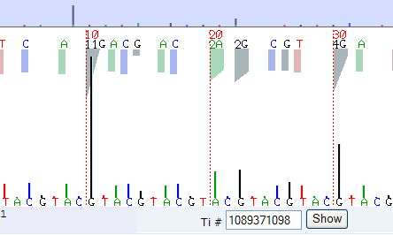

Next-gen sequencers
From John McPherson, OICR
Illumina/HiSeq short-read sequencers 10-600Gb, 150/150 bp, 11 days
100 Gb
bases per
machine run
AB/SOLiD5500, 200+Gb,75/35 bp reads, 10 days
10 Gb
1 Gb
Roche 454 GS FLX+ 2.8
(0.2-1Gb in 800-1000 bp reads,
1M reads, 20 hours)
100 Mb
10 Mb
ABI capillary sequencer
(0.04-0.08 Mb in 450-800 bp reads,
96 reads, 1-3 hours)
1 Mb
10 bp
100 bp
1,000 bp
read length
Notes:
02/04/12
Very different types of data. Different run times. Different costs

Slide 17
Next Generation Sequencers
3 main platforms:
- Solexa/illumina
- Roche 454
- ABI SOLiD
  Follow an approach similar to Sanger sequencing, but do away with separation of fragments by size and “read” the sequence as the reaction occurs
  Several different “next generation” sequencing platforms developed and commercialized, more on the way.
  Simultaneously sequence entire libraries of DNA sequence fragments
Notes:
02/04/12

Slide 18
454 (Roche)
First next generation method to be commercially available
Uses a “sequencing by synthesis” (SBS) approach:
    DNA is broken into pieces of 500-1,400 bp, ligated to adaptors, and amplified on tiny beads by PCR (emulsion PCR)
    Beads (with DNA attached) are placed into tiny wells (one bead per well) on a PicoTiter Plate that has millions of wells. Each well is connected to an optical fibre.
    DNA is sequenced by adding polymerase and DNA bases containing pyrophosphate. The different bases (A,C,G,T) are added sequentially in a flow chamber
    When a base complementary to the template is added, the pyrophosphate is released and a burst of light is produced
    The light is detected and used to call the base
- Initially 100-150 bp, but they have been improved to 600-1000 bp
- >1 million, filter-passed reads per run (20 hours)
- 1 billion bases per day
Notes:
02/04/12

Slide 19
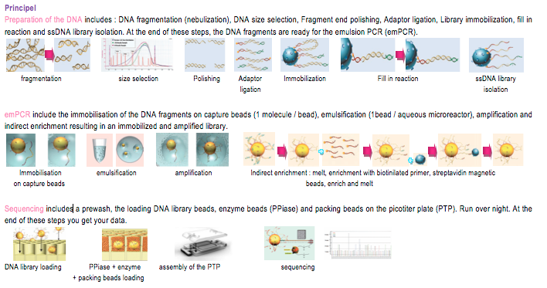
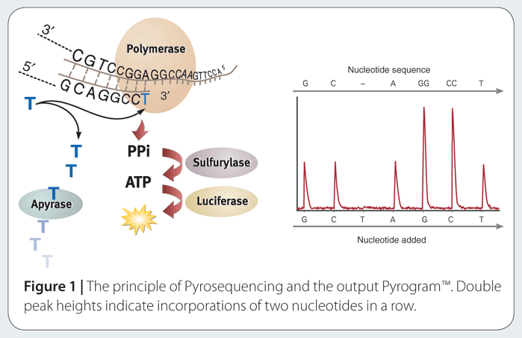
Roche 454 pyrosequencing
Notes:
01/30/12

Slide 20
Roche / 454 : GS FLX
Good for
  “de novo“ sequencing (longer reads).
  Resequencing (expensive)
  New bacterial genomes.
  Amplicons
Pyrosequencing. Bias with long polinucleotide streches
Notes:
02/04/12

Slide 21
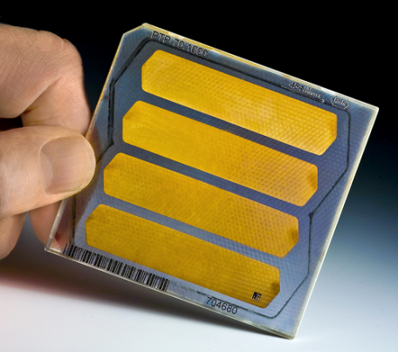
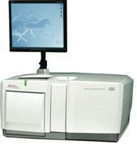
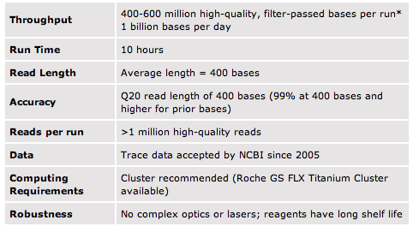
Roche 454
Notes:
01/30/12

Slide 22
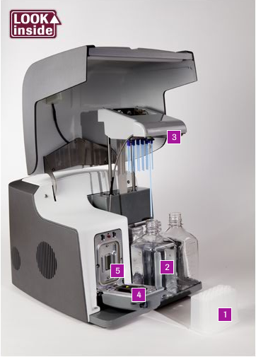
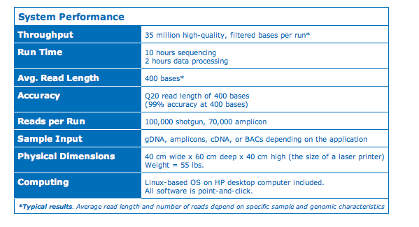
GS Junior, benchtop
Notes:
01/30/12

Slide 23
Solexa (Illumina)
Over 90% of all sequencing data is produced on Illumina systems.
Uses a “sequencing by synthesis” approach:
    DNA is broken into small fragments and ligated to an adaptor.
    The fragments are attached to the surface of a flow cell and amplified.
    DNA is sequenced by adding polymerase and labeled reversible terminator nucleotides (each base with a different color).
    The incorporated base is determined by fluorescence.
    The fluorescent label is removed from the terminator and the 3’ OH is unblocked, allowing a new base to be incorporated
Started with 35 bp, increased now to up to 150 bp
One run can give up to 10-600 Gb, 300-6000 million paired-end reads
75-85% of bases at or above Q30
Notes:
02/04/12

Slide 24
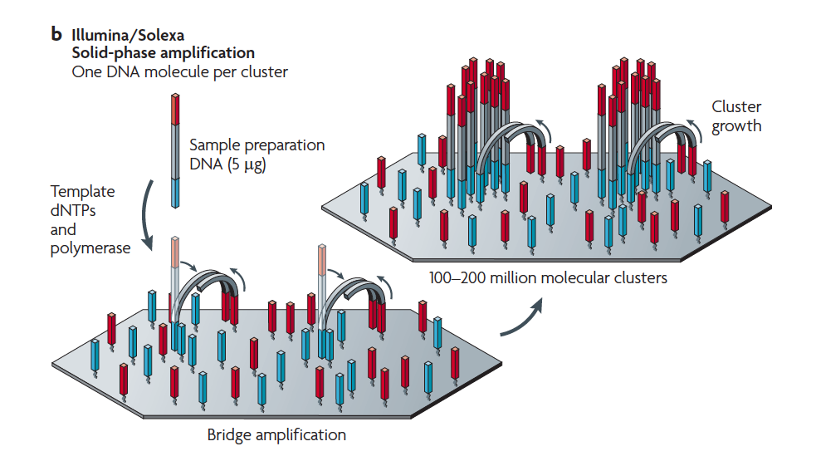
Solexa / illumina
From Michael Metzker, http://view.ncbi.nlm.nih.gov/pubmed/19997069
Notes:
02/04/12

Slide 25
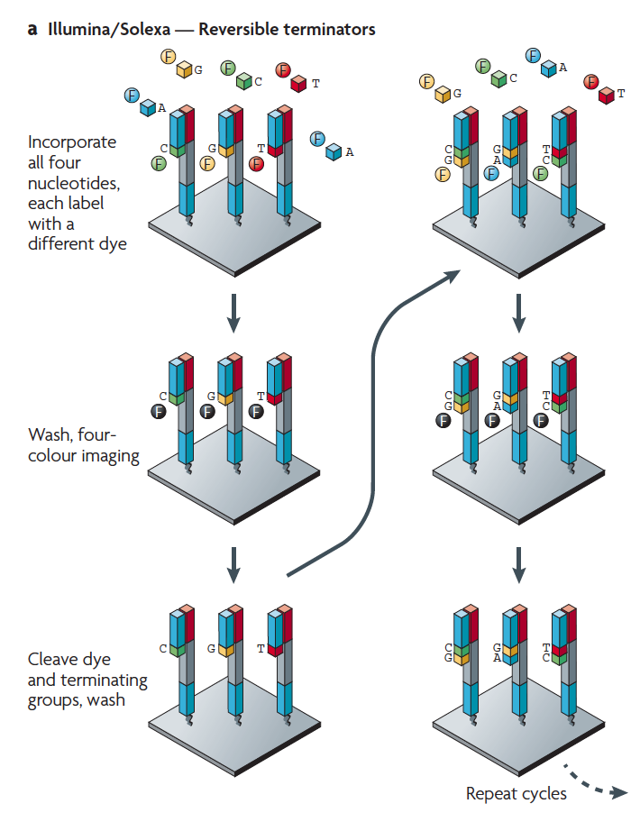
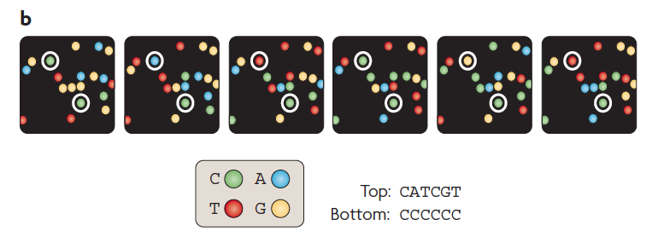
Solexa / illumina
From Michael Metzker, http://view.ncbi.nlm.nih.gov/pubmed/19997069
Notes:
02/04/12

Slide 26
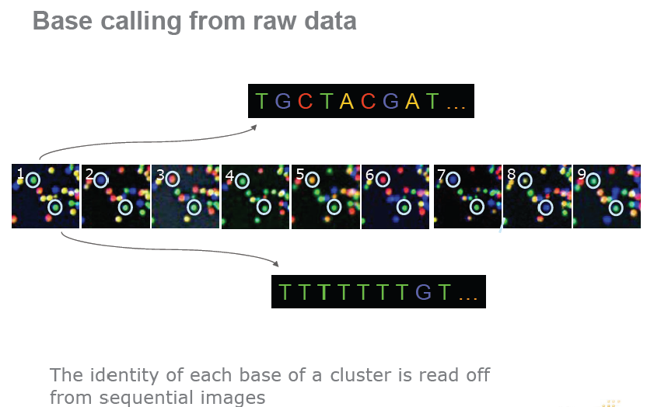
Solexa / illumina
From Debbie Nickerson, Department of Genome Sciences, University of Washington, http://tinyurl.com/6zbzh4
Notes:
02/04/12

Slide 27
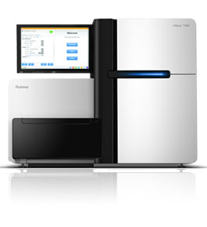
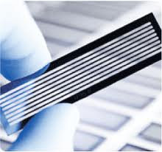
Illumina-HiSeq 2500
600 Gb/run in 11 days
2x100 bp fragments
6 billion reads per run
Notes:
01/30/12

Slide 28
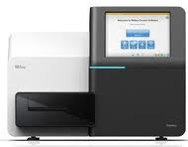
Illumina-MiSeq
175-245 Mb 4h 1x 36bp
1.5-2.0 Gb 27h 2x150 bp
Notes:
01/30/12

Slide 29
SOLiD (ABI / Life Technologies)
Colorspace
“sequencing by ligation” method
Does not use polymerase, instead uses DNA ligase for sequencing:
    DNA is broken into small fragments and ligated to an adaptor.
    The fragments are attached to beads and amplified by emulsion PCR. Beads are attached to the surface of a glass slide.
    DNA is sequenced by adding 8-mer fluorescently labelled oligonucleotides
    If an oligo is complementary to the template, it will be ligated and 2 of the bases can be called.
    The attached oligo is then cut to remove the label and the next set of labelled oligos are added
    The process is repeated from different starting points (using different universal primers) so that each base is called twice
200 Gb, 1.8 billion reads per run, 35bp-75bp, 10 days
Notes:
02/04/12

Slide 30
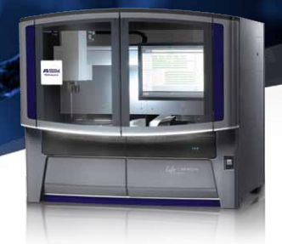
5500XL SOLiD
200 Gb/run (microbeads)
300 Gb/run (nanobeads)
35-75 bp fragments
1.8 - 4.8 billion reads/run
2x6 lanes/run
96 bar-codes
ECC: 99.99% accuracy
Notes:
01/30/12

Slide 31
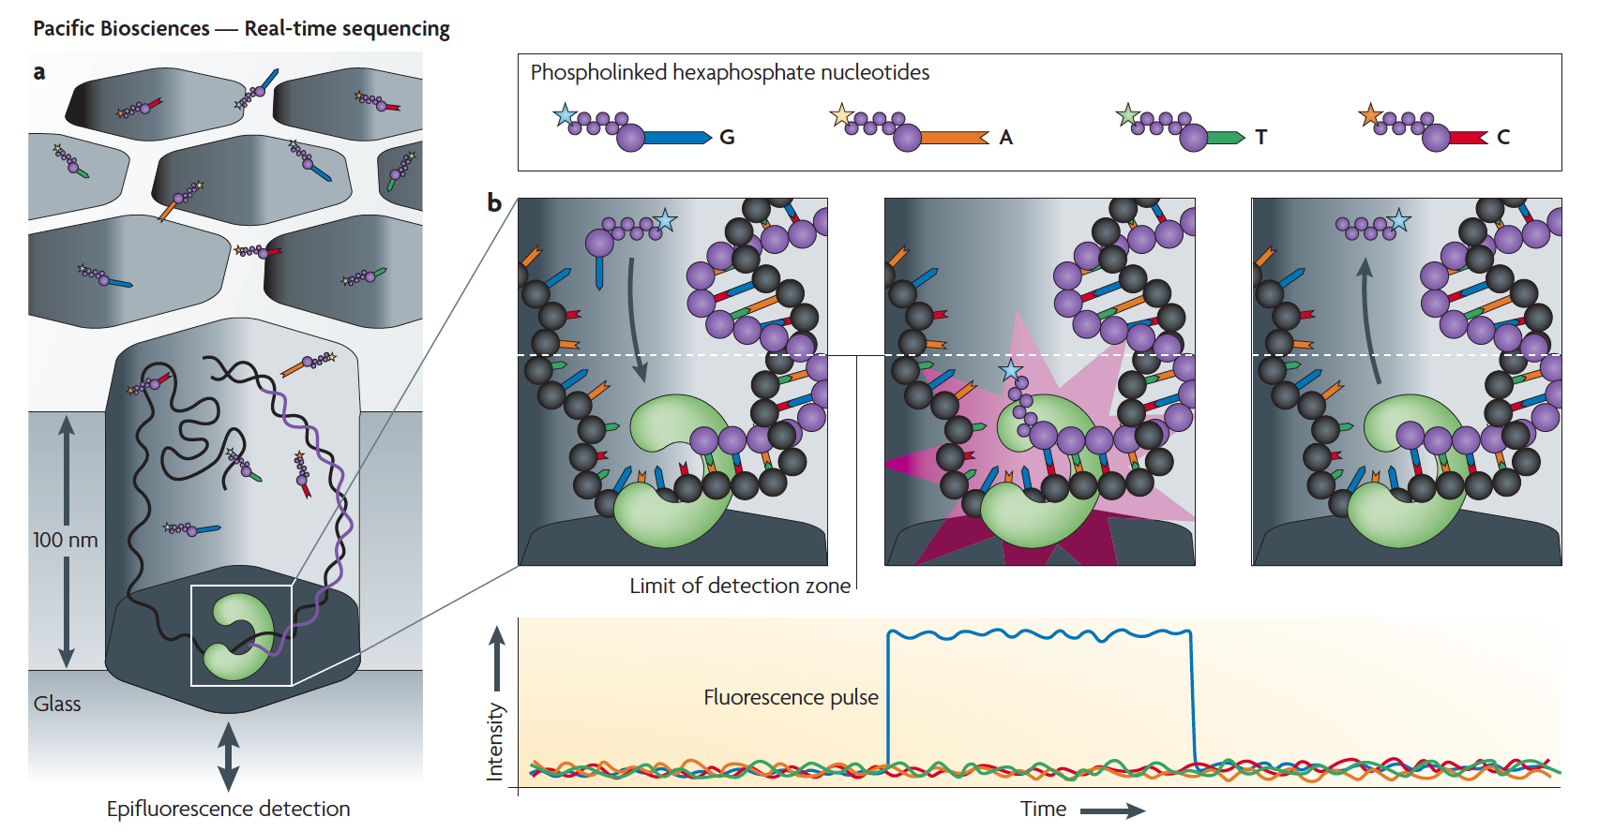
PacBio
From Michael Metzker, http://view.ncbi.nlm.nih.gov/pubmed/19997069
Notes:
02/04/12

Slide 32
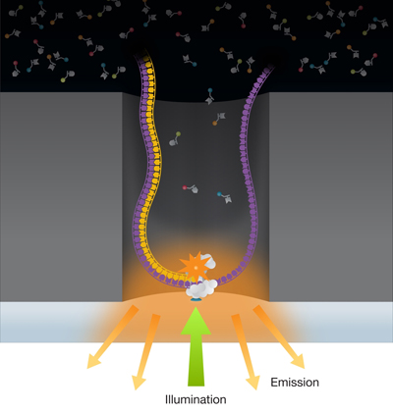
Pacific
Bioscience
SMRT: Singel Molecule Real time DNA synthesis
Up to 12000 nt
50 bases/second
ZMW: Zero Mode Waveguide
Notes:
01/30/12

Slide 33
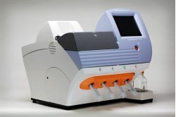
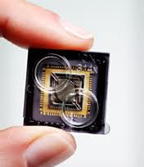
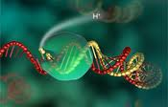
Ion Torrent
$ 50.000
$ 500 /sample
1 hour/run
> 200 nt lengths
Reads H+ released by DNA polymerase
Notes:
01/30/12

Slide 34
Comparison
Roche 454
Illumina
SOLiD
Long fragments
Errors: poly nts
Low throughput
Expensive
De novo sequencing
Amplicon sequencing
RNASeq
Short fragments
Errors: Hexamer bias
High throughput
Cheap
Resequencing
De novo sequencing
ChipSeq
RNASeq
MethylSeq
Short fragments
Color-space
High throughput
Cheap
Resequencing
ChipSeq
RNASeq
MethylSeq
Notes:
01/30/12

Slide 35

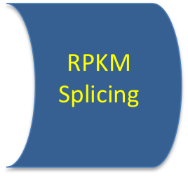
Basic steps NGS data processing
QC and
read cleaning
Mapping
Feature
identification
Notes:
01/30/12

Slide 36
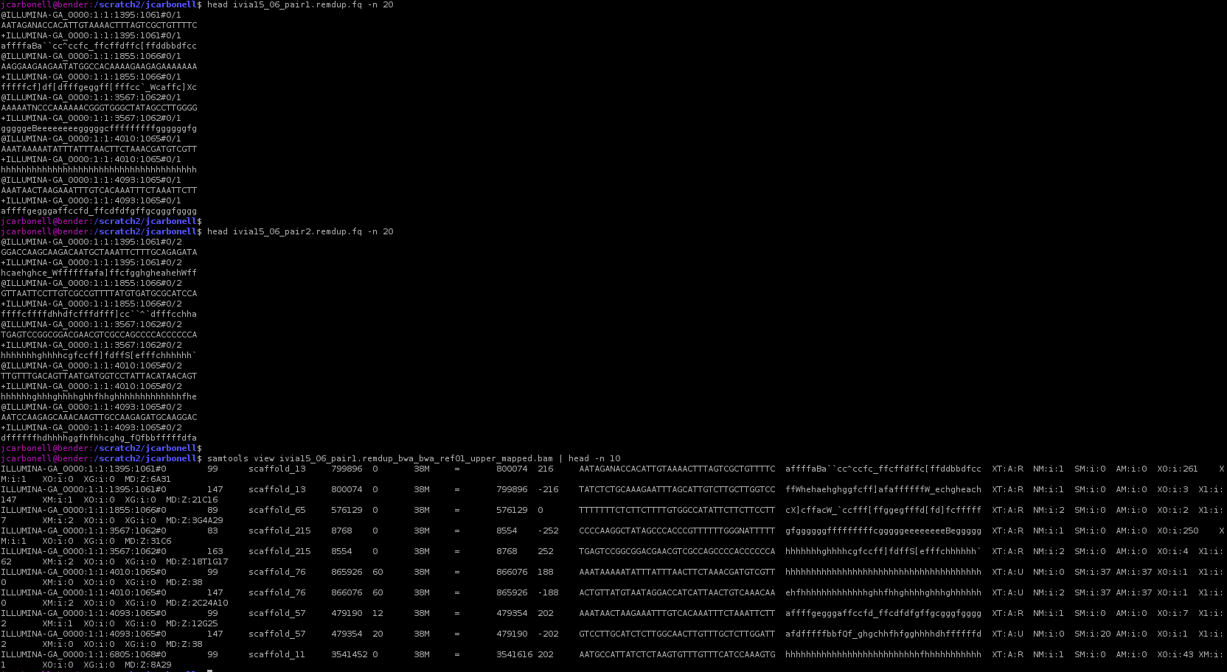
File formats
fastq: sequence data and qualities
SAM/BAM: mapping data and qualities
Notes:
01/30/12

Slide 37
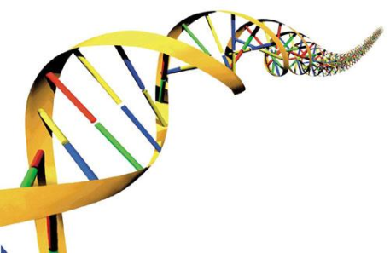
Most common applications of NGS
Resequencing
Mutation calling
Profiling
Genome annotation
RNA-seq /Transcriptomics
Quantitative
Descriptive
Alternative splicing
miRNA profiling
De novo sequencing
Exome sequencing
Targeted sequencing
ChIP-seq /Epigenomics
Protein-DNA interactions
Active transcription factor binding sites
Histone methilation
Copy number variation
Metagenomics
Metatranscriptomics
Notes:
02/04/12

Slide 38
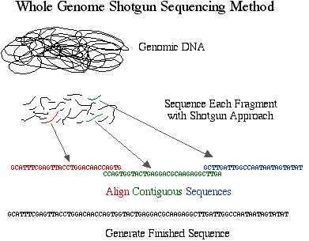
DNA sequencing - 1
Whole GENOME Resequencing
  Need reference genome
  Variation discovery

Slide 39
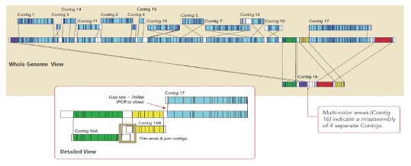
DNA sequencing - 2
Whole GENOME “de novo” sequencing
  Uncharacterized genomes with no reference genome available
  known genomes where significant structural variation is expected.
  Long reads or mate-pair libraries. Sequencing mostly done by Roche 454 and also Illumina.
  Assembly of reads is needed: Computational intensive
  E.g. Genome bacteria sequencing

Slide 40
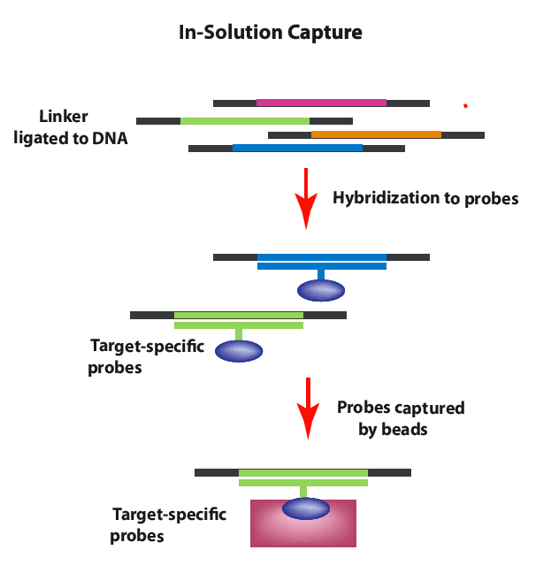
DNA sequencing - 3
Whole EXOME Resequencing
  Need reference genome
    Available for Human and Mouse
  Variation discovery on ORFs
    2% of human genome (lower cost)
    85% disesease mutation are in the exome
  Need probes complementary to exons
    Nimblegen
    Agilent
E.g. Human exome

Slide 41
DNA sequencing - 4
Targeted Resequencing
  Capture of specific regions in the genome
Custom genes panel sequencing
  Allows to cover high number of genes related to a disease
  E.g. Disease gene panel
Low cost and quicker than capillary sequencing
Multiplexing is possible
Need custom probes complementary to the genomic regions
  Nimblegen
  Agilent

Slide 42
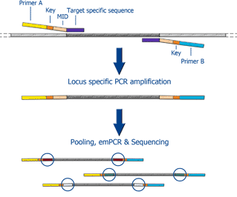
DNA sequencing - 5
Amplicon sequencing
  Sequencing of regions amplified by PCR.
  Shorter regions to cover than targeted capture
  No need of custom probes
  Primer design is needed
  High fidelity polymerase
  Multiplexing is needed
E.g. P53 exon amplicon sequencing

Slide 43
Transcriptomics - 1
RNA-Seq
  Sequencing of mRNA
  rRNA depleted samples
  Very high dynamic range
  No prior knwoledge of expressed genes
  Gives information about (richer than microarrays)
    Differential expression of known or unknown transcripts during a treatment or condition
    Isoforms and
    New alternative splicing events
    Non-coding RNAs
    Post-transcriptional mutations or editing,
    Gene fusions.

Slide 44
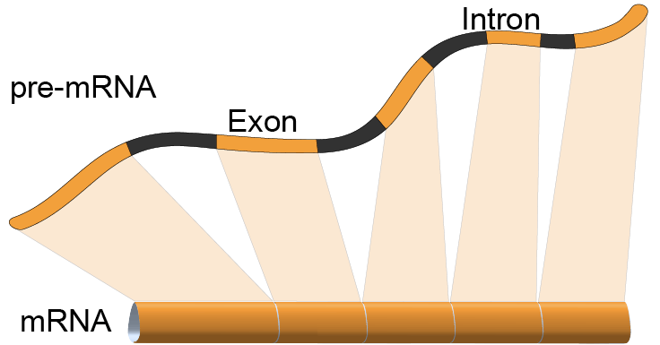
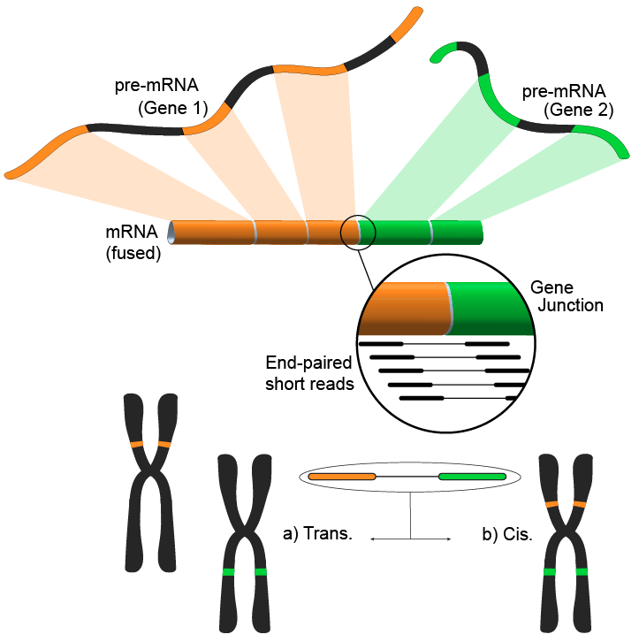
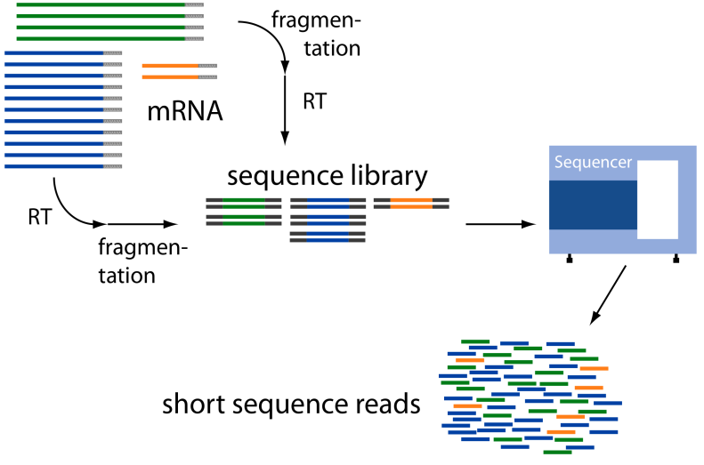
Transcriptomics - 2
RNA-Seq
  Sequencing of mRNA
  Detecting gene fusions

Slide 45
Applications of RNAseq
Qualitative:
* Alternative splicing
* Antisense expression
* Extragenic expression
* Alternative 5’ and 3’ usage
* Detection of fusion transcripts
….
Quantitative:
* Differential expression
* Dynamic range of gene expression
….
Tophat/Cufflinks
Scripture
Alexa
edgeR
DESeq
baySeq
NOISeq
Notes:
01/30/12

Slide 46
Advantages of RNAseq?
RNAseq
microarrays
* Non targeted transcript detection
* No need of reference genome
* Strand specificity
* Find novels splicing sites
* Larger dynamic range
* Detects expression and SNVs
* Detects rare transcripts
….
* Restricted to probes on array
* Needs genome knowledge
* Normally, not strand specific
* Exon arrays difficult to use
* Smaller dynamic range
* Does not provide sequence info
* Rare transcripts difficult
….
and…. are there any disadvantages?????
Notes:
01/30/12

Slide 47
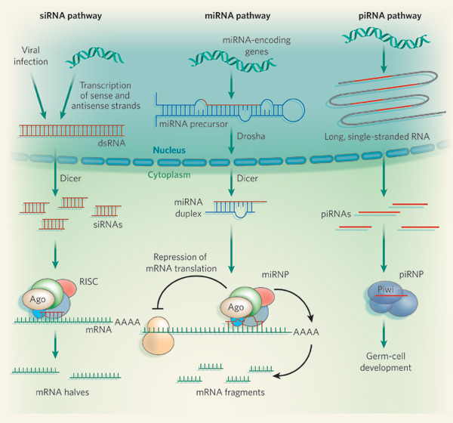
Transcriptomics - 3
miRNA/small nonCoding RNA sequencing
  RNA Size selection step
    18-40 bp
  Profiling of known miRNAs
  miRNA discovery

Slide 48
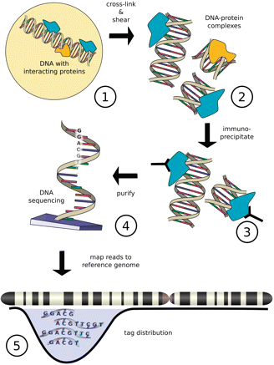
TFBS detection
ChIP-Seq
  Identification of genomic region for gDNA binding proteins:
    Transcription Factor binding site detection

Slide 49

Epigenomics - I
Epigenomics refers to functionally relevant modifications to the genome that do not involve a change in the nucleotide sequence
  Play a role in turning genes off or on
Epigenomic Marks.
Methyl groups attach to the backbone of a DNA molecule.
A variety of chemical tags attach to the tails of histones. This action affects how tightly DNA is wound around the histones.
ChIP-Seq: Histone methylation detection

Slide 50

Epigenomics - 2
Methyl-Seq
  CpG island methylation
  Bisulfite sequencing-based method
> E.g. Cancer studies.
    Different degree of chromatin methylation affects expression of genes

Slide 51
Successful NGStories
Notes:
01/30/12

Slide 52



Notes:
01/30/12

Slide 53


Notes:
01/30/12

Slide 54



Miller syndrome
Notes:
01/30/12

Slide 55


Notes:
01/30/12

Slide 56


Notes:
01/30/12

Slide 57



Species composition of metagenomic DNA
extracted from mammoth hair
Notes:
01/30/12

Slide 58
Not that easy, some challenges

Slide 59

Secondary analysis:
Finding the mutations causative of diseases
The simplest case: monogenic disease due to a single gene
A
C
B
D
E
Controls
Cases

Slide 60
The principle: comparison of patients (or families) and reference controls
mutation
Patient 1
Patient 2
Patient 3
Control 1
Control 2
Control 3
candidate gene (shares mutation for all patients but no controls)

Slide 61
Is this approach realistic?
Can we detect such rare variants so easily?
Interrogating 50Mb produces too many variants
In many cases we are not hunting new but known variants
Same phenotype can be due to different mutations and different genes

Slide 62
Filtering with multiple family information
 | Families
 | 1 | 2 | 3 | 4 | 5 | 6
Variants | 3403 | 82 | 4 | 0 | 0 | 0
Genes | 2560 | 331 | 35 | 8 | 1 | 0
Problem: how to prioritize putative candidate genes

Slide 63
Clear individual gene associations are difficult to find in some diseases
Controls
Cases
They can have different mutations (or combinations).
Many cases have to be used to obtain significant associations to many markers.
The only common element is the pathway (yet unknow) affected.

Slide 64


Conclusions
NGS is revolutionizing how we do genome research
But it will also revolutionize our lives….
If we manage to process and analyze ALL the DATA
Notes:
01/30/12

