Slide 1
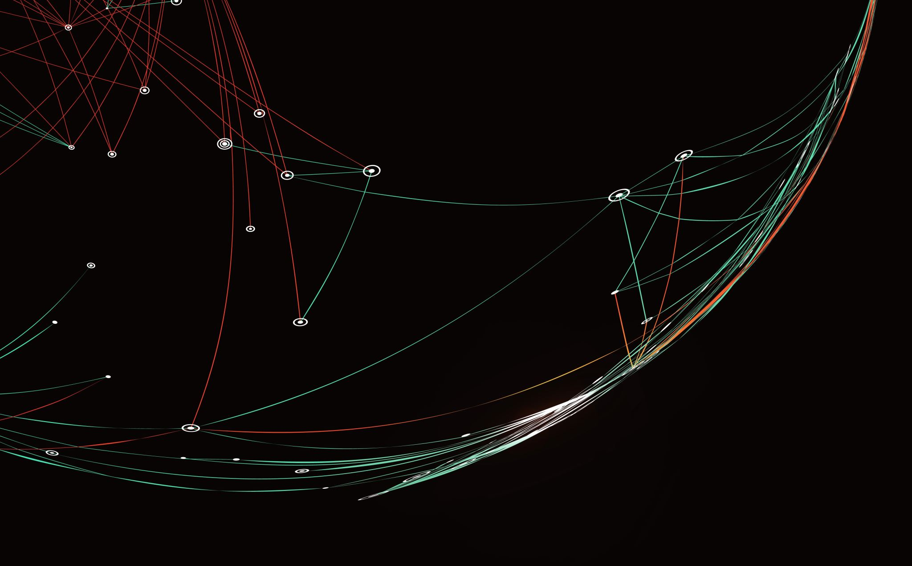
Colour Spaces
Digital Image Processing
Project Demo application
Interactive visualization of switching color spaces
BLERONA MULADAUTI 221541

Slide 2
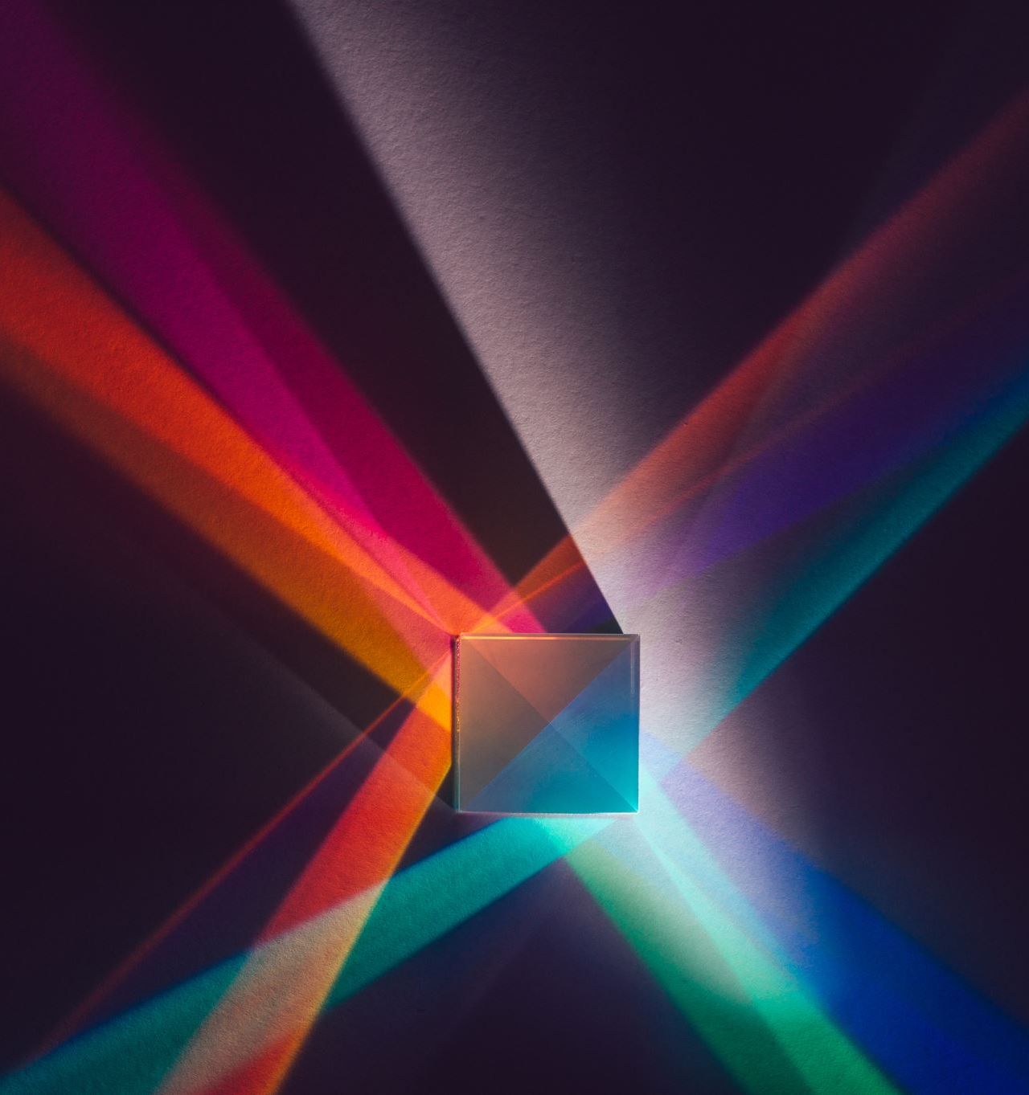
Introduction
Colour spaces are fundamental in digital imaging, providing a framework to represent and manipulate colours. The demo application aims to visualize and manipulate colour spaces in real-time using a webcam feed, leveraging OpenCV for dynamic adjustments in RGB, HSV, and LAB colour spaces.

Slide 3
Objective of the Demo Application
The application provides an interactive platform for real-time color space conversion and adjustments. Key objectives include: - Understanding the differences between RGB, HSV, and LAB color spaces. - Demonstrating practical use cases for color space conversions. - Enabling users to visualize the impact of channel adjustments in real-time.

Slide 4
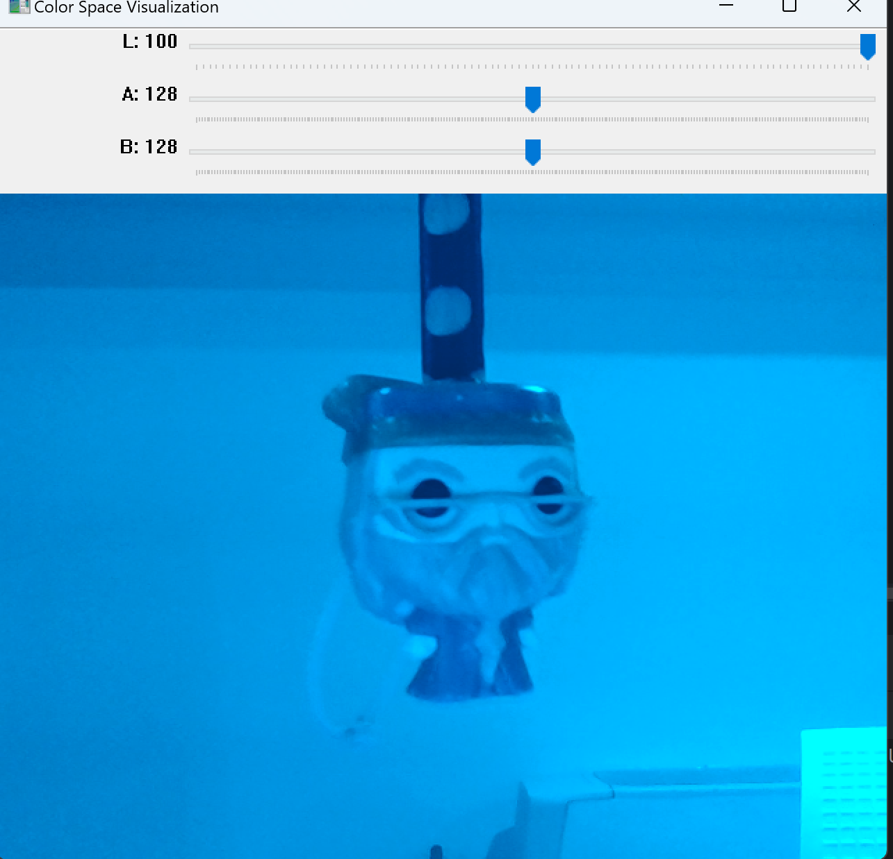
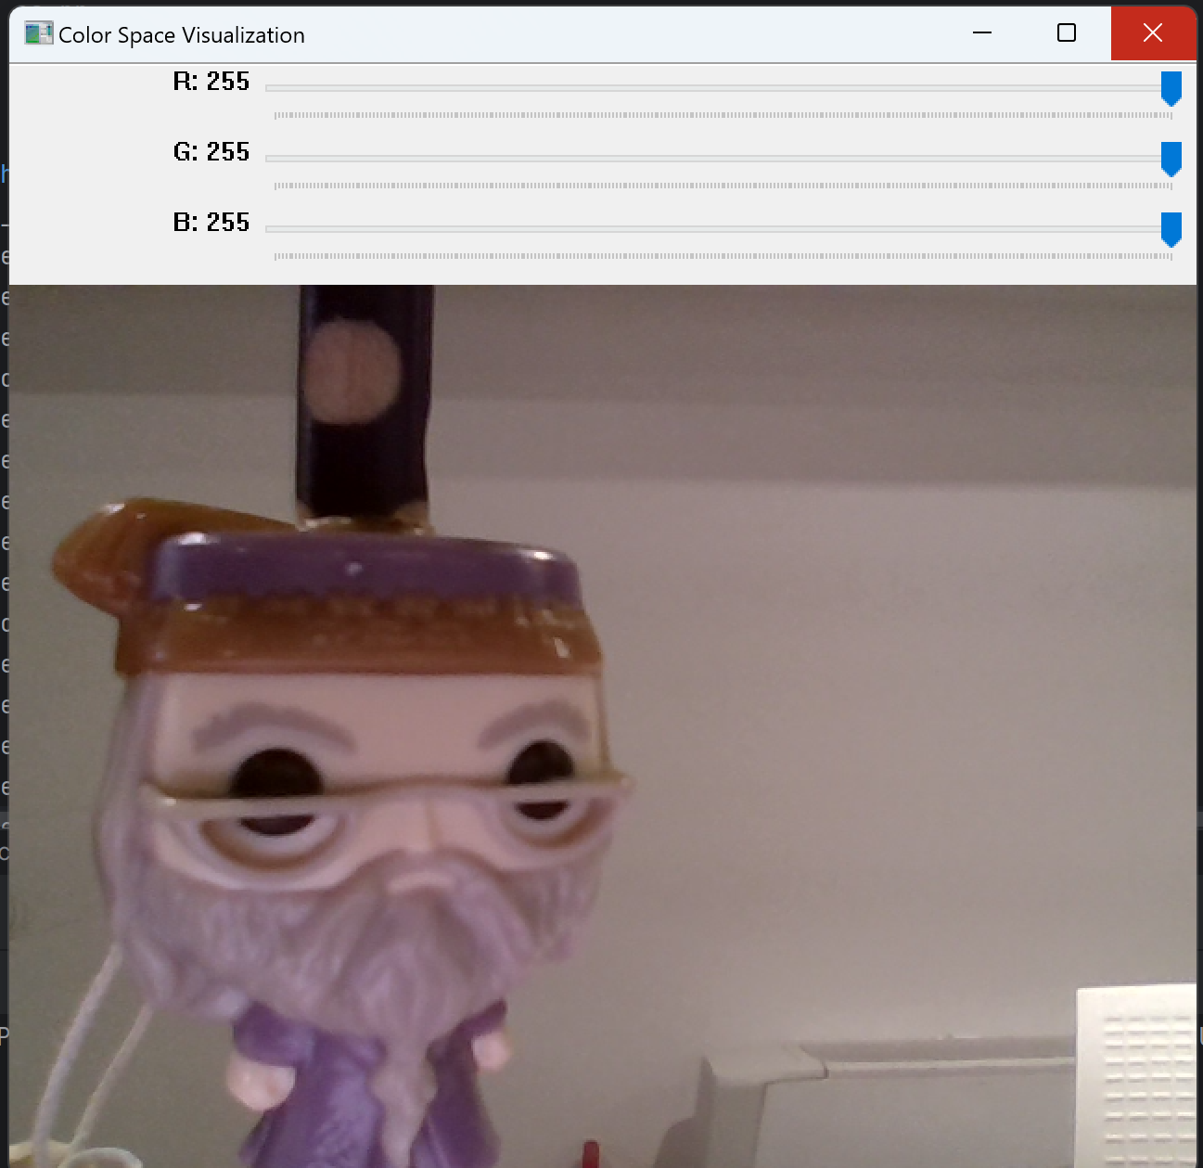
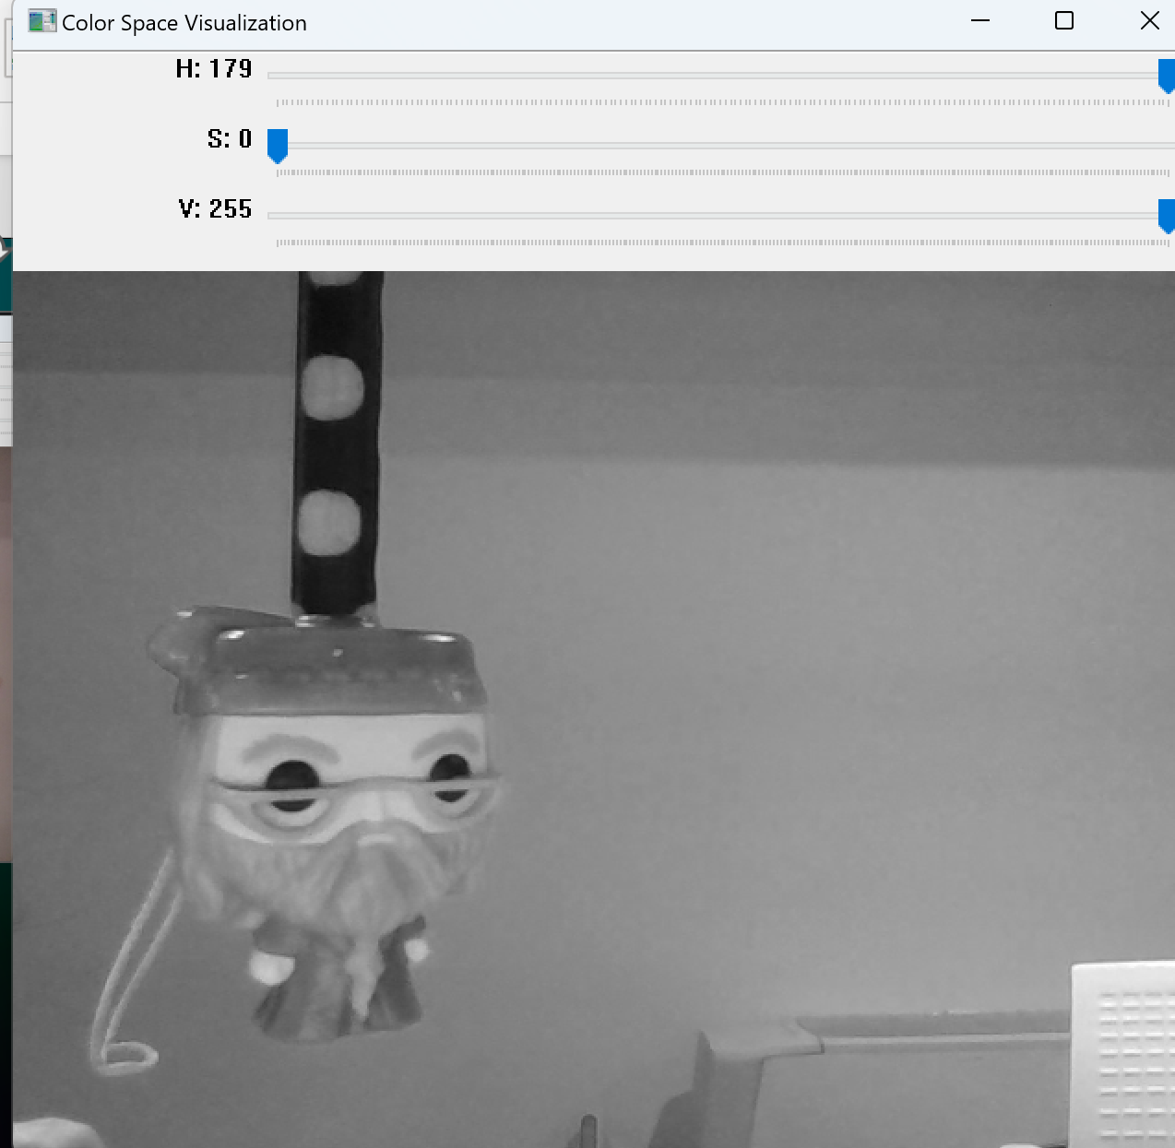

Slide 5
Colour Spaces Overview
RGB • RGB (Red, Green, Blue): Used in electronic displays, represents colors by mixing red, green, and blue light. Range of values 0-255. The value of each channel represents the intensity of the respective color:0
means no contribution (e.g., no red).255 means full contribution (e.g., maximum red).
When all three channels are set to 0, the color is black.
When all are set to 255, the color is white.

Slide 6
HSV
• HSV (Hue, Saturation, Value): Aligns more closely with human perception, often used in graphic design.
H (Hue): Represents the color type (red, green, blue, etc.).
( 0-179 degrees in OpenCV (scaled from 0-360 degrees, which covers the full color spectrum)).
===============
S (Saturation): Represents the intensity or purity of the color.
(0-255, where 0 is completely desaturated (gray), and 255 is fully saturated).
===============
V (Value): Represents the brightness or luminance of the color. (0-255, where 0 is completely dark (black), and 255 is fully bright).

Slide 7
LAB
LAB (Lightness, A, B): Device-independent, designed to be perceptually uniform for human vision. These spaces enable accurate color representation and manipulation across different devices.
L (Lightness): Represents the brightness of the color.
0-100, where 0 is black and 100 is white.
==========
A (A Channel): Represents the color on a green-red axis.
-128 to 127; negative values indicate more green, while positive values indicate more red.
==========
B (B Channel): Represents the color on a blue-yellow axis.
-128 to 127; negative values indicate more blue, while positive values indicate more yellow.
==========

Slide 8
Application Features
• Real-time conversion of webcam feed into RGB, HSV, and LAB color spaces. • Dynamic adjustment of channel values for each color space using interactive trackbars. • Easy switching between color spaces ('r' for RGB, 'h' for HSV, 'l' for LAB) and capturing frames ('c' to capture). • User-friendly interface with intuitive controls and immediate feedback on adjustments.

Slide 9
Code Structure and Organization
1. adjust_channels(): Adjusts color channel values based on the selected color space (RGB, HSV, LAB). 2. create_trackbars(): Creates trackbars for each channel, allowing users to modify color space parameters. 3. main(): Handles webcam input, color space selection, and visualization, ensuring real-time feedback and interaction. Efficient organization ensures smooth performance and ease of use.

Slide 10
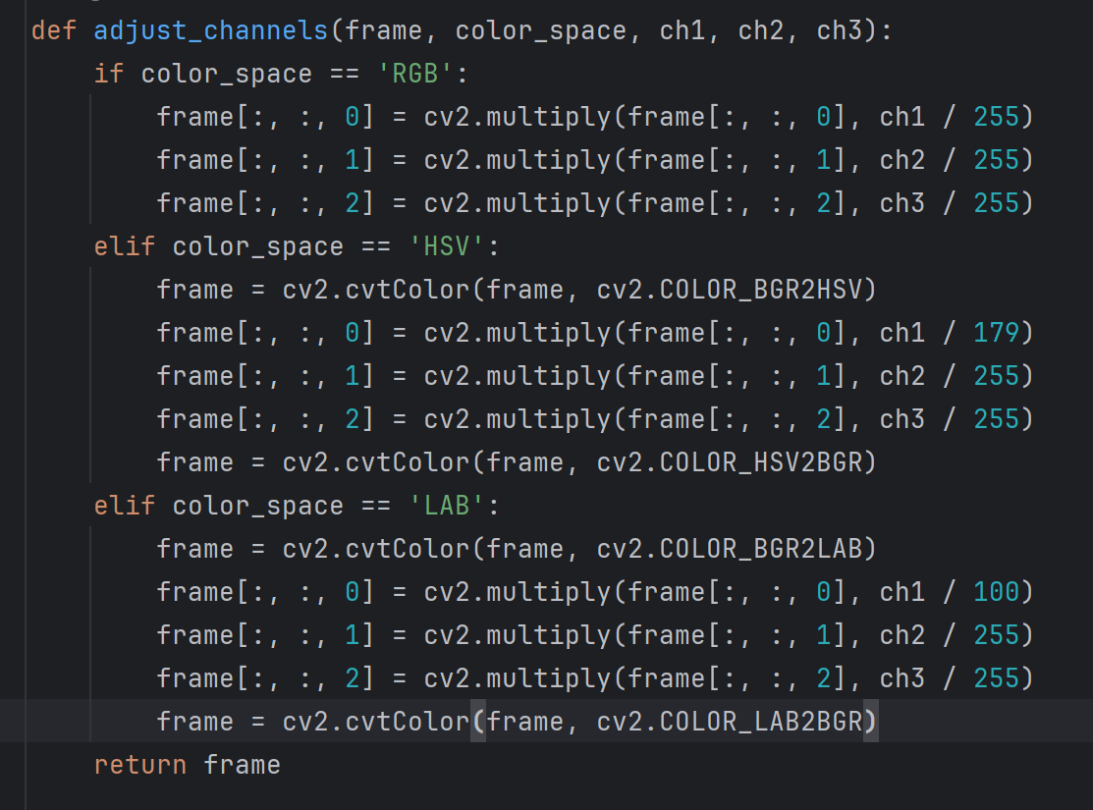
Algorithm Analysis
OpenCV Methods Utilized: - cv2.cvtColor(): Efficient color space conversion for real-time applications. - cv2.multiply(): Scales and adjusts channel values, maintaining image quality. - cv2.createTrackbar(): Provides dynamic user interaction through adjustable sliders. These algorithms allow rapid processing and display of video streams, crucial for real-time visualization.
This is the openCv algorithm that does the main job
Behind the idea

Slide 11
OpenCV’s (cv2.cvtcolour()) in the background does all the mathematical calculations needed to get the result. In short points this is how: 1. RGB to HSV: Normalizes RGB values, calculates hue, saturation, and value. 2. HSV to RGB: Computes intermediate values to determine RGB output. 3. RGB to LAB: Converts RGB to linear RGB, then transforms to LAB using the XYZ color space. 4. LAB to RGB: Reverses the LAB to XYZ conversion, applies gamma correction to get RGB.
• Normalization: All color values are scaled to a standard range (0-1 or 0-255). • Chroma Calculation: Determines color intensity differences in RGB to HSV. • Matrix Transformation: Converts between color models (RGB to XYZ to LAB). • Gamma Correction: Adjusts RGB values to match human perception.

Slide 12
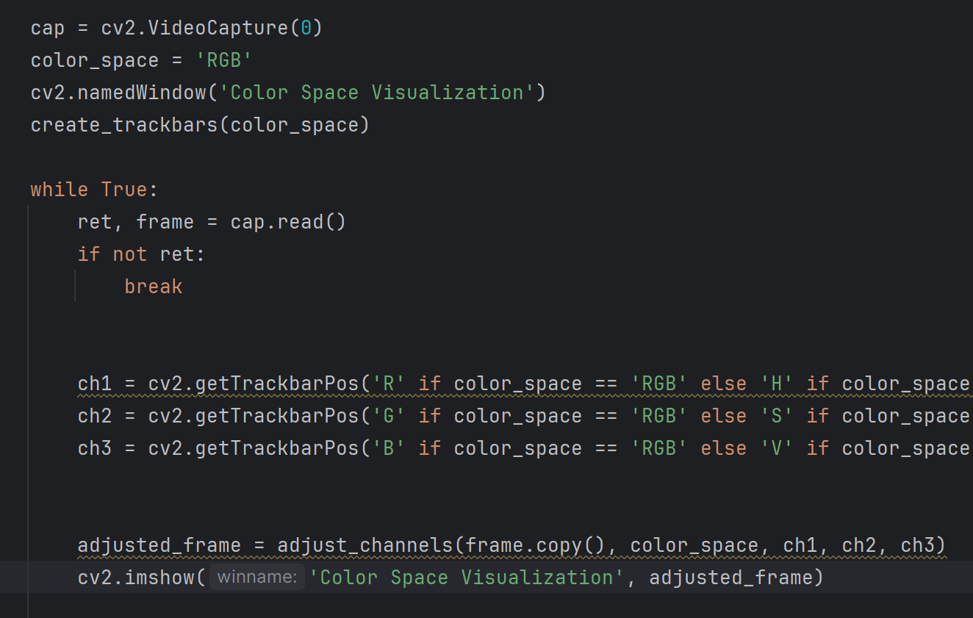
Apart from the color space switching, another crucial component for the app to work is the video stream through the webcam. That is handled in the main part of the code, again using OpenCv’s algorithm.
Enter loop

Slide 13
Performance and Error Handling
Performance Optimizations: - Real-time processing achieved through OpenCV's optimized functions. - Use of cv2.cvtColor() and cv2.multiply() for fast, efficient adjustments. - Dynamic trackbar creation improves user interaction. Error Handling: - Robust error handling for webcam input and color space switching. - Graceful handling of unexpected user inputs and frame capture issues.

Slide 14
Demo Testing and Results
Testing: - Application tested extensively for smooth, real-time interaction across color spaces. - Successful channel adjustments and seamless transitions between RGB, HSV, and LAB. Results: - Effective demonstration of color space concepts. - Minor UI improvements enhanced the user experience.

