Slide 1
Metagenomics, Day 3, Morning: Sampling & Presence/Absence
Titus Brown
July 17, 2025
STAMPS 2025

Slide 2
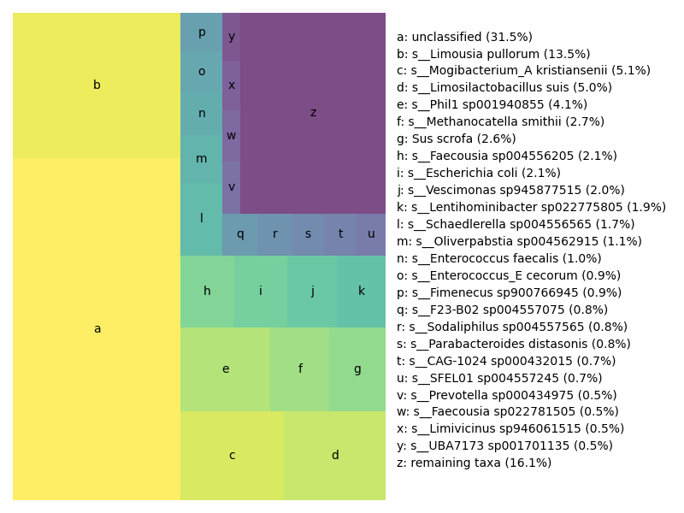
This is an proportional representation of the content of a metagenome, as estimated by sourmash.
The sizes are ”accurate” in that they are visually proportional.

Slide 3
The size of each box is, essentially:
size of genome x
abundance of genome
(The actual bp numbers are available, too; ask me when we get to the command line!)

Slide 4
Think of this as a dartboard, and of sequencing as throwing a dart at this map.
Throwing more darts is sequencing more deeply.

Slide 5
Q1: What will you mostly get if you throw twice as many darts at this dart board?

Slide 6
Q2: What happens to the abundances (not displayed ;) if you throw twice as many darts at this dart board?

Slide 7
Let’s suppose you can select darts with different size tips.
Q3: How does this change your dart throwing strategy?

Slide 8
(linkage & sequencing read length)

Slide 9
Now let’s change the darts to be strongly magnetic, so that they ONLY hit the red circles.
Q4: How does this change your dart throwing strategy?
(This is a 16S/amplicon analogy ☺)

Slide 10
Q5: what is the unclassified stuff?
(What could it be?)

Slide 11
The size of each box is, essentially:
size of genome x
abundance of genome
Bacteria: ~5 million base pairs.
Eukaryotes: 100 million-5 billion base pairs (20-1000x bigger)
Viruses: 10,000-50,000 base pairs. (100x smaller)
Q6: what would viruses look like on here?

Slide 12
Q7: What would rarefaction be doing in this situation?
(We’ll talk about this more on Monday… stats day!)

