Slide 1
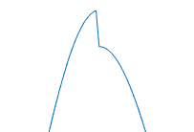
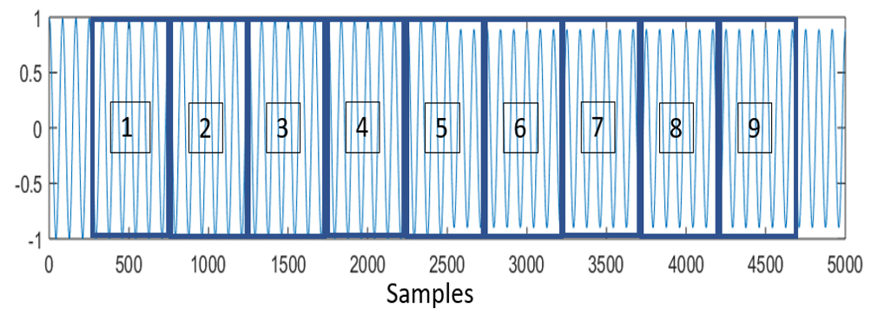
1 PPS
Trigger
1 PPS
Trigger
+0.1 s
+0.2 s
+0.3 s
+0.7 s
+0.8 s
+0.9 s

