Slide 1


Step Change Detection Based on Analytic Signal for PMU Calibrators
Marcelo Britto Martins
Renata T. de Barros e Vasconcelos
Paulo A. A. Esquef
26-Sep-2019

Slide 2
Step Change Detection Based on Analytic Signal for PMU Calibrators
Intro/Context.
Math
Hilbert
Parametric Model
Detection Signals
Hybrid detector
Frequency estimation
Numeric Simulations
Metrics
Performance
Step Location
Frequency
Laboratory Setup

Slide 3
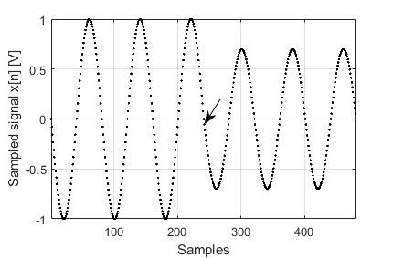
Introduction
Assessement of PMU calibrators
Step tests: (IEEE Std)
Magnitude (KxS = 0.1)
Phase (KaS = 10°)
Special cases

Slide 4

Mathematical Background
Instantaneous magnitude, phase and frequency
$$FFT →H\left(x\left[n\right]\right)→a_{i}\left[n\right], θ_{i}\left[n\right], f_{i}[n]$$

Slide 5
Mathematical Background

Slide 6
Numerical Simulations

Slide 7
Performance

Slide 8
Laboratory Setup
Atomic Clock
1 PPS
10 MHz
PXI System
CPU
Timing
Clock
Timestamp
Trigger
18 MHz
Samples
Generation
Sampling
Waveforms
Output
RVD
Voltage
amplifier
DUT

Slide 9
Sugestões para títulos, textos e destaques:
Títulos (fonte Calibri Bold - corpo 24 a 32)
Subtítulos (fonte Calibri Bold - corpo 20 a 24)
Texto (fonte Calibri regular ou Calibri Bold - corpo 14 a 22)
Texto para tabelas (fonte Calibri – corpo 12 a 18)
Cor: Azul marinho (RGB: 16, 52, 92)
Cor: Preto ou cinza
Alguns destaques (setas, links e etc...)
Cor: Azul claro (RGB: 0, 176, 240)

Slide 10

