Slide 1
CPEM 2018
Models for synchrophasor with step discontinuities in magnitude and phase: estimation and performance
Marcelo Britto Martins
Researcher

Slide 2
Discussion
Advantages of the proposed models
  Uses the actual window (more of a measurement, less an estimate)
  Intermediary phasor (weak)
  Better observability of supposed constant quantities
    Frequency
    Magnitude during phase step
    Phase during magnitude step
Noise level: SNR (uniform, gaussian)
  Uniform: was subestimating noise level (wrong variance, limited boundaries)
  Gaussian is better model, but higher maximum errors
  Uncertainties: Max error x Standard Deviation

Slide 3
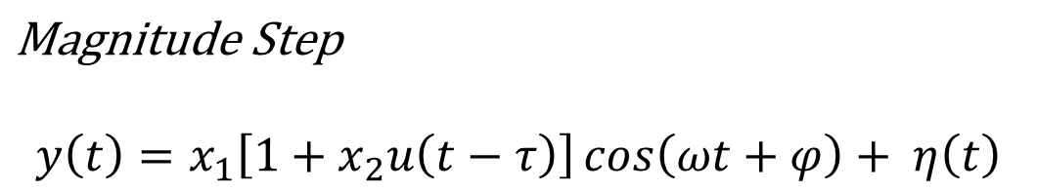
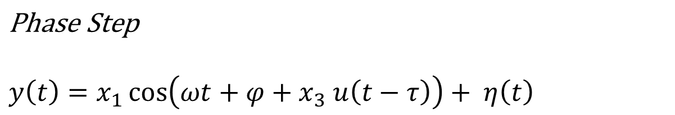

Slide 4
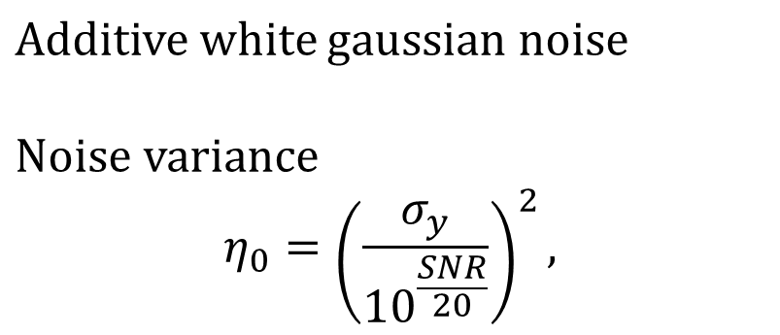

Slide 5
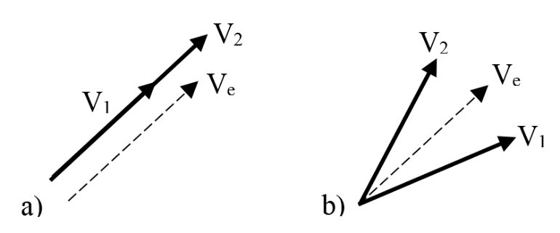
Fig. 1 Transitioning phasors for a) magnitude step, b) phase step
We can still measure frequency and phase
We can still measure frequency and magnitude

Slide 6
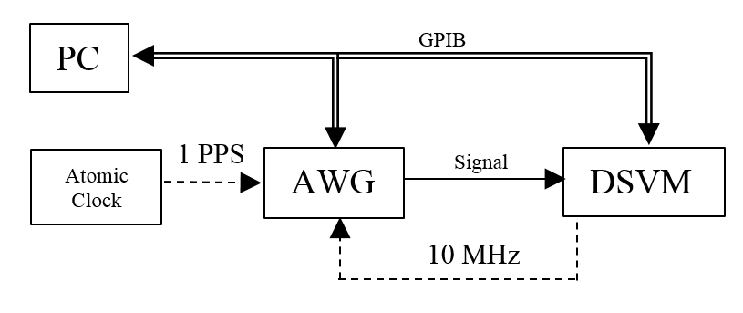
Fig. 6 - Block Diagram

Slide 7
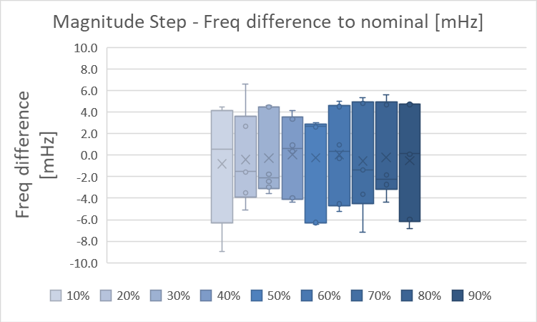
Fig. 11 Frequency variation during magnitude tests in function of the step instant.
Fnom = 60 Hz
6.0 mHz = 100 ppm
LM error:
std_dev = 0.14 ppm
Max_abs = 0.5 ppm = 3mHz

Slide 8
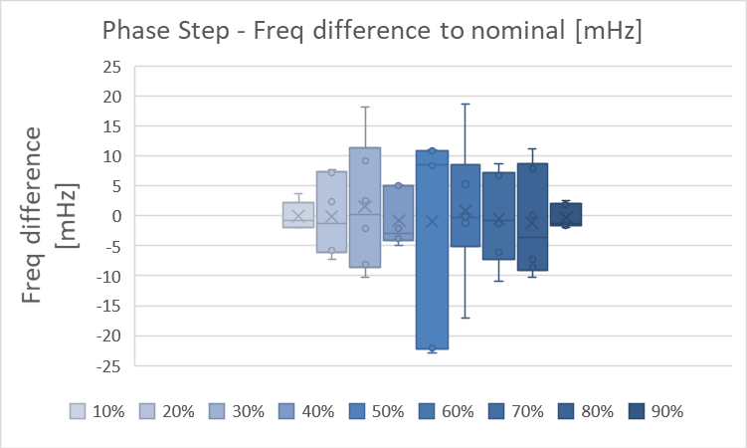
ERR_MAX_ABS
MAX [ppm]
0.6
0.6
0.9
0.9
1.1
1.0
0.8
0.7
0.5
STD_DEV
MAX [ppm]
0.16
0.19
0.23
0.26
0.27
0.26
0.22
0.20
0.16
Fig. 12 Frequency variation during phase steps in function of the step instant.
Fnom = 60 Hz
6.0 mHz
24 mHz
LM error:
std_dev = 0.3 ppm
Max_abs = 1.1 ppm

Slide 9
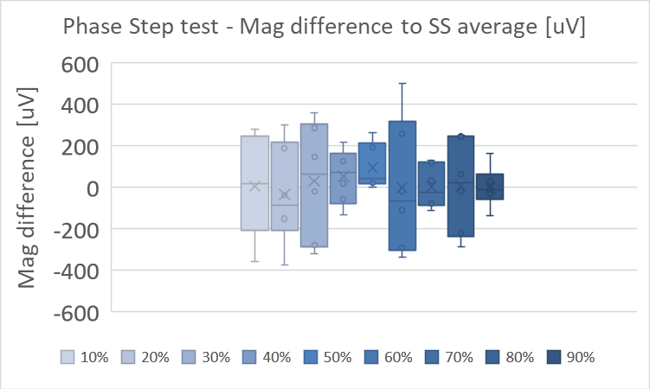
ERR_MAX_ABS
MAX [ppm]
5.7
5.1
5.2
5.1
5.2
5.2
5.8
5.1
5.2
STD_DEV
MAX [ppm]
1.5
1.5
1.5
1.5
1.5
1.5
1.4
1.5
1.5
Fig. 13 Magnitude variation during phase steps in function of the step instant of occurrence
Vnom = 1 Vp
400 uV = 400 ppm difference to steady state average

Slide 10
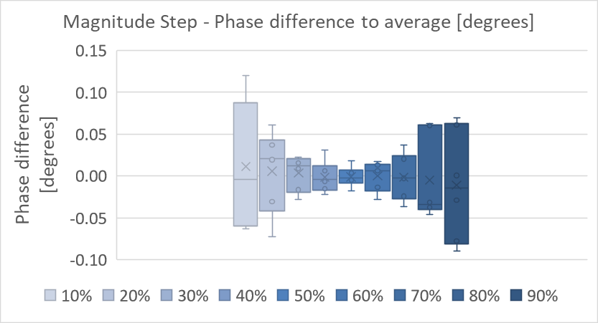
LM
uncertainty
ERR_MAX ABS
MAX [m deg]
0.51
0.45
0.41
0.31
0.29
0.38
0.37
0.41
0.54
STD_DEV
MAX [m deg]
0.15
0.12
0.11
0.09
0.08
0.09
0.10
0.12
0.14
Fig. 14 Phase variation during magnitude steps in function
of the step instant of occurrence.
Phase errors ~ 0.1 degrees

Slide 11
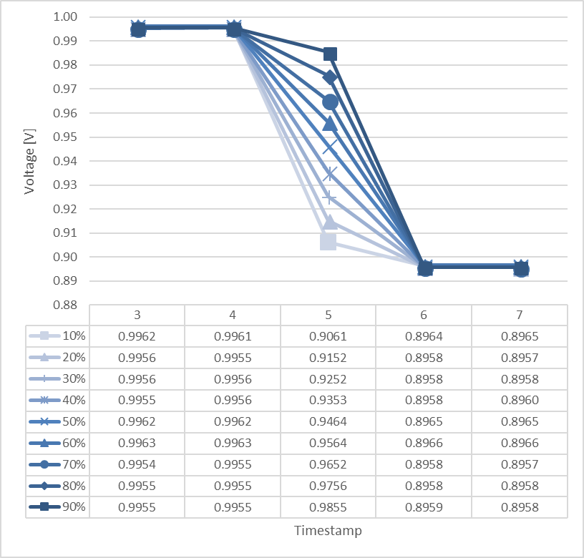
Intermediary phasor – negative magnitude step

Slide 12
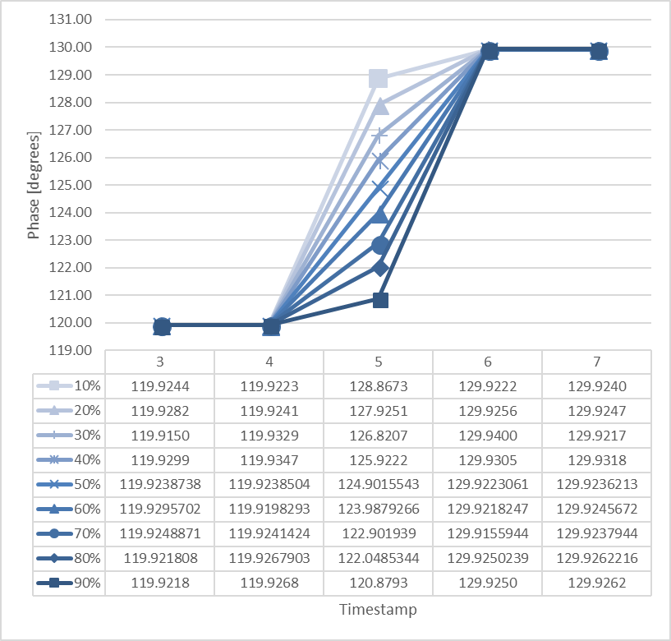
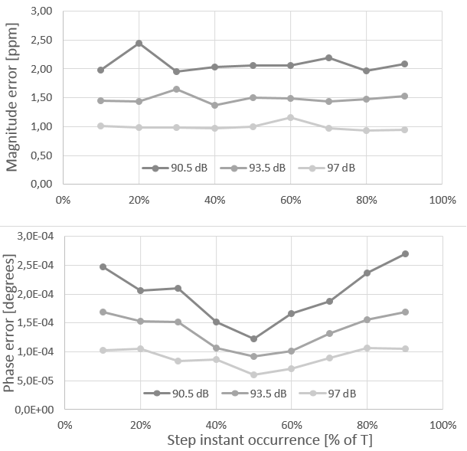
Intermediary phasor – positive phase step
Fig. 10 Intermediary Phase. Phase positive step of 10 degrees, starting at 120 degrees.
Fig. 5 - Phase Step test: maximum errors for intermediate phasor

Slide 13
Aumentar referencias – em torno de 20
Consertar figuras e tabelas
Todas as referencias em desvio padrao

Slide 14
Títulos (fonte Arial Bold - corpo 32 a 36)
Subtítulos (fonte Arial Bold - corpo 25 a 28)
Texto (fonte Arial Bold - corpo 18 a 21)
Texto para tabelas (fonte Arial Bold Italic - corpo 16)
Cor: Azul marinho
Cor: Preto ou cinza
Cor para linhas e setas
Cores para aplicações em gráficos e desenhos:

Slide 15

