Slide 1


Step Change Detection Based on Analytic Signal for PMU Calibrators
Marcelo Britto Martins
Renata T. de Barros e Vasconcelos
Paulo A. A. Esquef
26-Sep-2019

Slide 2
Step Change Detection Based on Analytic Signal for PMU Calibrators
Intro/Context.
Math
Hilbert
Parametric Model
Detection Signals
Hybrid detector
Frequency estimation
Numeric Simulations
Metrics
Performance
Step Location
Frequency
Laboratory Setup

Slide 3
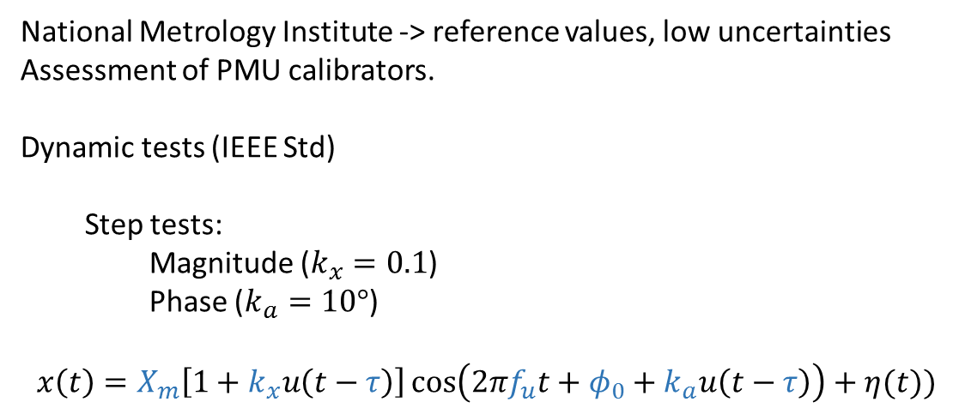
Introduction
National Metrology Institute -> reference values, low uncertainties
Assessment of PMU calibrators.
Dynamic tests (IEEE Std)
Step tests:
Magnitude ($k_{x}=0.1$)
Phase ($k_{a}=10°$)
$$x\left(t\right)=X_{m}\left[1+k_{x}u\left(t−τ\right)\right]\cos\left(2πf_{u}t+φ_{0}+k_{a}u\left(t−τ\right)\right)+η(t))$$
Assessment of errors and uncertainties
Nominal values
Parametric model;
Iterative procedure -Levenberg-Marquardt (LMI)
Voltage
Generation
Sampling
Analysis
Introduce errors, uncertainties, and noise

Slide 4
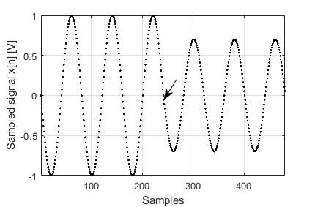
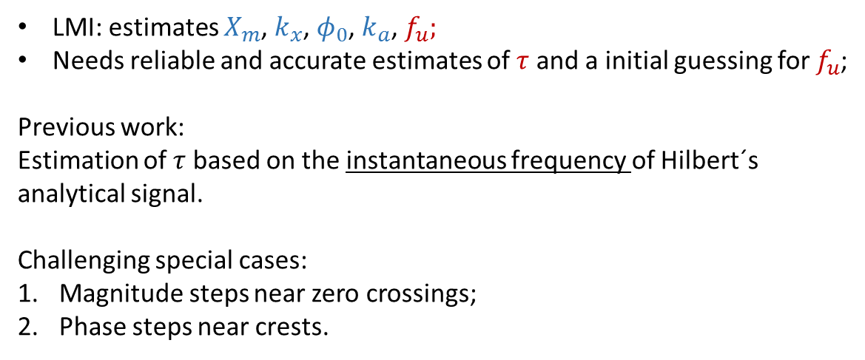
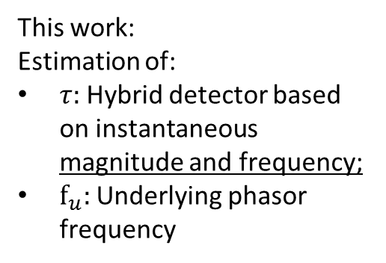
Introduction
$$x\left(t\right)=X_{m}\left[1+k_{x}u\left(t−τ\right)\right]\cos\left(2πf_{u}t+φ_{0}+k_{a}u\left(t−τ\right)\right)+η(t)$$
LMI: estimates $X_{m}$, $k_{x}$, $φ_{0}$, $k_{a}$, $f_{u};$
Needs reliable and accurate estimates of $τ$ and a initial guessing for $f_{u}$;
Previous work:
Estimation of $τ$ based on the instantaneous frequency of Hilbert´s analytical signal.
Challenging special cases:
Magnitude steps near zero crossings;
Phase steps near crests.
This work:
Estimation of:
$τ:$Hybrid detector based on instantaneous magnitude and frequency;
$f_{u}:$Underlying phasor frequency

Slide 5

Mathematical Background
Instantaneous magnitude, phase and frequency
$$FFT →H\left(x\left[n\right]\right)→a_{i}\left[n\right], θ_{i}\left[n\right], f_{i}[n]$$

Slide 6
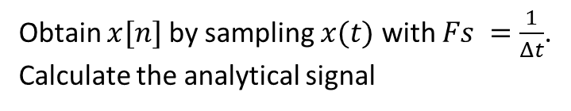
Mathematical Background
$$x\left(t\right)=X_{m}\left[1+k_{x}u\left(t−τ\right)\right]\cos\left(2πf_{u}t+φ_{0}+k_{a}u\left(t−τ\right)\right)+η(t))$$
Obtain $x[n]$by sampling $x(t)$with $Fs =\frac{1}{Δt}$.
Calculate the analytical signal
Hybrid detector
Frequency

Slide 7
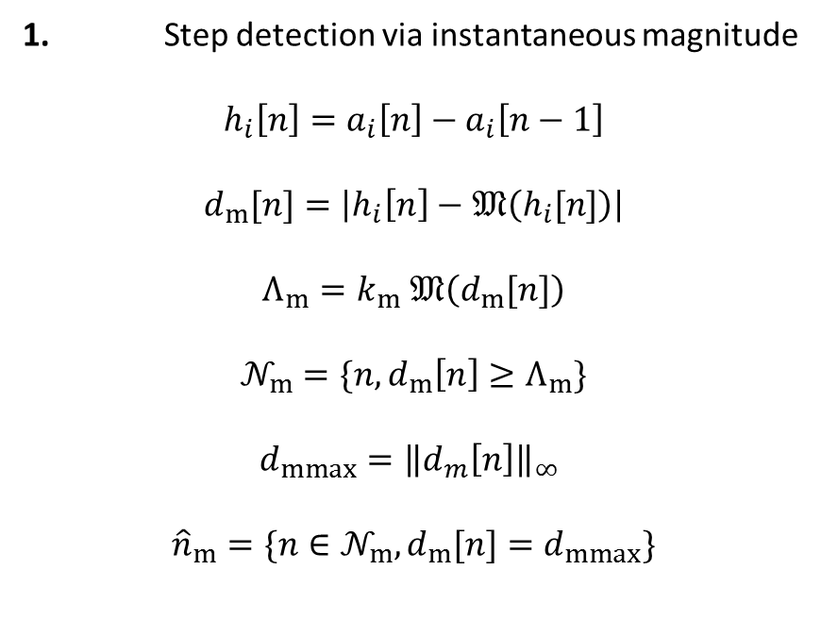
Detection signals
1. Step detection via instantaneous magnitude
$$h_{i}\left[n\right]=a_{i}\left[n\right]−a_{i}\left[n−1\right]$$
$$d_{m}[n]=\left|h_{i}\left[n\right]−𝔐\left(h_{i}[n]\right)\right|$$
$Λ_{m}=k_{m}$ $𝔐\left(d_{m}[n]\right)$
$$𝒩_{m}=\{n,d_{m}\left[n\right]≥Λ_{m}\}$$
$d_{mmax}={\left\|d_{m}\left[n\right]\right\|}_{∞}$
$${\hat{n}}_{m}=\{n∈𝒩_{m},d_{m}[n]=d_{mmax}\}$$

Slide 8
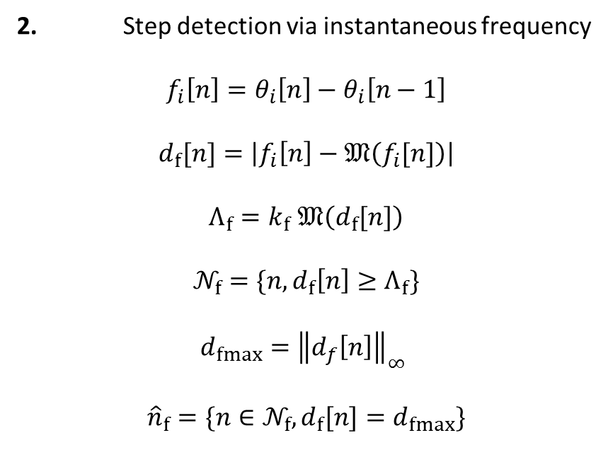
Detection signals
2. Step detection via instantaneous frequency
$$f_{i}\left[n\right]=θ_{i}\left[n\right]−θ_{i}\left[n−1\right]$$
$$d_{f}[n]=\left|f_{i}\left[n\right]−𝔐\left(f_{i}[n]\right)\right|$$
$Λ_{f}=k_{f}$ $𝔐\left(d_{f}[n]\right)$
$$𝒩_{f}=\{n,d_{f}\left[n\right]≥Λ_{f}\}$$
$d_{fmax}={\left\|d_{f}\left[n\right]\right\|}_{∞}$
$${\hat{n}}_{f}=\{n∈𝒩_{f},d_{f}[n]=d_{fmax}\}$$

Slide 9




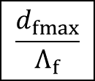
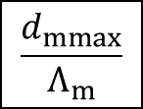
Hybrid detector
$${\hat{n}}_{m}$$
$${\hat{n}}_{f}$$
$$\frac{d_{mmax}}{Λ_{m}}$$
$$\frac{d_{fmax}}{Λ_{f}}$$
Highest ratio
$$\hat{n}$$
$$\hat{τ}=\hat{n}Δt$$
Underlying Phasor Frequency estimator: ${\hat{f}}_{u}=𝔐\left(f_{i}[n]\right)$

Slide 10
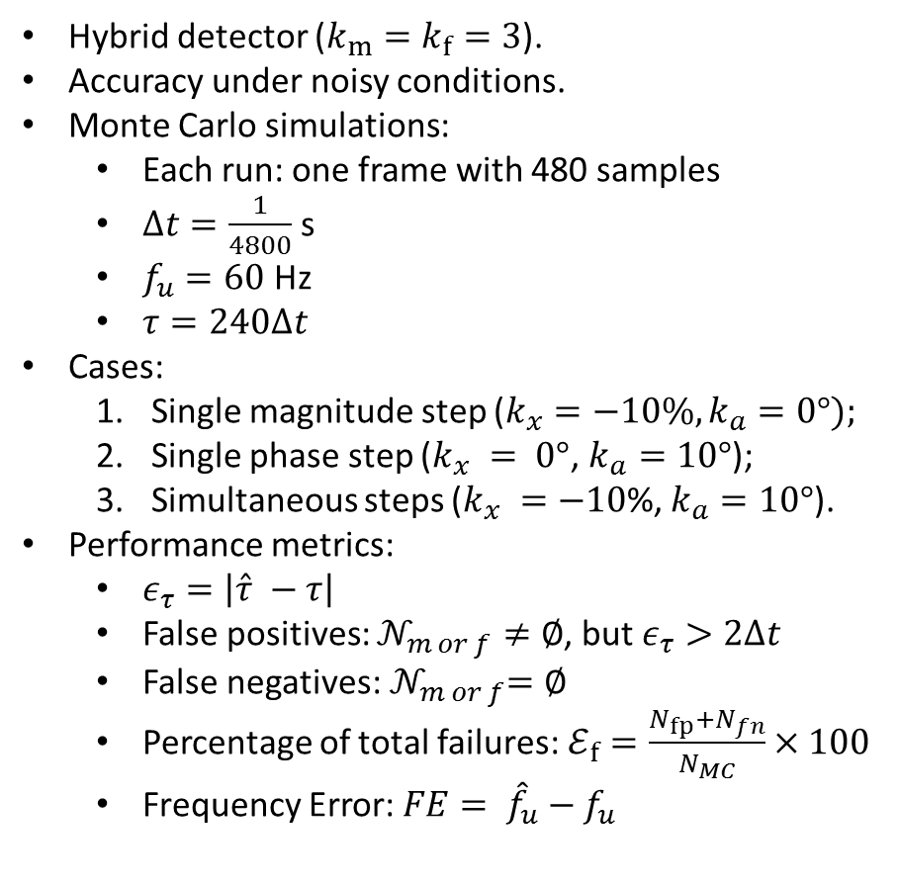
Numeric Simulations
Hybrid detector ($k_{m}=k_{f}=3$).
Accuracy under noisy conditions.
Monte Carlo simulations:
Each run: one frame with 480 samples
$Δt=\frac{1}{4800}$ s
$f_{u}=60$ Hz
$τ=240Δt$
Cases:
Single magnitude step ($k_{x}=−10\%, k_{a}=0°);$
Single phase step ($k_{x} = 0°$, $k_{a}=10°$);
Simultaneous steps ($k_{x} =−10$%, $k_{a}=10°$).
Performance metrics:
$ε_{τ}=\left|\hat{τ} −τ\right|$
False positives: $𝒩_{m or f}≠∅$, but $ε_{τ}>2Δt$
False negatives:${ 𝒩}_{m or f}=∅$
Percentage of total failures:$ℰ_{f}=\frac{N_{fp}+N_{fn}}{N_{MC}}×100$
Frequency Error: $FE= {\hat{f}}_{u}−f_{u}$

Slide 11
Performance

Slide 12
Performance

Slide 13
Performance

Slide 14
Performance

Slide 15
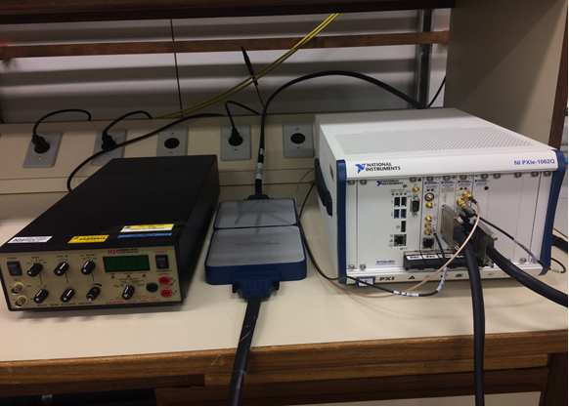
Laboratory Setup
Atomic Clock
1 PPS
10 MHz
Analysis
PXI System
CPU
Timing
Clock
Timestamp
Trigger
18 MHz
Samples
Generation
Sampling
Waveforms
Output
RVD
Voltage
amplifier
DUT

Slide 16
Measurements

Slide 17
Conclusions
Blindly detect and locate step changes;
Simple estimator for underlying phasor frequency under step conditions;
Ongoing investigation:
Voltage sags: two or more steps inside a window;
Implementation of denoising techniques.

Slide 18
Thank you

Slide 19
Sugestões para títulos, textos e destaques:
Títulos (fonte Calibri Bold - corpo 24 a 32)
Subtítulos (fonte Calibri Bold - corpo 20 a 24)
Texto (fonte Calibri regular ou Calibri Bold - corpo 14 a 22)
Texto para tabelas (fonte Calibri – corpo 12 a 18)
Cor: Azul marinho (RGB: 16, 52, 92)
Cor: Preto ou cinza
Alguns destaques (setas, links e etc...)
Cor: Azul claro (RGB: 0, 176, 240)

Slide 20

