Slide 1
APIs
A What?

Slide 2
APIs or Web Services
An application programming interface is a protocol intended to be used as an interface by software components to communicate with each other.

Slide 3
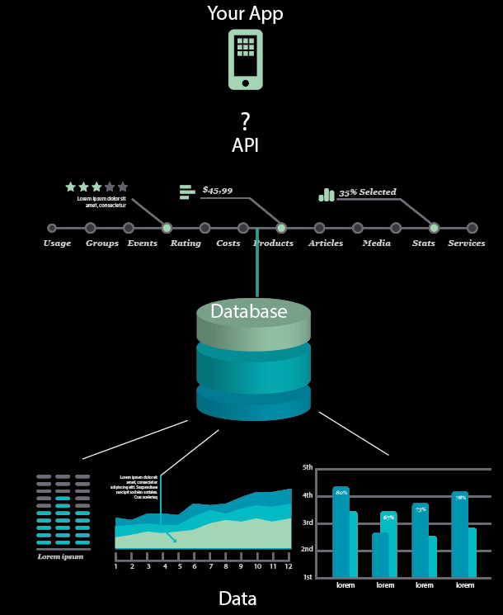

Slide 4
Typically Structured and Documented Language
Predictive URL Structures
GET/POST XML/JSON
Other

Slide 5
Typically Separations between data and presentation
Most APIs return Data and you present it
Exceptions like Maps, Video APIs. etc.

Slide 6
Amazon Game Changer
Jeff Bezos issued a mandate in 2002
All teams will henceforth expose their data and functionality through service interfaces.
Teams must communicate with each other through these interfaces.
There will be no other form of inter-process communication allowed: no direct linking, no direct reads of another team’s data store, no shared-memory model, no back-doors whatsoever. The only communication allowed is via service interface calls over the network.
It doesn’t matter what technology they use.
All service interfaces, without exception, must be designed from the ground up to be externalizable. That is to say, the team must plan and design to be able to expose the interface to developers in the outside world. No exceptions.
The mandate closed with:
Anyone who doesn’t do this will be fired. Thank you; have a nice day!

Slide 7
Historical Examples
Amazon Web Services 2002 / 2004
Goggle Search Interface 2007
Google Maps 2008
NYTimes Campaign Finance API 2008
NYTimes All Content 2009
NPR, BBC, Guardian 2009-2010

Slide 8
And there is more
Twitter
Facebook
Instagram
Flickr
Tumblr
and much, much more!

Slide 9
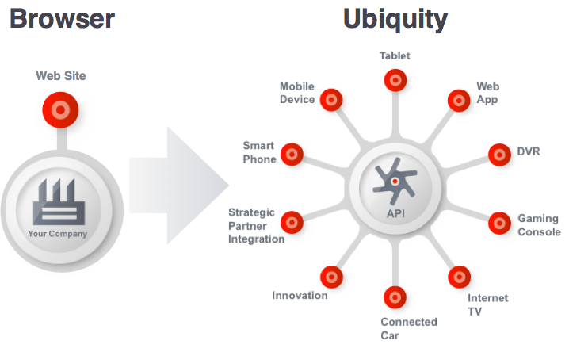
Why

Slide 10
Why
Internal Development
Community Development
Innovation

Slide 11
Let’s Get Started!
Google Maps
https://goodlife.allstate.com/dashboard/
http://news-explorer.mybluemix.net/

