Slide 1
APIs
A What?

Slide 2
APIs or Web Services
An application programming interface is a protocol intended to be used as an interface by software components to communicate with each other.

Slide 3
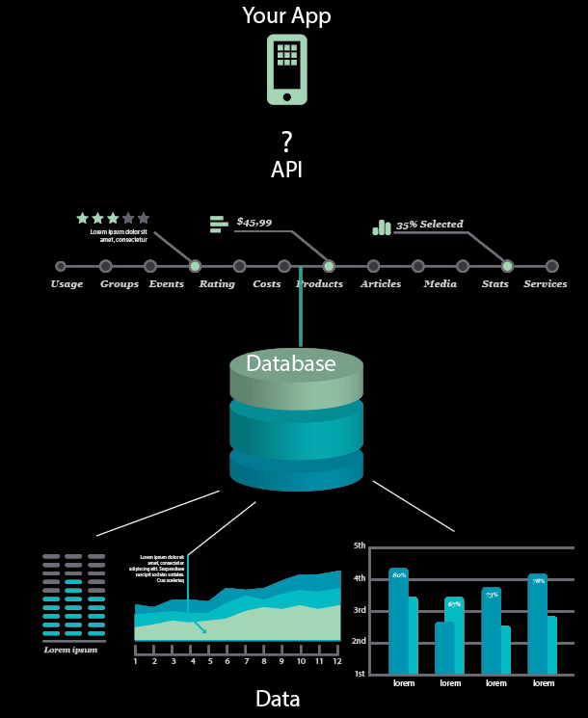

Slide 4
Typically Structured and Documented Language
Predictive URL Structures
GET/POST XML/JSON
Other

Slide 5
Typically Separations between data and presentation
Most APIs return Data and you present it
Exceptions like Maps, Video APIs. etc.

Slide 6
Historical Examples
Amazon Web Services 2006
Goggle Search Interface 2007
Google Maps 2008
NYTimes Campaign Finance API 2008
NYTimes All Content 2009
NPR, BBC, Guardian 2009-2010

Slide 7
And there is more
Twitter
Facebook
Instagram
Flickr
Tumblr
and much, much more!

Slide 8
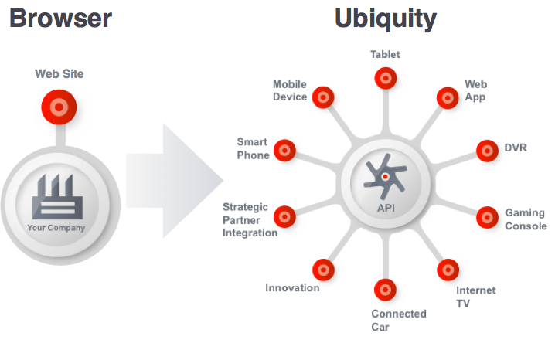
Why

Slide 9
Why
Internal Development
Community Development
Innovation

Slide 10
Let’s Get Started!
Google Maps
https://goodlife.allstate.com/dashboard/
http://news-explorer.mybluemix.net/

