Slide 1
Refill & Persistency
Generated: 09-Jul-2026 12:32 PM
Filters Applied: Period: Specific Month(s) · Months: March 2025, April 2025, May 2025 · Region: All · Territory: All · State: All · Payer: All · Primary Parent: All · Patient Type: All · Specialist: All · Status: All · Diagnosis Code: All

Slide 2
Key Performance Indicators
REFILL ON-TIME RATE
22.8%
PERSISTENCY (12-MONTH)
75%
DISCONTINUATION RATE
4.9%
CANCELLATION RATE
20%

Slide 3
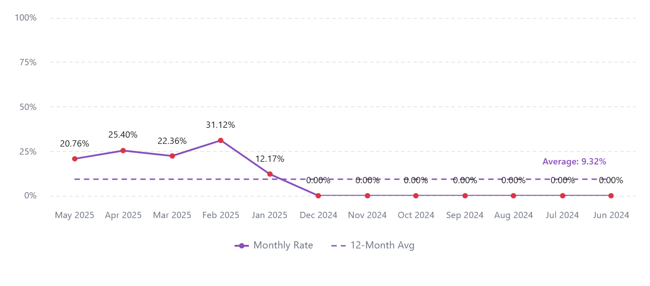
Refill On-Time Rate (12-Month Trend)

Slide 4
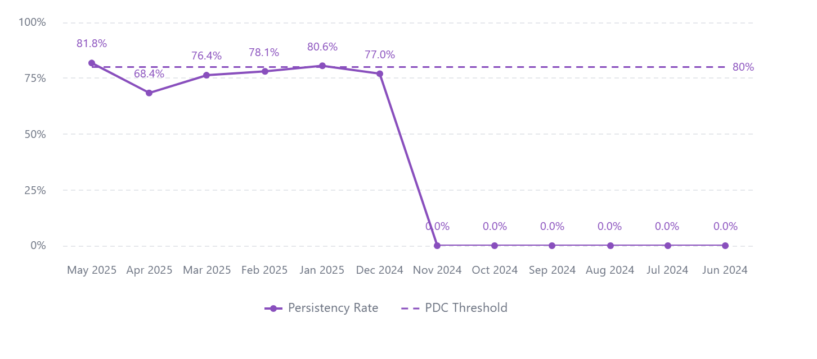
Patients on Therapy (12-Month Trend)

Slide 5
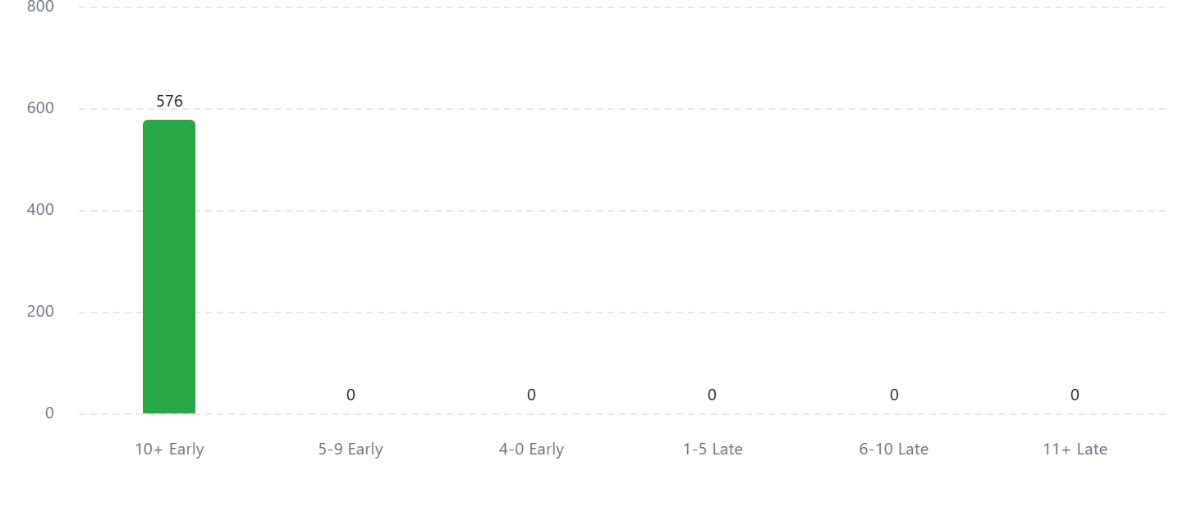
Shipments by Time to Refill

Slide 6
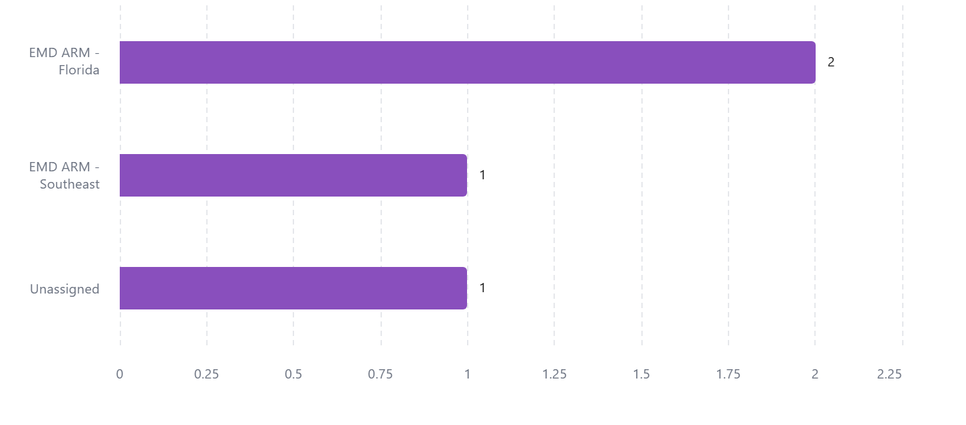
Discontinued Patients by Territory

