Slide 1
Time to First Fill
Generated: 09-Jul-2026 12:41 PM
Filters Applied: Period: Specific Month(s) · Months: April 2025, March 2025, May 2025 · Region: All · Territory: All · State: All · Payer: All · Primary Parent: All · Patient Type: All · Specialist: All · Status: All · Diagnosis Code: All

Slide 2
Key Performance Indicators
AVG TTFF
9 days
MEDIAN TTFF
8 days
FILLED <=15 DAYS
74.4%
PATIENTS >45 DAYS
0

Slide 3
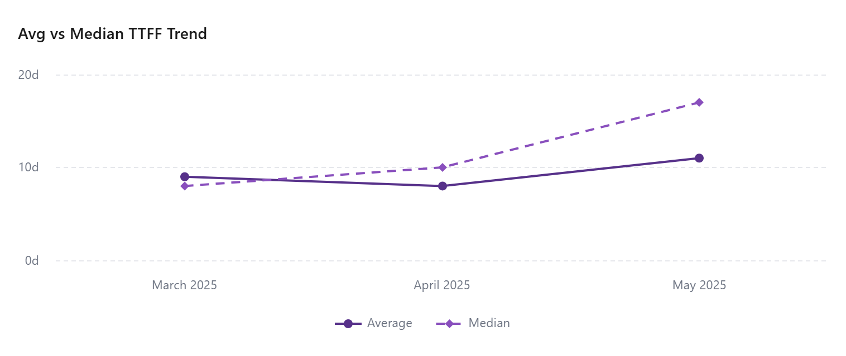

Slide 4
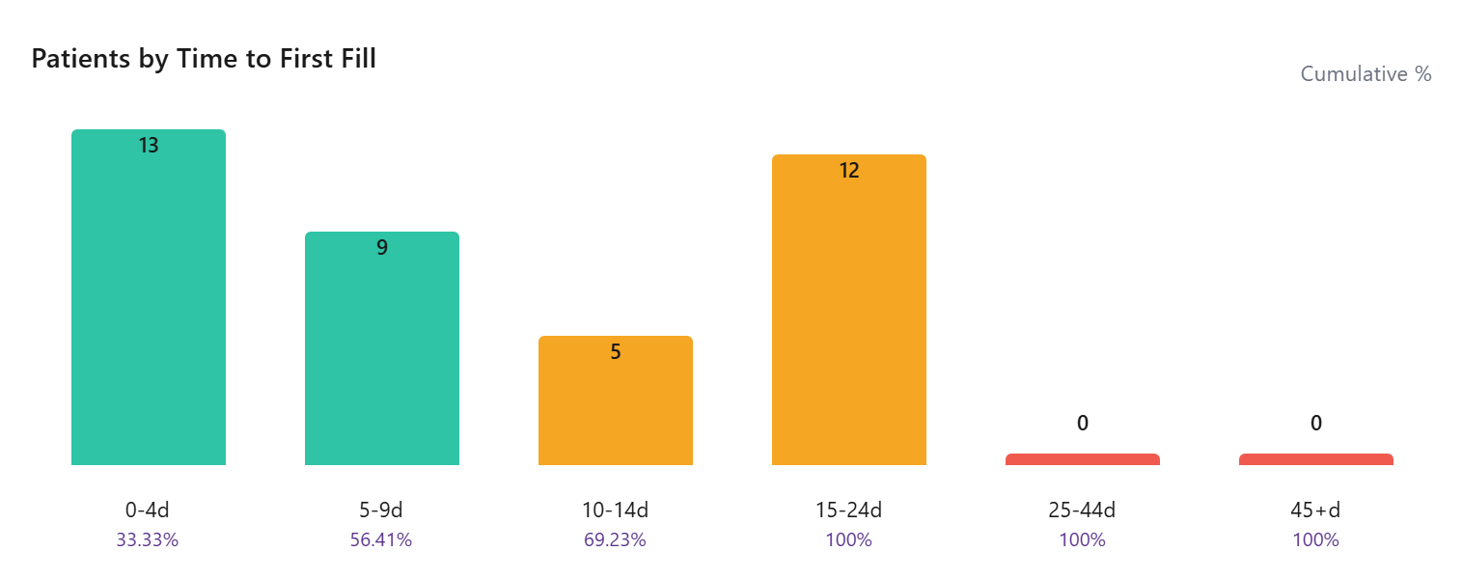

Slide 5
Time To First Fill By Payer
Payer | Patients | Avg TTFF | Median TTFF | % <=15 Days
Third Party | 32 | 10 | 12 | 40.63
State Medicaid | 1
Other | 1 | 5 | 5 | 100.00
Medicare Advantage | 1
Medicare | 15 | 9 | 8 | 33.33
Medicaid | 17 | 10 | 10 | 29.41
Managed Medicaid | 1
COMMERCIAL | 14 | 7 | 6 | 35.71
Cash | 3

Slide 6
Time To First Fill By Territory
Territory | Patients | Avg TTFF | Median TTFF | % <=15 Days
 | 21
EMD ARM - West | 7 | 8 | 5 | 28.57
EMD ARM - Upper Southeast | 2 | 7 | 7 | 100.00
EMD ARM - Upper Midwest | 5 | 10 | 10 | 20.00
EMD ARM - Southeast | 5 | 7 | 7 | 40.00
EMD ARM - South Central | 3 | 16 | 16 | 33.33
EMD ARM - Northwest | 4
EMD ARM - North Central | 2 | 11 | 11 | 50.00
EMD ARM - N.Florida & SC | 5 | 12 | 14 | 40.00
EMD ARM - New England | 3 | 10 | 10 | 33.33
EMD ARM - Mountain West | 5 | 10 | 10 | 20.00
EMD ARM - Mid-West | 7 | 4 | 4 | 57.14
EMD ARM - Mid Atlantic | 3 | 19 | 19 | 0.00
EMD ARM - Gulf & OK | 6 | 7 | 7 | 66.67
EMD ARM - Florida | 2
EMD ARM - East | 5 | 10 | 12 | 40.00

