Slide 1
Conversion
Generated: 09-Jul-2026 01:31 PM
Filters Applied: Period: Specific Month(s) · Months: April 2025, May 2025, March 2025 ...1+ · Region: All · Territory: All · State: All · Payer: All · Primary Parent: All · Patient Type: All · Specialist: All · Status: All · Diagnosis Code: All

Slide 2
Key Performance Indicators
CONVERSION RATE
50.7%
ELIGIBLE PATIENTS
90
DID NOT FILL
47
FILLED <=15 DAYS
36.7%

Slide 3
12-Month Conversion Trend
No data available

Slide 4
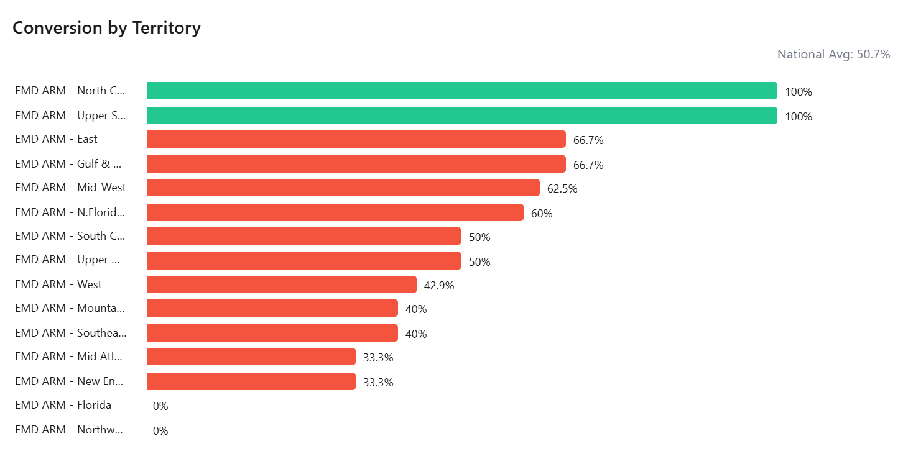

Slide 5
