Slide 1
Team & Operations
Generated: 09-Jul-2026 01:32 PM
Filters Applied: Period: This Month · Region: All · Territory: All · State: All · Payer: All · Primary Parent: All · Patient Type: All · Specialist: All · Status: All · Diagnosis Code: All

Slide 2
Key Performance Indicators
TOTAL CASES
5
OPEN CASES
5
100%
CLOSED RESOLVED
0
0%
CLOSED UNRESOLVED
0
0%
AVG DAYS TO RESOLVED
—

Slide 3
Specialist Scorecard
Specialist | Region | Cases | Open Cases | New PAT Open Cases | Existing PAT Open Cases | Closed Resolved | Closed Unresolved | Avg Days Resolved | Unresolved % | Closed ≤20 Days
chad.dawkins@jazzpharma.com | EMD ARM - Region | 1 | 1 | 0 | 0 | 0 | 0 | 0d | 0.0% | 0%
eric.winfree@jazzpharma.com | EMD ARM - Region | 2 | 2 | 0 | 1 | 0 | 0 | 134.0d | 0.0% | 0%
jerica.eco@jazzpharma.com | EMD ARM - Region | 2 | 2 | 0 | 1 | 0 | 0 | 513.0d | 0.0% | 0%

Slide 4
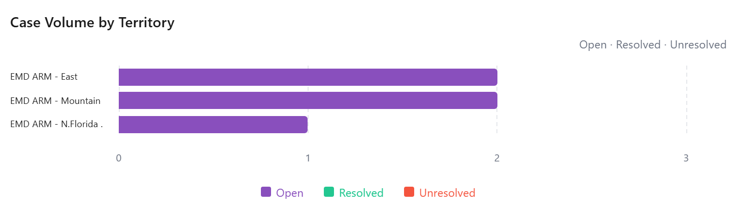

Slide 5
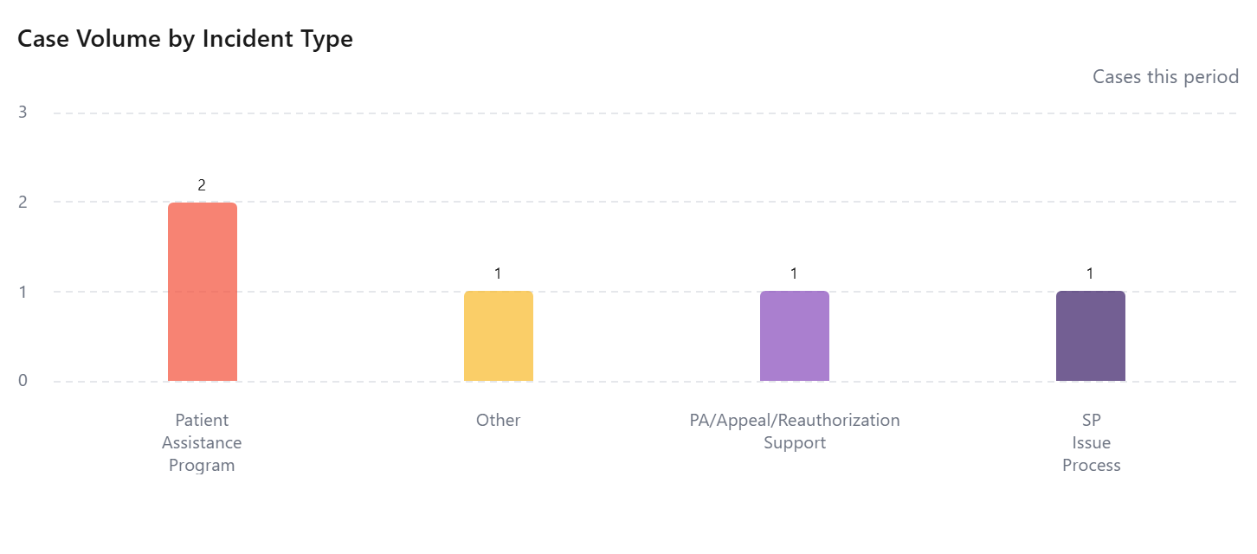

Slide 6
Case Turnaround by Territory
No data available

Slide 7
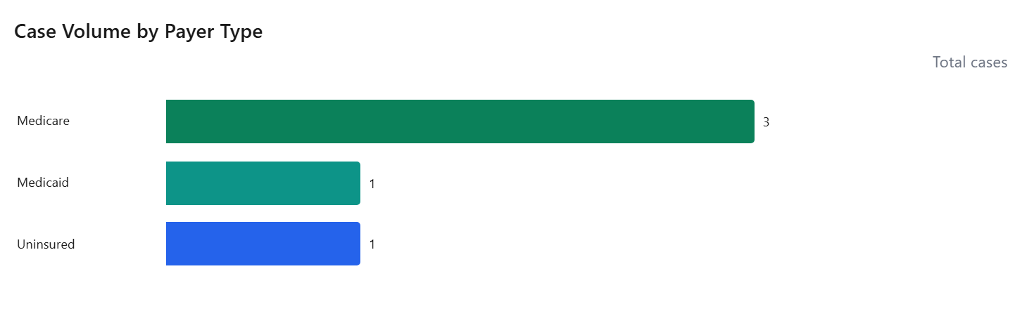

Slide 8
Did Not Fill Patient List
No data available

