Slide 1
Time to First Fill
Generated: 09-Jul-2026 01:30 PM
Filters Applied: Period: Specific Month(s) · Months: April 2025, March 2025, May 2025 ...1+ · Region: All · Territory: All · State: All · Payer: All · Primary Parent: All · Patient Type: All · Specialist: All · Status: All · Diagnosis Code: All

Slide 2
Key Performance Indicators
AVG TTFF
9 days
MEDIAN TTFF
8 days
FILLED <=15 DAYS
76.7%
PATIENTS >45 DAYS
0

Slide 3
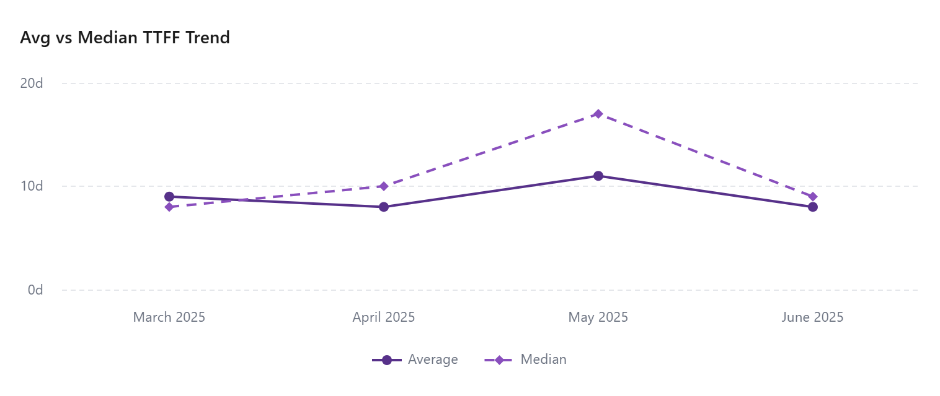

Slide 4
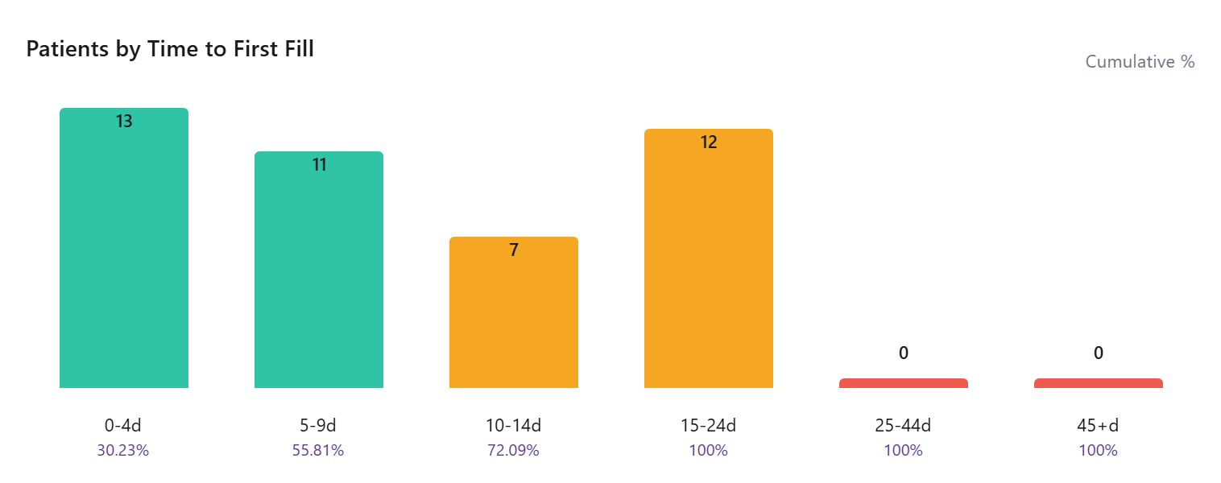

Slide 5
Time To First Fill By Payer
Payer | Patients | Avg TTFF | Median TTFF | % <=15 Days
Third Party | 34 | 10 | 11 | 41.18
State Medicaid | 1
Other | 1 | 5 | 5 | 100.00
Medicare Advantage | 1
Medicare | 16 | 9 | 9 | 37.50
Medicaid | 19 | 10 | 10 | 36.84
Managed Medicaid | 1
COMMERCIAL | 14 | 7 | 6 | 35.71
Cash | 3

Slide 6
Time To First Fill By Territory
Territory | Patients | Avg TTFF | Median TTFF | % <=15 Days
 | 21
EMD ARM - West | 7 | 8 | 5 | 28.57
EMD ARM - Upper Southeast | 3 | 6 | 5 | 100.00
EMD ARM - Upper Midwest | 6 | 10 | 11 | 33.33
EMD ARM - Southeast | 5 | 7 | 7 | 40.00
EMD ARM - South Central | 4 | 16 | 16 | 25.00
EMD ARM - Northwest | 4
EMD ARM - North Central | 2 | 11 | 11 | 50.00
EMD ARM - N.Florida & SC | 5 | 12 | 14 | 40.00
EMD ARM - New England | 3 | 10 | 10 | 33.33
EMD ARM - Mountain West | 5 | 10 | 10 | 20.00
EMD ARM - Mid-West | 8 | 5 | 4 | 62.50
EMD ARM - Mid Atlantic | 3 | 19 | 19 | 0.00
EMD ARM - Gulf & OK | 6 | 7 | 7 | 66.67
EMD ARM - Florida | 2
EMD ARM - East | 6 | 10 | 10 | 50.00

