Slide 1
Team & Operations
Generated: 10-Jun-2026 07:23 PM
Filters Applied: Period: This Month · Region: All · Territory: All · State: All · Payer: All · Primary Parent: All · Patient Type: All · Specialist: All · Status: Open

Slide 2
Key Performance Indicators
TOTAL CASES
18
OPEN CASES
18
100%
CLOSED RESOLVED
0
CLOSED UNRESOLVED
0
AVG DAYS TO RESOLVED
—

Slide 3
Specialist Scorecard
Specialist | Region | Cases | Conv % | TTFF | Aging Case % | Unresolved %
chad.dawkins@jazzpharma.com | EMD ARM - Region | 5 | 40.0% | 0.0d | 0.0% | 0.0%
eric.winfree@jazzpharma.com | EMD ARM - Region | 2 | 0.0% |  | 0.0% | 0.0%
greg.rechtenbach@jazzpharma.com | Unassigned | 2 | 50.0% | 85.0d | 0.0% | 0.0%
heather.dant@jazzpharma.com | EMD ARM - Region | 2 | 0.0% |  | 0.0% | 0.0%
jerica.eco@jazzpharma.com | EMD ARM - Region | 1 | 0.0% |  | 0.0% | 0.0%
luis.cruz@jazzpharma.com | EMD ARM - Region | 1 | 100.0% | 0.0d | 0.0% | 0.0%
mark.finnegan@jazzpharma.com | EMD ARM - Region | 1 | 100.0% | 26.0d | 0.0% | 0.0%
randall.unzicker@jazzpharma.com | EMD ARM - Region | 1 | 100.0% | 0.0d | 0.0% | 0.0%
tracy.scott@jazzpharma.com | EMD ARM - Region | 1 | 100.0% | 0.0d | 0.0% | 0.0%
Unassigned | Unassigned | 2 | 0.0% |  | 0.0% | 0.0%

Slide 4
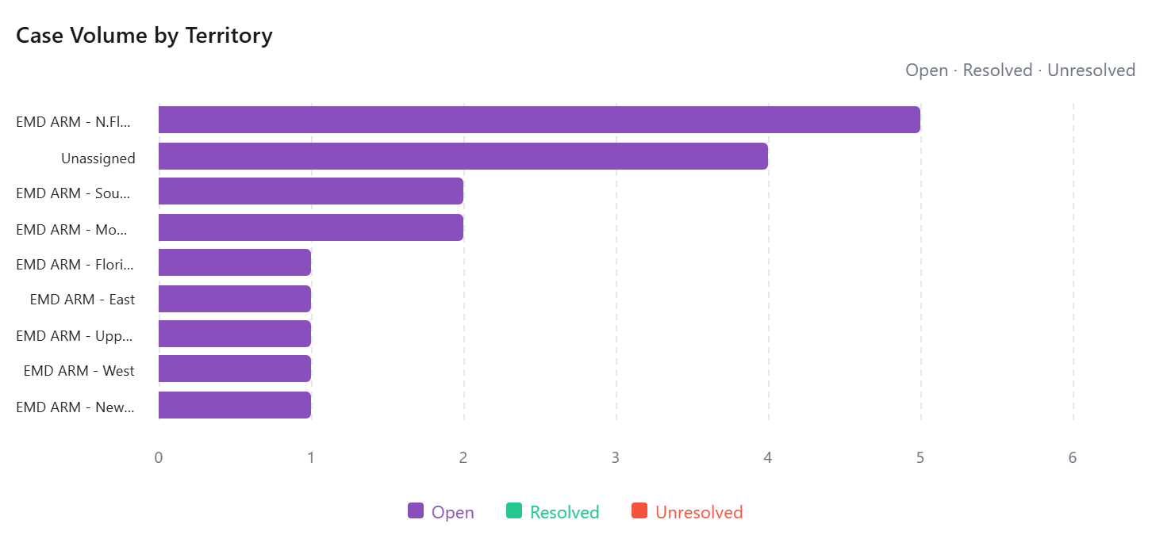
Case Volume by Territory

Slide 5
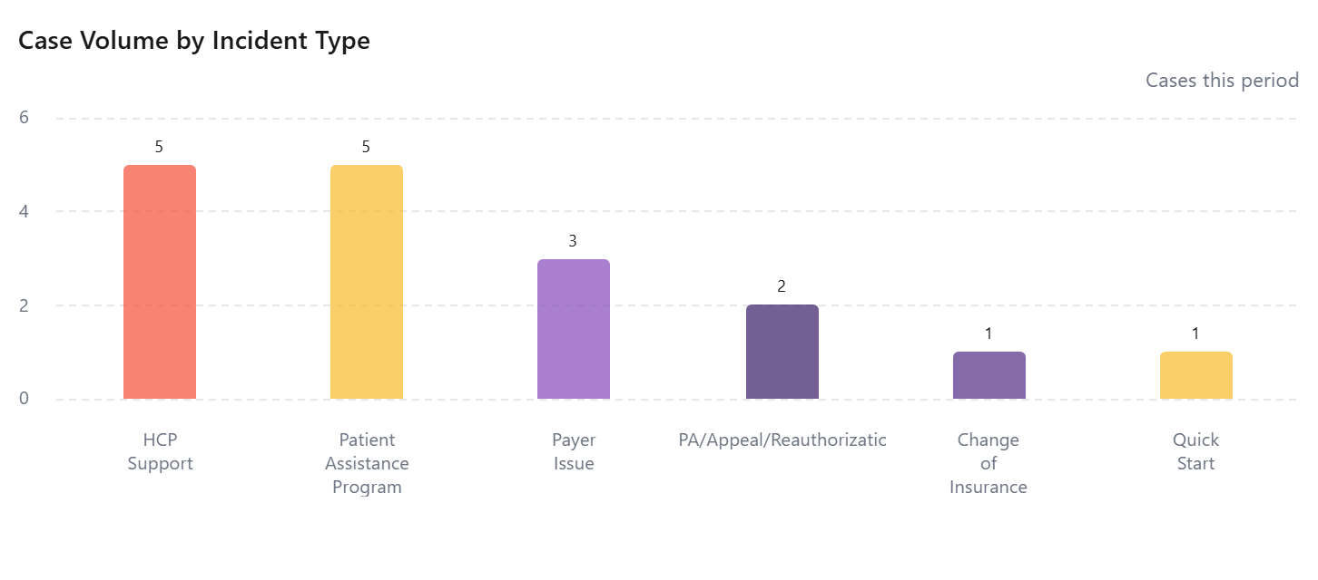
Incident Type Breakdown

Slide 6
Case Turnaround by Territory
No data available

Slide 7
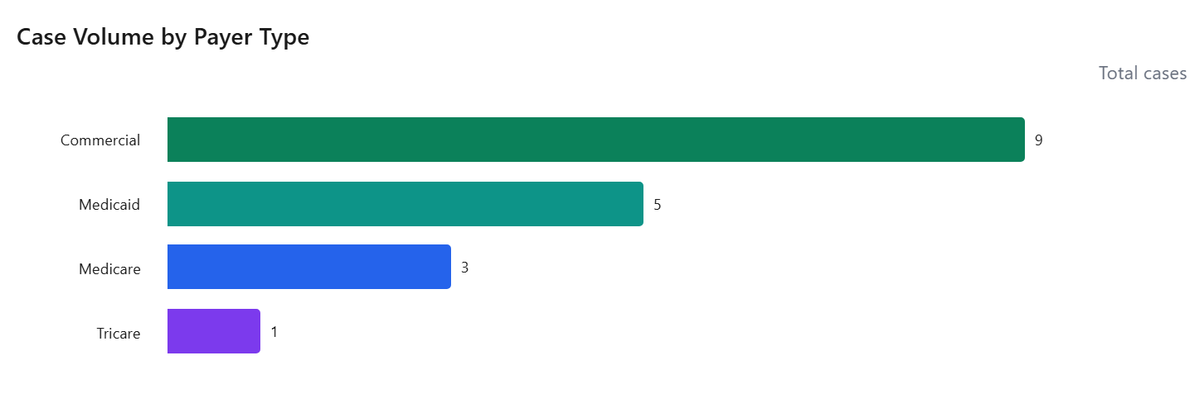
Case Volume by Payer Type

Slide 8
Did Not Fill Patient List
No data available

