Slide 1
Time to First Fill
Generated: 07-Jul-2026 10:55 PM
Filters Applied: Period: Specific Month(s) · Months: April 2025, March 2025 · Region: All · Territory: All · State: All · Payer: All · Primary Parent: All · Patient Type: All · Specialist: All · Status: All · Diagnosis Code: All

Slide 2
Key Performance Indicators
AVG TTFF
9 days
MEDIAN TTFF
10 days
FILLED ≤15 DAYS
81.3%
PATIENTS >45 DAYS
0

Slide 3
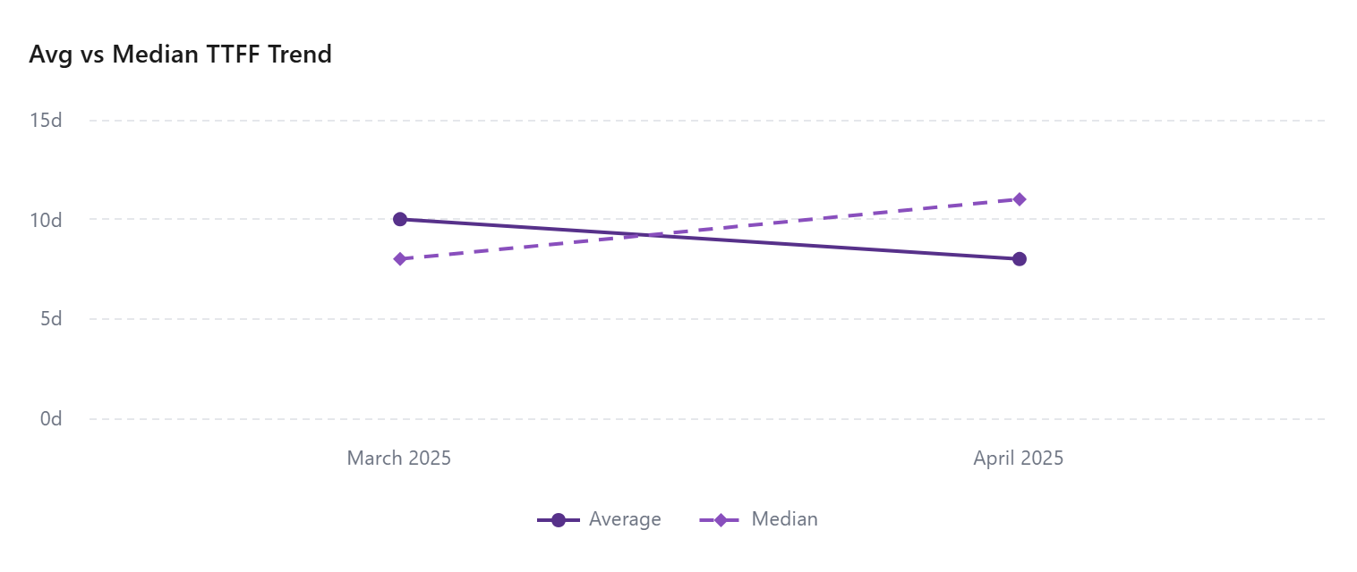
Avg & Median Time to First Fill

Slide 4
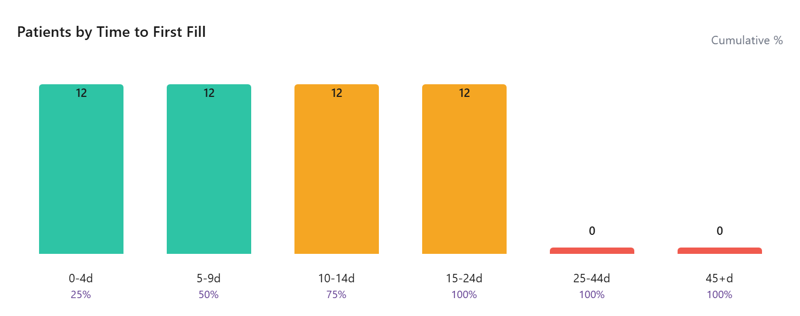
Patients by Time to First Fill

Slide 5
Time To First Fill By Payer
Payer | Avg TTFF | Median TTFF | Filled ≤15 Days | Patients
UNSPECIFIED | 8 | 7 | 50.00 | 48
UnitedHealth Group, Inc. | 7 | 7 | 100.00 | 1
UCARE - EXPRESS |  |  |  | 1
TEXAS MEDICAID |  |  |  | 1
Quartz Health | 12 | 12 | 100.00 | 1
ProAct | 19 | 19 | 0.00 | 1
PRIORITY HEALTH OF MI-ESI | 11 | 11 | 100.00 | 1
Premera Blue Cross | 15 | 15 | 100.00 | 1
OptumRx | 18 | 18 | 0.00 | 1
MedImpact | 10 | 10 | 100.00 | 1
Medica | 15 | 15 | 100.00 | 1
MEDCO HOME DELIVERY | 10 | 10 | 100.00 | 1
MAGNOLIA HEALTH PLAN - ESI | 6 | 6 | 100.00 | 1
Kaiser Permanente |  |  |  | 1
Independence Blue Cross | 5 | 5 | 100.00 | 1
EMPOWER PASSE ARKANSAS-ESI | 2 | 2 | 100.00 | 1
CVS Health | 9 | 9 | 100.00 | 2
COMMUNITY HLTH PLAN WA - EXP SCRIPT | 1 | 1 | 100.00 | 1
Community Health Network of Washington | 11 | 11 | 100.00 | 1
CerpassRx | 20 | 20 | 0.00 | 1
CAREMARK / PROVIDENT PREFERRED PLUS | 19 | 19 | 0.00 | 1
CAPITAL RX-RELAYHEALTH |  |  |  | 1

Slide 6
Payer | Avg TTFF | Median TTFF | Filled ≤15 Days | Patients
BlueCross BlueShield of Tennessee | 6 | 6 | 100.00 | 1

Slide 7
Time To First Fill By Territory
Territory | Avg TTFF | Median TTFF | Filled ≤15 Days | Patients
 |  |  |  | 23
EMD ARM - West | 1 | 1 | 33.33 | 3
EMD ARM - Upper Southeast | 2 | 2 | 100.00 | 1
EMD ARM - Upper Midwest | 12 | 12 | 50.00 | 4
EMD ARM - Southeast | 1 | 1 | 50.00 | 2
EMD ARM - South Central | 13 | 13 | 100.00 | 2
EMD ARM - Northwest | 19 | 19 | 0.00 | 3
EMD ARM - North Central | 8 | 5 | 71.43 | 7
EMD ARM - N.Florida & SC | 4 | 4 | 100.00 | 2
EMD ARM - New England | 9 | 9 | 50.00 | 2
EMD ARM - Mountain West | 7 | 7 | 66.67 | 3
EMD ARM - Mid-West | 8 | 10 | 100.00 | 5
EMD ARM - Mid Atlantic | 9 | 9 | 100.00 | 2
EMD ARM - Gulf & OK | 10 | 7 | 33.33 | 6
EMD ARM - Florida | 13 | 14 | 75.00 | 4
EMD ARM - East | 19 | 19 | 0.00 | 2

