Slide 1
Conversion
Generated: 09-Jul-2026 03:18 PM
Filters Applied: Period: Specific Month(s) · Months: December 2025, November 2025, October 2025 ...7+ · Region: All · Territory: All · State: All · Payer: All · Primary Parent: All · Patient Type: All · Specialist: All · Status: All · Diagnosis Code: All

Slide 2
Key Performance Indicators
CONVERSION RATE
50.7%
ELIGIBLE PATIENTS
96
DID NOT FILL
49
FILLED <=15 DAYS
38.5%

Slide 3
12-Month Conversion Trend
No data available

Slide 4
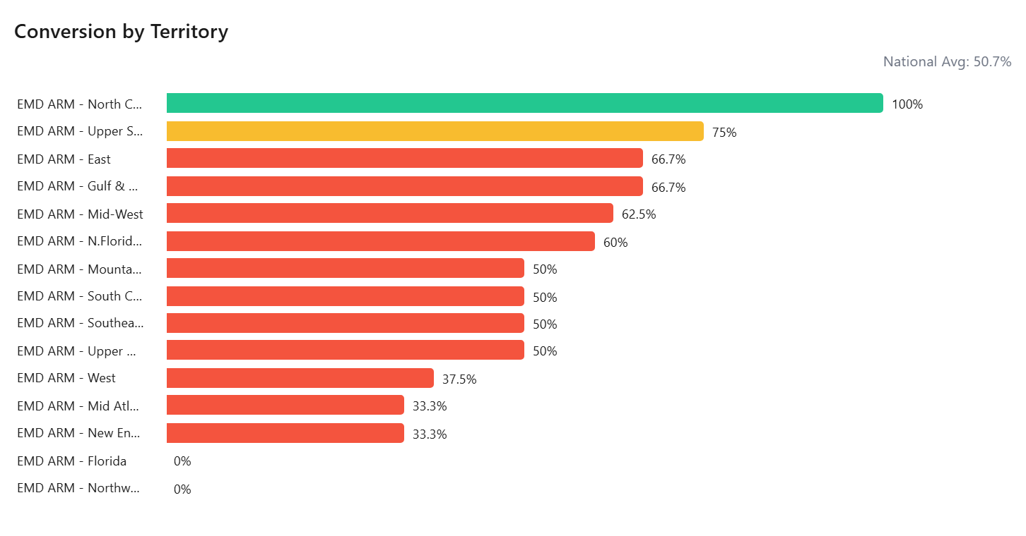

Slide 5
