Slide 1
Time to First Fill
Generated: 09-Jul-2026 03:17 PM
Filters Applied: Period: Specific Month(s) · Months: March 2025, April 2025, June 2025 ...5+ · Region: All · Territory: All · State: All · Payer: All · Primary Parent: All · Patient Type: All · Specialist: All · Status: All · Diagnosis Code: All

Slide 2
Key Performance Indicators
AVG TTFF
10 days
MEDIAN TTFF
9 days
FILLED <=15 DAYS
79.9%
PATIENTS >45 DAYS
0

Slide 3
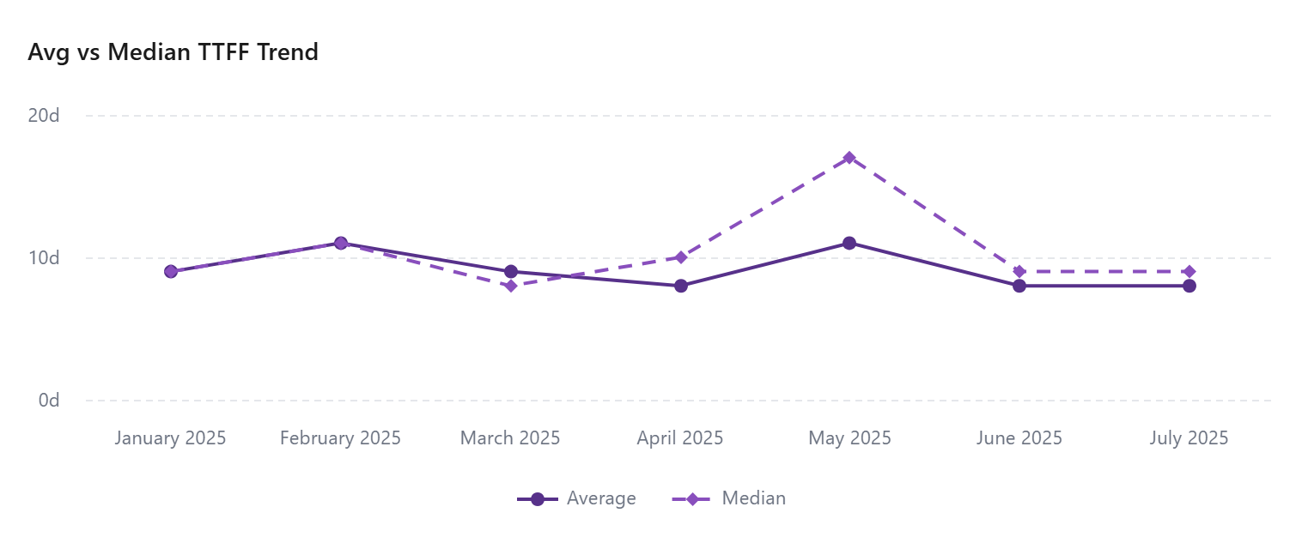

Slide 4
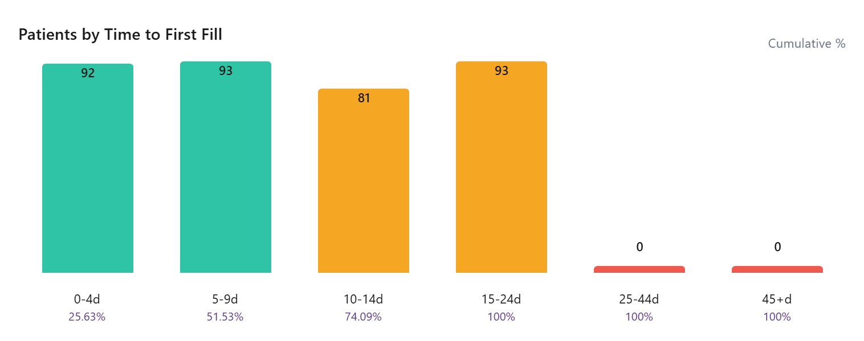

Slide 5
Time To First Fill By Payer
Payer | Patients | Avg TTFF | Median TTFF | % <=15 Days
UNSPECIFIED | 6 | 15 | 14 | 33.33
TRICARE | 1 | 10 | 10 | 100.00
Third Party | 252 | 10 | 9 | 40.48
State Medicaid | 8 | 12 | 12 | 37.50
State Assistance | 1
Other | 14 | 11 | 11 | 28.57
Medicare Part A | 7 | 12 | 12 | 28.57
Medicare Advantage | 1
Medicare | 159 | 9 | 8 | 40.88
Medicaid | 141 | 9 | 9 | 39.72
Managed Medicaid | 5
Health Exchange | 1
COMMERCIAL | 150 | 10 | 11 | 31.33
Cash | 10 | 13 | 15 | 20.00
Assistance Program | 6 | 8 | 8 | 50.00

Slide 6
Time To First Fill By Territory
Territory | Patients | Avg TTFF | Median TTFF | % <=15 Days
 | 243
EMD ARM - West | 40 | 9 | 6 | 37.50
EMD ARM - Upper Southeast | 28 | 10 | 9 | 39.29
EMD ARM - Upper Midwest | 42 | 11 | 11 | 30.95
EMD ARM - Southeast | 43 | 10 | 12 | 41.86
EMD ARM - South Central | 29 | 10 | 10 | 41.38
EMD ARM - Northwest | 32 | 11 | 12 | 37.50
EMD ARM - North Central | 31 | 8 | 6 | 35.48
EMD ARM - N.Florida & SC | 43 | 10 | 9 | 37.21
EMD ARM - New England | 27 | 11 | 10 | 29.63
EMD ARM - Mountain West | 22 | 9 | 7 | 50.00
EMD ARM - Mid-West | 47 | 7 | 6 | 46.81
EMD ARM - Mid Atlantic | 30 | 13 | 14 | 23.33
EMD ARM - Gulf & OK | 37 | 9 | 9 | 37.84
EMD ARM - Florida | 33 | 10 | 9 | 39.39
EMD ARM - East | 35 | 9 | 7 | 45.71

