Slide 1
Team & Operations
Generated: 13-Jul-2026 01:48 PM
Filters Applied: Period: Last Month · Region: All · Territory: All · State: All · Payer: All · Primary Parent: All · Patient Type: All · Specialist: All · Status: All

Slide 2
Key Performance Indicators
TOTAL CASES
32
OPEN CASES
16
50%
CLOSED RESOLVED
9
28.1%
CLOSED UNRESOLVED
7
21.9%
AVG DAYS TO RESOLVED
18.7

Slide 3
Specialist Scorecard
Specialist | Region | Cases | Open Cases | New PAT Open Cases | Existing PAT Open Cases | Closed Resolved | Closed Unresolved | Avg Days Resolved | Unresolved % | Closed ≤20 Days
chad.dawkins@jazzpharma.com | EMD ARM - Region | 11 | 6 | 0 | 5 | 3 | 2 | 185.0d | 18.2% | 60.0%
eric.winfree@jazzpharma.com | EMD ARM - Region | 3 | 1 | 0 | 1 | 1 | 1 | 143.0d | 33.3% | 100.0%
greg.rechtenbach@jazzpharma.com | Unassigned | 1 | 1 | 0 | 1 | 0 | 0 | 0d | 0.0% | 0%
heather.dant@jazzpharma.com | EMD ARM - Region | 3 | 1 | 0 | 1 | 2 | 0 | 0d | 0.0% | 100.0%
jerica.eco@jazzpharma.com | EMD ARM - Region | 1 | 1 | 0 | 1 | 0 | 0 | 517.0d | 0.0% | 0%
joanna.janota@jazzpharma.com | EMD ARM - Region | 3 | 1 | 0 | 1 | 1 | 1 | 202.0d | 33.3% | 100.0%
julie.leach@jazzpharma.com | EMD ARM - Region | 1 | 0 | 0 | 0 | 0 | 1 | 205.0d | 100.0% | 100.0%
luis.cruz@jazzpharma.com | EMD ARM - Region | 1 | 1 | 0 | 1 | 0 | 0 | 187.0d | 0.0% | 0%
mark.finnegan@jazzpharma.com | EMD ARM - Region | 1 | 1 | 0 | 1 | 0 | 0 | 0d | 0.0% | 0%
randall.unzicker@jazzpharma.com | EMD ARM - Region | 1 | 0 | 0 | 0 | 1 | 0 | 0d | 0.0% | 0.0%
tracy.scott@jazzpharma.com | EMD ARM - Region | 1 | 0 | 0 | 0 | 1 | 0 | 205.0d | 0.0% | 100.0%
Unassigned | Unassigned | 5 | 3 | 0 | 3 | 0 | 2 | 492.0d | 40.0% | 100.0%

Slide 4
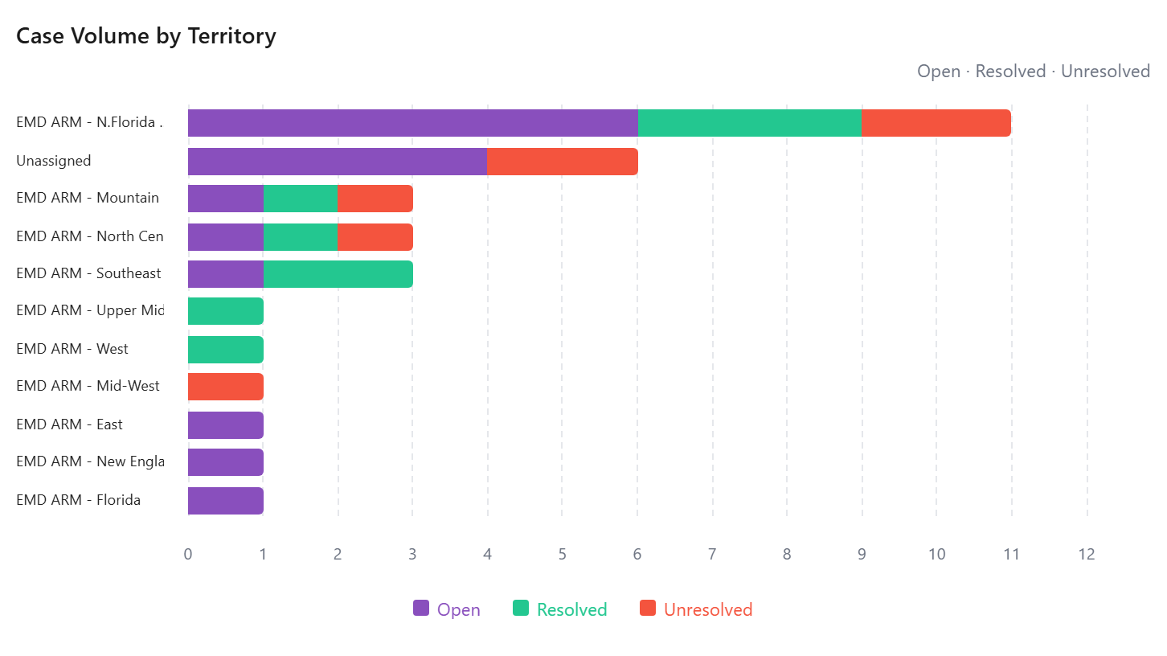
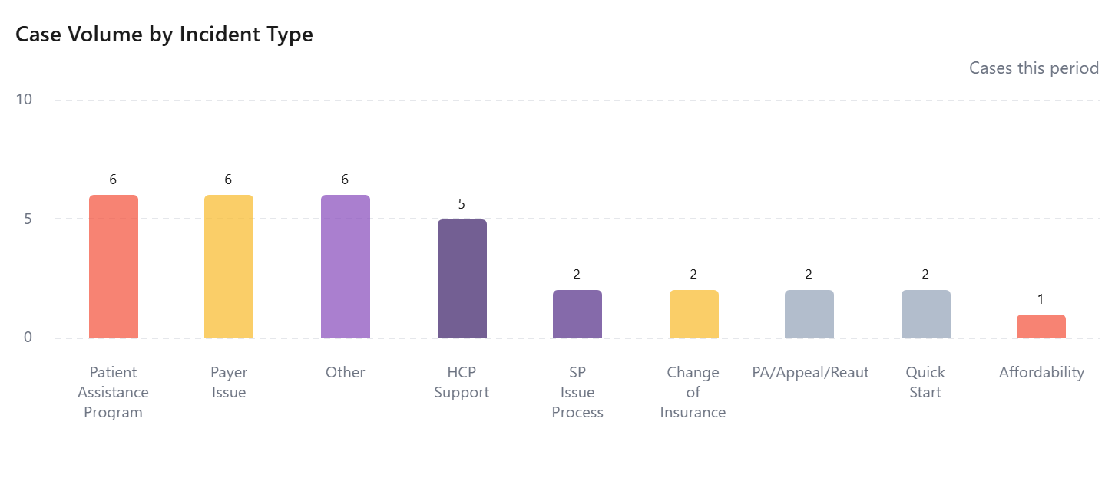
Case Volume by Territory
Incident Type Breakdown

Slide 5
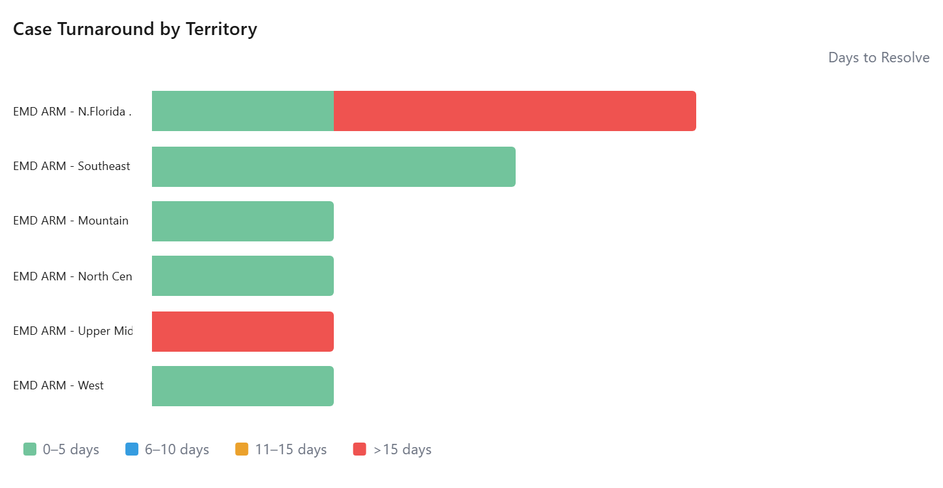
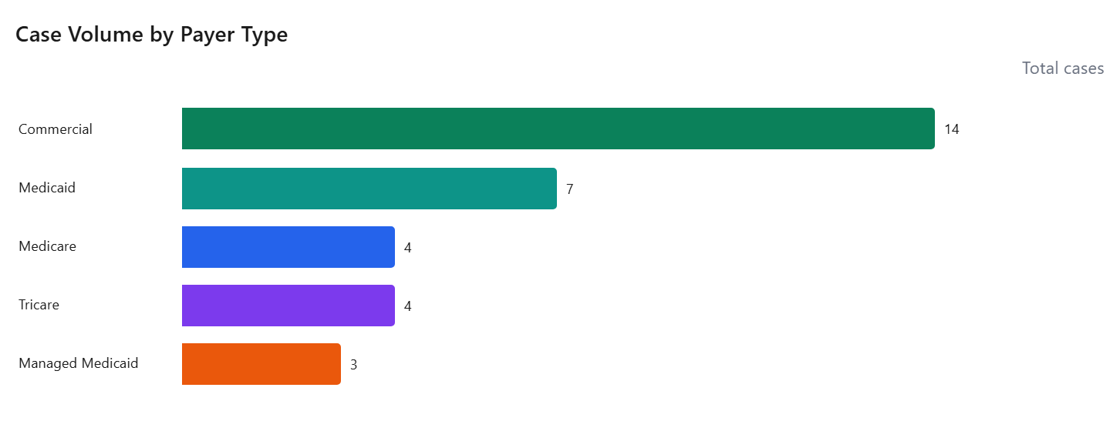
Case Turnaround by Territory
Case Volume by Payer Type

Slide 6
Did Not Fill Patient List
No data available

