Slide 1
Refill & Persistency
Generated: 13-Jul-2026 05:16 PM
Filters: Period: Last Month · Region: All · Territory: All · State: All · Payer: All · Primary Parent: All · Patient Type: All · Specialist: All · Status: All · Diagnosis Code: All
Key Performance Indicators
REFILL ON-TIME RATE
18.9%
PERSISTENCY (12-MONTH)
83.3%
DISCONTINUATION RATE
—
CANCELLATION RATE
—

Slide 2
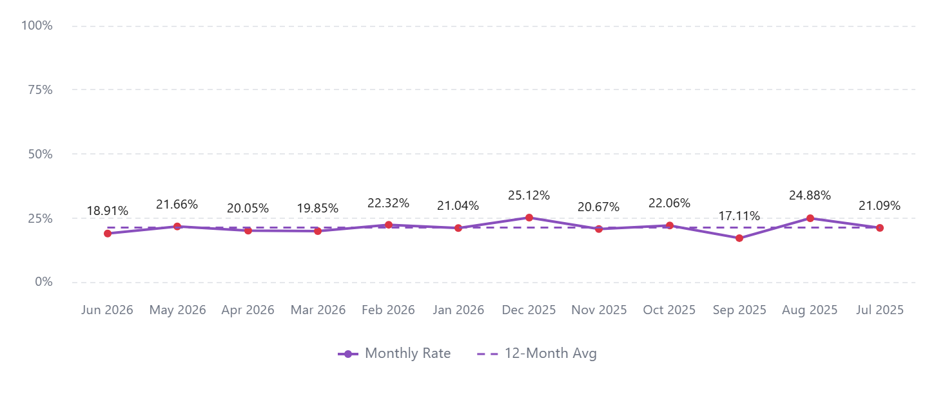
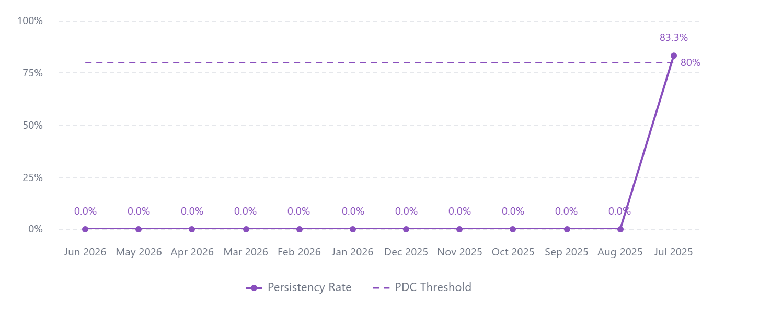
Refill On-Time Rate (12-Month Trend)
Patients on Therapy (12-Month Trend)

Slide 3
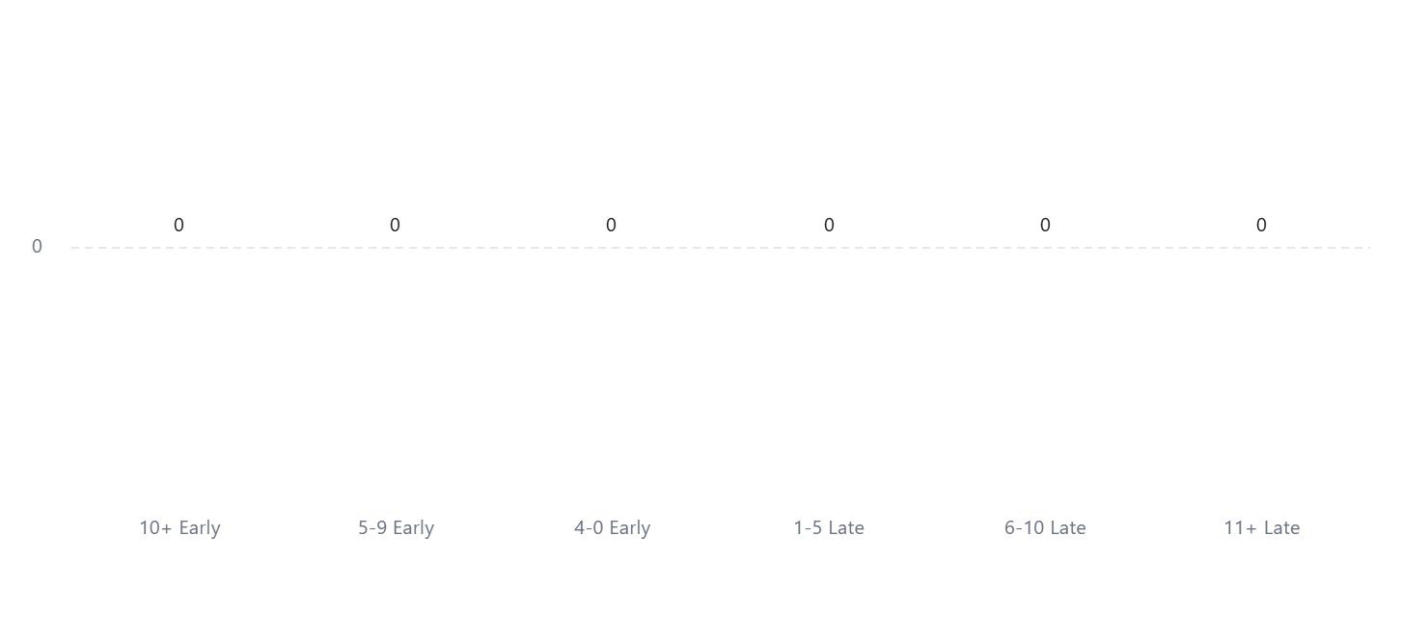
Shipments by Time to Refill
Discontinued Patients by Territory
No data available

