Slide 1
Time to First Fill
Generated: 13-Jul-2026 08:03 PM
Filters: Period: Specific Month(s) · Months: July 2025, June 2025, May 2025 ...3+ · Region: All · Territory: All · State: All · Payer: All · Primary Parent: All · Patient Type: All · Specialist: All · Status: All · Diagnosis Code: All
Key Performance Indicators
AVG TTFF
10 days
MEDIAN TTFF
10 days
FILLED <=15 DAYS
74.8%
PATIENTS >45 DAYS
0

Slide 2
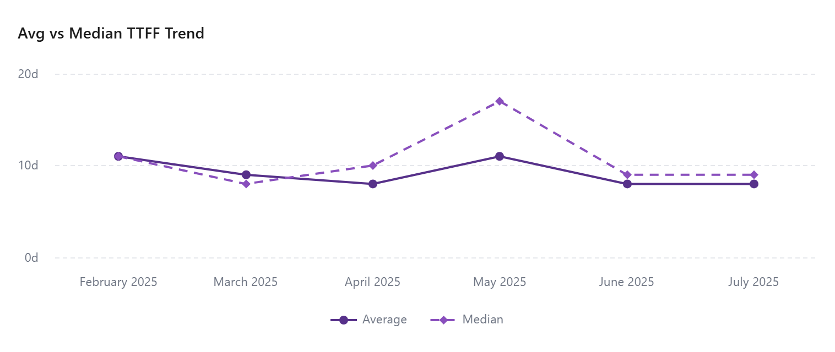
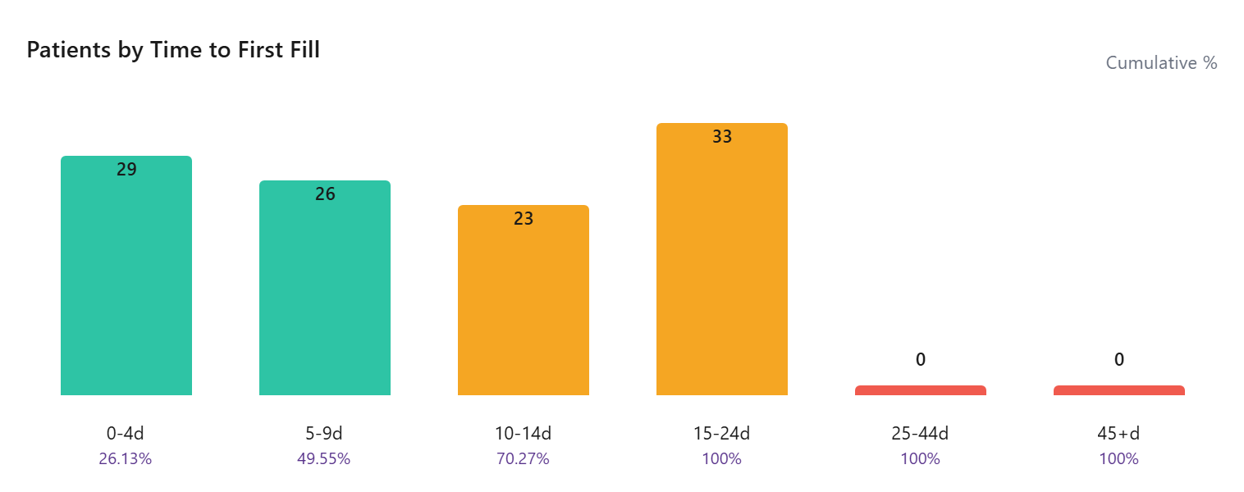

Slide 3
Time To First Fill By Payer
Payer | Patients | Avg TTFF | Median TTFF | % <=15 Days
Third Party | 84 | 10 | 10 | 38.10
State Medicaid | 2
Other | 4 | 9 | 9 | 50.00
Medicare Part A | 3 | 7 | 7 | 33.33
Medicare Advantage | 1
Medicare | 49 | 10 | 10 | 36.73
Medicaid | 42 | 10 | 10 | 33.33
Managed Medicaid | 1
COMMERCIAL | 46 | 10 | 8 | 28.26
Cash | 8 | 11 | 13 | 25.00
Assistance Program | 2 | 4 | 4 | 50.00

Slide 4
Time To First Fill By Territory
Territory | Patients | Avg TTFF | Median TTFF | % <=15 Days
 | 77
EMD ARM - West | 16 | 10 | 11 | 25.00
EMD ARM - Upper Southeast | 7 | 10 | 9 | 57.14
EMD ARM - Upper Midwest | 16 | 9 | 11 | 25.00
EMD ARM - Southeast | 15 | 9 | 7 | 53.33
EMD ARM - South Central | 10 | 13 | 15 | 20.00
EMD ARM - Northwest | 6 | 17 | 17 | 0.00
EMD ARM - North Central | 8 | 9 | 7 | 62.50
EMD ARM - N.Florida & SC | 15 | 11 | 11 | 40.00
EMD ARM - New England | 9 | 10 | 11 | 44.44
EMD ARM - Mountain West | 12 | 8 | 6 | 41.67
EMD ARM - Mid-West | 16 | 7 | 5 | 43.75
EMD ARM - Mid Atlantic | 6 | 19 | 19 | 0.00
EMD ARM - Gulf & OK | 13 | 7 | 7 | 46.15
EMD ARM - Florida | 8 | 12 | 12 | 12.50
EMD ARM - East | 8 | 11 | 12 | 37.50

