Slide 1
Conversion
Generated: 09-Jul-2026 12:57 PM
Filters Applied: Period: This Month · Region: All · Territory: All · State: All · Payer: All · Primary Parent: All · Patient Type: All · Specialist: All · Status: All · Diagnosis Code: All

Slide 2
Key Performance Indicators
CONVERSION RATE
—
ELIGIBLE PATIENTS
0
DID NOT FILL
0
FILLED <=15 DAYS
—

Slide 3
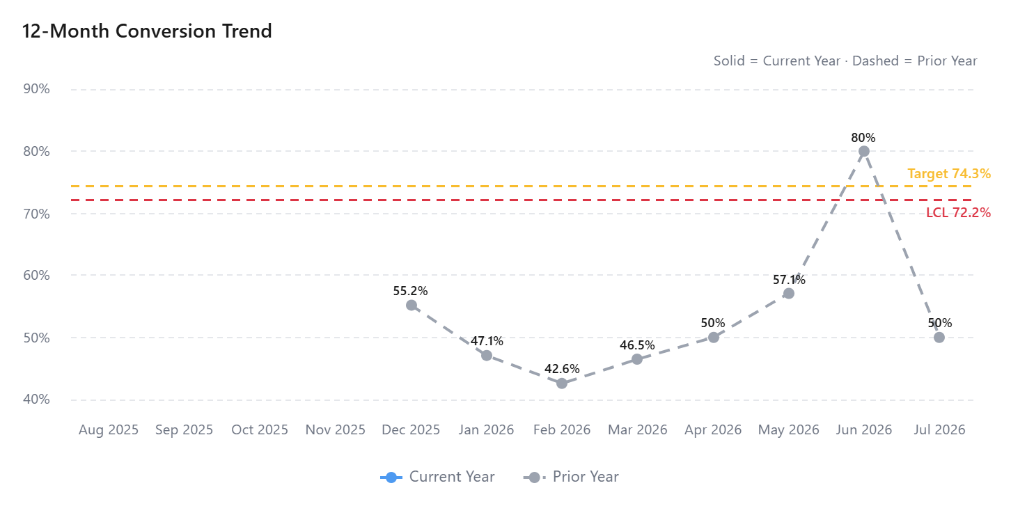

Slide 4
Conversion by Territory
No data available

Slide 5
Did Not Fill by Outcome
No data available

