Slide 1
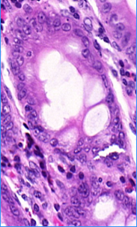
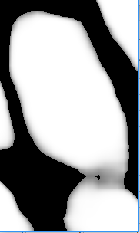
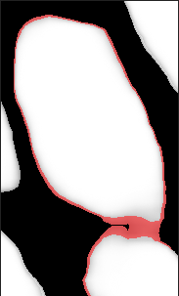
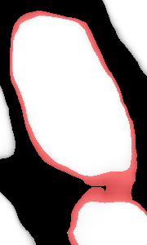
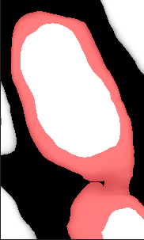


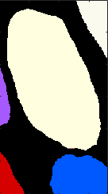

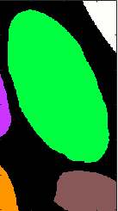




image
objectness map
ground truth
$$τ_{1}=0.5$$
$$τ_{2}=0.5$$
$$τ_{1}=0.3$$
$$τ_{2}=0.7$$
$τ_{1}=0.1$
$$τ_{2}=0.9$$
$τ_{1}=0.01$
$$τ_{2}=0.99$$

