Slide 1
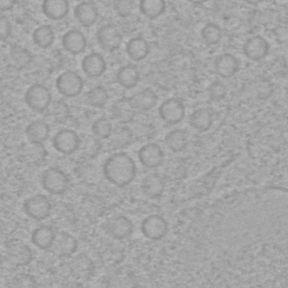
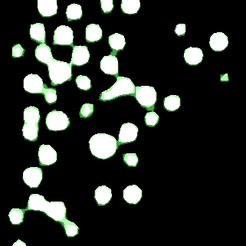
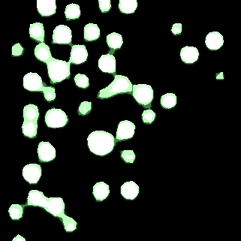


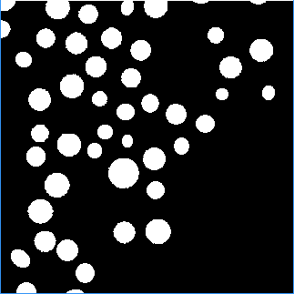
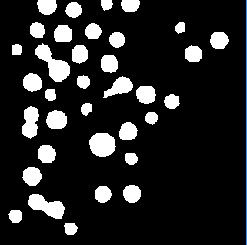
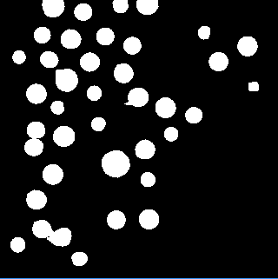
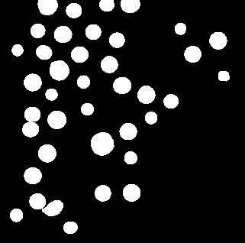





1361
(a) Image
(b) $τ_{1}=0.5, τ_{2}=0.6$
(c) $τ_{1}=0.4, τ_{2}=0.7$
(d) $τ_{1}=0.3, τ_{2}=0.8$
(e) $τ_{1}=0.2, τ_{2}=0.9$

