Slide 1
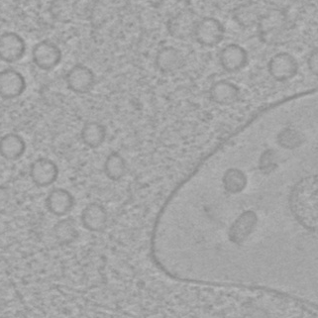
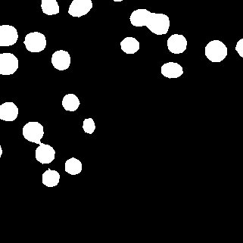
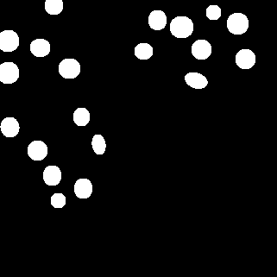



1081
conv
joint
max pooling
(c) $O_{aux}$
1
(e) $O_{aux}$
2
conv
conv
optimizing
(a) Input Image
(b) shared feature maps
(d) $O_{seg}$
(f) Final Segmentation

