Slide 1
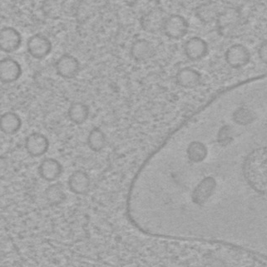
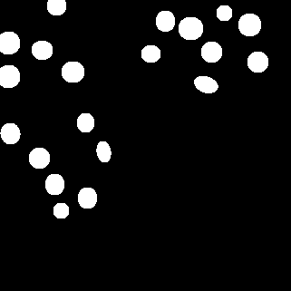


conv
objectness
score
conv
conv
joint
max pooling
shape
generation
feature
maps
shape
depiction
shape
depiction
ϴ, $x_{c},y_{c}, a, b$
ϴ, $x_{c},y_{c}, a, b$
(a) Input Image
(b) Intermediate Output
(c) Raw Segmentation Map
(d) Final Segmentation

