Slide 1

Python basics II.
JSON, subprocess

Slide 2
JSON - JavaScript Object Notation
Segédlet: https://realpython.com/python-json/
{
"firstName": "Jane",
"lastName": "Doe",
"hobbies": ["running", "sky diving", "singing"],
"age": 35,
"children": [
{
"firstName": "Alice",
"age": 6
},
{
"firstName": "Bob",
"age": 8
}
]
}

Slide 3
JSON & Python – import json
Dump JSON object to JSON file
import json
data = {
"president": {
"name": "Zaphod Beeblebrox",
"species": "Betelgeusian"
}
}
with open("data_file.json", "w") as write_file:
json.dump(data, write_file)
JSON string from a JSON object
json_string = json.dumps(data)

Slide 4
JSON & Python – Type association during serialization
Python | JSON
dict | object
list, tuple | array
str | string
int, long, float | number
True | true
False | false
None | null

Slide 5
JSON & Python – Type association during deserialization
JSON | Python
object | dict
array | list
string | str
number (int) | int
number (real) | float
true | True
false | False
null | None

Slide 6
JSON & Python – JSON files
Read JSON object from a JSON file
import json
with open("data_file.json", "r") as read_file:
data = json.load(read_file)
print( data["president"]["name"] )

Slide 7
JSON & Python – JSON files
import json
json_string = """
{
"researcher": {
"name": "Ford Prefect",
"species": "Betelgeusian",
"relatives": [
{
"name": "Zaphod Beeblebrox",
"species": "Betelgeusian"
}
]
}
}
"""
data = json.loads(json_string)
for rel in data["researcher"]["relatives"]:
print('Name: %s (%s)' % ( rel["name"], rel["species"] ) )

Slide 8
Subprocess calls and shell commands
If the output is not needed
import subprocess
subprocess.call(['df', '-h']) # run(…) in new version
If we need the output
import subprocess
p = subprocess.Popen(["echo", "hello world"], stdout=subprocess.PIPE)
print(p.communicate()) # results a tuple (stdout, stderr)
# ('hello world', None)
Sometimes shell=True parameter is needed.
Help:
https://docs.python.org/3/library/subprocess.html
https://www.pythonforbeginners.com/os/subprocess-for-system-administrators

Slide 9
subprocess – PIPE handling
Expected output: dmesg | grep hda
from subprocess import PIPE, Popen
p1 = Popen(["dmesg"], stdout=PIPE)
p2 = Popen(["grep", "hda"], stdin=p1.stdout, stdout=PIPE)
p1.stdout.close() # Allow p2 to receive a SIGPIPE if p1 exits.
output = p2.communicate()[0]

Slide 10
subprocess – wait for process finish
Check process status
from subprocess import PIPE, Popen
import time
p1 = Popen(["ping", '-n', '20', 'berkeley.edu'], stdout=PIPE)
while p1.poll()==None:
print(" still running " )
time.sleep(1)
Wait until process finishes
p1 = Popen(["ping", '-n', '20', 'berkeley.edu'], stdout=PIPE)
p1.wait() # wait till the end

Slide 11
Network tools I.
traceroute, ping

Slide 12
traceroute (linux) – tracert (windows)
The goal is to get network route to a destination
Linux
lakis@dpdk-pktgen:~$ traceroute berkeley.edu
traceroute to berkeley.edu (35.163.72.93), 30 hops max, 60 byte packets
1 192.168.0.192 (192.168.0.192) 0.292 ms 0.344 ms 0.390 ms
2 ikoktatok-gate.inf.elte.hu (157.181.167.254) 1.251 ms 1.250 ms 1.265 ms
3 taurus.centaur-taurus.elte.hu (157.181.126.134) 5.180 ms 5.267 ms 5.325 ms
4 fw1.firewall.elte.hu (157.181.141.145) 1.271 ms 1.358 ms 1.299 ms
5 taurus.fw1.fw.backbone.elte.hu (192.153.18.146) 5.626 ms 5.356 ms 5.395 ms
6 rtr.hbone-elte.elte.hu (157.181.141.9) 2.229 ms 1.245 ms 1.749 ms
7 tg0-0-0-14.rtr2.vh.hbone.hu (195.111.100.47) 2.377 ms 2.415 ms 2.407 ms
8 be1.rtr1.vh.hbone.hu (195.111.96.56) 1.945 ms 1.642 ms 1.877 ms
9 bpt-b4-link.telia.net (80.239.195.56) 1.626 ms 1.581 ms 1.097 ms
10 win-bb2-link.telia.net (62.115.143.116) 196.574 ms win-bb2-link.telia.net (213.155.137.38) 196.993 ms win-bb2-link.telia.net (213.155.135.222) 180.071 ms
11 ffm-bb4-link.telia.net (62.115.133.79) 199.425 ms 199.232 ms *
12 * * *
13 prs-bb3-link.telia.net (62.115.137.114) 180.494 ms 179.986 ms *
14 sjo-b21-link.telia.net (62.115.119.229) 197.252 ms 197.249 ms 197.264 ms
15 * a100row-ic-300117-sjo-b21.c.telia.net (213.248.87.118) 196.555 ms *
16 nyk-bb4-link.telia.net (62.115.142.222) 180.081 ms 54.240.242.148 (54.240.242.148) 200.986 ms 54.240.242.88 (54.240.242.88) 201.877 ms
17 54.240.242.161 (54.240.242.161) 200.935 ms * *
18 * * *
19 * * *

Slide 13
traceroute (linux) – tracert (windows)
The goal is to get network route to a destination
C:\Users\laki>tracert berkeley.edu
Tracing route to berkeley.edu [35.163.72.93]
over a maximum of 30 hops:
1 1 ms <1 ms <1 ms dlinkrouter [192.168.0.1]
2 24 ms 6 ms 60 ms 10.0.0.85
3 54 ms 18 ms 13 ms fibhost-66-110-33.fibernet.hu [85.66.110.33]
4 13 ms 14 ms 13 ms ae0.info-c1.invitech.hu [213.163.54.245]
5 13 ms 12 ms 17 ms te0-0-2-3.nr11.b020698-1.bud01.atlas.cogentco.com [149.6.182.13]
6 13 ms 13 ms 16 ms te0-0-2-1.agr11.bud01.atlas.cogentco.com [154.25.3.237]
7 15 ms 13 ms 12 ms be3272.ccr31.bud01.atlas.cogentco.com [154.54.59.197]
8 17 ms 16 ms 19 ms be3263.ccr22.bts01.atlas.cogentco.com [154.54.59.177]
9 22 ms 22 ms 21 ms be3045.ccr21.prg01.atlas.cogentco.com [154.54.59.105]
10 29 ms 30 ms 27 ms be3027.ccr41.ham01.atlas.cogentco.com [130.117.1.205]
11 41 ms 36 ms 41 ms be2815.ccr41.ams03.atlas.cogentco.com [154.54.38.205]
12 134 ms 136 ms 133 ms be12194.ccr41.lon13.atlas.cogentco.com [154.54.56.93]
13 133 ms 136 ms 132 ms be2982.ccr31.bos01.atlas.cogentco.com [154.54.1.117]
14 135 ms 134 ms 137 ms be3599.ccr21.alb02.atlas.cogentco.com [66.28.4.237]
15 134 ms 134 ms 135 ms be2878.ccr21.cle04.atlas.cogentco.com [154.54.26.129]
16 136 ms 136 ms 134 ms be2717.ccr41.ord01.atlas.cogentco.com [154.54.6.221]
17 148 ms 147 ms 146 ms be2831.ccr21.mci01.atlas.cogentco.com [154.54.42.165]
18 158 ms 159 ms 159 ms be3035.ccr21.den01.atlas.cogentco.com [154.54.5.89]
19 168 ms 169 ms 167 ms be3037.ccr21.slc01.atlas.cogentco.com [154.54.41.145]
20 183 ms 183 ms 183 ms be3109.ccr21.sfo01.atlas.cogentco.com [154.54.44.137]
21 186 ms 187 ms 184 ms be3669.ccr41.sjc03.atlas.cogentco.com [154.54.43.10]
22 184 ms 186 ms 185 ms 38.88.224.218
23 * * * Request timed out.
24 * * * Request timed out.
25 * * * Request timed out.
Windows

Slide 14
Ping to chech the awailability of a host, and measure Round Trip Time (RTT)
Linux
lakis@dpdk-pktgen:~$ ping -c 3 berkeley.edu
PING berkeley.edu (35.163.72.93) 56(84) bytes of data.
64 bytes from ec2-35-163-72-93.us-west-2.compute.amazonaws.com (35.163.72.93): icmp_seq=1 ttl=23 time=194 ms
64 bytes from ec2-35-163-72-93.us-west-2.compute.amazonaws.com (35.163.72.93): icmp_seq=2 ttl=23 time=194 ms
64 bytes from ec2-35-163-72-93.us-west-2.compute.amazonaws.com (35.163.72.93): icmp_seq=3 ttl=23 time=193 ms
--- berkeley.edu ping statistics ---
3 packets transmitted, 3 received, 0% packet loss, time 2002ms
rtt min/avg/max/mdev = 193.093/193.937/194.428/0.786 ms

Slide 15
Ping to chech the awailability of a host, and measure Round Trip Time (RTT)
Windows
C:\Users\laki>ping -n 3 berkeley.edu
Pinging berkeley.edu [35.163.72.93] with 32 bytes of data:
Reply from 35.163.72.93: bytes=32 time=200ms TTL=39
Reply from 35.163.72.93: bytes=32 time=201ms TTL=39
Reply from 35.163.72.93: bytes=32 time=200ms TTL=39
Ping statistics for 35.163.72.93:
Packets: Sent = 3, Received = 3, Lost = 0 (0% loss),
Approximate round trip times in milli-seconds:
Minimum = 200ms, Maximum = 201ms, Average = 200ms

Slide 16

1th Task (4 points)
Deadline: By the end of the 3rd lesson (or 1 week later for 2 points)

Slide 17
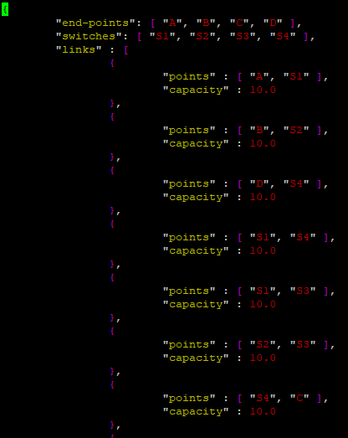
Topology – cs1.json
D
10 Mbps
A
10 Mbps
S1
10 Mbps
S4
10 Mbps
10 Mbps
C
B
10 Mbps
S2
S3
10 Mbps
10 Mbps
The links are bidirectional!

Slide 18
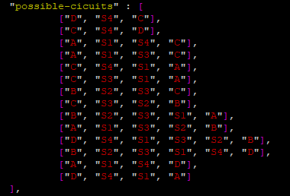
Possible ciurcuits – cs1.json
D
10 Mbps
A
10 Mbps
S1
10 Mbps
S4
10 Mbps
10 Mbps
C
B
10 Mbps
S2
S3
10 Mbps
10 Mbps
The links are bidirectional!

Slide 19
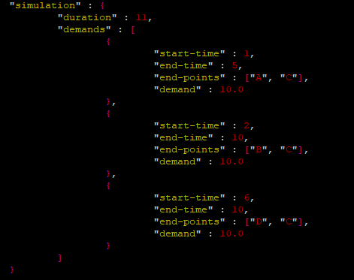
Demands – cs1.json
D
10 Mbps
A
10 Mbps
S1
10 Mbps
S4
10 Mbps
10 Mbps
C
B
10 Mbps
S2
S3
10 Mbps
10 Mbps
The links are bidirectional!

Slide 20
Task
Given cs1.json, that contains a description of a graph. The graph contains nodes (end-points) and swithches. The links has a given capacity. Our network is circuit-switched. We assume that the links’ capacities are the only bottleneck. The json contains the possible-cicuits, and the demands between nodes, with it’s begining and end times. The simulation starts at t=1 time and end at t=duration.
Write a program, that simulates the reservation and release of the resources, due to the given topology, capacities, and demands!
Input for the program: cs1.json
Output: Print out to the stdout each resource reservation and release. During reservation print out if it was successful or not. Note.: Don’t release a demand that was not reserved.
Pl.:
1st demand reservation: A<->C st:1 – successful
2nd demand reservation: B<->C st:2 – successful
3rd demand release: A<->C st:5
4th demand reservation: D<->C st:6 – successful
5th demand reservation: A<->C st:7 – UNSUCCESSFUL
…

Slide 21
1st Homework (4 points)
Deadline: 2018-10-07 23:59

Slide 22

Alexa-top-1M
The Alexa-top-1M dataset contains the 1 million most popular website domain names in order:
http://s3.amazonaws.com/alexa-static/top-1m.csv.zip
Select the top 100 and bottom 100, and a python program that runs ping and traceroute on each of these 200 hosts and saves the output in the given format. Use subprocess! If possible run the scripst at home, and not in the university.
Traceroute parameters: max. 30 hopos
Ping parameters: 10 tries
Output files (next slide):
traceroute.json
ping.json
If you’re running these paralel, limit the number of processes!!!
Send me the program and the 2 json outputs: vpetya@mensa.hu
Deadline: 2018-10-07 23:59

Slide 23
traceroute.json
traceroute.json:
{
"date" : "20180916",
"system" : "windows",
"traces" : [
{
"target" : "www.something.com",
"output" : "Tracing route to www. . . "
},
…
]
}

Slide 24
ping.json
ping.json:
{
"date" : "20180916",
"system" : "linux",
"pings" : [
{
"target" : "www.something.com",
"output" : „Pinging www. . . "
},
…
]
}

Slide 25
The end!

