Slide 1



P.O.P. People Oriented Programming
Marco Bolis
Full stack developer
Notes:
<numero>

Slide 2


The most important components of your software
Notes:
<numero>

Slide 3
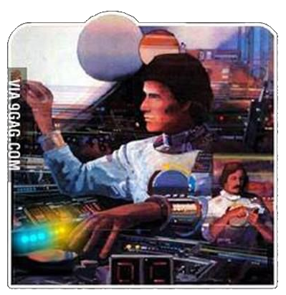
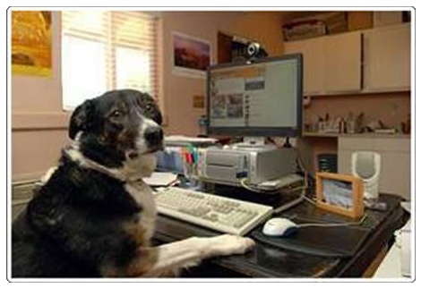
The most important components of your software
USER
DEVELOPER
Notes:
<numero>

Slide 4
The most important components of your software
THEY COULD BE
THE SAME PERSON !!!
USER
DEVELOPER
Notes:
<numero>

Slide 5

The USER and the DEVELOPER need communicate
Notes:
<numero>

Slide 6
The USER and the DEVELOPER need communicate
But HOW?
Notes:
<numero>

Slide 7


The USER and the DEVELOPER need communicate
But HOW?
People communicate by sharing IDEAS and FEELINGS
through LANGUAGE
We communicate best when
telling a STORY which involves
movement through SPACE
If we want to be understood
we need to stick to CONVENTIONS
Engaging communication needs
an element of PLAYFULNESS
Notes:
<numero>

Slide 8
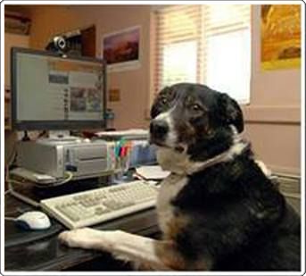
The USER and the DEVELOPER need communicate
But HOW?
How can we achieve this
in the context of software development?
Notes:
<numero>

Slide 9
The USER and the DEVELOPER need communicate
But HOW?
How can we achieve this
in the context of software development?
Understand the user’s NEEDS
Be aware of the existing DIFFICULTIES
Deal with CONFLICT
Notes:
<numero>

Slide 10
The USER and the DEVELOPER need communicate
But HOW?
The user NEEDS to understand
what’s going on in the application
It’s DIFFICULT because:
- the screen is not infinitely big
- our attention to detail is not perfect
- some things are difficult to visualize
How do we deal with these
CONFLICTING instances?
Notes:
<numero>

Slide 11
What if the “user” is another developer
reading our code after we wrote it?
Notes:
<numero>

Slide 12
What if the “user” is another developer
reading our code after we wrote it?
The user NEEDS to understand
our code in order to maintain it
It’s DIFFICULT because:
- they may not know the code’s purpose
- they may not know the context
- functions could span many 100s lines
- there may be many nested ifs/loops
- there could be NO FUNCTIONS at all
- variables and functions could have silly names
- function parameters’ purpose could be unclear
- library code could be badly documented
- “somebody” could have used some “smart” algorithm to do sth simple
Notes:
<numero>

Slide 13
What if the “user” is another developer
reading our code after we wrote it?
Should I go on or
you get the point?
Notes:
<numero>

Slide 14

The almighty
INTERFACE
Notes:
<numero>

Slide 15
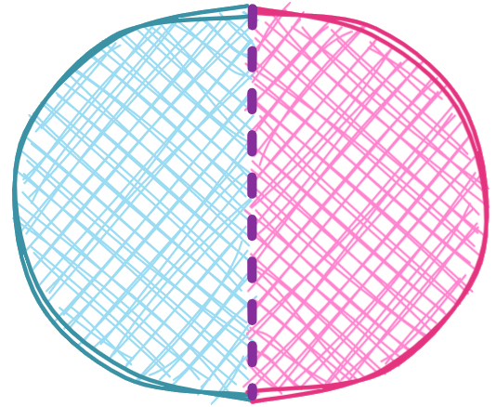
Interfaces are everywhere
What is an interface?
“An interface is a surface forming a common boundary of two spaces”
Notes:
<numero>

Slide 16
Interfaces are everywhere
What is an interface?
“An interface is a surface forming a common boundary of two spaces”
- it both separates and joins
- the two spaces could be very different
- they need not know anything about each other
- they COMMUNICATE through the interface
- the interface lets through only the essential
Notes:
<numero>

Slide 17
UI = User Interface
Notes:
<numero>

Slide 18
UI = User Interface
Interface between the USER and the APPLICATION
UI should:
- keep the internal complexity of software away from the user
- keep user stupiditycreativity away from our delicate software
- let the user get an idea of the application STATE through
· a shared metaphor
· appropriate feedback
- empower the user with control over the application functionality

Slide 19
UI = User Interface
“A user interface should be so simple that a beginner in an emergency can understand it within ten seconds.”
– Ted Nelson (IT visionary and pioneer of the 1960s)
Notes:
<numero>

Slide 20
UI = User Interface
“A user interface should be so simple that a beginner in an emergency can understand it within ten seconds.”
– Ted Nelson (IT visionary and pioneer of the 1960s)
“A user interface is like a joke. If you have to explain it, it’s not that good.”
– Martin Leblanc (UI designer)
Notes:
<numero>

Slide 21

UI = User Interface
UI design is not
“being an artist”!
Notes:
<numero>

Slide 22

UI = User Interface
UI design is not
“being an artist”!
UI design is trying to think as the user does…
Notes:
<numero>

Slide 23
REST interfaces
Notes:
<numero>

Slide 24
REST interfaces
HTTP client-server interface
The client can:
- See domain entities organized as a hierarchy of resources
- Act upon resources with the usual HTTP methods:
· GET, POST, PUT, PATCH, DELETE
- Get feedback on the request outcome via the HTTP status

Slide 25
REST interfaces
HTTP client-server interface
Client and server:
- Share data structures in the request/response body (with JSON)
- Handle additional metadata through HTTP headers
- Need only know what concerns the current request (it’s stateless!)
Notes:
<numero>

Slide 26
API = Application Programming Interface
Notes:
<numero>

Slide 27
API = Application Programming Interface
Interface between software components
It’s a form of abstraction
Keeps the components decoupled from each other
Each component can remain cohesive in itself

Slide 28
Words of Wisdom
Notes:
<numero>

Slide 29
Code as “Developer Interface”
Interface between you and who comes after
Notes:
<numero>

Slide 30
Code as “Developer Interface”
Interface between you and who comes after
“Any fool can write code that a computer can understand.
Good programmers write code that humans can understand.”
— Martin Fowler (OOP guru)
Notes:
<numero>

Slide 31
Code as “Developer Interface”
Interface between you and who comes after
“Any fool can write code that a computer can understand.
Good programmers write code that humans can understand.”
— Martin Fowler (OOP guru)
“Always code as if the guy who ends up maintaining your code
will be a violent psychopath who knows where you live.
Code for readability.”
— John F. Woods (game programmer)
Notes:
<numero>

Slide 32

Code as “Developer Interface”
Interface between you and who comes after
“Any code of your own that you haven’t looked at for six or more months
might as well have been written by someone else.”
— "Eagleson’s Law"
WUT!
Notes:
<numero>

Slide 33
Code as “Developer Interface”
Documentation is no substitute for well written code
Notes:
<numero>

Slide 34
Code as “Developer Interface”
Documentation is no substitute for well written code
“Code never lies, comments sometimes do.”
— Ron Jeffries (Extreme Programming guru)

Slide 35
Code as “Developer Interface”
Documentation is no substitute for well written code
“Code never lies, comments sometimes do.”
— Ron Jeffries (Extreme Programming guru)
“Good code is its own best documentation.
As you're about to add a comment, ask yourself, ‘How can I improve the code so that this comment isn't needed?’
Improve the code and then document it to make it even clearer.”
– Steve McDonnell (coding methodology evangelist)
Notes:
<numero>

Slide 36
Code as “Developer Interface”
Nielsen’s laws of Computer Documentation
Notes:
<numero>

Slide 37
Code as “Developer Interface”
Nielsen’s laws of Computer Documentation
Nielsen's first law of computer documentation:
“Uers don't read it”
Nielsen’s second law of computer documentation:
“If they read it anyway, it's because they are in deep trouble
and need the answer to a specific problem.”
– Jakob Nielsen (the “Guru of web page usability”)

Slide 38
Code as “Developer Interface”
Nielsen’s laws of Computer Documentation
“Even though it is better if the system can be used without documentation,
it may be necessary to provide help and documentation.
Any such information should be easy to search, focused on the user's task,
list concrete steps to be carried out, and not be too large.”
– Jakob Nielsen
Notes:
<numero>

Slide 39
“Talk is cheap, show me the code.”
– Linus Torvalds (creator of the Linux kernel)
Notes:
<numero>

Slide 40
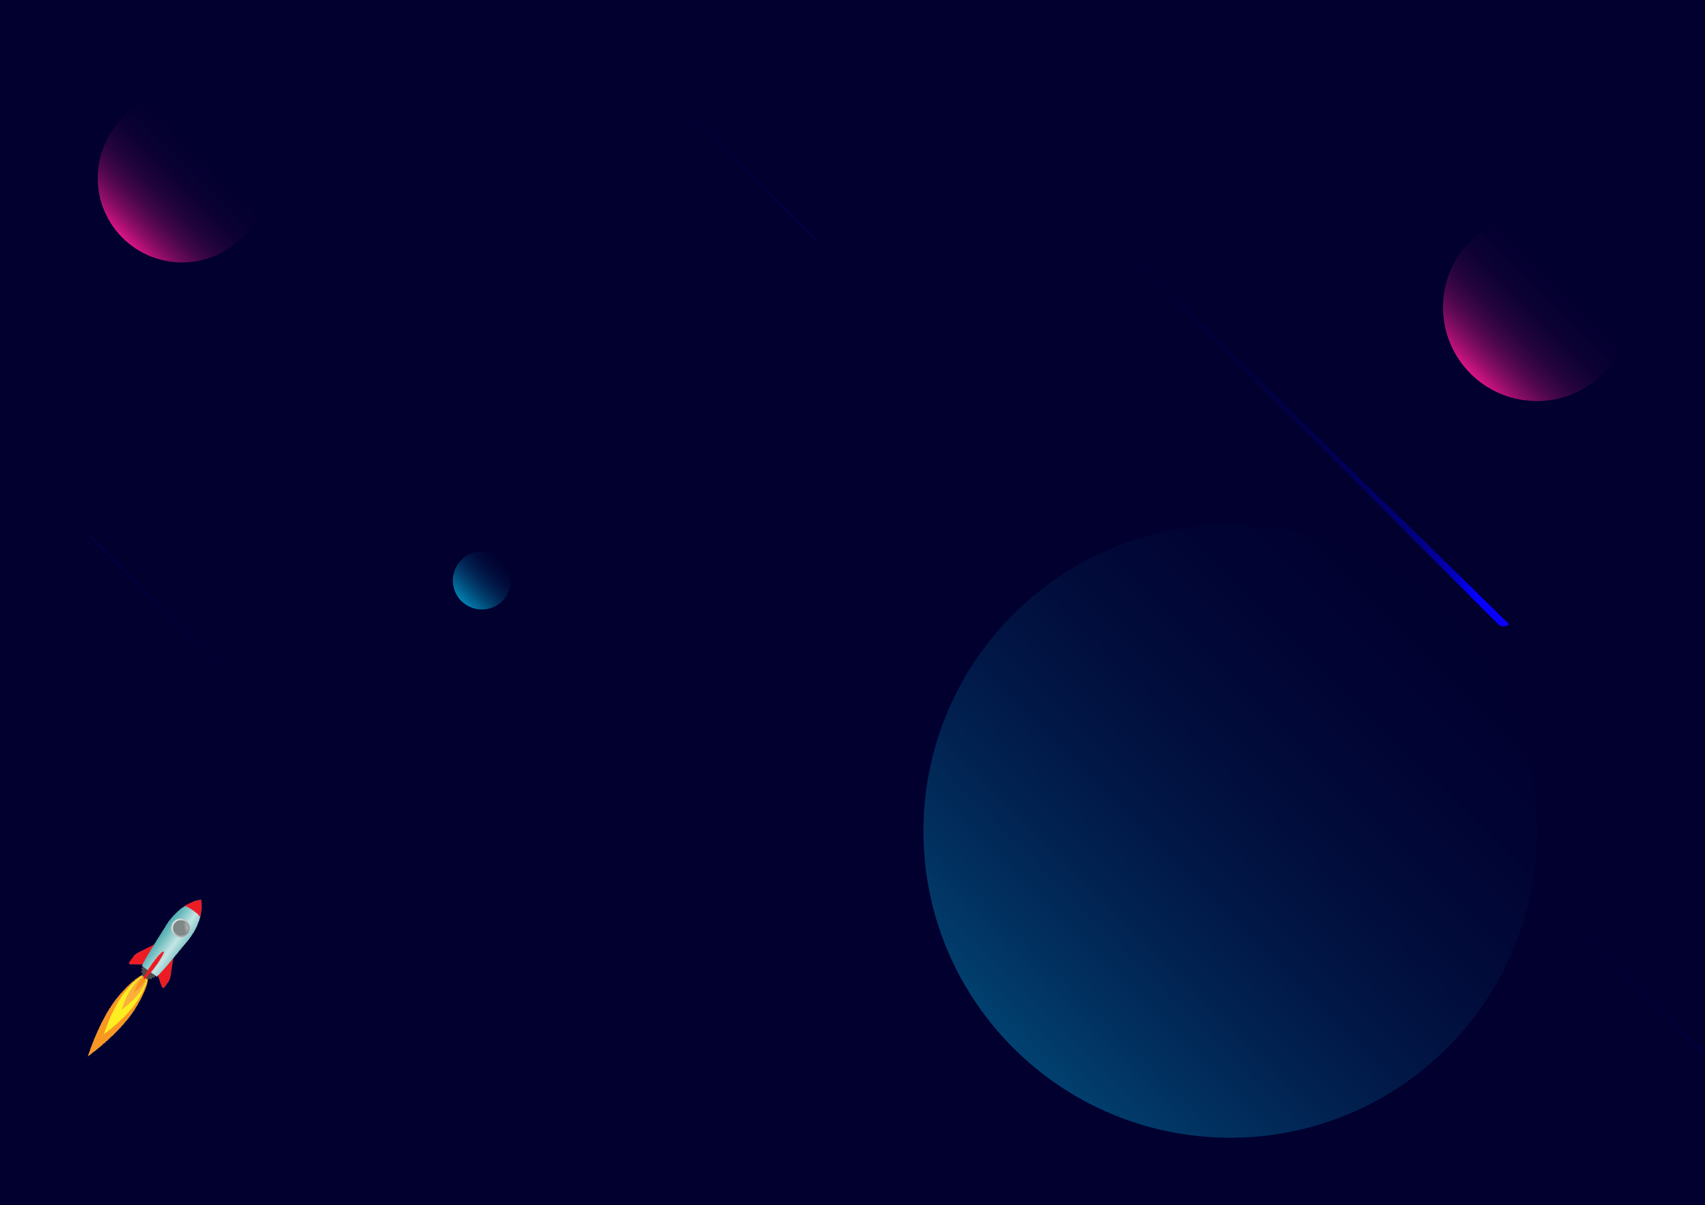
THANKS!
mbolis@sorint.com
github.com/mbolis/quick-survey
Notes:
<numero>

