Slide 1

Push Notifications
React Native

Slide 2
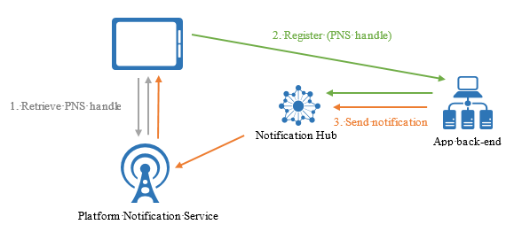
Azure Notification Hubs
Easy-to-use and scaled-out push engine
Allows to send notifications to any platform
Cross backends

Slide 3
React Native Firebase
Collection of RN modules connecting you to Firebase services
Light-weight JavaScript modules to connect to the native Firebase SDKs
Analytics
Cloud Messaging
Notifications
...
Source: https://rnfirebase.io/

Slide 4
Workflow example
(1) Create Azure Notification Hub
(2) API ASP.NET Core Web Application
(3) React Native App

Slide 5
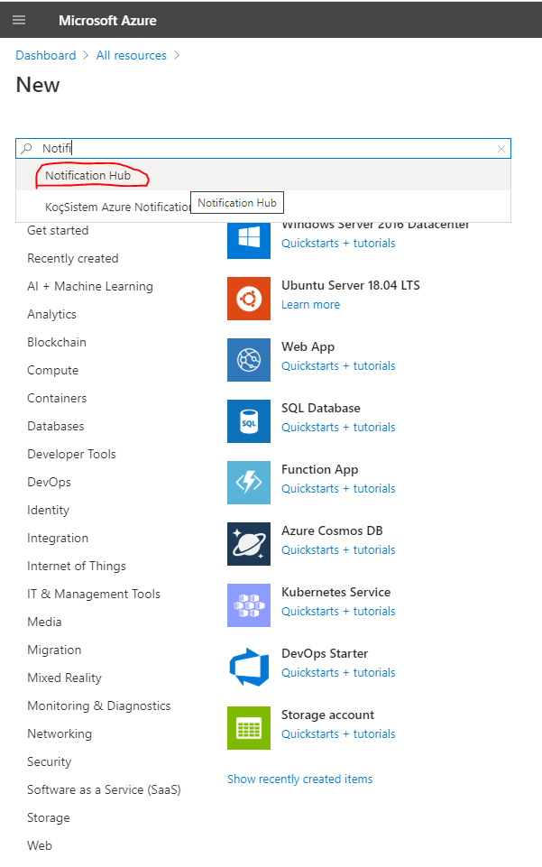
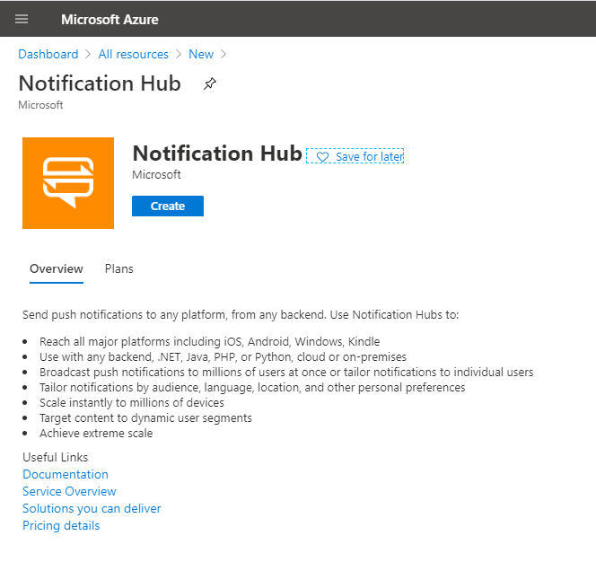
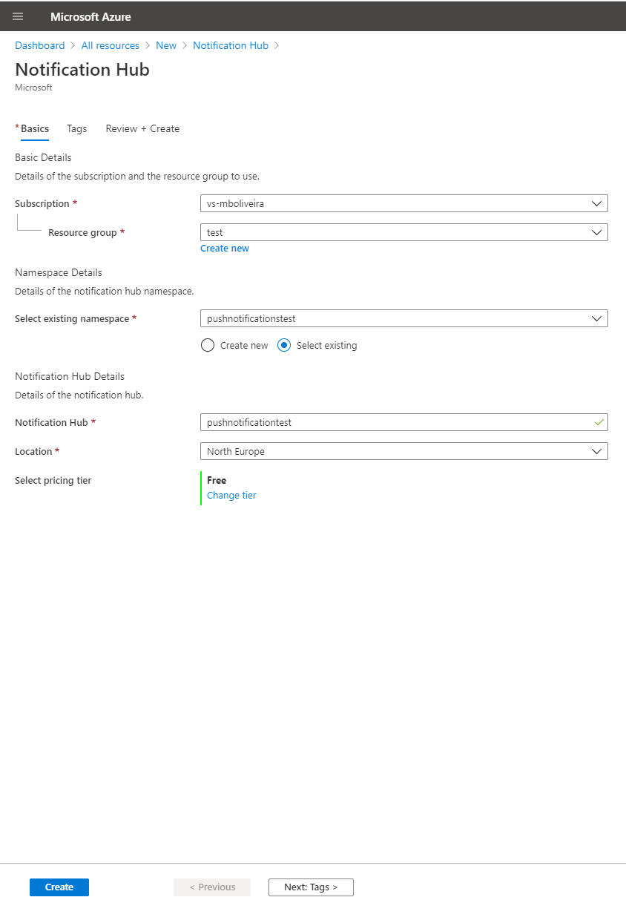
(1) Create Azure Notification Hub

Slide 6
(2) API ASP.NET Core Web Application
Install Microsoft.Azure.NotificationHubs.Messaging from NuGet
[POST] notifications/register
NotificationHubClient.CreateClientFromConnectionString(connection, name)
string registrationId = await notificationHub.CreateRegistrationIdAsync()
Create a FcmRegistrationDescription
Info with registrationId, PnsToken and Tags
await notificationHub.CreateOrUpdateRegistrationAsync(registration)
[POST] notifications/send
NotificationHubClient.CreateClientFromConnectionString(connection, name)
await notificationHub.SendFcmNativeNotificationAsync(serializedPayload, tags);

Slide 7
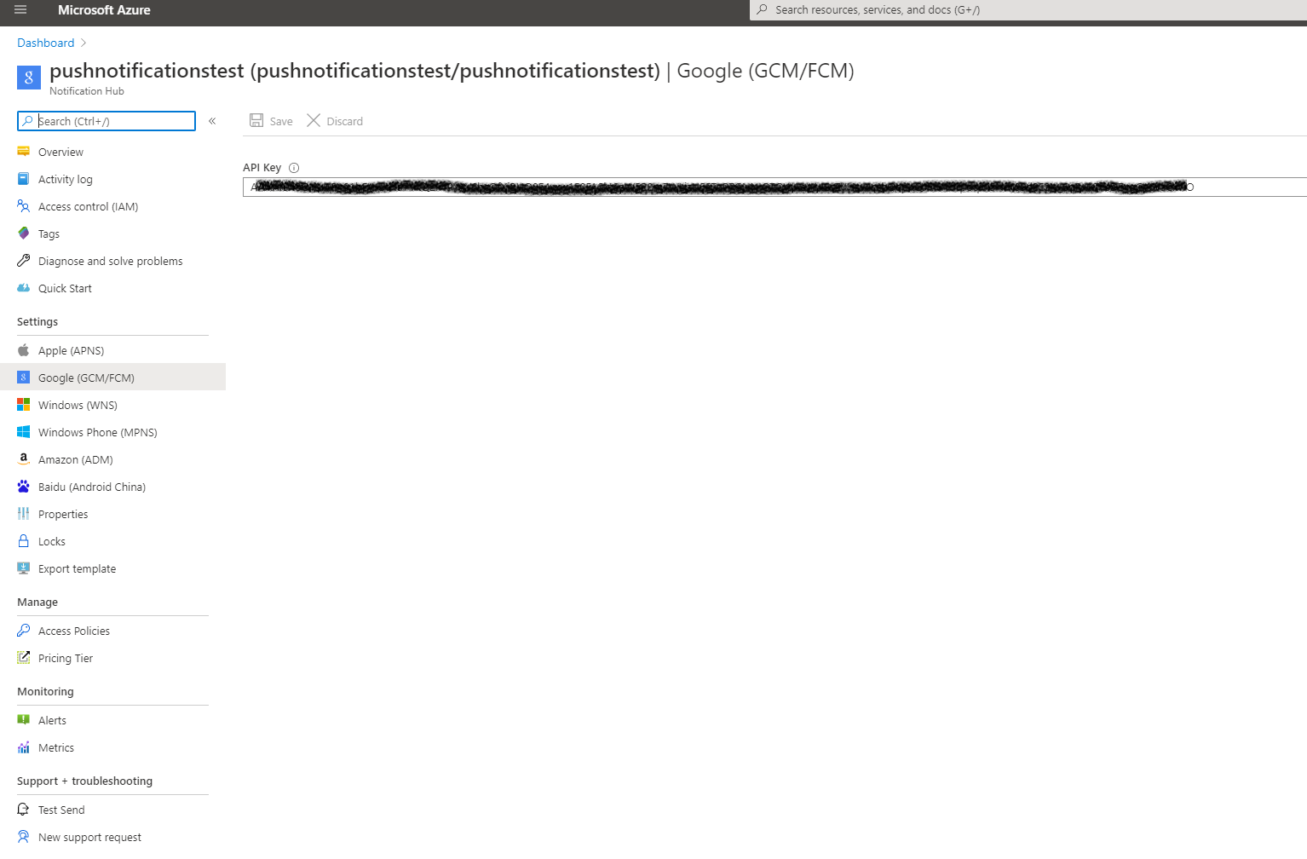
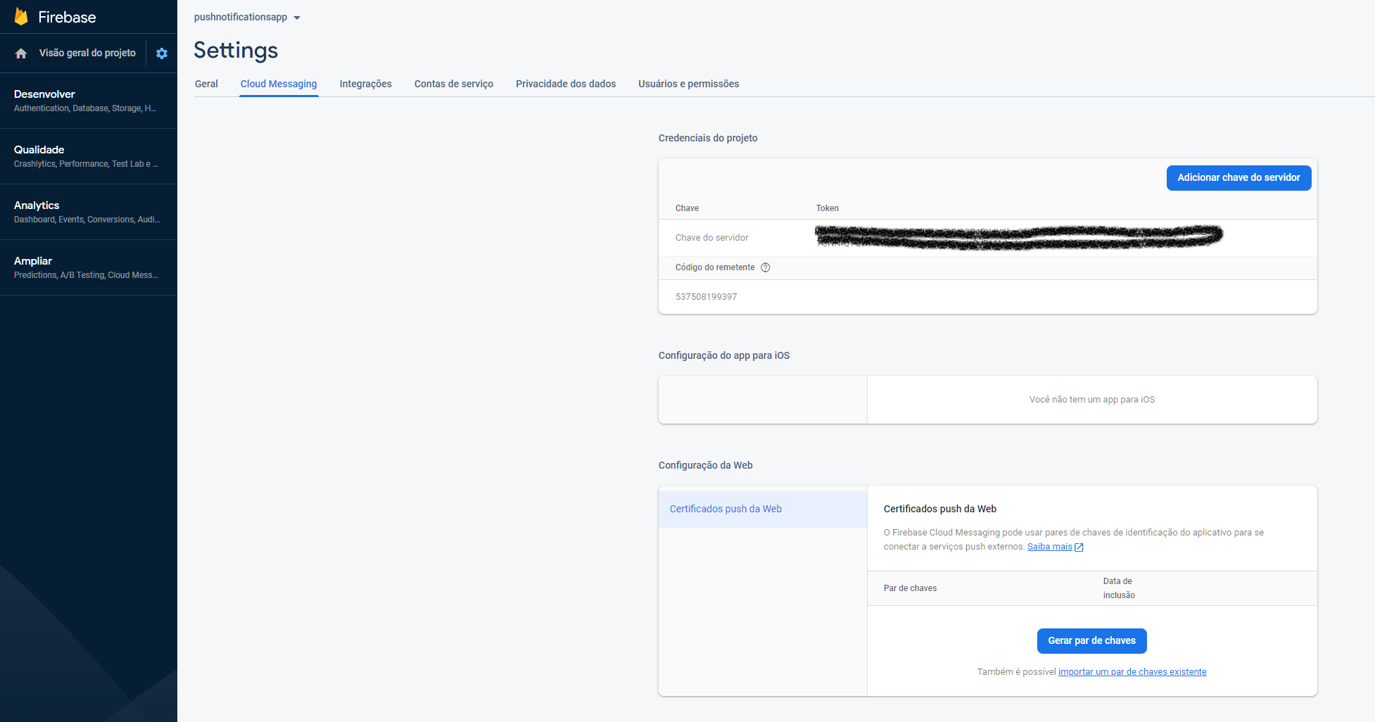
(3) React Native App
Boilerplate - npx react-native init PushNotificationsApp
yarn add axios
yarn add react-native-firebase
Setup google-services.json/ GoogleService-Info.plist
https://firebase.google.com/docs/android/setup

Slide 8
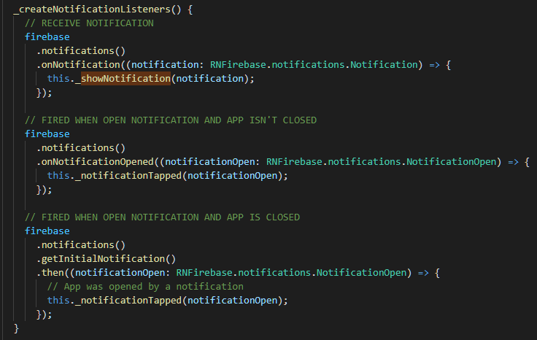
(3) React Native App
Add google-services and Firebase Modules as a dependency
Install the RNFirebase Messaging and Notifications packages
Development
Retrieve token from Firebase
Implement notification listeners

Slide 9
Thank you
mario.oliveira@anova.com

