Slide 1
Impacts of Climate Change on Vector-Borne Disease
Meghan Bongartz

Slide 2
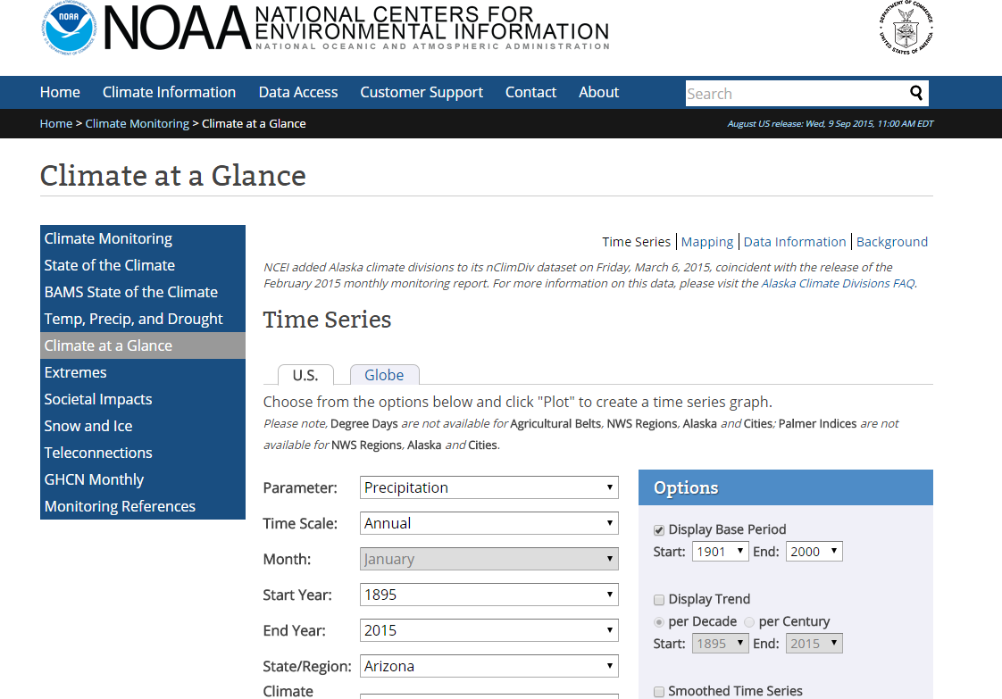
Climate Data Scraping

Slide 3
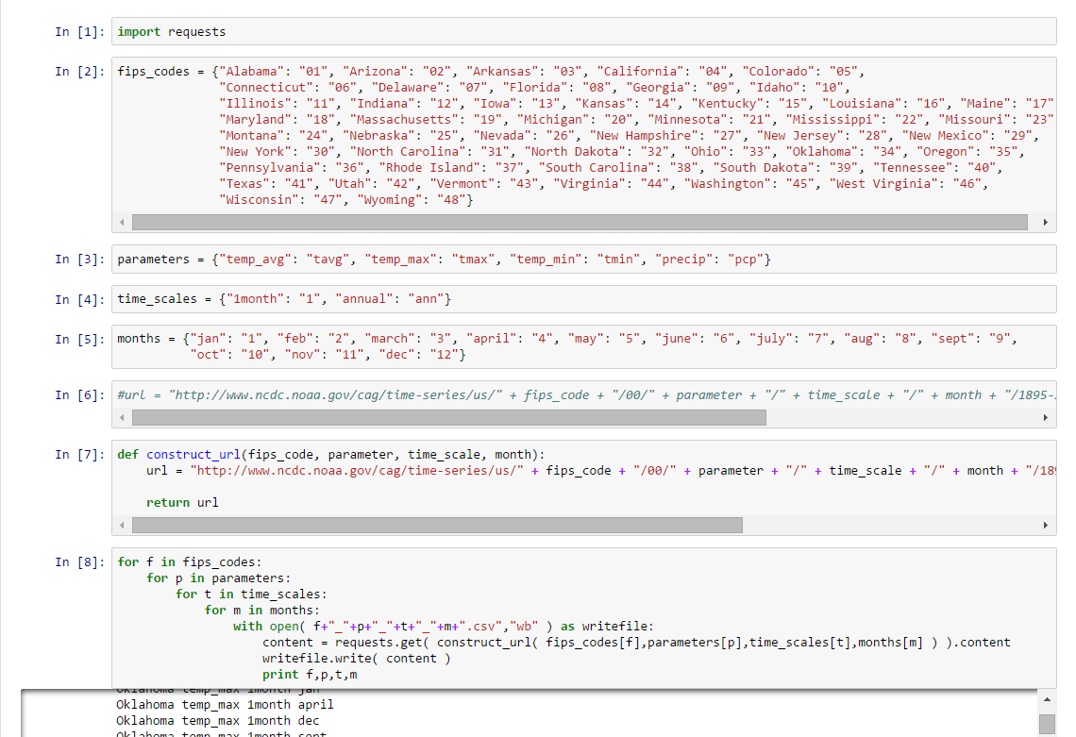
Climate Data Scraping

Slide 4
Disease Vectors
Tiger Mosquito
Dengue fever
Yellow fever
Chikungunya
Southern House Mosquito
St Louis encephalitis
West Nile virus
Lymphatic filariasis

Slide 5
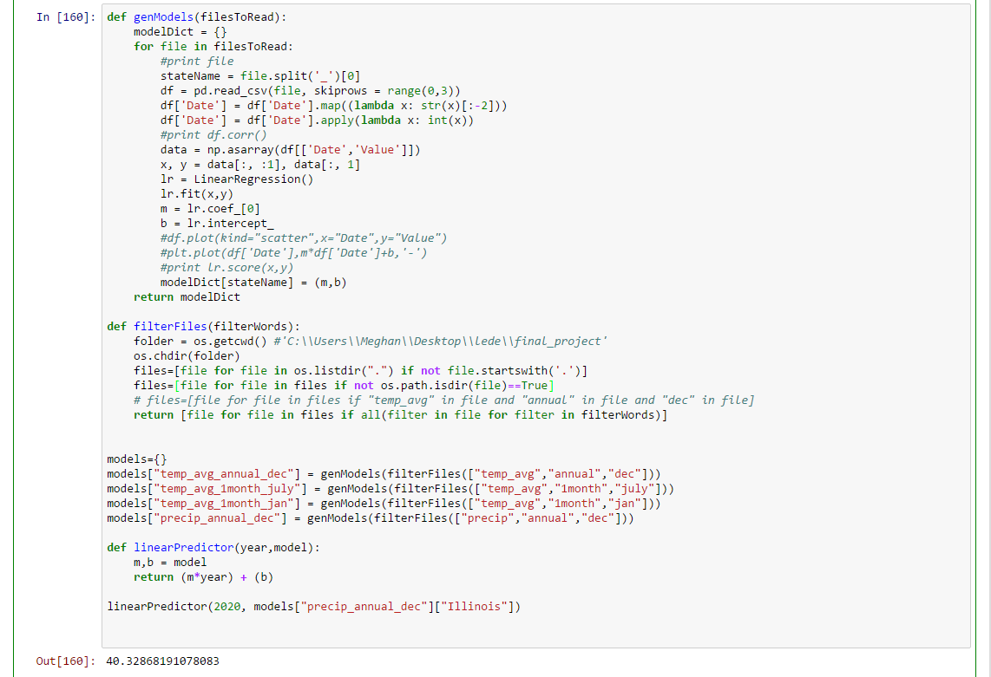
Predictive Modeling with Linear Regression

Slide 6
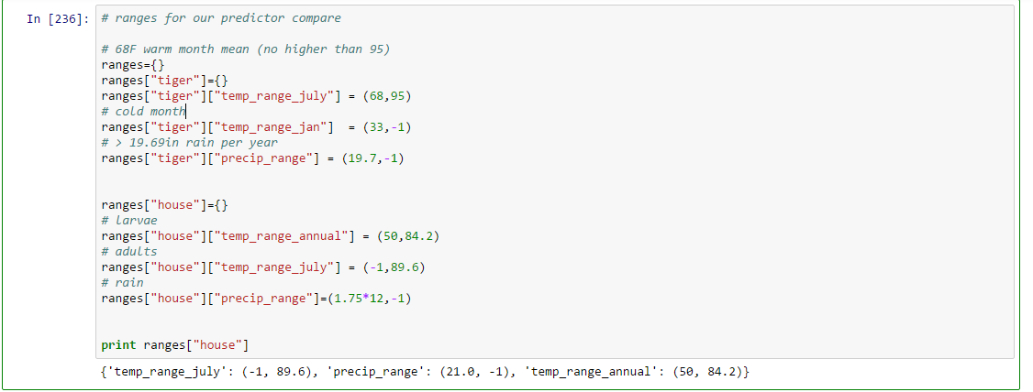
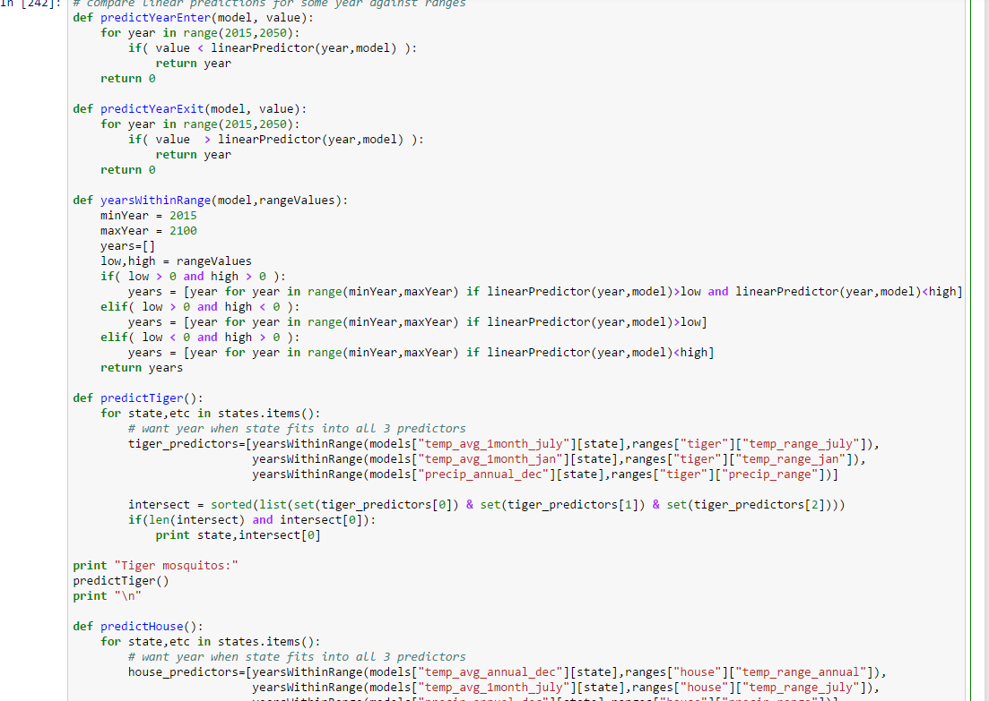
Predictive Modeling with Linear Regression

Slide 7
Tiger Mosquito Locations
Current Actual
Predicted
California
Delaware
Florida
Georgia
Illinois
Indiana
Kentucky
Louisiana
Maryland
Mississippi
Missouri
New Jersey
North Carolina
Ohio
South Carolina
Tennessee
Texas
Washington
Alabama
Arkansas
California
Delaware
Florida
Georgia
Louisiana
Mississippi
Oklahoma
North Carolina
South Carolina
Tennessee
Texas
Virginia
Maryland (2042)
Oregon (2088)

Slide 8
Southern House Mosquito Locations
Current Actual
Predicted
Alabama
Arkansas
California
Delaware
Florida
Georgia
Illinois
Indiana
Kansas
Kentucky
Louisiana
Maryland
Mississippi
Mississippi
Missouri
New Jersey
North Carolina
Ohio
Oklahoma
Rhode Island
South Carolina
Tennessee
Texas
Virginia
West Virginia
Connecticut (2027)
Pennsylvania (2096
Massachusetts (2077)
Nebraska (2066)
Alabama
Arizona
Arkansas
California
Florida
Georgia
Illinois
Indiana
Iowa
Kansas
Kentucky
Louisiana
Maryland
Mississippi
Missouri
Nebraska
Nevada
New Mexico
North Carolina
Ohio
Oklahoma
South Carolina
Tennessee
Texas
Utah
Virginia
West Virginia

