Slide 1
Realtime 3D Graphics on a MicroPython ESP32
Hacking the EMF Camp
Conference Badge
By Mat Booth

Slide 2
This is not a how-to!
This is a what-did!

Slide 3
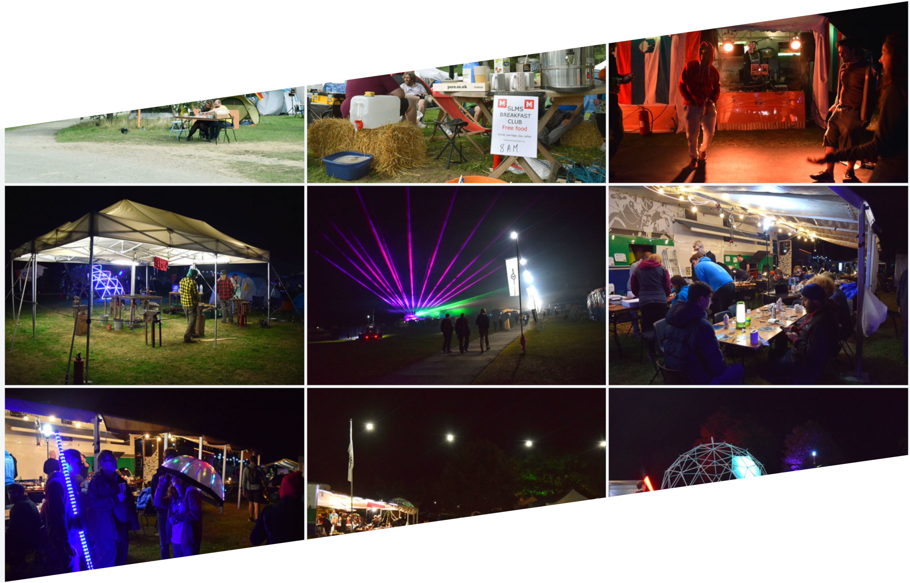
Some Background
Photos by Em O’Sullivan
Creative Commons BY-NC-SA 2.0 Licenced

Slide 4
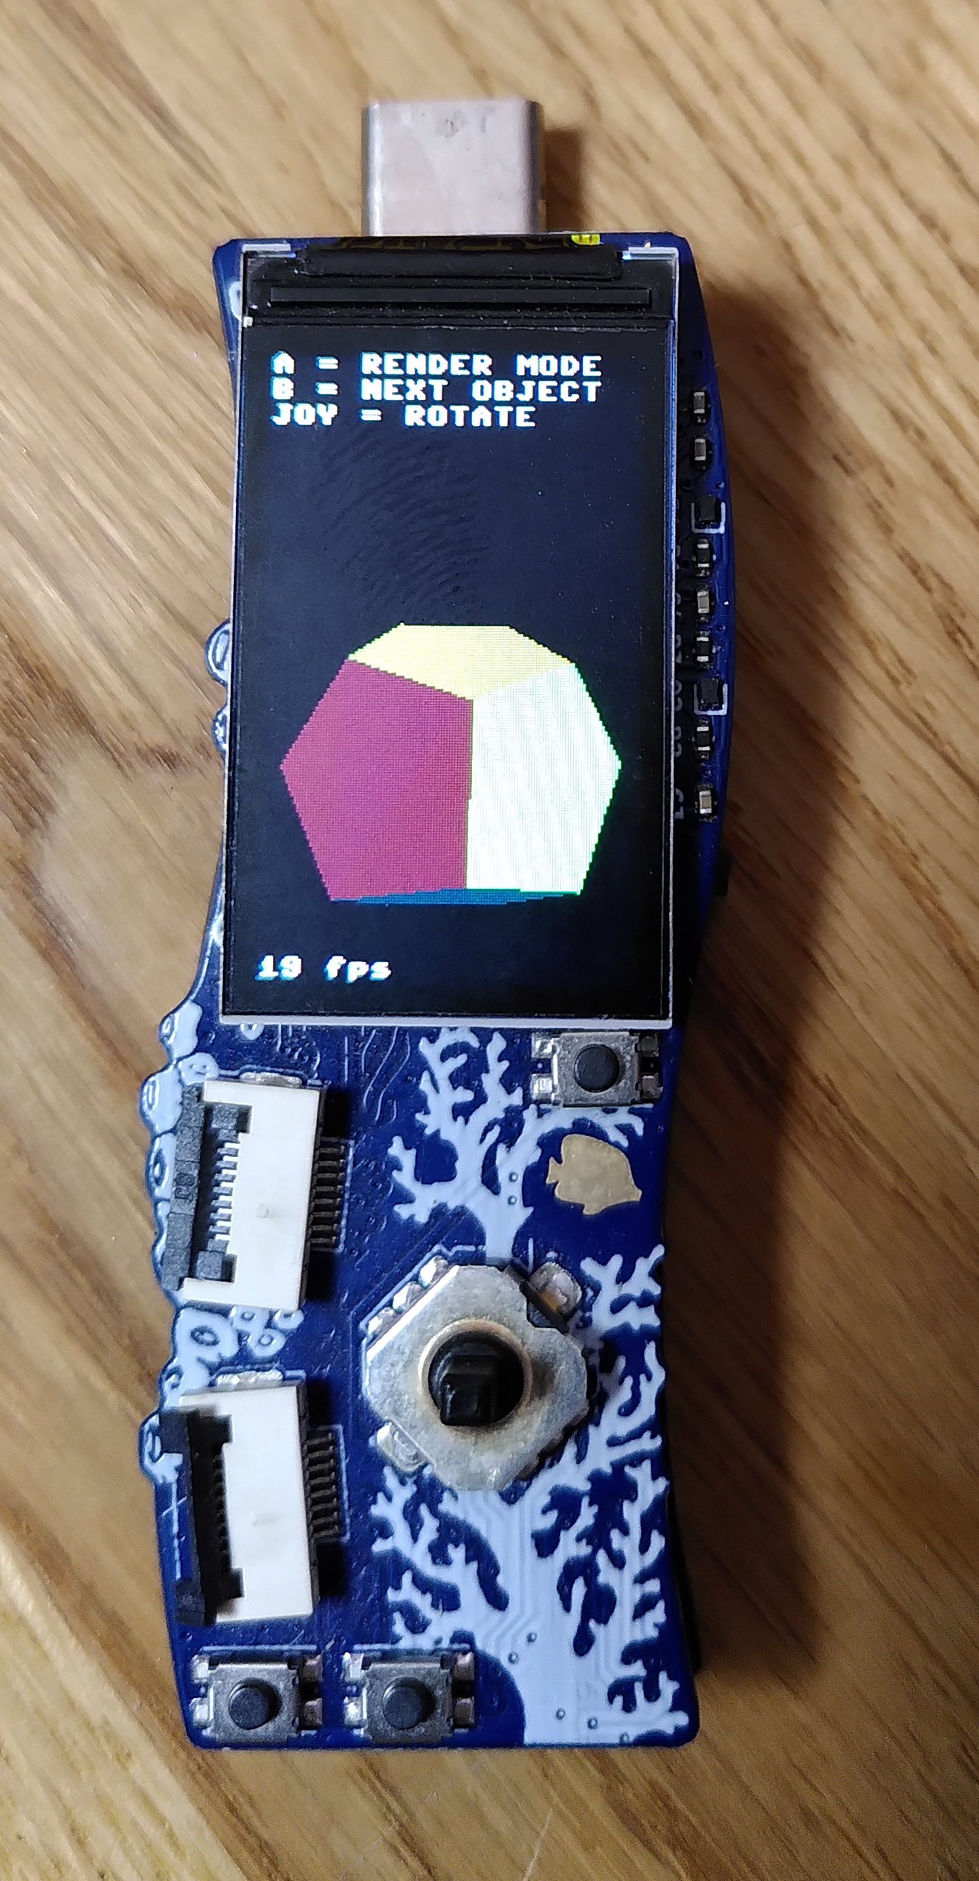
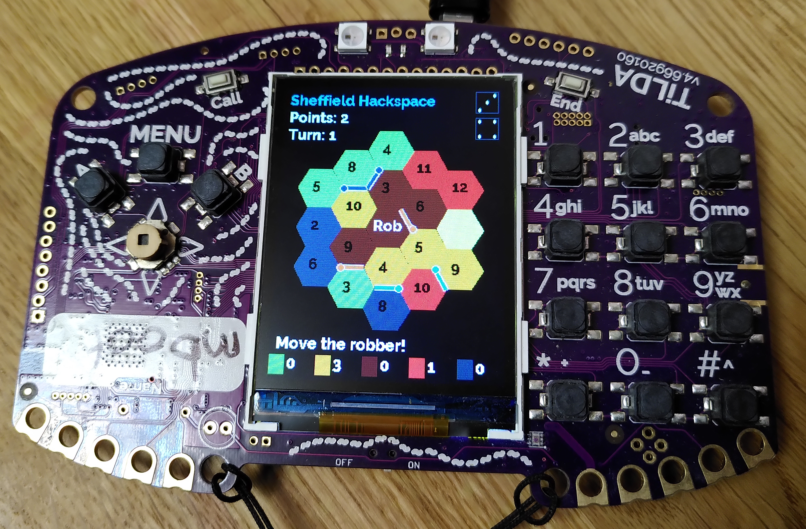
The Badge

Slide 5
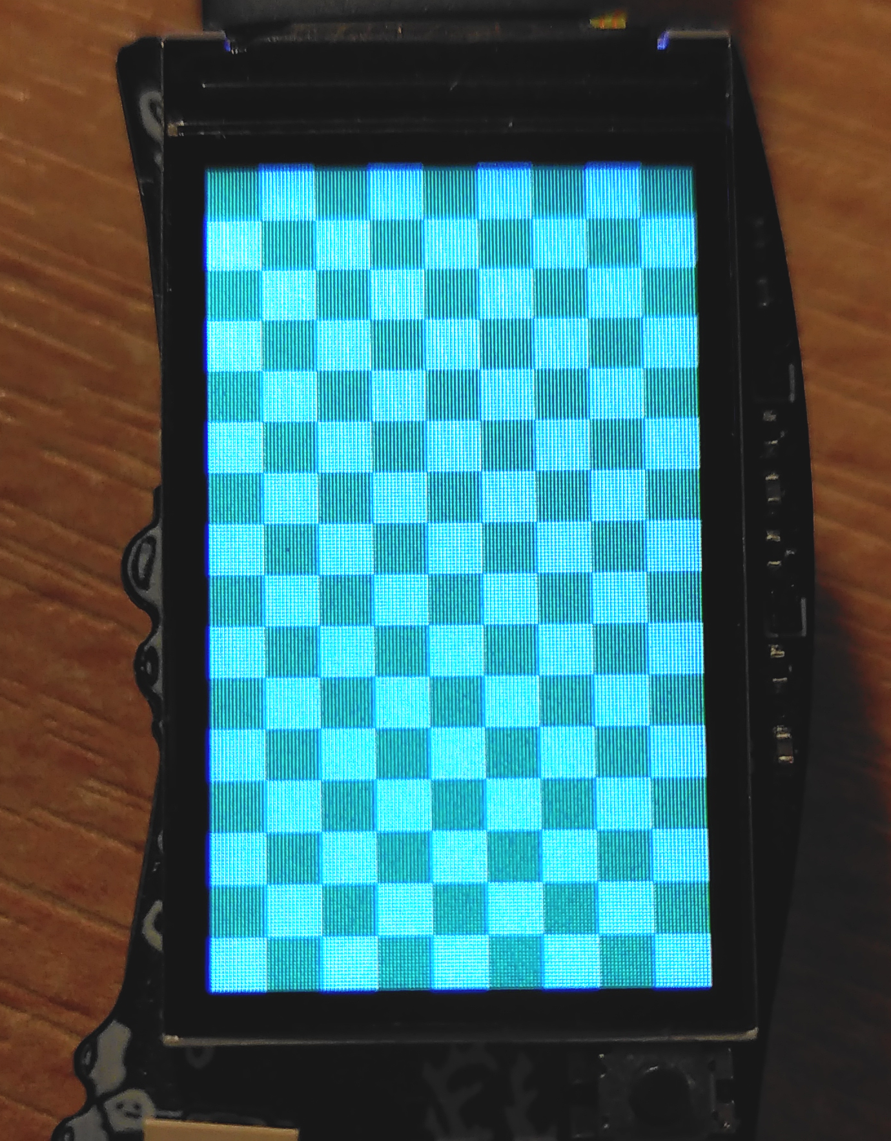
Blitting
71ms direct draw to screen device
  Using display.fill_rect()
32ms blit from off screen bytearray buffer
  But have to implement my own primitive drawing functions
41ms blit from off screen MicroPython framebuf buffer

Slide 6
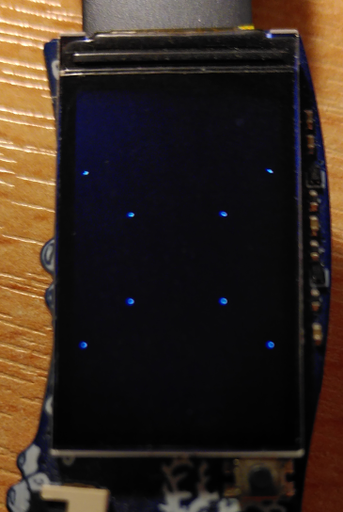
3D Rasterisation
Local × model_matrix = World space
World × view_matrix = View space
View × projection_matrix = Clip space
Clip ÷ W (perspective division) = NDC space
NDC × screen_dimensions = Screen space
framebuf.pixel() x 8
41ms + 12ms = 53ms to rasterise 8 points

Slide 7
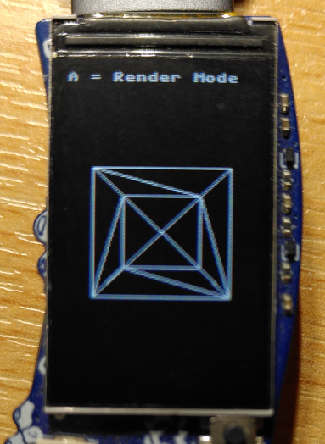
3D Rasterisation
Local × model_matrix = World space
World × view_matrix = View space
View × projection_matrix = Clip space
Clip ÷ W (perspective division) = NDC space
NDC × screen_dimensions = Screen space
framebuf.line() x 36
41ms + 18ms = 59ms to rasterise 12 triangles

Slide 8
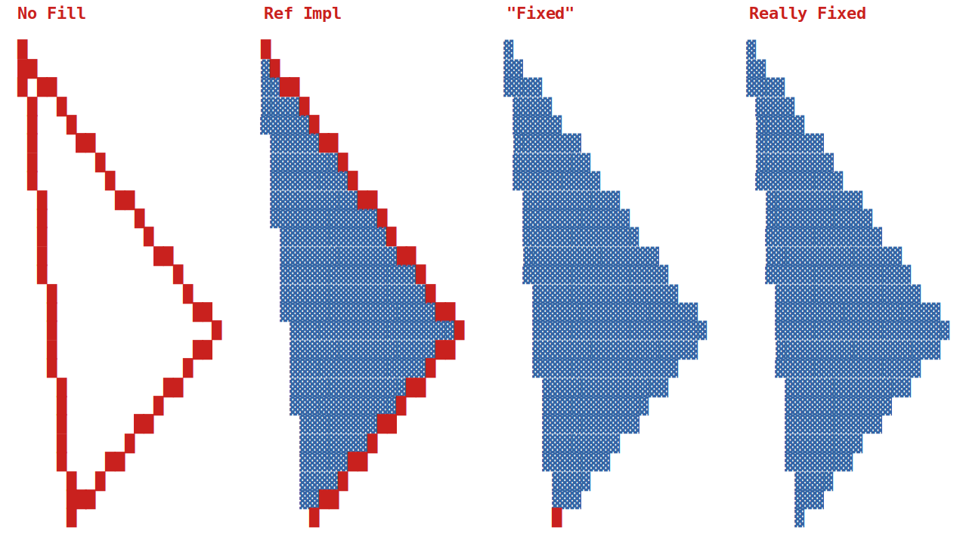
Infinitely Thin Edges

Slide 9
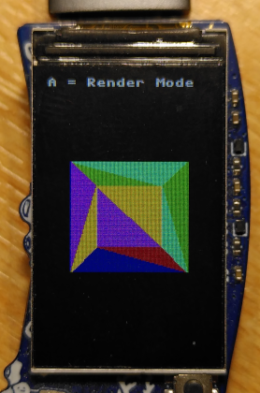
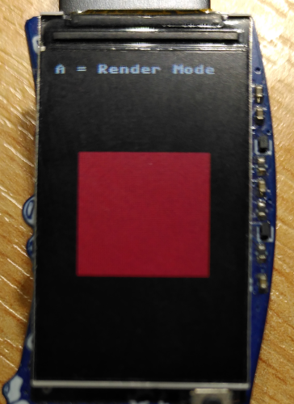
The 3D Hello World
framebuf.fill_polygon() x 12
41ms + 25ms = 66ms to rasterise 12 triangles
With back-face culling...
41ms + 36ms = 77ms to rasterise 12 triangles
Occasional 226ms frame….‽

Slide 10
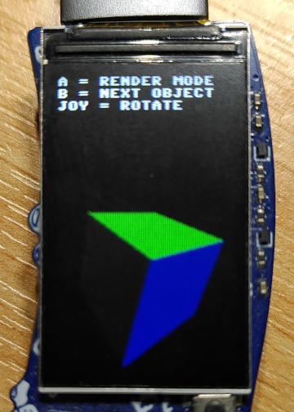
Obvious Optimisations
Pre-calculate normals
Avoid doing perspective division if it would not change the result
With shading...
41ms + 36ms = 77ms to rasterise 12 triangles

Slide 11
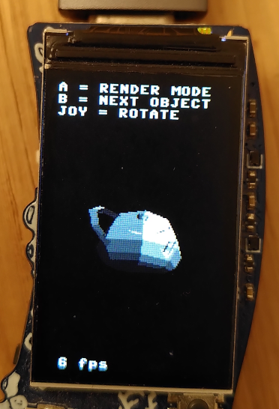
The Plate-onic Solid
665ms !! to rasterise 240 triangles
After re-writing the hottest functions as MicroPython native module:
  vector matrix multiplication & dot product
320ms to rasterise 240 triangles
After re-writing ALL the maths in C:
160ms a glorious 6 frames per second

Slide 12
ExtMods & NatMods
External C Modules are compiled directly into firmware
Native Machine Code Modules allows applications to supply native code in a *.mpy file
NatMods are preferable but there were obstacles…
undefined symbol: __divsf3 (may be fixed now?)
Building assembly into a natmod…. (fixed)
Crash after garbage collection…. (not fixed)

Slide 13
Optimisations
Reduce object instantiations
  Pre-allocate and reuse lists and arrays
Reduce Python/Native barrier crossings
  Save 10ms per frame by batch processing vertices
Pass arrays and not lists to native functions
  You can make assumptions that MicroPython cannot
Native qsort() instead of list.sort() ­— about 100 times faster
Locally cache object references
  bar = self.foo

Slide 14
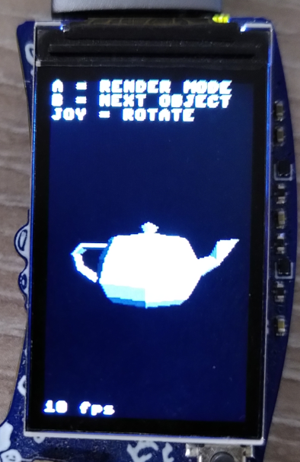
Final Result
41ms + 51ms = 92ms to render the teapot
  More than 10 fps
41ms + 5ms = 46ms to render the cube
  More than 20 fps

Slide 15
Outroduction
Thanks to EMF and EMF Badge teams for running a great event and creating a wonderfully fun device: https://emfcamp.org/
Thanks to MicroPython team for helping me whip my contributions into shape: http://micropython.org/
Source available here under MIT license: https://github.com/mbooth101/tidal3d

