Slide 1
Uncertainty-aware Pseudo-labeling for Quantum Calculations
Kexin Huang
Mentor:
Mykola Bordyuh
Principal Collaborators:
Brajesh Rai, Vishnu Sresht

Slide 2
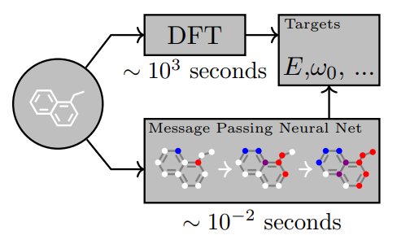
Machine Learning for QM Calculations in Real Life
Recent machine learning methods can predict molecular properties accurately given large amount of data.
But in real life, people often work with small datasets. E.g. CCSD(T)
Architectural
Innovation
Learning
Strategy Innovation

Slide 3


Pseudo-label Improves Low-data QM Learning
f
Classic Optimization
Gold-
Label
Mols
Molecular Properties
g
Pseudo-Label Optimization
Gold-
Label
Mols
Pseudo-Label
Mols
Molecular Properties

Slide 4
The Algorithmic Challenge: Pseudo-labels are noisy Problem 1: How to detect which data point has bad pseudo-label?
Model
Key observation: a data point with higher prediction uncertainty means lower quality of pseudo-labels!
Uncertainty
Model Prediction

Slide 5
The Algorithmic Challenge: Pseudo-labels are noisy Problem 2: How to prevent bad pseudo-labels from affecting the model?
Naïve solution: remove bad pseudo-labels at some uncertainty
Disadvantages:
Introduces a hyperparameter
Many inputs are omitted
Our solution: adaptively downplay the weight of bad pseudo-label in the final objective.
Solve the disadvantages:
No hyperparameters introduced!
All input data are seen!

Slide 6
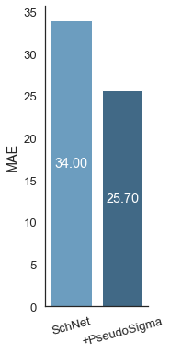
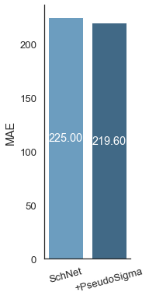
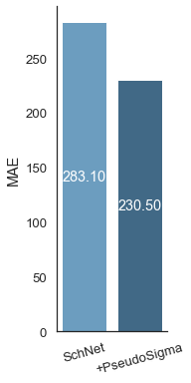

Experimental Setup and Results from QM9 Dataset
Full Data
OOD
The lower, the better
10% Data
1% Data
SchNet
Our Method
Conclusion: Our method significantly improves QM calculations across low-data, full-data, and out-of-distribution settings.

